Slide 2
Module 3
Application of digital tools
Unit 1
Tools and technology for managing and organising care services

Slide 3
01 Tools in Healthcare for managing and
organisig Care
What digital tools could you use at work?
02 Application of digital tools – safety considerations
What to consider when using digital tools at work?
TABLE OF CONTENTS
03 Safe Communication at Work
Why is safe communication important at work?
04 Installing digital tools on your devices
How can you install these tools on your devices
04 Self-Reflection Exercise
Time for Self-Reflection!

Slide 4
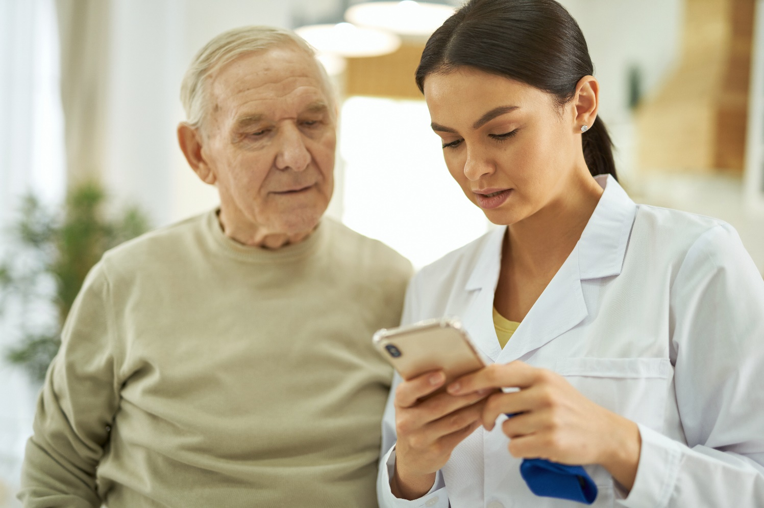
Tools in healthcare for managing and organising care
In healthcare settings, caretakers use different digital tools to organise and manage the care they are giving on a daily basis.

Slide 5
Tools in healthcare for managing and organising care
?
What digital tools could you use at work

Slide 6
What digital tools could you use at work
In Module 2 you learned that there are different types of digital tools designed to help scheduling of appointments, and enhance documenting and organising care activities.
In order to ensure privacy, as well as to protect patients, employees, and data from potential harm, every organisation usually has certain rules and restrictions in place regarding the tools used.

Slide 7
What digital tools could you use at work
Depending on the organisation at which you work, you might encounter different digital tools used to manage and organise care.
Designed by Freeepik

Slide 8
What digital tools could you use at work
Calendars
Calendars in healthcare are essential for organising care activities; they ensure precise scheduling of patient appointments, treatments, and staff shifts, thereby enhancing the efficiency and coordination of care delivery.
They also serve as a critical tool for adherence to treatment timelines and regulatory compliance, keeping all care-related activities in sync.

Slide 9
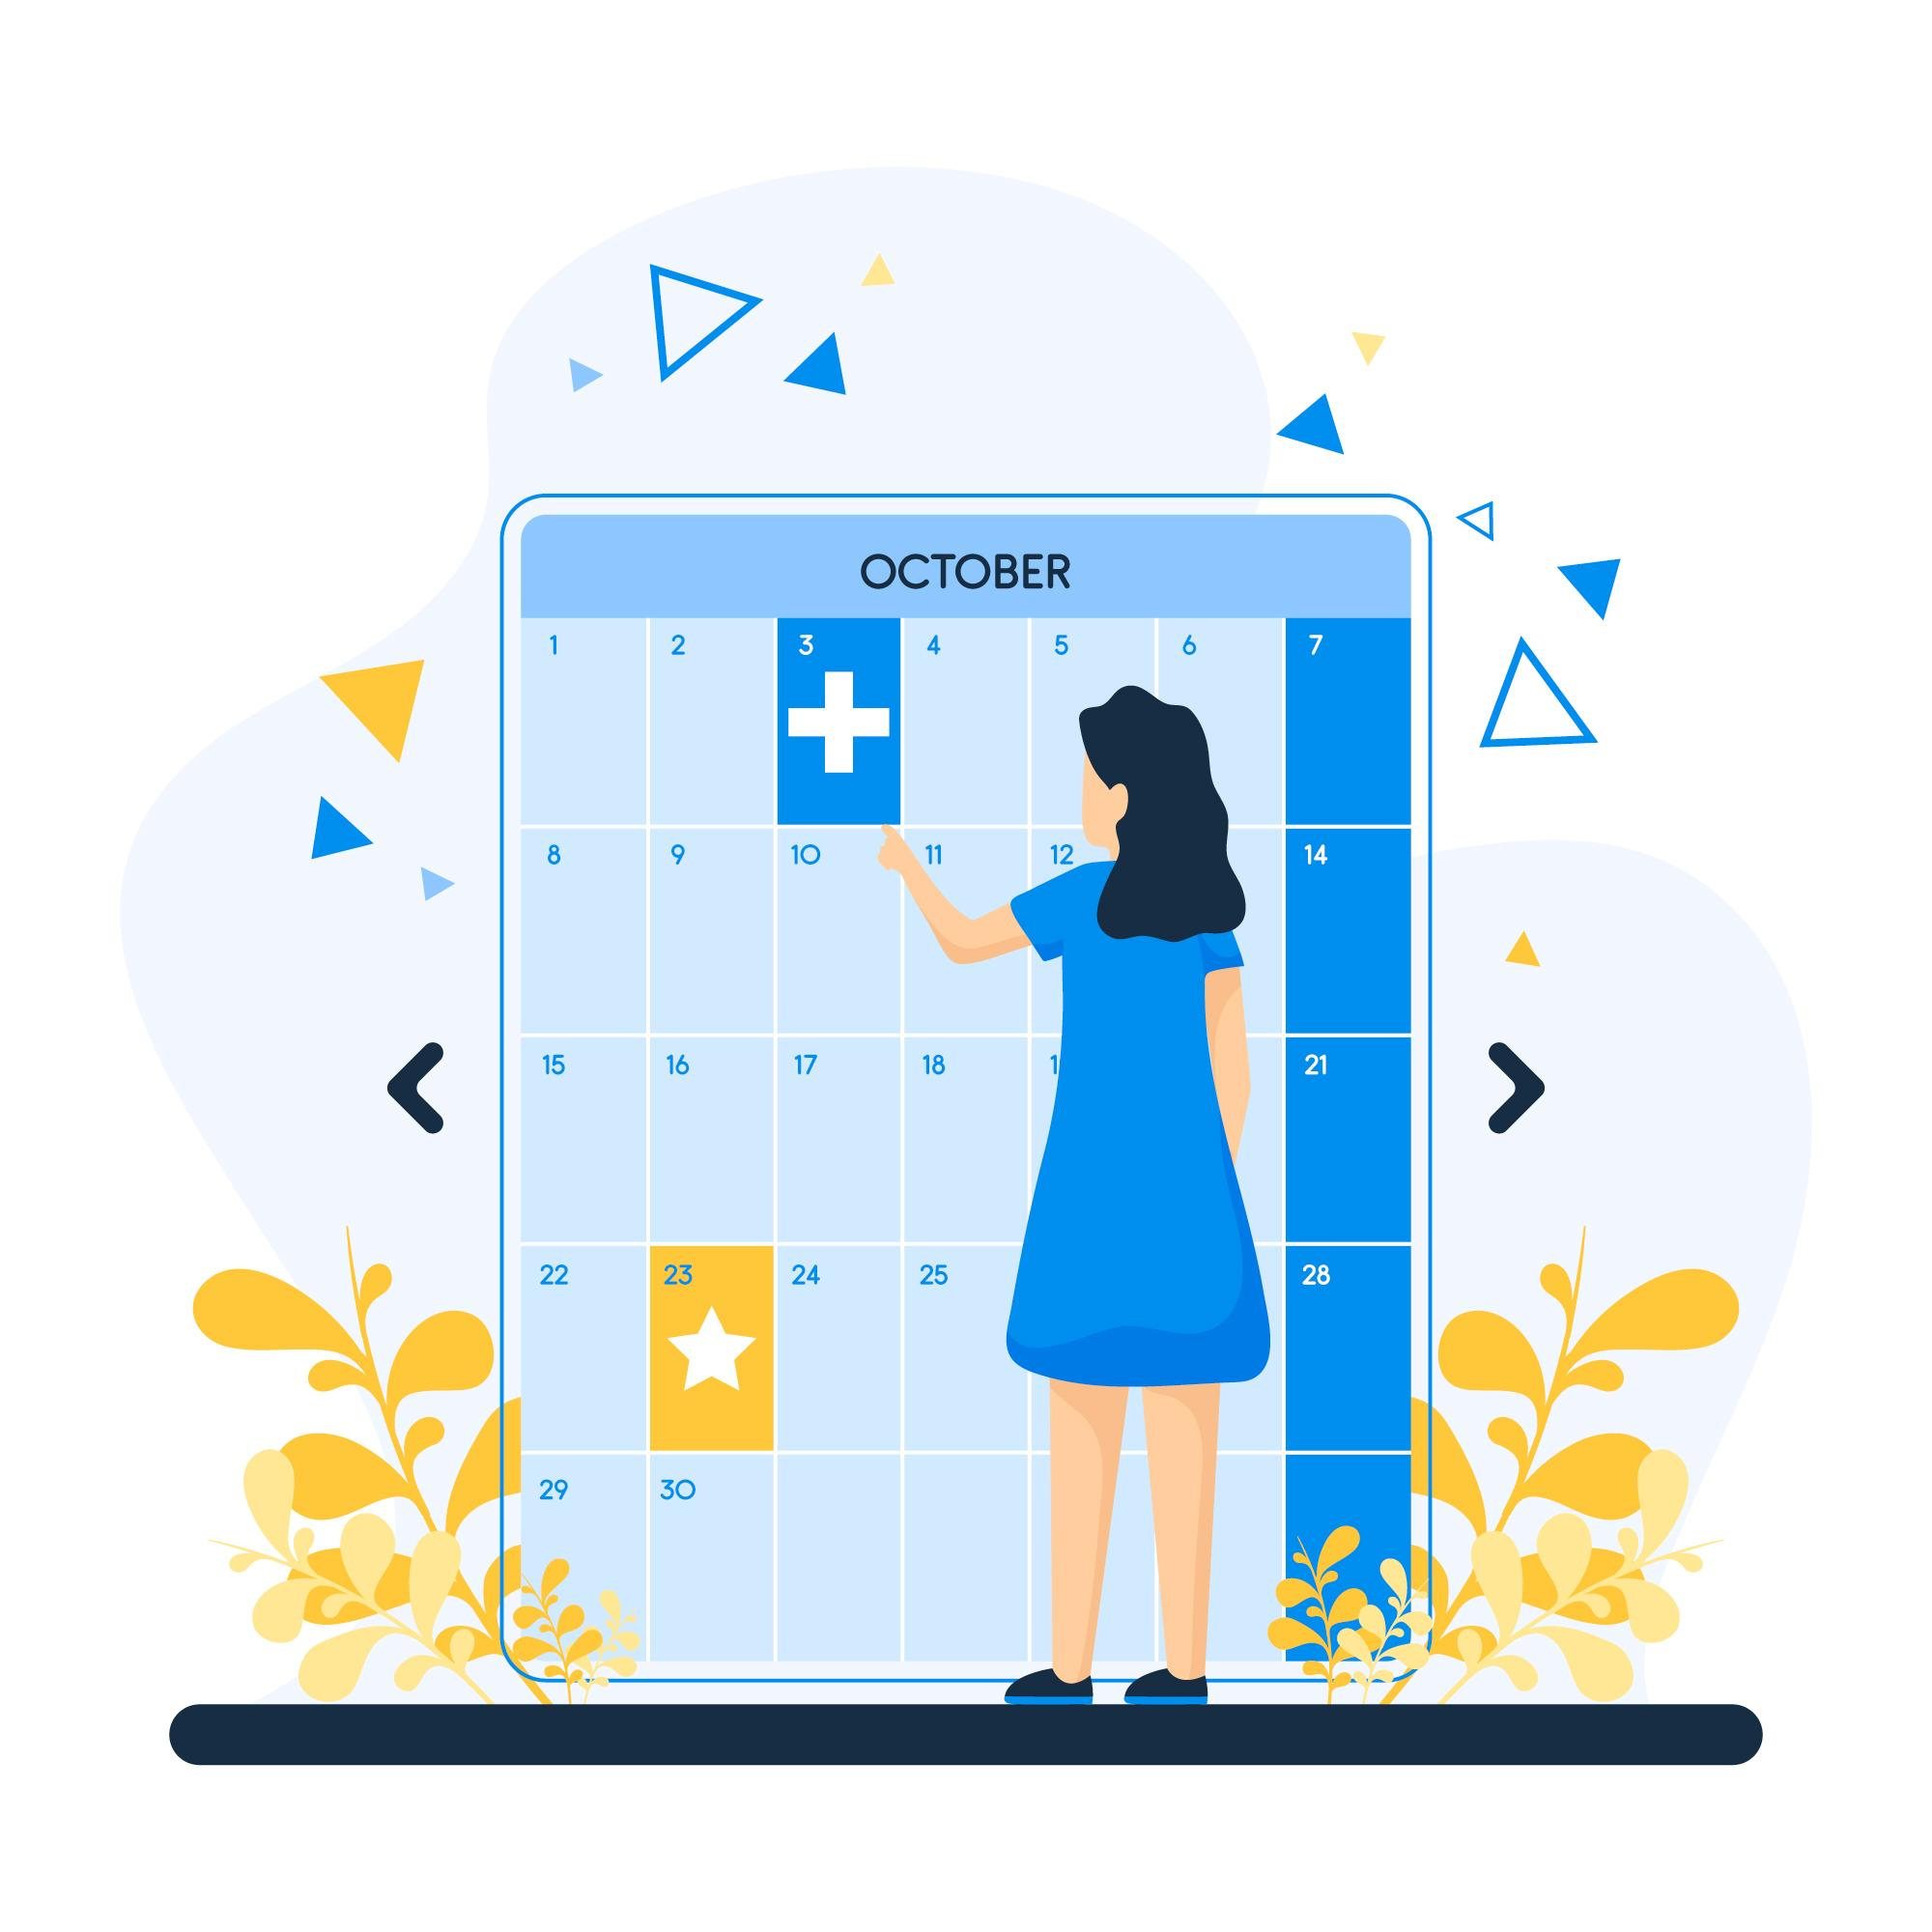
What digital tools could you use at work
Calendars
There are different calendars you can use at work, but these two are the most commonly used ones by organisations, which are
also connected to your email:
Outlook Calendar
Google Calendar
Designed by Freeepik

Slide 10
What digital tools could you use at work
Calendars
Outlook Calendar
If you would like to learn how to book appointments using an Outlook Calendar, watch this video and get your schedule organised!
How To Use Microsoft Outlook Calendar for Beginners (2024)
https://www.youtube.com/watch?v=qqmcYKqVe-w

Slide 11
What digital tools could you use at work
Calendars
Using calendars to coordinate your schedule helps you and your colleagues to work more efficiently, as well as to plan activities easily, because yur colleagues also now have an insight in your schedule. This way the overall communication is also improved within your team!
Do you recognise the benefits of using digital calendars? If not already, do you plan to use them in the future?

Slide 12
What digital tools could you use at work
AI-supported care documentation
In Module 2 you learned about AI-supported care documentation, as well as its benefits and potential limitations.
These softwares help you to dictate notes hands-free directly into the patients‘ records, streamlining your workflow and enhancing the efficiency of your workday.

Slide 13
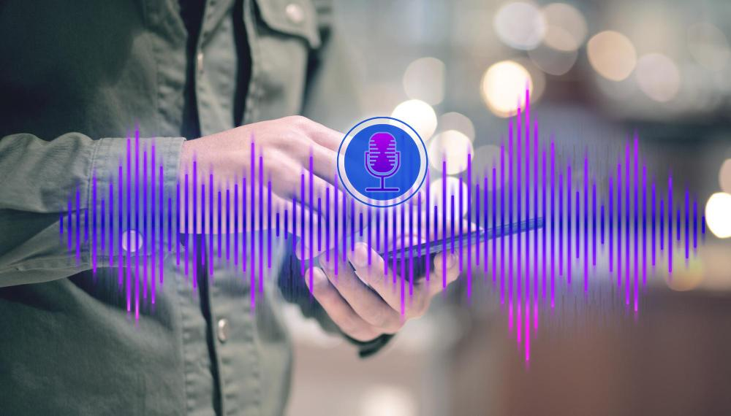
What digital tools could you use at work
AI-supported care documentation
If you would like to explore how AI-supported care documentation functions, try out a general speech recognition tool. Simply click on the following link, choose your preferred language, and press start to begin recording.
As you speak, the tool will transcribe your words in real time!
Did it accurately document your sentence?

Slide 14
What digital tools could you use at work
AI-supported tools in general
Now that you had the opportunity to try out a AI-supported tool that simplifies care documentation, do you think that artificial intelligence is an option for the future?
Do you see the benefits of aplying such tools in your daily work?

Slide 15
What digital tools could you use at work
AI-supported tools in general
Explore the transformative impact and benefits of integrating AI in healthcare by watching these two insightful videos!
The Future of AI in Healthcare
https://youtu.be/uEPs-RL_VlQ?si=KcgDEuH1Lk5Pmvk_
4 Ways Artificial Intelligence is Transforming Healthcare
https://youtu.be/TfkHrvct1hg?si=aBF9nWCqGMGWAXtA
Notes:
https://youtu.be/uEPs-RL_VlQ?si=KcgDEuH1Lk5Pmvk_

Slide 16
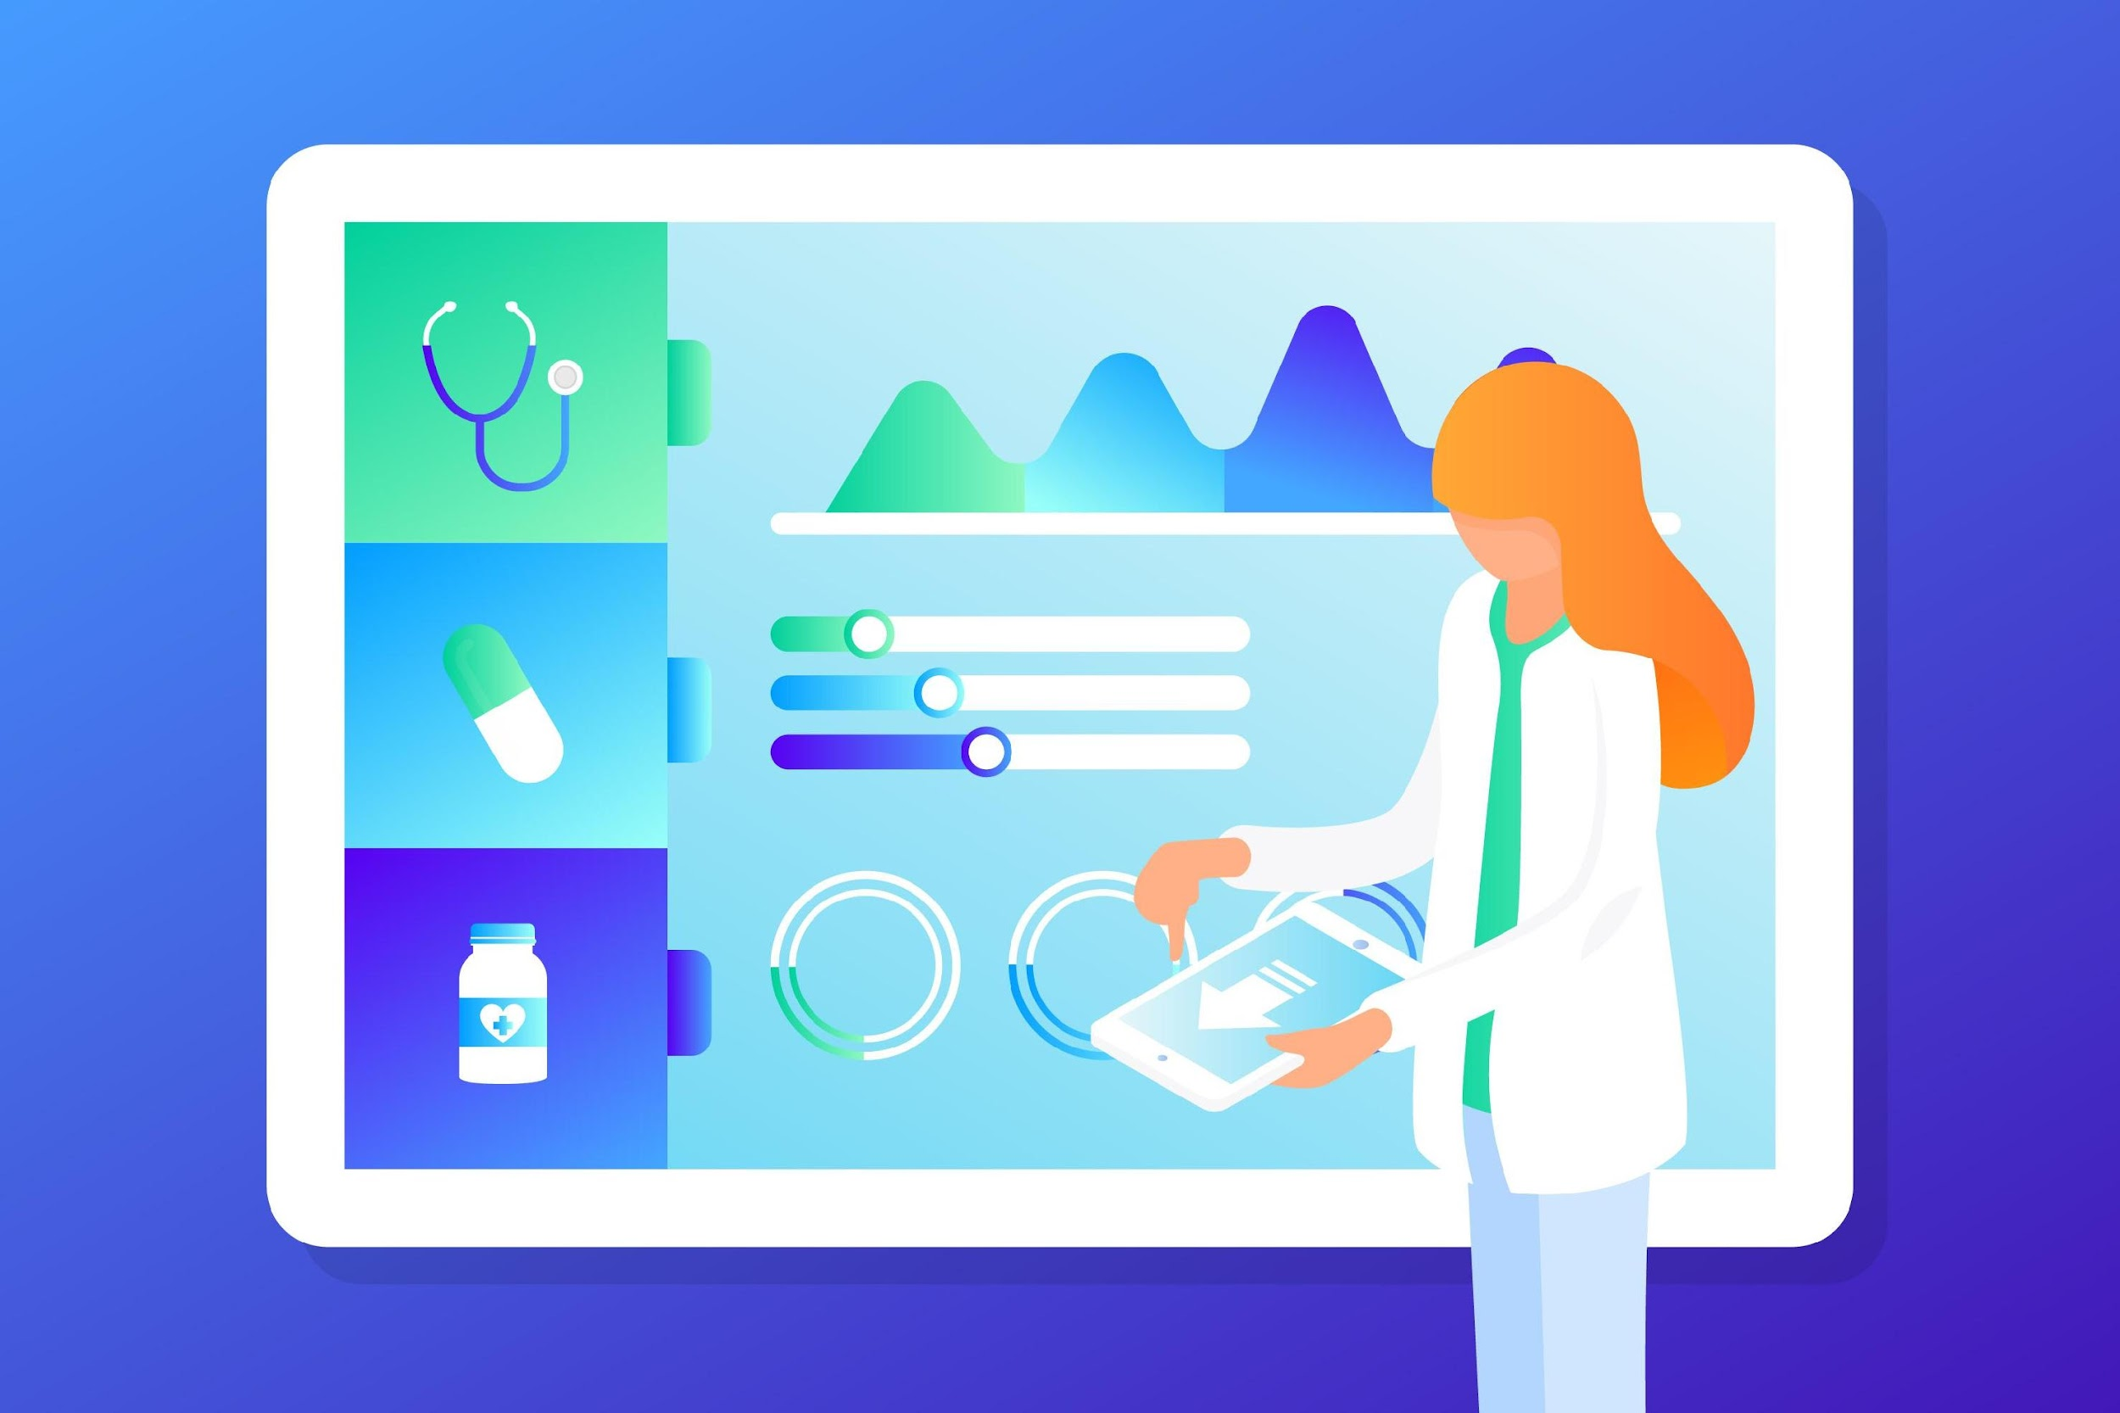
What digital tools could you use at work
Electronic Health Records (EHR)
Even though there is no EU-wide EHR system, here are some frequently used by organisations across the EU, which you even may encounter at your workplace.
Designed by Freeepik
Notes:
https://www.treatsoft.at/?mtm_campaign=treatsoftSuchAnzeigenPhysio&gad_source=1&gclid=CjwKCAjw_LOwBhBFEiwAmSEQAdapT68m-fWSCbuC--byGWJkpe2fkpyts_17Qk5T-KVSjufI3LaiDhoC1SAQAvD_BwE
https://scythe-studio.com/en/industries/medical-software-development?gad_source=1&gclid=CjwKCAjw_LOwBhBFEiwAmSEQAVF8czBocfsCnxNBzQOjvpUAbhHRNpXPqAO1LyxF13jSRyFRwvZ8wRoC5gkQAvD_BwE
https://www.myneva.eu/en/sectors/elderly-care

Slide 17
What digital tools could you use at work
Electronic Health Records (EHR)
Currently, these is no universal EHR on EU level. However, the EU set out a framework for the development of a European electronic health record exchange format (EEHRxF) to achieve secure, interoperable, cross-border access to, and exchange of, electronic health data in the EU.
EEHRxF will help citizens to access and share their health data quickly with health professionals, for example, when consulting a specialist or receiving emergency treatment in another Member State.¹
¹ European Commission. eHealth network
Notes:
https://health.ec.europa.eu/ehealth-digital-health-and-care/eu-cooperation/ehealth-network_en

Slide 18
What digital tools could you use at work
Electronic Health Records (EHR)
There are three EHR systems that are getting popular in Europe:¹
EPIC
CERNER
ALLSCRIPTS
¹Healthcare News. Epic, Cerner, Allscripts gaining traction in a European EHR market that's in competitive flux
Notes:
https://www.healthcareitnews.com/news/epic-cerner-allscripts-gaining-traction-european-ehr-market-thats-competitive-flux

Slide 19
What digital tools could you use at work
Electronic Health Records (EHR)
EPIC
EPIC is an EHR system that helps healthcare organisations manage patient information, streamline workflows, and improve patient care.
It offers several key features that enhance patient care, and simplify the everyday work of care workers.
Notes:
https://www.treatsoft.at/?mtm_campaign=treatsoftSuchAnzeigenPhysio&gad_source=1&gclid=CjwKCAjw_LOwBhBFEiwAmSEQAdapT68m-fWSCbuC--byGWJkpe2fkpyts_17Qk5T-KVSjufI3LaiDhoC1SAQAvD_BwE
https://scythe-studio.com/en/industries/medical-software-development?gad_source=1&gclid=CjwKCAjw_LOwBhBFEiwAmSEQAVF8czBocfsCnxNBzQOjvpUAbhHRNpXPqAO1LyxF13jSRyFRwvZ8wRoC5gkQAvD_BwE
https://www.myneva.eu/en/sectors/elderly-care

Slide 20
What digital tools could you use at work
Electronic Health Records (EHR)
EPIC – Key Features
Comprehensive Patient Records | Epic provides a centralised repository for patient information, including medical history, diagnoses, medications, allergies, lab results, and more. Clinicians can access this data quickly, leading to better-informed decisions.
Interoperability: | Epic supports data exchange between different healthcare organisations. It enables seamless sharing of patient records across hospitals, clinics, and other healthcare providers. This interoperability improves care coordination and reduces duplication of tests.
Clinical Decision Support | The system offers alerts, reminders, and evidence-based guidelines to assist clinicians during patient encounters. These prompts help prevent medication errors, identify potential drug interactions, and recommend appropriate treatments.
Order Management | Epic allows providers to place orders for tests, medications, and procedures electronically. It streamlines the order entry process, reduces paperwork, and ensures accurate communication between clinicians and other departments.
MyChart Patient Portal | Patients can access their health information through the MyChart portal. They can view test results, schedule appointments, communicate with their care team, and manage prescriptions. MyChart enhances patient engagement and empowers individuals to take an active role in their health.
Telehealth Integration | Epic supports telemedicine by enabling virtual visits, secure messaging, and video consultations. Especially relevant during the COVID-19 pandemic, telehealth features allow patients to connect with providers remotely.
Notes:
https://www.treatsoft.at/?mtm_campaign=treatsoftSuchAnzeigenPhysio&gad_source=1&gclid=CjwKCAjw_LOwBhBFEiwAmSEQAdapT68m-fWSCbuC--byGWJkpe2fkpyts_17Qk5T-KVSjufI3LaiDhoC1SAQAvD_BwE
https://scythe-studio.com/en/industries/medical-software-development?gad_source=1&gclid=CjwKCAjw_LOwBhBFEiwAmSEQAVF8czBocfsCnxNBzQOjvpUAbhHRNpXPqAO1LyxF13jSRyFRwvZ8wRoC5gkQAvD_BwE
https://www.myneva.eu/en/sectors/elderly-care

Slide 21
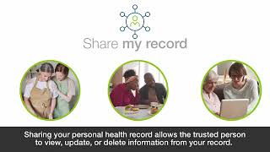
What digital tools could you use at work
Electronic Health Records (EHR)
EPIC
If you are eager to discover EPIC and its multiple functionalities, the Epic Systems Corporation provides detailed tutorials and overviews of the system's advantages on YouTube.
Organised by specific features, you can easily select your topic of interest and begin your educational journey!
How to Share Your Health Record - PLAYLIST
How to Share your Health Record - PLAYLIST
Notes:
https://youtube.com/playlist?list=PL_BugwFzfwRRo9g5eVVJmW9rYRvcmVtAl&feature=shared

Slide 22
What digital tools could you use at work
Electronic Health Records (EHR)
What do you think of the EPIC EHR? Do you think you could work with a system like this? When you begin working at a new workplace, you might encounter a different EHR system, and you will receive comprehensive training on the organisation's specific system.

Slide 23
Application of digital tools – safety considerations
?
What to consider when using digital tools at work

Slide 24
What to consider when using digital tools at work
When selecting and using digital tools at work, ensure they are GDPR-compliant, feature strong encryption and access controls, and align with your organisation’s specific data protection and privacy policies to maintain safety and regulatory compliance.
If you are uncertain about some regulations within your organisation, contact your supervisor and IT department, in order to ensure you are compliant.
To learn more about data protection and GDPR, and their relevance in healthcare, view Module 5!

Slide 25
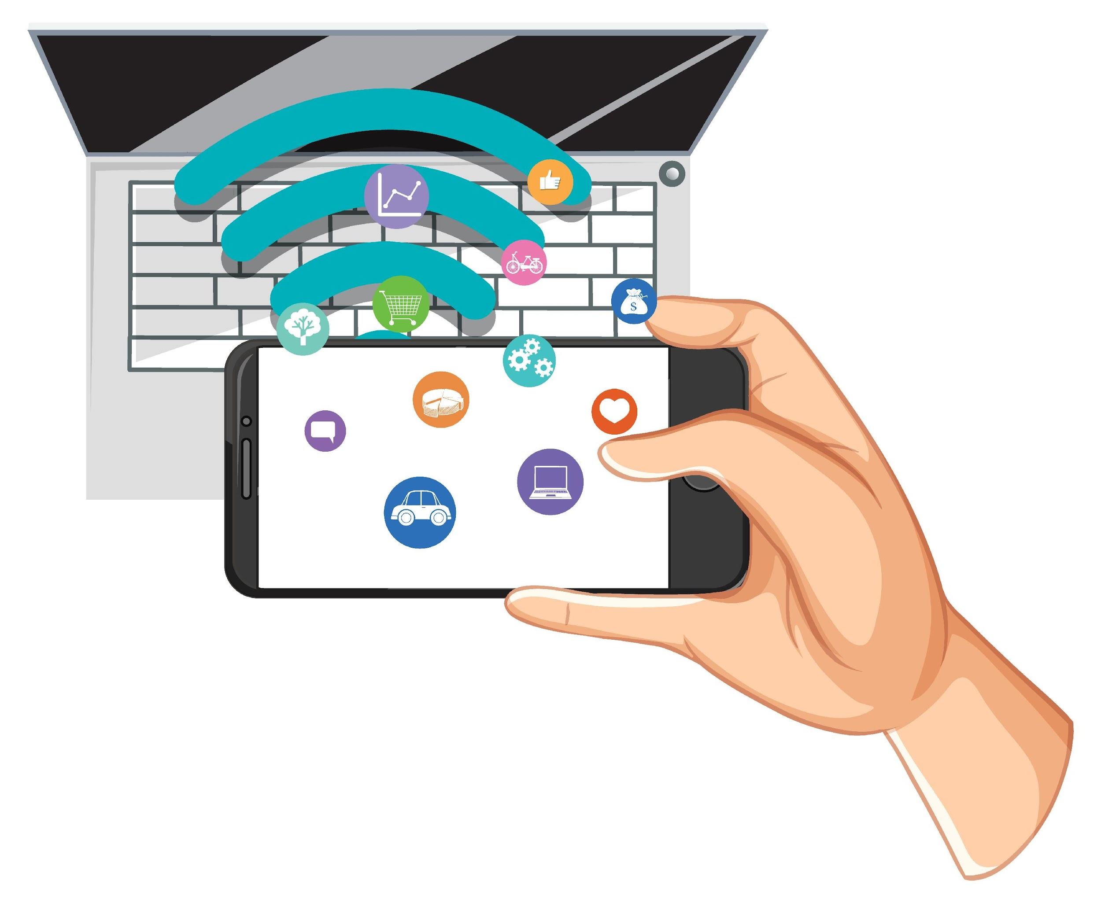
Interoperability with other digital technologies
Some apps and tools can work together with other digital technologies. For example, the calendar app on your phone can sync with the calendar on your computer and share appointments with your coworkers. Also, when you create reports, they can be combined with those of your coworkers and saved in the patient's file.

Slide 26
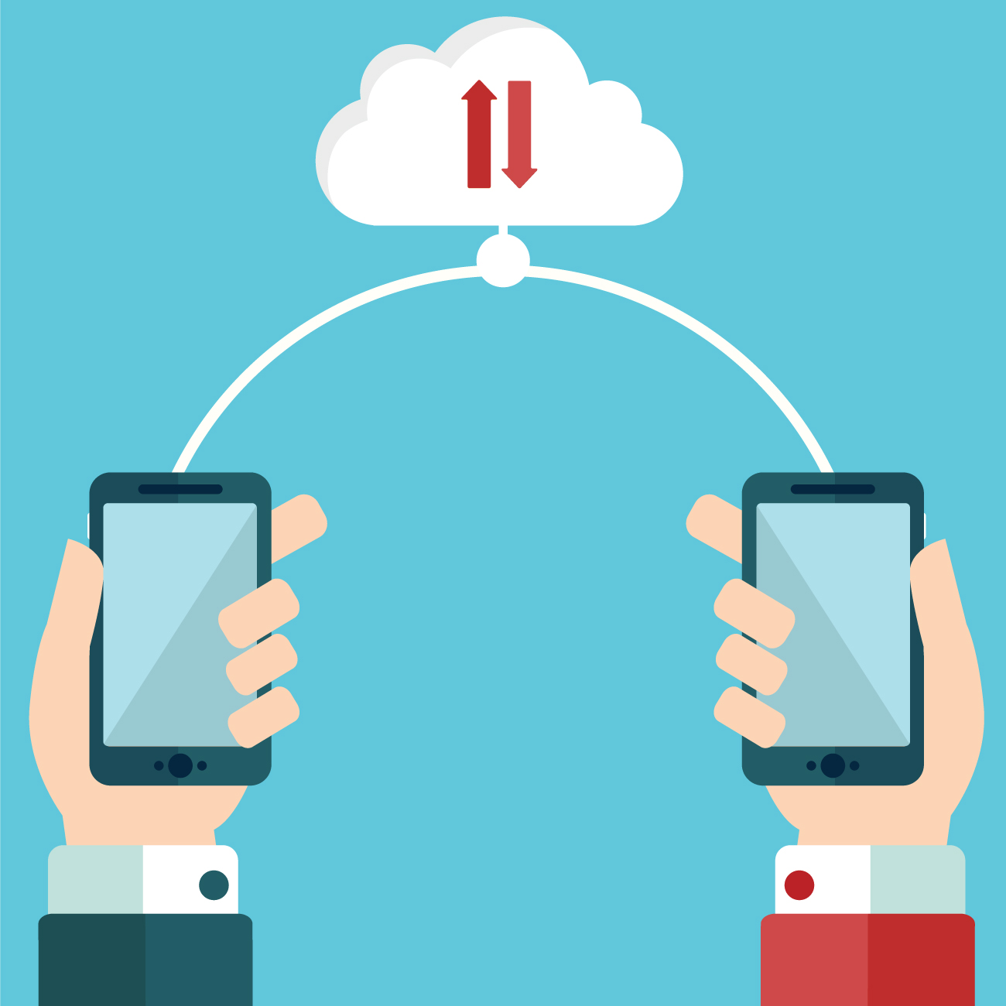
Best practice of using a care software
As a care worker you schedule appointments with clients using an app and also submit reports through the same app. Your colleagues can access and join these appointments and discussions.
This improves communication between you and your colleagues, involved family members and other professionals through a user-friendly interface:

Slide 27
Safe Communication at Work
?
Why is safe communication important at work

Slide 28
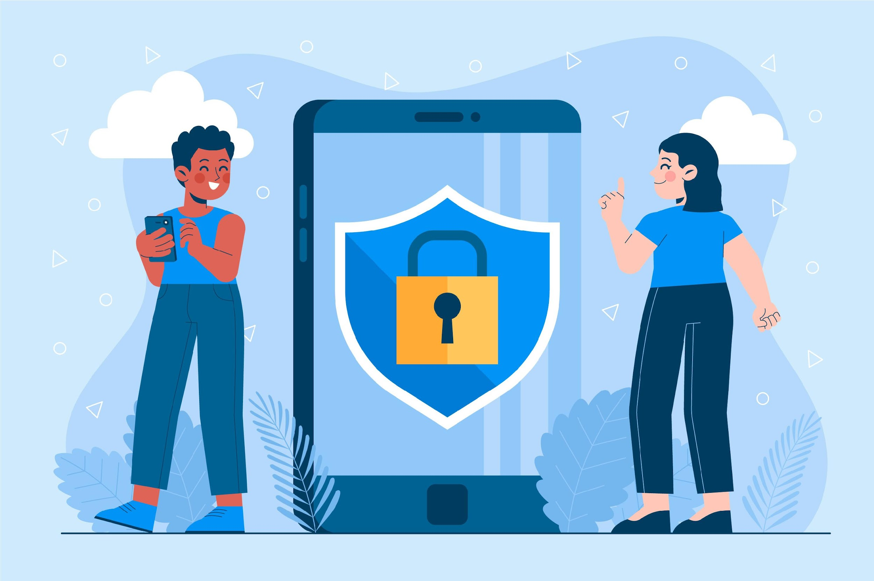
Why is safe communication important at work
Safe communication in healthcare settings is vital for protecting patient information and ensuring clear, error-free interactions.

Slide 29
Why is safe communication important at work
For an easy and quick communication among colleagues, there are different tools and messaging apps to be used safely for written communication or video-conferencing.
Now you will see some examples you could try out!

Slide 30
Which digital tools can you use for safe communication with your colleagues
Messaging Apps
Depending on the organisation, not all messaging apps are allowed to be used at work, and there could be certain restrictions due to data protection matters.

Slide 31
Which digital tools can you use for safe communication with your colleagues
Messaging Apps
Now we we will show you two messaging apps that are GDPR-compliant and are commonly used among care workers in the EU for fast and easy communication at work among colleagues:
Doctolib Siilo
MedText

Slide 32
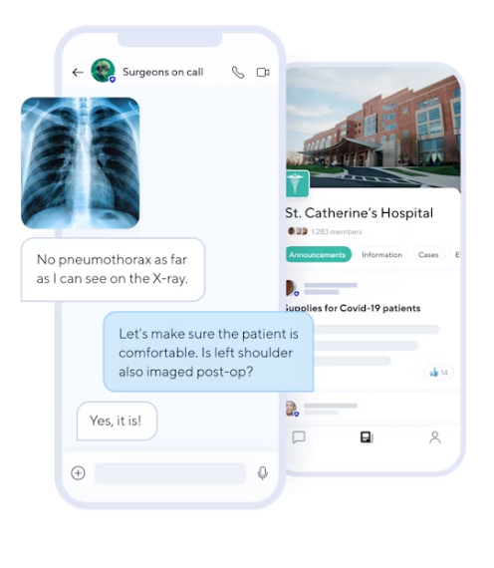
Which digital tools can you use for safe communication with your colleagues
Messaging Apps
Doctolib Siilo enhances secure communication among healthcare professionals with end-to-end encryption for messaging, voice and video calls, and a protected media library.
It facilitates patient case management through organised chats that can be exported as PDFs and offers photo editing tools for confidentiality.
Additionally, it includes a medical directory for networking, customisable availability statuses, and a Dark Mode for nighttime use.
Image by siilo.com

Slide 33
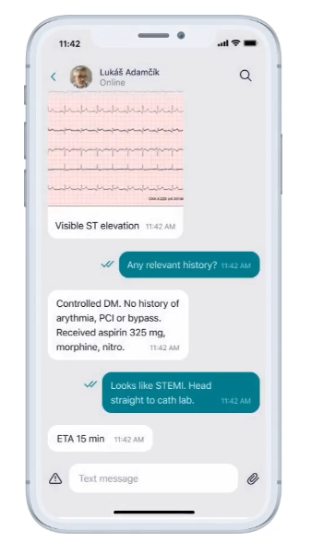
Which digital tools can you use for safe communication with your colleagues
Messaging Apps
MedText is a GDPR-compliant communication app for healthcare professionals, offering rapid and secure sharing of patient information with a focus on data privacy.
It features wide accessibility across devices, is tailored for the unique communication needs of the healthcare sector, and boasts a simple, intuitive interface with robust security measures.
Key functionalities include versatile messaging options, prioritisation of urgent communications, support for teamwork and inter-organisational collaboration.
Image by medtext.eu

Slide 34
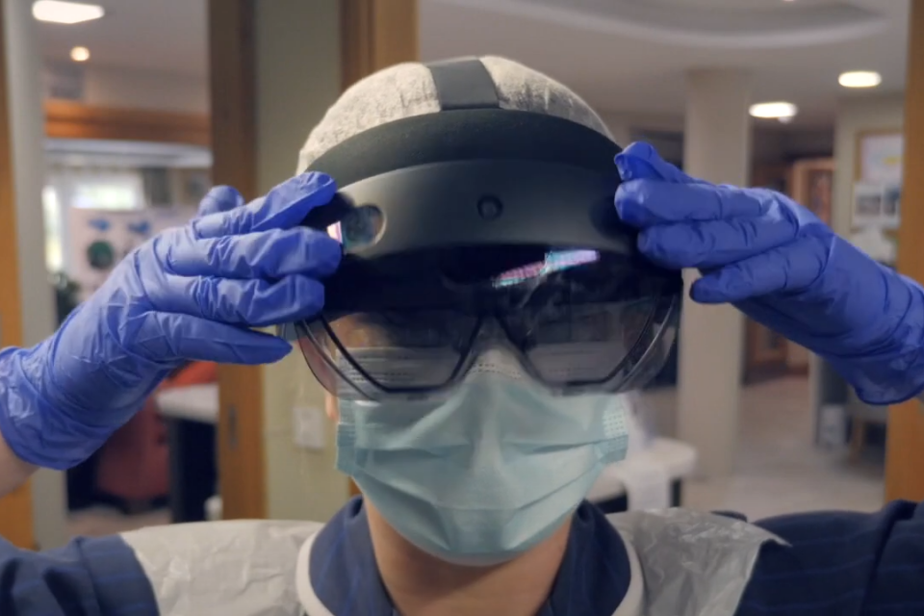
Which digital tools can you use for safe communication with your colleagues
HoloLens
Microsoft HoloLens is an augmented reality (AR)/mixed reality (MR) headset developed and manufactured by Microsoft.
Image by Microsoft

Slide 35
Which digital tools can you use for safe communication with your colleagues
HoloLens
The device facilitates a shared visual environment, where team members, regardless of their physical location, can see and interact with the same 3D models and patient data, enabling more effective discussion and collaboration on treatment plans.
HoloLens supports live, holographic telepresence of remote experts, who can provide immediate advice and support during medical procedures, fostering a collaborative care environment that transcends traditional geographical limitations.
Click on this LINK to see what it looks like!
Notes:
https://www.microsoft.com/en-us/hololens/industry-healthcare

Slide 36
Which digital tools can you use for safe communication with your colleagues
HoloLens
Discover the capabilities of HoloLens 2 and master its use by watching this tutorial video!
How to use the Microsoft Hololens 2
https://www.youtube.com/watch?v=4sZY_Daxg1U
Notes:
https://www.youtube.com/watch?v=4sZY_Daxg1U

Slide 37
Why is safe communication important at work
What communication tools are there in your country or organisation?
How can effective communication with colleagues be enhanced through various media channels in a modern workplace environment?

Slide 38
Installing Digital Tools on Your Devices
?
How can you install these tools on your devices

Slide 39
Downloading apps
Before downloading any app to your work devices, ensure compliance with organisational safety regulations by consulting your IT department or supervisor!

Slide 40
Downloading apps
To download an app on your Android phone, follow these steps:
Open Google Play:
On your device, find and open the Play Store app.
If you're using a computer, go to play.google.com.
Find the app you want:
Look for the app you're interested in.
Before downloading, check the app's reliability by reading reviews and checking star ratings and download counts.
Scroll down to the "Ratings and reviews" section to read individual reviews.
Install the app:
Once you've chosen an app, tap "Install" for free apps or the app's price if it's a paid app.

Slide 41
Downloading apps
To download an app on your Android phone, follow these steps:
Open the App Store app
On you iPhone or iPad, open the AppStore App.
Look for the app you want
Browse through the Today, Games, Apps, or Arcade tabs to find apps you like. If you want a specific app, open the Search tab.
Before downloading, check the app's reliability by reading reviews and checking star ratings and download counts.
Scroll down to the "Ratings and reviews" section to read individual reviews.
Install the app:
Once you've chosen an app, tap the price or GET button.
Double-click the side button on the right side of your iPhone—or the top button on your iPad— to complete the download/purchase.

Slide 42
Downloading apps
Exercise – Download Siilo to your phone!
Now that you learned how to download/install apps, it is time to try it out!
In the App store, or Google Play on your phone, search for Doctolib Siilo.
Follow the instructions we provided you in the previous slides, and download the app to your phone.
How did it go?

Slide 43
Self-Reflection Exercise
!
Time for
Self-Reflection

Slide 44
Self-Reflection Exercise
Next on, you will see questions related to the content of this unit.
Reflect on the questions and answer them by writing them in your (digital) journal!

Slide 45
Self-Reflection Exercise
How can you start using digital tools like calendars and AI for documenting care in your work? Think about one tool you're not using yet but seems helpful.
Why is it important to keep patient information safe when using digital tools, and what can you do to help with this?
How can technology like Doctolib Siilo or HoloLens help you work better with your team, especially when you're not in the same place? Can you think of a time when this would have been useful?+
Do you feel confident to download apps to your devices by yourself?
Designed by Freepik

Slide 46
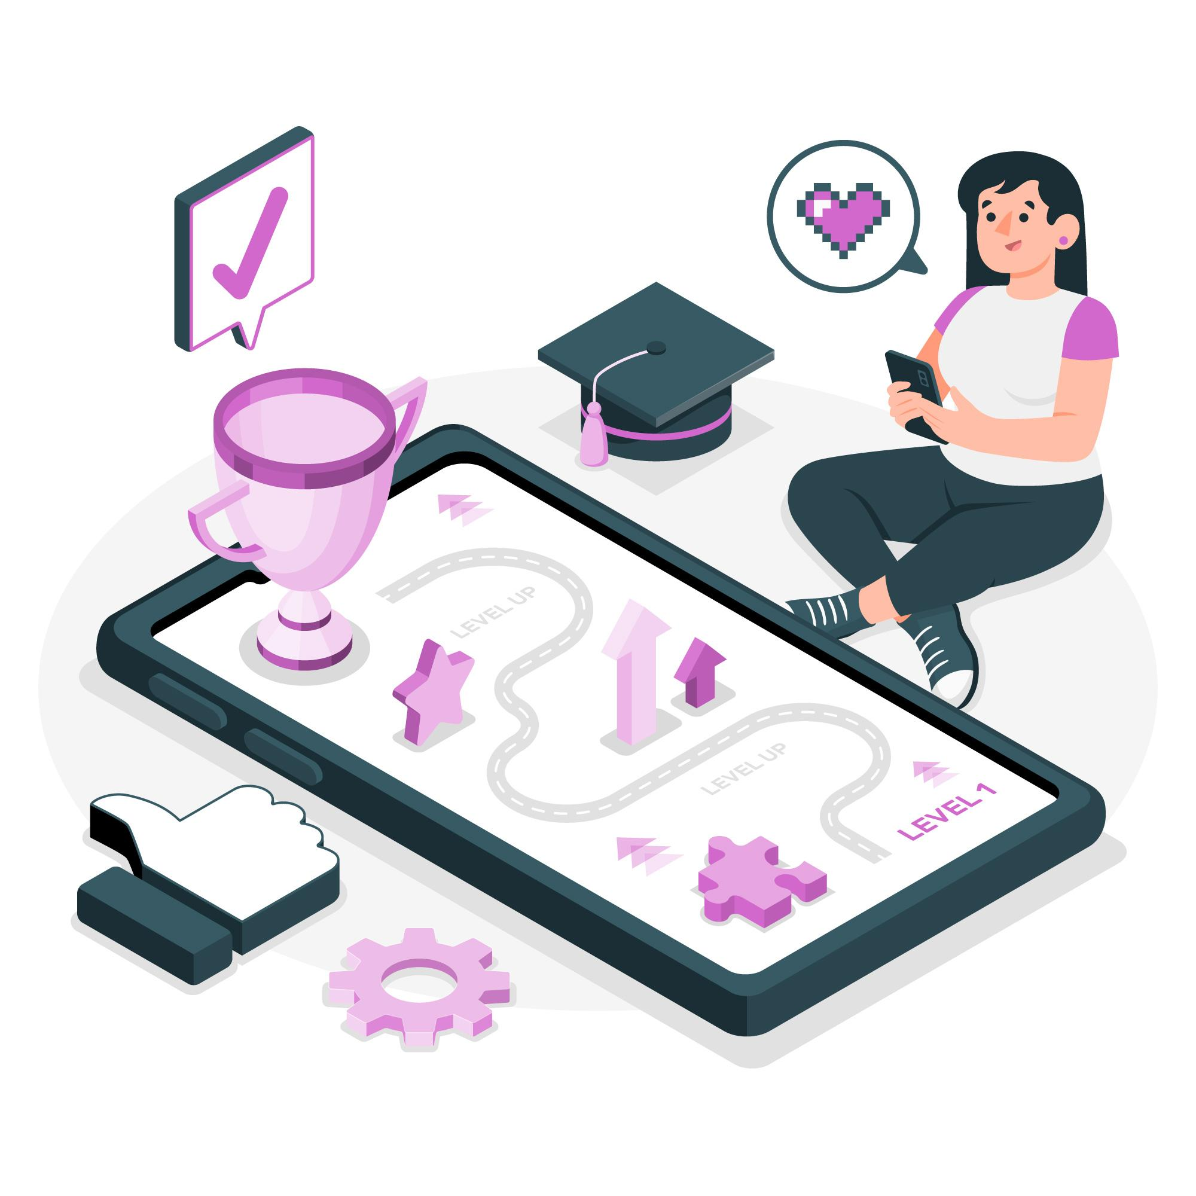
Congratulations, you completed Unit 1 of the Module 3.
Designed by Freepik

Slide 47
This learning unit has been developed as part of an Erasmus+ KA2 project DiMiCare and is funded with the support from the European Union. The work is intended for educational purposes and is licensed under Creative Commons Attribution-NonCommercial-ShareAlike 4.0 International License @ The DiMiCare Consortium (except for referenced screenshots and content).
Funded by the European Union. Views and opinions expressed are however those of the author(s) only and do not necessarily reflect those of the European Union or OeAD-GmbH. Neither the European Union nor the granting authority can be held responsible for them

Slide 48
List of References
European Commission. eHealth network https://health.ec.europa.eu/ehealth-digital-health-and-care/eu-cooperation/ehealth-network_en
Doctolib Siilo https://www.siilo.com/
MedText https://www.medtext.eu/en
Microsoft.com. HoLoLens 2 https://www.microsoft.com/en-us/hololens/industry-healthcare
Dictation. https://dictation.io/speech

Slide 50
Module 3
Application of digital tools
Unit 2
Home-based assistive technology for care recipients

Slide 51
01 Home-based assistive technology for care recipients
What can home-based technology do for care
What home-based technology can clients use
02 Virtual reality (VR) in home care
TABLE OF CONTENTS
How can VR support you and your clients in home care
03 Best practice in care homes: Livy Care
About Livy Care
04 Self-Reflection Exercise
Time for Self-Reflection!

Slide 52
Home-based assistive technology for care recipients
?
What can home-based technology do for care

Slide 53
What can home-based technology do for care
As you have already learned in Module 2, home-based technology greatly aids caregiving by automating daily tasks, enhancing safety with alert systems, and improving independence for care recipients.
These advancements support caregivers with efficient task management and provide quick assistance, ensuring a safer and more comfortable living environment.

Slide 54
Home-based assistive technology for care recipients
?
What home-based technology can clients use

Slide 55
What home-based technology can clients use
As a care worker, knowing the right home technology can make a big difference for your clients.
Here are some options to help make their daily lives a bit easier and allow for more independence.
We’ll go over how these tools work, so you can be there to help your clients use them effectively!

Slide 56
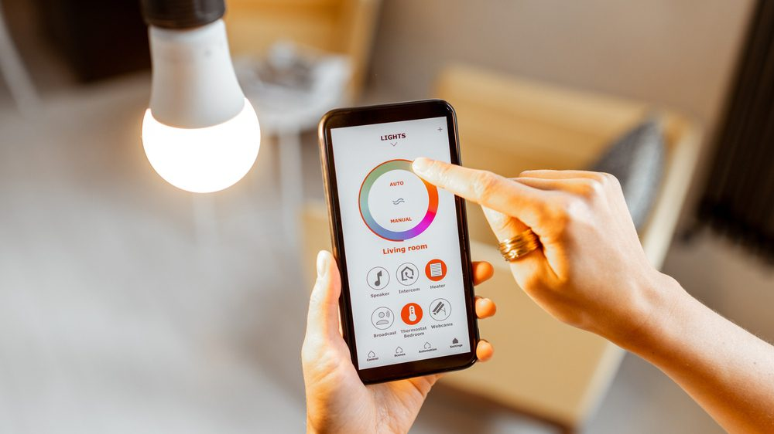
What home-based technology can clients use
Smart Light Systems
Smart lighting systems, especially those with voice activation, can greatly benefit elderly individuals by allowing them to adjust lighting without physical switches, providing ease of use and the ability to control their environment through an app remotely, thereby enhancing their comfort and autonomy at home.
Image by Horizon Services
Besides, it is also possible to set up certain times when the lights will go on and off every day.

Slide 57
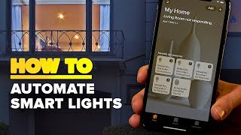
What home-based technology can clients use
Smart Light Systems
There are various apps that can be used for smart light at home.
The following video helps you to understand how automatic light systems work through the use of an App (Philips HUE)
How to turn your smart lights on automatically when you get home
Notes:
https://youtu.be/twbG5yQhlMg?si=eANo4DfL4HawdB05&t=11

Slide 58
What home-based technology can clients use
Smart Light Systems
How can this help a client?
Margaret, an elderly woman with limited mobility, finds it difficult to reach for light switches around her home. To ease her daily routine, she has a smart lighting system installed that is controlled through an intuitive app on her phone. Now, when she needs to light a room, she doesn't have to move an inch; she can simply tap on her phone to illuminate any area of her house.
If she's settled in bed and realizes she left the kitchen lights on, a quick swipe on her screen turns them off. This control at her fingertips not only minimises her risk of falls during the night but also empowers her with a sense of independence and reassurance in her daily life.

Slide 59
What home-based technology can clients use
Smart Light Systems,
How can this help a client?
Margaret, an elderly woman with limited mobility, finds it cumbersome to reach for light switches around her home. To ease her daily routine, she has a smart lighting system installed that is controlled through an intuitive app on her tablet. Now, when she needs to light a room, she doesn't have to move an inch; she can simply tap on her tablet to illuminate any area of her house.
If she's settled in bed and realises she left the kitchen lights on, a quick swipe on her screen turns them off. This control at her fingertips not only minimises her risk of falls during the night but also empowers her with a sense of independence and reassurance in her daily life.

Slide 60
What home-based technology can clients use
Medical Alert Devices
Similar to Emergency Call Aids (Module 2), medical alert devices devices programmed to contact emergency services or a monitoring center that can dispatch medical help.
These devices are usually wearable and have a simple button that, when pressed, connects the user to the help they need.
They often come with features like fall detection or GPS tracking for added safety.

Slide 61
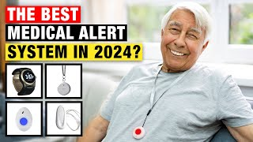
What home-based technology can clients use
Medical Alert Devices
This video provides insights into the features and user experiences of different medical alert devices:
The Best Medical Alert System For You in 2024
How can these devices help a client?

Slide 62
What home-based technology can clients use
Calendar App
In Module 2, we've explored various applications for managing tasks and reminders efficiently.
Building on what we covered in Unit 1, we can extend our toolset to include Outlook and Google Calendar for scheduling appointments and setting reminders. By utilising a shared calendar, both you and your clients can benefit from streamlined communication and enhanced organisation of at-home care activities.

Slide 63
?
Virtual reality (VR) in home care
How can VR support you and your clients in home care

Slide 64
How can VR support you and your clients in home care
Virtual Reality (VR) can enhance home care by offering physical therapy through engaging exercises, providing mental stimulation for cognitive health, creating opportunities for socialising in a virtual space, aiding in pain management with immersive distractions, and training caregivers with realistic simulations.
Additionally, it can offer relaxing leisure activities for those unable to leave their homes.

Slide 65
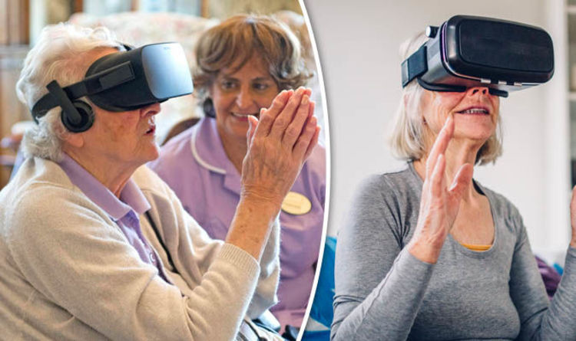
How can VR support you and your clients in home care
Overall, when used thoughtfully, VR can be a powerful tool in enhancing the quality of care for the elderly, offering both entertainment and health benefits.

Slide 66
How can VR support you and your clients in home care
On this video you can see how trips made using VR can help elderly unable to leave their home deal with depression!
VR Trips Help Treat Depression in the Elderly
https://youtu.be/YW99DHOl098?si=2UwE_Y8Ka-4uGiGZ

Slide 67
How can VR support you and your clients in home care
However, care must be taken to ensure that VR experiences do not cause disorientation or motion sickness, which can be a concern for some elderly individuals!

Slide 68
How can VR support you and your clients in home care
What do you think of VR in home care?
Would you recommend and/or use it with your clients?
Do you already have something similar at your organisation?

Slide 69
Best practice in care homes: Livy Care
Throughout our learning, we've uncovered the ways in which various devices and technologies simplify daily organisation for clients and caregivers, contributing to a safer, more autonomous living environment.
Yet, it's exciting to note that there are comprehensive platforms and technologies that integrate functionalities across multiple devices, further easing daily management and enhancing the monitoring of home care activities.

Slide 70
Livy Care
For example, Livy Care is a smart solution designed to increase the safety and well-being of clients in care settings, such as those with limited mobility or conditions that increase the risk of falls.
The technology includes a Livy Sensor Station that detects falls and notifies caregivers immediately, ensuring rapid response and support. It also has features to alert staff when clients with a high risk of falling leave their bed or room, especially at night, and integrates a night light to help prevent falls.
Additionally, it includes a helpcall detection system that can recognise calls for help from clients and trigger an alarm without the need for the client to physically press a button

Slide 71
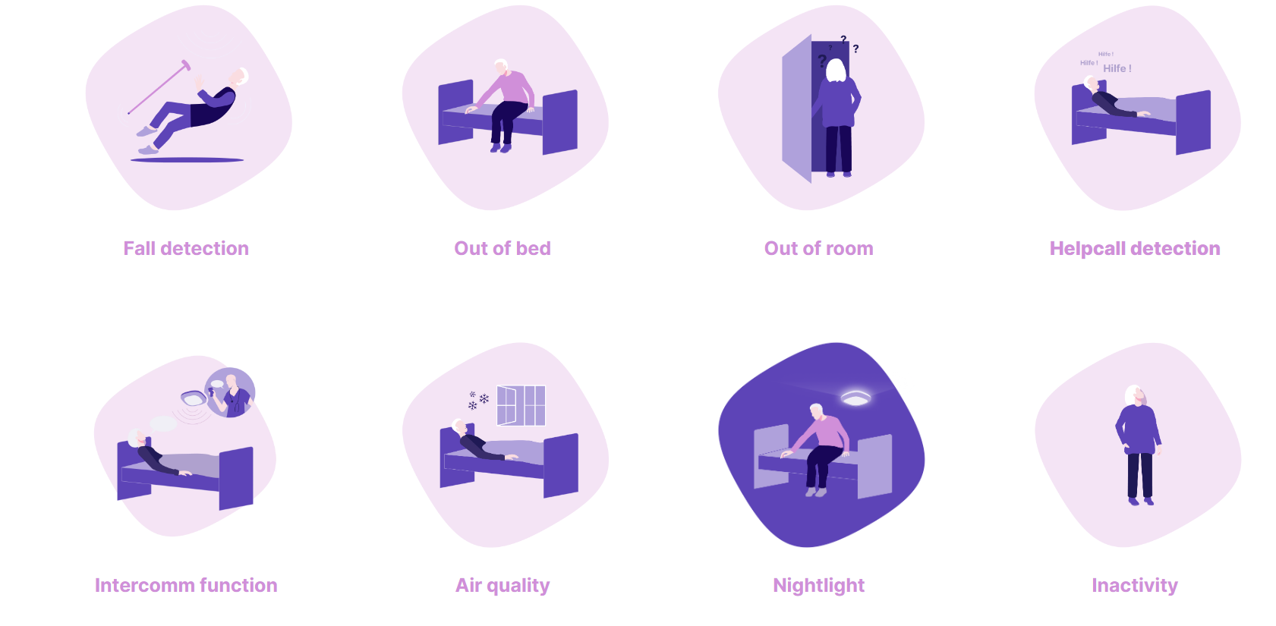
Livy Care
The features and functionalities of Livy Care
Image by Livy Care

Slide 72
Livy Care
The system emphasises data privacy, with encrypted data transmission, local data processing on secure servers in Germany, and a commitment not to store personal data unnecessarily.
Livy Care uses abstracted images for its detection features to ensure the privacy of clients and caregivers. Furthermore, the technology has backups for internet and power outages, ensuring its reliability.
If you are interested in the system, click here to read more about ist multifunctionality and benefits!

Slide 73
Livy Care
What do you think of Livy Care?
Does your organisation use it or maybe a system similar to it?
Does it help with your daily work?
Do you see its benefits for the clients?

Slide 74
Summary
Assistive technology devices are basically helpful products that improve or maintain a person's ability to live and function independently. Some Assistive technology can be as simple and some of them are quite difficult to use.
As a caretaker you can tell the clients about it and help them to install or use such technology.
VR, AI and HoloLens are examples of how to use technology in healthcare
A

Slide 75
Self-Reflection Exercise
!
Time for
Self-Reflection

Slide 76
Self-Reflection Exercise
Next on, you will see questions related to the content of this unit.
Reflect on the questions and answer them by writing them in your (digital) journal!

Slide 77
Self-Reflection Exercise
In what ways have I adapted the use of home-based technologies, such as smart lighting systems and medical alert devices, to meet the unique needs of my clients, and how has this improved their independence and safety?
How do I ensure that while employing these technologies, such as Livy Care, the privacy and dignity of my clients are respected, and what steps can I take to enhance data protection in my daily practice?
How has the integration of digital tools like shared calendars and VR applications influenced my communication with clients and coordination with my team, and what improvements can I still make?
Designed by Freepik

Slide 78
Congratulations, you completed Unit 2 of the Module 3.
Designed by Freepik

Slide 79
This learning unit has been developed as part of an Erasmus+ KA2 project DiMiCare and is funded with the support from the European Union. The work is intended for educational purposes and is licensed under Creative Commons Attribution-NonCommercial-ShareAlike 4.0 International License @ The DiMiCare Consortium (except for referenced screenshots and content).
Funded by the European Union. Views and opinions expressed are however those of the author(s) only and do not necessarily reflect those of the European Union or OeAD-GmbH. Neither the European Union nor the granting authority can be held responsible for them

Slide 80
List of References
Livy Care. https://livy-care.com/en/
The Best Medical Alert System For You in 2024. https://youtu.be/YW99DHOl098?si=2UwE_Y8Ka-4uGiGZ
VR Trips Help Treat Depression in the Elderly. https://www.youtube.com/watch?v=YW99DHOl098

Slide 81
Modulo 1
Competenze digitali di base
Unità 1
Alfabetizzazione informatica e dei dati

Slide 82
Module 3
Application of digital tools
Unit 3
Health Tools and Self-Monitoring Apps

Slide 83
01 How does a pedometer work?
Pedometer
Recommendation for use
02 How does a drink reminder app work?
Drink reminder
Recommendations for use
TABLE OF CONTENTS
03 How does a diabetes management app work?
Diabetes Management
Recommendation for use
04 How does a mental health app work?
Mental Health Apps
Wysa-Mental Health App
Recommendations for use

Slide 84
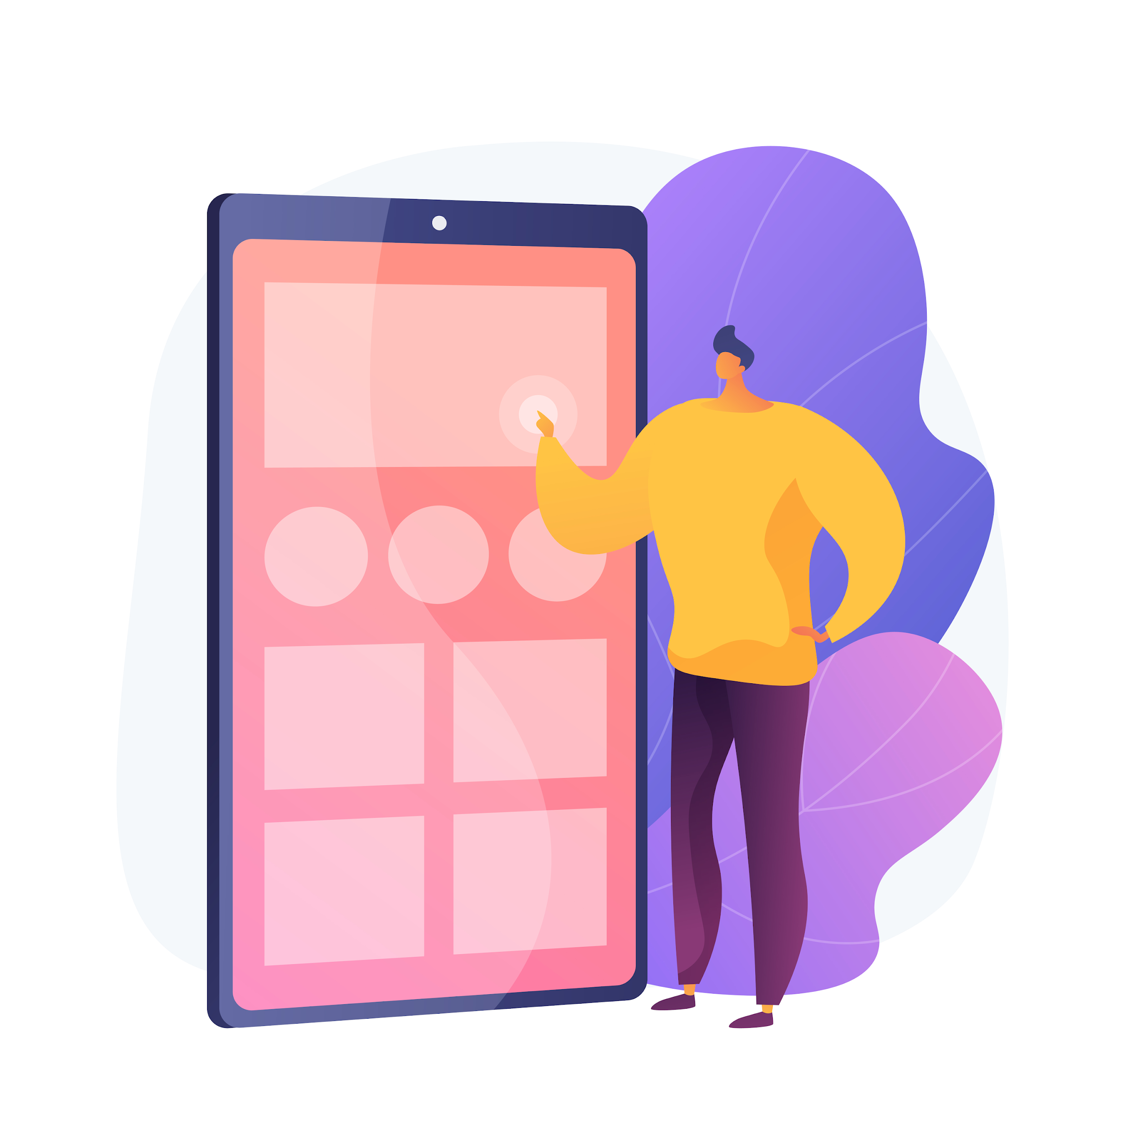
INTRODUCTION
You have already been introduced to several apps that can help monitor health or personal lifestyle in Module 2 Unit 4. Let's take a closer look now at how to use these apps effectively.

Slide 85
Applying fitness apps
?
How does a pedometer work

Slide 86
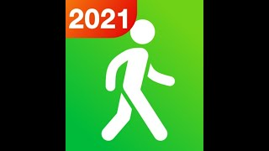
Pedometer
A pedometer records the number of steps of the user and displays them along with other information, e.g. distance, walking time or speed per hour. Regular use can boost daily workouts and improve fitness.
Pedometers can be used as an App on a smartphone and also combined with a smart watch.
The following video explains how to use the Step Tracker App on a smartphone.
How to use a Step Tracker

Slide 87
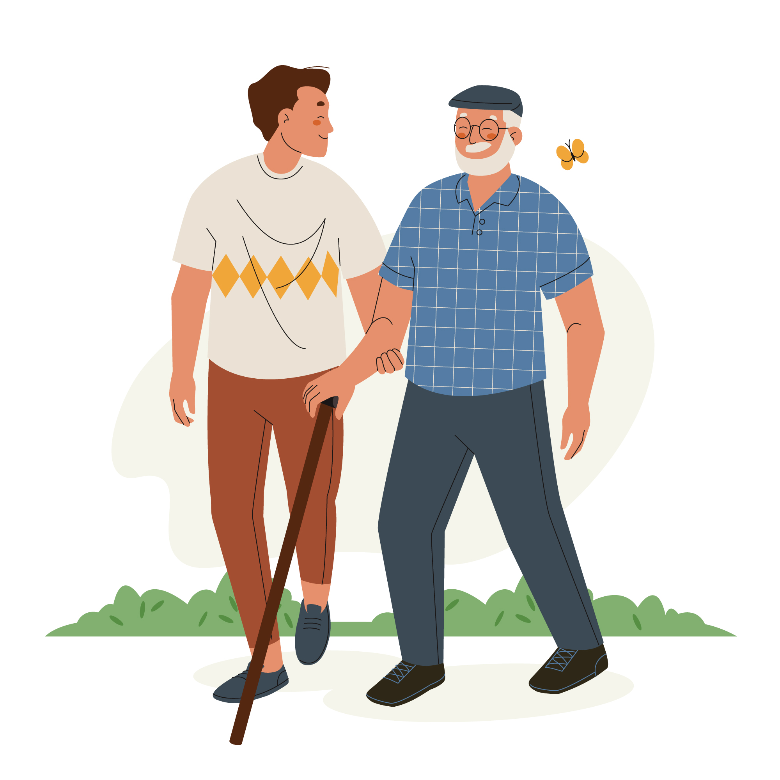
Recommendations for use
Remember that older people may have different mobility levels and abilities. Therefore, 10.000 steps (recommendation by the WHO) will not be a realistic goal for them. The primary goal should be to provide an incentive for movement.
Often, pedometers count steps by measuring wrist movements.
For people using a walker, they can use a pedometer that clips onto their waistband.
We recommend avoiding apps with Bluetooth interfaces to prevent data transfer over the Internet.

Slide 88
Applying reminder apps
?
How does a water reminder app work

Slide 89
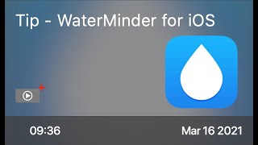
Drink Reminder
For some clients, remembering to drink regularly can be a challenge and they struggle to meet the daily recommended intake of water.
Waterminder is an app designed to help people stay hydrated. It calculates your daily target and reminds you to drink water at regular intervals throughout the day.
The following video shows you how the App works:
WaterMinder for iOS

Slide 90
Recommendations
There are similar apps that also measure urine output and colour as a sign and symptom for dehydration
People with dementia may benefit from water reminder apps in case that they forget to drink water.

Slide 91
Applying diabetes apps
?
How does a diabetes management app work

Slide 92
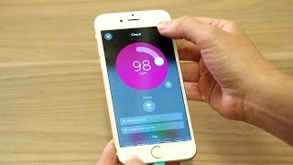
Diabetes Management App
Diabetes Management Apps help people with diabetes to monitor and manage their condition.
These apps typically include features such as tracking blood sugar levels, recording food intake and physical activity and information about diabetes.
The following video shows you how One Drop, A Diabetes Management App works:
One Drop Diabetes Management App

Slide 93
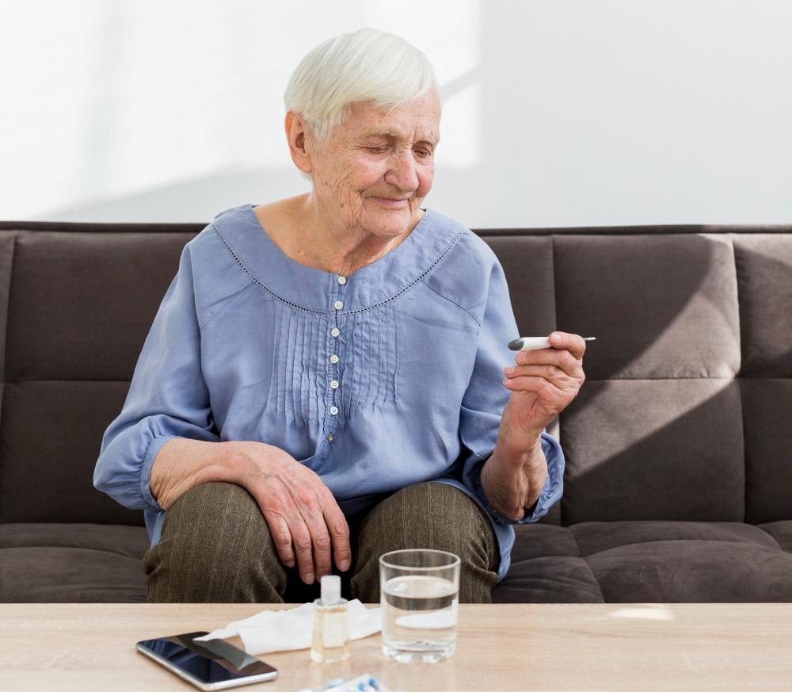
Recommendations for use
There are numerous apps available from various providers, including pharmaceutical companies or health insurance companies.
Regarding data security, people with diabetes should ensure that the data remains on their own smartphone when selecting an App.
Clients who are not very experienced with using a smartphone should choose an App that is simple and easy to use:
Examples available in Austria:
mySugr Diabetes Tagebuch
SiDiary
DiabetesConnect
DDG Pocket Guidelines

Slide 94
Applying mental health apps
?
How does a mental health app work

Slide 95
Mental Health Apps
Older adults may experience loneliness or challenging mental conditions such as memory loss or depression.
Sleep disorders are also common among older people.
While mental health apps cannot replace the expertise of a mental health professional, they offer valuable services such as meditation, mood tracking and counselling that can provide support.

Slide 96
Wysa - Mental Health App
The Wysa App gives access to instant support through cogntitive behavioural therapy (CBT) exercises and journaling using AI technology.
Watch this tutorial to find out how WYSA works:
How to use wysa

Slide 97
Recommendations for use
The consultation of a doctor is beneficial, as they often have a good understanding of the efficacy of a particular app
When choosing an App, it is recommend to check whether a mental health professional was involved in developing the app
It is important to stop using the app if the user experiences any adverse effects

Slide 98
Activity
Following the video tutorial you watched at the beginning, download the Step Counter App or a similar pedometer app to your smartphone and use it for a week. You can set a daily step goal.
The World Health Organization recommends 10,000 steps a day for a healthy person with no mobility problems. Are you meeting this goal?
Write the following in your (digital) journal:
What were your experiences using a step tracker?
How did tracking your steps impact your motivation?
Do you think such a tool could motivate older people to increase their mobility?

Slide 99
More Health App Examples (English)
Sleep Time by Azumio
Cost: Free
Aims: Monitors sleep patterns and sleep efficiency
How it works: Users can track their frequency of light and deep sleep to understand the amount needed for them to feel rested.
Bellybio Interactive Breathing by RelaxLine
Cost: Free
Pace breathing to achieve calmness
By placing the mobile phone against the abdomen, users follow
the sounds to practice deep abdominal breathing

Slide 100
Summary
There are many health tools and self-monitoring apps available that may improve the quality of life of care-dependent people and thus also ease your work as carer. The selected apps, a pedometer, a drink reminder app, a diabetes management app and a mental health app are 4 examples that may be useful for your clients. You may have observed that these apps are typically designed to be intuitive and user-friendly. Once you understand their functionality, navigating most apps should be a straightforward process.

Slide 101
Self-Reflection Exercise
!
Time for
Self-Reflection

Slide 102
Self-Reflection Exercise
Next on, you will see questions related to the content of this unit.
Reflect on the questions and answer them in writing in your (digital) journal!

Slide 103
Self-Reflection Exercise
Do you feel confident in your ability to explain the functionality of these apps to your clients? What else would you need to know?
How do you envision discussing apps such as a pedometer, a water reminder, or a diabetes management app with your clients?

Slide 104
Congratulations, you completed Unit 3 of the Module 3.

Slide 105
This learning unit has been developed as part of an Erasmus+ KA2 project DiMiCare and is funded with the support from the European Union. The work is intended for educational purposes and is licensed under Creative Commons Attribution-NonCommercial-ShareAlike 4.0 International License @ The DiMiCare Consortium (except for referenced screenshots and content).
Funded by the European Union. Views and opinions expressed are however those of the author(s) only and do not necessarily reflect those of the European Union or OeAD-GmbH. Neither the European Union nor the granting authority can be held responsible for them

Slide 106
List of References
Apotheken.de: Was bringen Diabetes-Apps? Diabetes-Selbstmanagement mit Apps (2015). https://www.apotheken.de/medikamente/wirkstoffe/11019-diabetes-selbstmanagement-mit-apps
Explain that stuff: Pedometer (2023): https://www.explainthatstuff.com/how-pedometers-work.html
Make use of. The 8 best mental health apps for seniors (2023). https://www.makeuseof.com/mental-health-apps-for-seniors/
WaterMinder: https://waterminder.com/

Slide 108
Module 3
Application of digital tools
Unit 4
Robotics and Physical Support

Slide 109
01 Types of Robots
Overview robotics
02 Robotics and physical support
Tools for care workers
Tools for clients
Examples and Videos
TABLE OF CONTENTS
03 Social Robots
Technical insights
Have you met Pepper?
Video
04 Cognitive assistance robots
Cognitive assistance robots
Have you met Pepper?
Video
Example Netherland Tessa
05 Acceptance of robots
Acceptance of Robotics
Ethical concerns

Slide 110
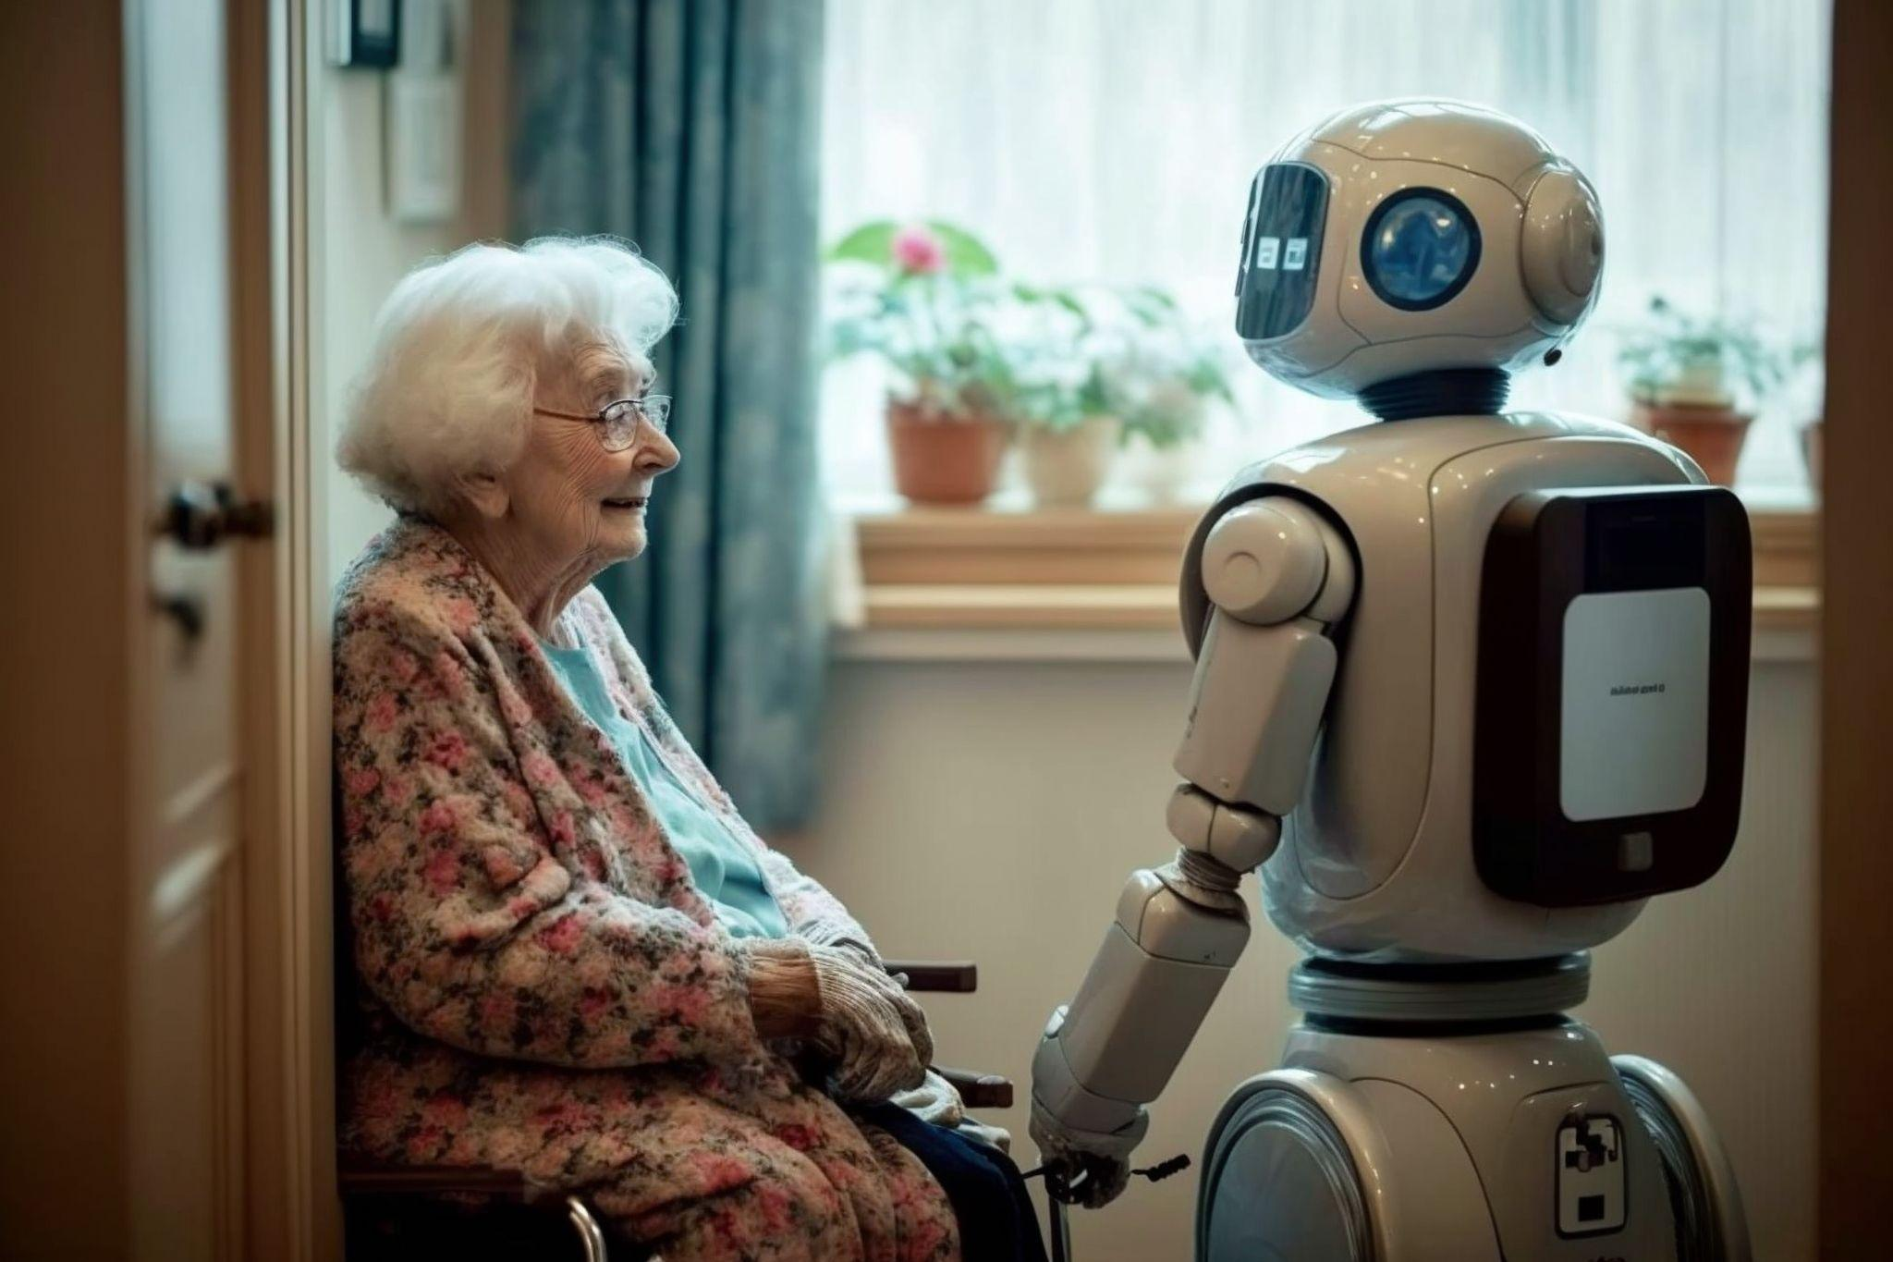
CONTENT
There are a number of robots that are used in the care and therapy sector
By making use of robotics and physical support, healthcare workers can do their job better and stay healthy themself.

Slide 111
Robotic and Physical Support
?
What are the different types of robots

Slide 112
Types of Robots
Pepper, Zora, Paro, Tessa—these are all names of robots used in healthcare. Some are designed for exercise and aiding with daily activities, while others provide support for daily routines. What are the various types of robots available, and how can they assist you in your work?

Slide 113
Robotics
Physical assistance robots: designed tu support careworkers to perform physical tasks
Social robots: designed to improve the overall well-being of users through companionship
Cognitive robotics: designed to support users in performing cogntive tasks

Slide 114
Robotic and Physical Support
?
What is robotic for physical support

Slide 115
Robotics and Physical Support
Physical support through robotics involves offering hands-on assistance with various physical needs. This includes helping with mobility, repositioning, transferring and lifting out of bed, or daily tasks such as cooking or cleaning.

Slide 116
Tools for care workers
The Vendlet is an electric turning system that allows the caregiver to easily move or turn the client in bed.
The HelpSoq is an aid to put on support stockings easily and without force and pain
Lifts
Electrically adjustable bed.
Adjustable shower chair.
Sliding sails.

Slide 117
Types of tools for clients
arm support to hold cutlery yourself.
a cup holder to make it easier to hold a glass or cup.
a splint or brace to hold a pen.
a page-turning device for reading a book without holding it.
grip adjustments for a seat belt or toothbrush.

Slide 118
Example Vendlet
The Vendlet is an electric turning system that allows the caregiver to easily move or turn the client in bed. It reduces physical strain on healthcare personnel, it optimizes healthcare processes and efficiency improvements and is effective in pressure ulcer treatment and prevention.

Slide 119
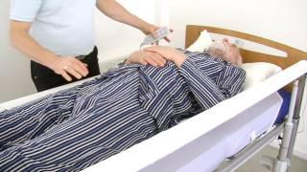
Video
The following video shows you how to use the Vendlet or similar electrical turn sheets to turn or reposition a client.
How to use Vendlet?
Do you think that this physical aid would ease your physical tasks?

Slide 120
?
Robotic and Physical Support
What are social robots

Slide 121
Social Robots
Social robots communicate and interact with people by following social behavior and rules.

Slide 122
Technical insights
Social robots use cameras to capture and analyse an image of the person. Additionally, voice and movement patterns are analysed to understand emotions.
Similar lie our brains using neural networks, robots rely on artificial intelligence algorithms to determine a person’s emotional state.

Slide 123
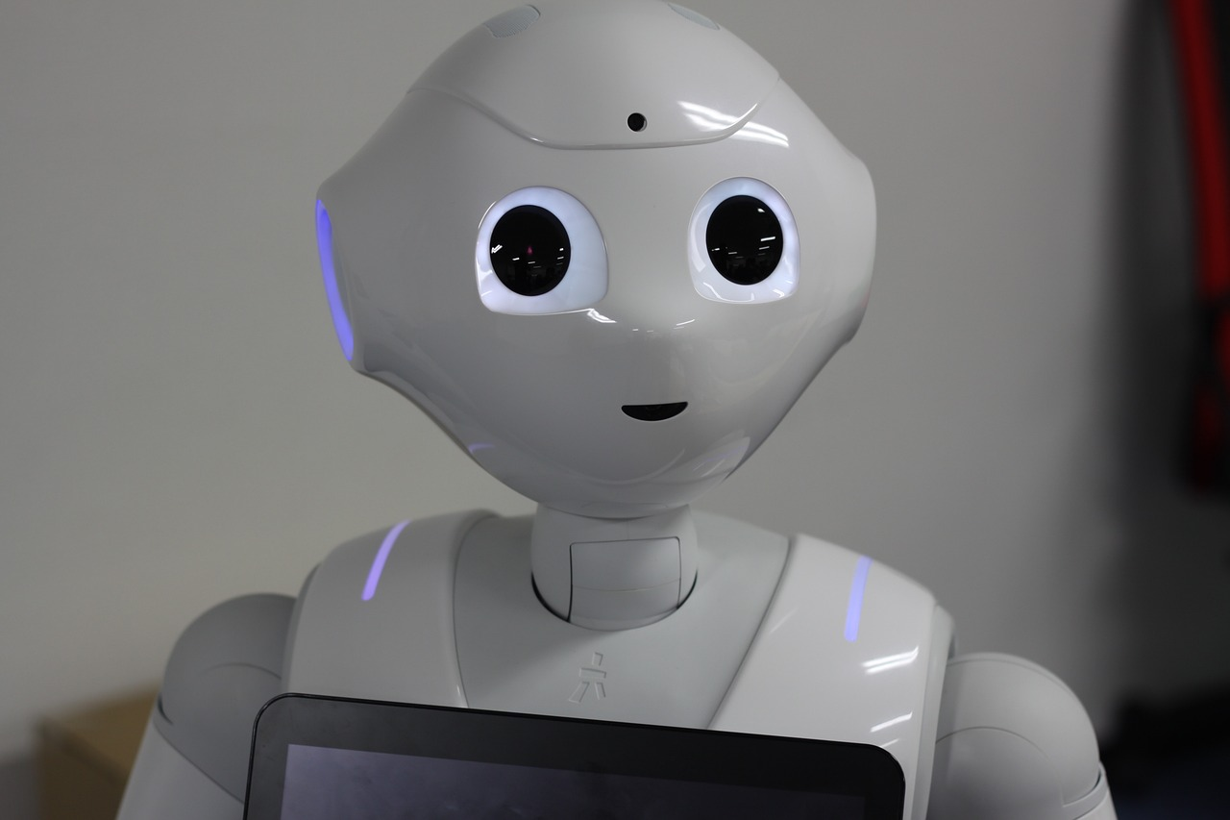
Have you met Pepper?
Pepper is a 1,20m tall robot, that is helping out in more and more care homes.
I can perceive my surroundings and hold conversations thanks to a microphone, a 3D camera and sensors.
I can tell jokes, reads fairy tales or imitate animals.

Slide 124
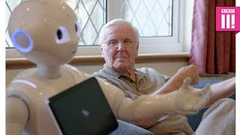
Video- Pepper
Watch this video to understand how Pepper interacts with older people and how older people interact with him.
Do you think that social robots like Paro can help to combat chronic loneliness?
Can robots take care of the elderly?
Notes:
Further information: https://www.youtube.com/watch?v=5gPAFSB7qc0&t=1s

Slide 125
?
Robotic and Physical Support
What are cognitive assistance robots

Slide 126
Have you met Paro?
Have you met Paro?
Paro is an artificial harp seal from Japan that is used for therapeutic purposes since 2009. Its positive effects on dementia patients are clinically proven.
I have calming effects on patients and can help to combat depression
I can learn a name, recognise voices and move in response to others.
I love attention and will show an array of emotions in response.
Source: National Institute of Advanced Industrial Science and Technology

Slide 127
Video Paro
Watch this video to see how people who are living with dementia interact with Paro and what dementia care specialists think about it:
Paro the robotic seal
According to the experts in the video, what are their experiences with using these technologies?
Could you imagine using Paro for your work? Why (not)?

Slide 128
Video Robotic Pets
This video provides insight into the use of robotics, helping to brighten the mood of senior residents and stimulating cognitive function.
Robotic Pets are helping dementia patients
What is your opinion on the use of robotic pets?

Slide 129
Example Netherland: Tessa
Tessa provides verbal support and daily structure to individuals with cognitive disabilities. Through verbal guidance, individuals can accomplish more tasks independently. As a caregiver, you can empower your clients with self-management skills and provide support even when you're not present.
Tessa delivers this guidance through spoken messages, inquiries, or personalised music selections set by you or the caregiver. Specifically designed for individuals with cognitive disabilities, Tessa has been shown to enhance self-reliance in individuals with dementia, autism, and acquired brain injury.

Slide 130
Example Netherland: Tessa
The following video helps you to understand how Tessa helps to structure a person’s life:
Tessa

Slide 131
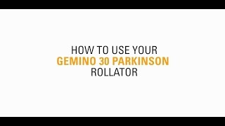
Example Gemino Parkinson
The Gemino Parkinson is specially made for people with Parkinson's disease. The distinguishing feature of this type of rollator is that it is equipped with a laser. This creates an imaginary walking line so that you can step over it as soon as 'freezing' occurs. In addition, the rollator is equipped with 'reverse' brakes: you must squeeze the brakes to release the rollator. As soon as you release the brakes, the walker is on the brakes.
Gemino 30 Parkinson Rollator

Slide 132
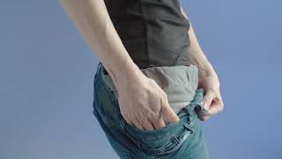
Example Hip Airbag
In addition to the Hip Airbag (Belt), Wolk now also has the Wolk Shorts. A pair of pants that you can no longer put on wrong. The hip protection is automatically in the right place. The materials and design have been chosen so that the Wolk Shorts offer optimal comfort for the wearer; with lightweight and breathable material. In addition, the function of protecting the hip is now even more effective.

Slide 133
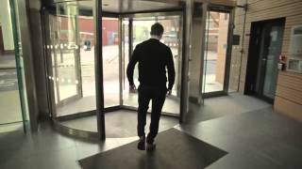
Example GERT!
Put yourself in the shoes of aging people with GERT! GERT stands for GERontological Test Clothing and experience the consequences of limitations associated with old age.
Age simulation suits shows healthcare professionals what it’s like being old

Slide 134
Acceptance of Robots
?
Are robots accepted by patients

Slide 135
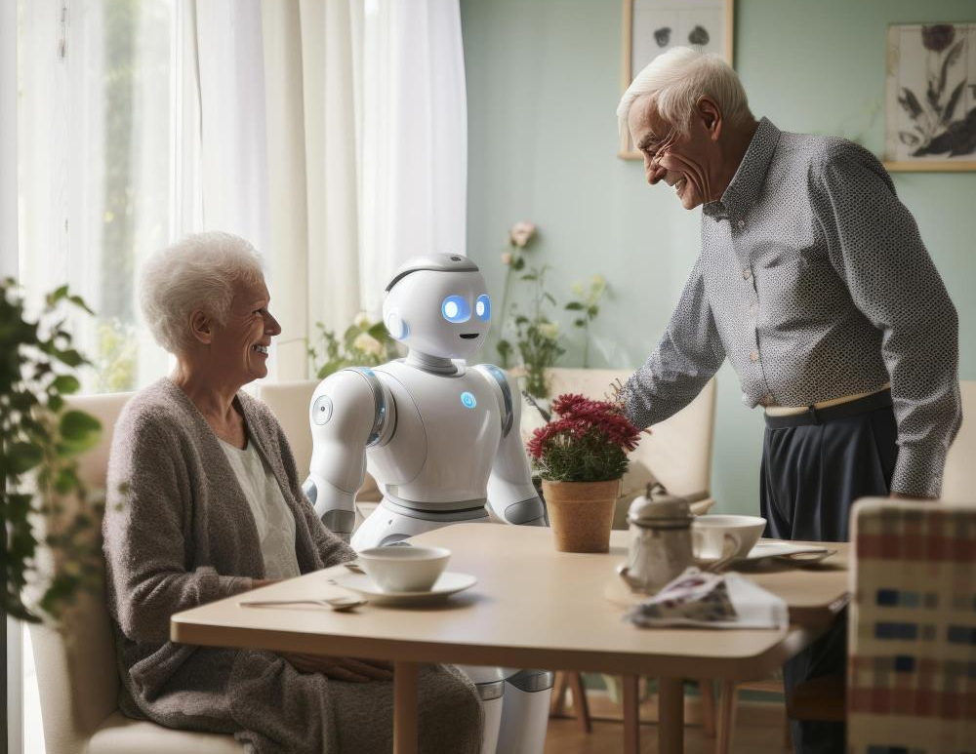
Acceptance of Robots
The practical success of robots depends heavily on the patients and this can vary greatly depending on individual experiences and beliefs.
Normative beliefs, such as established rules
and standards that are established in a
community strongly affect the people’s
Intention to use a robot.

Slide 136
Acceptance of Robotics
To date, many positive effects have been observed in people with dementia.
According to experts, care robots are accepted by patients above all when they bring clear added value.
For instance, if a woman is confined to bed and the care robot hands her a glass of water or a newspaper, this improves her personal autonomy.

Slide 137
Ethical concerns
Robots, like most other digital technologies used in care are coming with a variety of ethical questions about reduced human contact, privacy violations, consent issues, and loss of freedom.
This requires a reassessment of ethical principles such as autonomy, doing no harm, doing good, and fairness.
In Module 5 you will learn more about privacy and ethics in this context.

Slide 138
Experience and learn
You need to understand how various types of robotics work in healthcare. You've already watched some videos about robotics and physical support in healthcare, but now it's time to experience this technology firsthand and learn how to use it.
In your school or workplace, there may be materials available for you to use and experience. Perhaps there is a technical lab or classroom where you can practice using these technologies.

Slide 139
Summary
Several areas of use for robots in elderly care were identified, including, for example, affective therapy, cognitive training, social facilitation, companionship, physiological therapy, household tasks, personal care tasks, companionship tasks, and communication tasks.
While robots may not address the nursing shortage, they hold promise in the future for alleviating your routine tasks as caregiver by assisting with patient lifting and transfers or delivering refreshments.

Slide 140
Self-Reflection Exercise
!
Time for
Self-Reflection

Slide 141
Self-Reflection Exercise
Next on, you will see questions related to the content of this unit.
Reflect on the questions and answer them in writing in your (digital) journal!

Slide 142
Self-Reflection Exercise
As a caretaker, what tools and robotics do you believe would be beneficial for your work? Why do you think they would be useful?
How can robotics and physical support help to improve the quality of care services and the working conditions in the care sector?
How confident do you feel in using the tools and robotics available to you? Are there areas where you feel you need more training? If so, which areas?

Slide 143
Congratulations, you completed Unit 4 of the Module 3.

Slide 144
This learning unit has been developed as part of an Erasmus+ KA2 project DiMiCare and is funded with the support from the European Union. The work is intended for educational purposes and is licensed under Creative Commons Attribution-NonCommercial-ShareAlike 4.0 International License @ The DiMiCare Consortium (except for referenced screenshots and content).
Funded by the European Union. Views and opinions expressed are however those of the author(s) only and do not necessarily reflect those of the European Union or OeAD-GmbH. Neither the European Union nor the granting authority can be held responsible for them

Slide 145
List of References
Assistive Robots for Activities of Daily Living (2023): https://www.washington.edu/doit/programs/accessengineering/adept/adept-accessibility-briefs/assistive-robotics-activities-daily
Bartneck et al (2021): An Introduction ot Ethics in Robotics and AI. Application Areas of AI: https://www.researchgate.net/publication/343611471_Application_Areas_of_AI
Chatzoglou et al (2023): Factors Affecting Acceptance of Social Robots Among Prospective Users; in:International Journal of Robotics. https://link.springer.com/article/10.1007/s12369-023-01024-x
Navelrobotics (2023). What is a social robot? https://navelrobotics.com/en/social-robots/
Paro. Therapeutic Robot: https://www.paroseal.co.uk/
Research Outreach (2020): Social Robots – a new perspective in Health Care: https://researchoutreach.org/articles/social-robots-new-perspective-healthcare/

