Slide 2
Module 4
Supporting clients in digital tool use
Unit 1
Supporting usage of digital tools: What you have to know

Slide 3
01 How to support older persons to use digital tools and technology
Motivation
Active listening
Positive feedback
Empathetic approach
Patience/speed
TABLE OF CONTENTS
02 Ability to self-manage and demonstrate digital tools as a carer
Digital Literacy
Communication Skills
Remote Monitoring and Telehealth
Training and Continuous Learning
Adaptability and Problem-Solving
Client and Family Education

Slide 4
?
Supporting older people in digital tools use
How to support older people to use digital tools

Slide 5
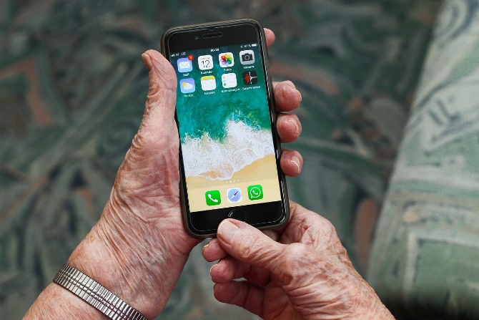
How to support older people to use digital tools and technologies
Lifelong learning is increasingly important in order to keep up with new IT technologies in society.
Acquiring basic IT knowledge and competences is therefore essential for older persons in order to improve their independence and quality of life.
In teaching basic digital competences to older persons, it is however important to be aware of certain educational factors.

Slide 6
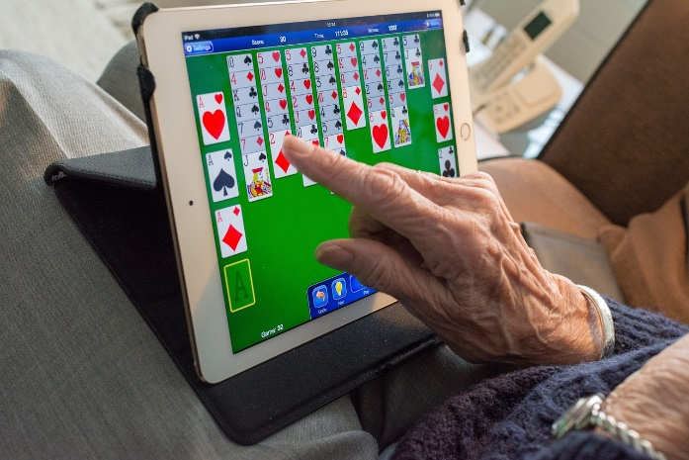
How to support older people to use digital tools and technologies
Teaching the usage of digital tools to older persons must accommodate their learning prerequisites, aiming at their digital inclusion.
There are 5 important aspects to consider:
Motivation
Active listening
Positive feedback
Empathetic approach
Patience/speed

Slide 7
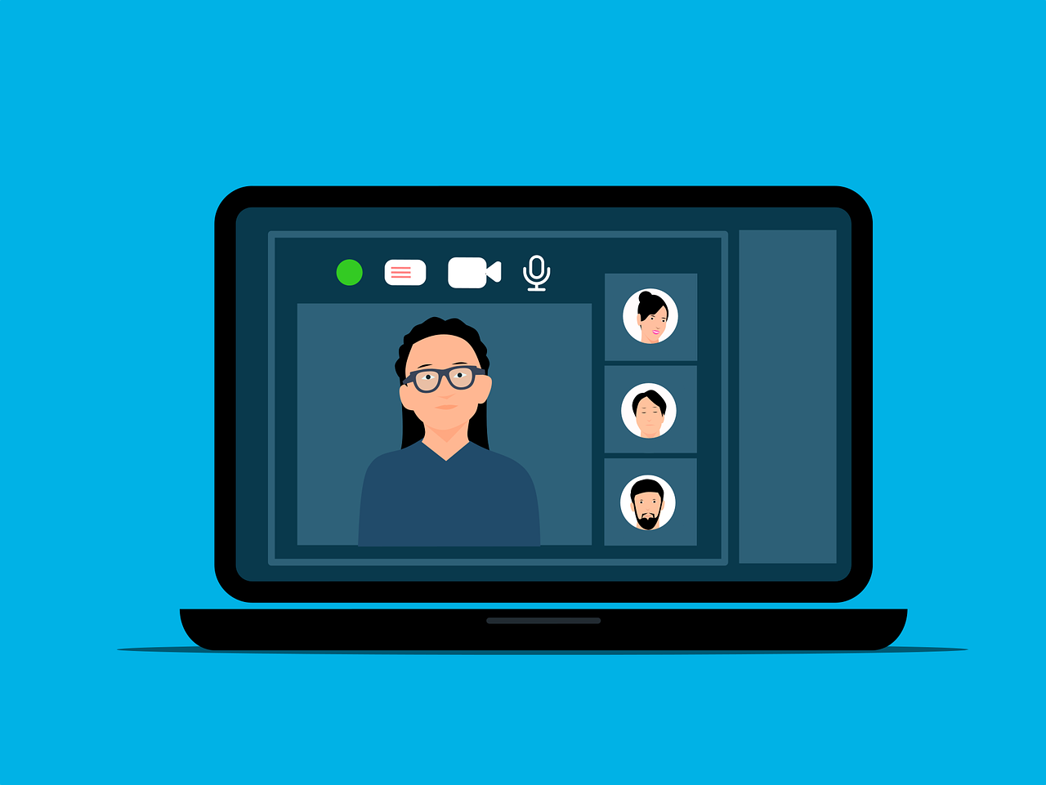
Motivation
Often the learning objectives are not reached at once but over time.
In order to keep up the motivation of the seniors, the carer/trainer must set intermediate objectives, adapted to the progression of the older person.
Progressive exercises should be followed by a positive feedback whenever the senior reach the intermediate objective.

Slide 8
Active listening
Training older persons, the carer/trainer should take into account the learner’s priorities, motivation, previous learning experiences and competences and potential areas of development.
The learning effort enhances, when connected to a real life context which is useful in daily practice.
The trainer therefore needs to adapt a situational approach rather than a theoretical approach, when teaching older persons.

Slide 9
Positive feedback
Acquiring digital competences can be a complex matter for older persons, positive feedback during learning is therefore essential for their learning experience and progress.
Positive feedback can in fact improve the mental abilities of elders, making progress in the learning process easier. The learner confidence can increase as a result of a successful experience.

Slide 10
Empathetic approach
In order to keep up the motivation, attention and curiosity of the learner, the carer/trainer must meet the older persons with an empathetic approach.
The carer/trainer therefore needs to take a real interest in the needs, competences and requirements of the learner.
Genuine interest, attention and positive feedback can foster the learner’s confidence.

Slide 11
Patience / speed
The brain’s cognitive functions, including learning, are slower with age. The trainer therefore needs to take into consideration the speed of the learning process.
Patience of the trainer is important, encouraging the elders to move forward step by step in their own speed.
Learning is a process where time to consideration is allowed for response, discussion and getting feedback several times.

Slide 12
Exercise: Supporting an older person
Case:
One of your clients is an older woman, living alone with her family located in distant parts of the country. She has bought a tablet with WhatsApp pre-installed and wishes to get connected online with her grandchildren, but she has very limited digital skills.
Based on the five factors below, consider how you can best support your client’s learning.
Motivation
Active listening
Positive feedback
Empathetic approach
Patience/speed

Slide 13
?
What are the key aspects of self-management and digital tool demonstration for caregivers

Slide 14
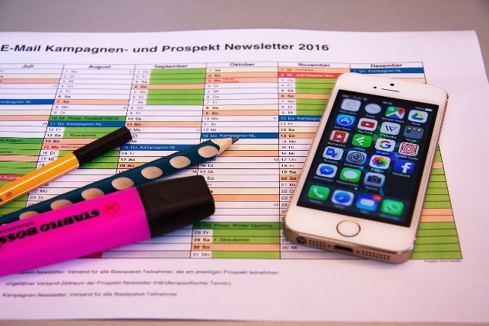
Ability to self-manage and demonstrate digital tools as a carer
The ability to self-manage and demonstrate digital tools as a caregiver is becoming increasingly important in today's technological landscape, in order to communicate effectively, and provide better care to their clients.
There are 6 key aspects of self-management and digital tool demonstration for caregivers.

Slide 15
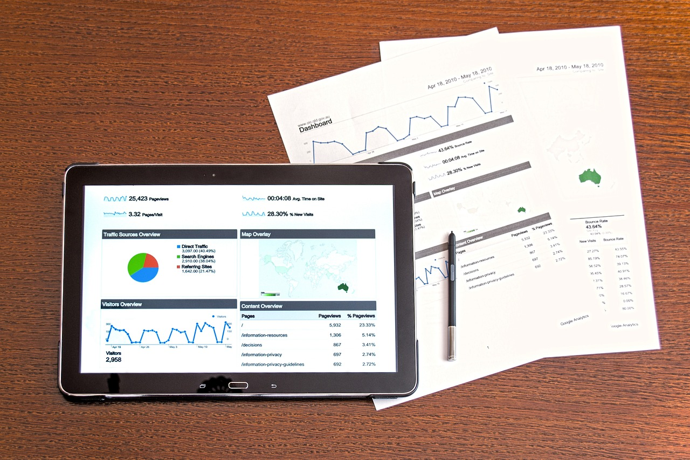
Ability to self-manage and demonstrate digital tools as a carer
6 key aspects of self-management and digital tool demonstration for caregivers:
Digital Literacy
Communication Skills
Remote Monitoring and Telehealth
Training and Continuous Learning
Adaptability and Problem-Solving
Client and Family Education

Slide 16
Digital literacy (acquisition of digital knowledge and skills)
The carer/trainer needs to develop basic computer skills, including using email, word processing, and internet browsing.
Possessing these basic skills is a prerequisite for helping older persons with digital competence development.
The carer/trainer needs to be familiar with the specific digital tools commonly used in the caregiving field and different digital devices.
Note: Module 1 elaborates more on basic digital competences.

Slide 17
Communication Skills
Enhance your ability to communicate through digital channels, such as email and messaging apps, will further improve your digital communication skills as a trainer/carer.
Learn to use video conferencing tools for virtual consultations and remote communication with elders and other healthcare professionals. This will also strengthen your competences as a trainer in teaching others how to use these digital media.
Note: Module 1 elaborates more on basic digital competences.

Slide 18
Remote monitoring and telehealth
Various telehealth solutions are increasingly gaining ground as a means of communication in the healthcare sector.
Familiarise yourself with telehealth platforms for virtual consultations and remote monitoring of patients applicable in your field.
As a carer/trainer, you need to stay updated on the latest advancements in digital healthcare technology to provide the best possible digital support.
Note: Module 2 and 3 elaborates more on specific digital tools.

Slide 19
Training and continuous learning
Attending training sessions or workshops on the latest digital tools and technologies will help keep you updated on digital developments in the caregiving field.
Keeping up-to-date with trends and innovations through online courses, webinars, or professional health associations is another way to continuously strengthen your competences.
Example: In DK healthcare employers/institutions offer regular updates on digital software and tools.
Contact your healthcare employer/institution in your country for further information on training possibilities.

Slide 20
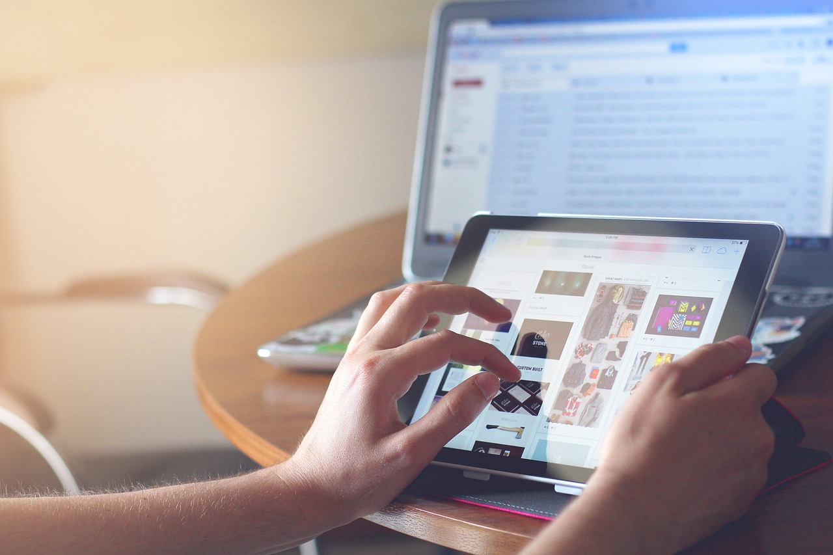
Adaptability and problem solving
As a carer/trainer you also need to develop the ability to adapt quickly to new digital tools and software updates in order to stay on track with the digital development.
You may need to enhance your problem-solving skills to troubleshoot issues that may arise when using digital devices and technologies. Your clients will most likely turn to you for help when such issues occur.

Slide 21
Client and family education
Depending on their needs, explaining digital tools to patients and their families is important. Digital skills development for relatives of clients will also strengthen clients' support options.
Provide guidance on how to use digital devices and technology, tailored to the needs and abilities of the client. Including the family members in the guidance can be a valuable resource for the older person.

Slide 22
Summary
Having completed Module 4 unit 1 regarding; Supporting clients in digital tool use – supporting usage of digital tools: what you have to know, you are now better prepared to actively support older adults in lifelong learning in order to keep up with new IT technologies in society, including which 5 aspects are the most important to consider when supporting your client.

Slide 23
Self-Reflection Exercise
!
Time for
Self-Reflection

Slide 24
Self-Reflection Exercise
Next on, you will see questions related to the content of this unit.
Reflect on the questions and answer them in writing in your (digital) journal!

Slide 25
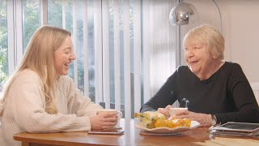
Self-reflection Exercise
Please watch the following video and answer the self-reflection questions on the next slide
Digital Championship

Slide 26
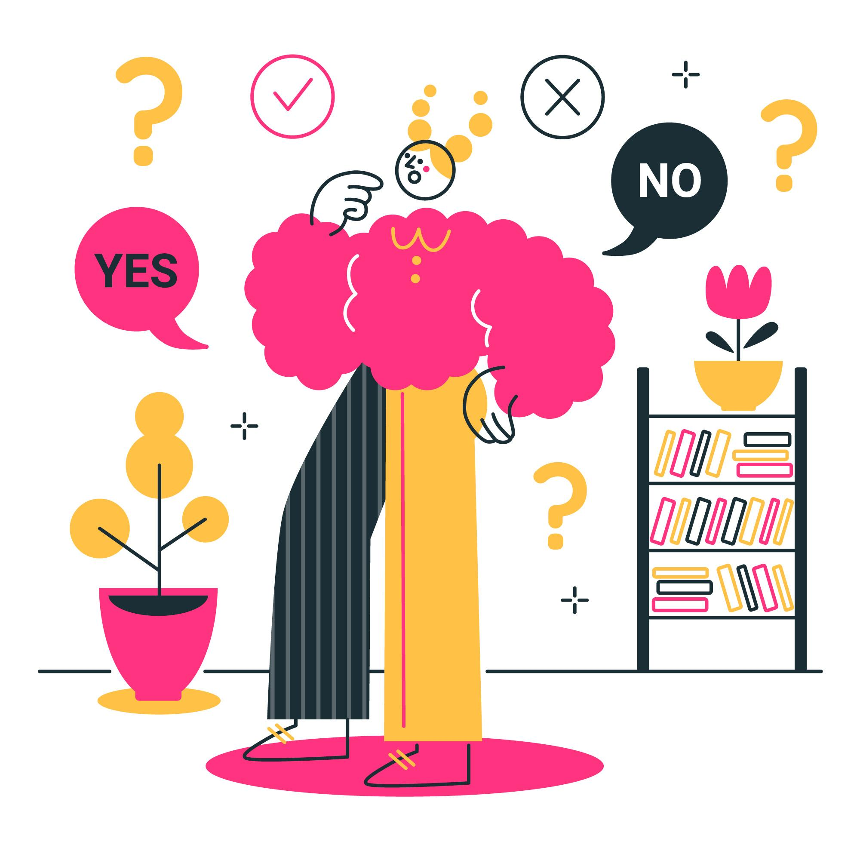
Self-Reflection Exercise
Having watched the video, reflect on:
Why access to the internet is important to older persons in general?
How can you as a carer support the older person to get connected to the internet?

Slide 27
This learning unit has been developed as part of an Erasmus+ KA2 project DiMiCare and is funded with the support from the European Union. The work is intended for educational purposes and is licensed under Creative Commons Attribution-NonCommercial-ShareAlike 4.0 International License @ The DiMiCare Consortium (except for referenced screenshots and content).
Funded by the European Union. Views and opinions expressed are however those of the author(s) only and do not necessarily reflect those of the European Union or OeAD-GmbH. Neither the European Union nor the granting authority can be held responsible for them

Slide 28
References
Web Accessibility Initiative - Strategies, standards, resources to make the Web accessible to people with disabilities
https://www.w3.org/WAI/older-users/
Web Accessibility Initiative - Strategies, standards, resources to make the Web accessible to people with disabilities
https://www.w3.org/WAI/fundamentals/accessibility-usability-inclusion/
WORLD TELECOMMUNICATION AND INFORMATION SOCIETY DAY--17 MAY 2022
https://www.un.org/en/un-chronicle/digital-technologies-can-help-older-persons-maintain-healthy-productive-lives
ITUPublications International Telecommunication Union - Ageing in a digital world – from vulnerable to valuable
https://www.itu.int/dms_pub/itu-d/opb/phcb/D-PHCB-DIG_AGE-2021-PDF-E.pdf

Slide 30
Module 4
Supporting clients in digital tool use
Unit 2
Creating a digital mind map & brainstorm

Slide 31
01 How to consider older persons learning conditions when organising training in the use of digital tools
Assess Digital Literacy Levels
Create a Comfortable Learning Environment
Use Age-Appropriate Technology
Provide Clear Instructions
Allow for Hands-On Practice
Be Patient and Supportive
TABLE OF CONTENTS
02 How to select the digital tools that best meet the older persons’ learning needs and improve their quality of life
User-Friendly Interface
Accessibility Features
Relevance to Interests
Social Connectivity
Health and Wellness Apps
Remote Monitoring Devices

Slide 32
Learning conditions
?
How to consider older persons’ learning conditions when organising training in the use of digital tools

Slide 33
How to consider older persons’ learning conditions when organising training in the use of digital tools
When organising training for older persons in the use of digital tools, it is important to consider their unique learning conditions and needs.
Following key factors should be considered:
Assess Digital Literacy Levels
Create a Comfortable Learning Environment
Use Age-Appropriate Technology
Provide Clear Instructions
Allow for Hands-On Practice
Be Patient and Supportive

Slide 34
Assess Digital Literacy Levels
Before designing the training program, you will need to assess the digital literacy levels of the older persons (their digital knowledge and skills).
The assessment can be done in a very practical way by asking what it is that challenges the older person in terms of using digital tools?
This will help you tailor the training to their specific needs and ensure that the content is neither too basic nor too advanced.

Slide 35
Create a comfortable Learning Environment
Ensure that the learning environment is comfortable and welcoming. It is also important to ensure that factors such as noise do not interfere with training.
Consider factors like seating arrangements, lighting, and temperature to make the space conducive to learning.

Slide 36
Use Age-Appropriate Technology
Choose digital tools that are user-friendly and age-appropriate. Touchscreen devices (Tablets/iPads) might be more intuitive for some elders, making it easier to navigate on the screen by swiping, rather than using a mouse for a PC/laptop.
Avoid complex interfaces (complicated websites or menus), at least in the beginning, and opt for tools with simple navigation using clear instructions.

Slide 37
Provide Clear Instructions
Clearly communicate instructions and provide step-by-step guidance. Be aware of the pace to allow the older person to ask questions.
Use plain language, avoid technical jargon, and repeat important information.
Consider using visuals or demonstrations to enhance understanding, but be sure not to overtake the learning experience.

Slide 38
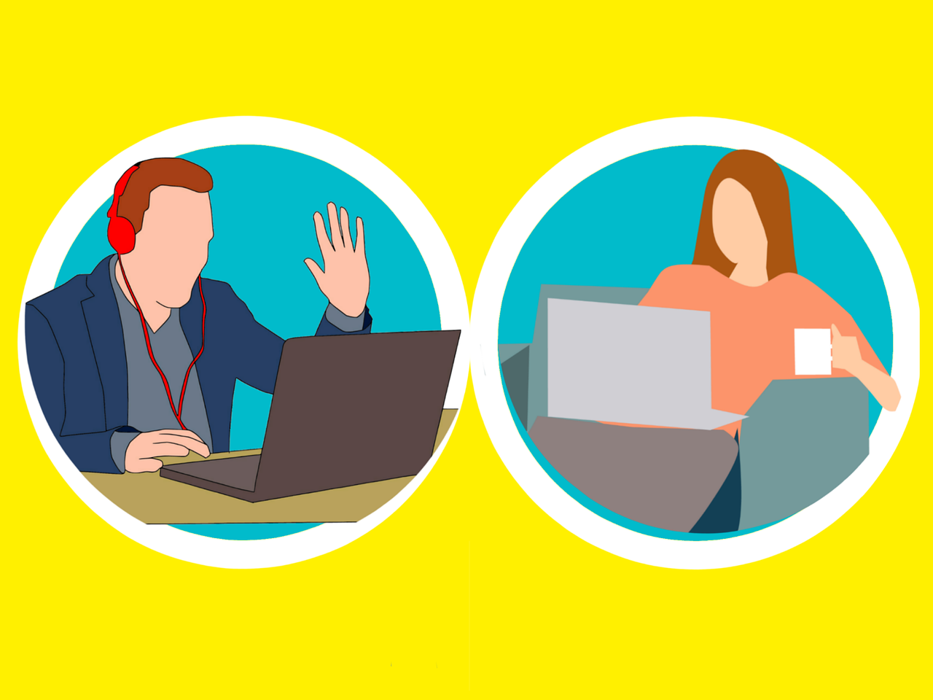
Allow for Hands-On Practice
Provide ample opportunities for hands-on practice. Repeated hands-on use of various digital tools is essential to feel comfortable using them.
Older persons often learn best through doing, so incorporating practical exercises will help reinforce their understanding of digital tools.
Remember that the exercises should reflect the older persons’ level of digital literacy.

Slide 39
Be Patient and Supportive
Understand that learning new technologies may take time, and seniors may need additional support and patience.
Offer one-on-one assistance when necessary and provide reassurance throughout the learning process. The inclusion of family members in the training can prove valuable for the older person in the longer term.

Slide 40
Selecting appropriate digital tools
?
How to select the digital tools that best meet the older persons’ learning needs and improve their quality of life

Slide 41
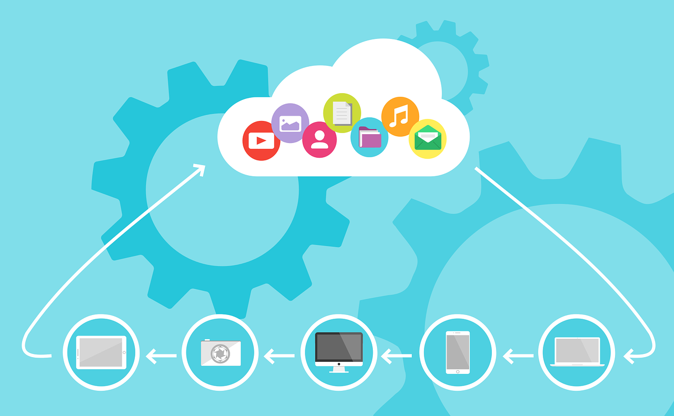
How to select the digital tools that best meet the older persons’ learning needs and improve their quality of life
Selecting digital tools for older persons to enhance their learning and improve their quality of life requires careful consideration of their specific needs, preferences, and abilities.
Following should be considered:
User-Friendly Interface
Accessibility Features
Relevance to Interests
Social Connectivity
Health and Wellness Apps
Remote Monitoring Devices

Slide 42
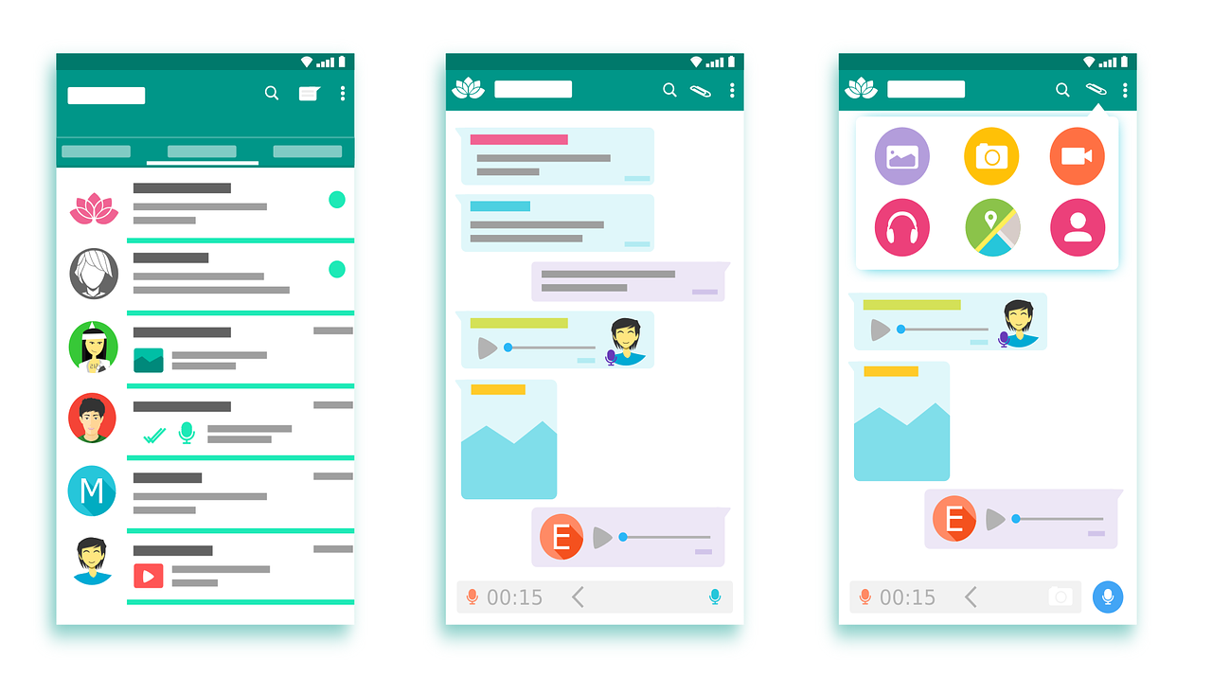
User-Friendly Interface
Choose tools with simple and intuitive interfaces. Many elders may not be familiar with technology, so an easy-to-use interface is crucial.
Look for tools with large, clear buttons and text, and minimalistic design to avoid confusion. Consider whether a tablet or a PC/laptop would best accommodate the learning needs of the elder.

Slide 43
Accessibility Features
Prioritise tools that have built-in accessibility features, such as adjustable text size, high contrast options, and voice commands. These features can aid those with visual or motor impairments.
Web accessibility features also benefit people and situations focused on inclusive design, ensuring that web design is technically and functionally usable by people with disabilities.

Slide 44
Relevance to Interests
Identify tools that align with the interests and hobbies of the older person.
Example; Your client is interested in digital image editing. For this purpose a PC/laptop might be a more suitable tool than a tablet, enabling the user to better select small features in an editing menu with a mouse.
Whether it is educational apps, games, or social networking platforms, connecting the technology to the existing interests of the older person can enhance their engagement.

Slide 45
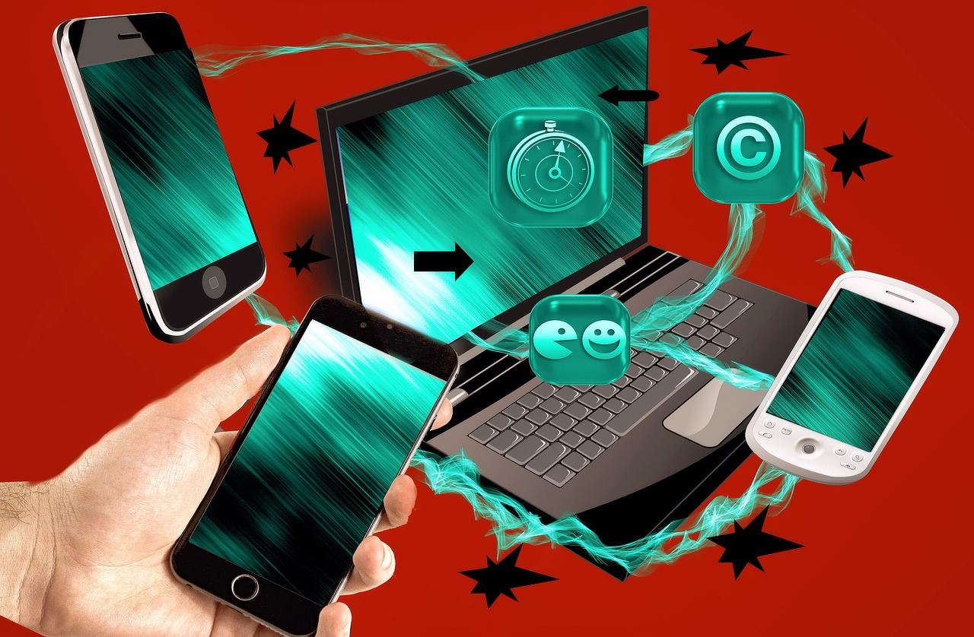
Social Connectivity
Select tools that facilitate digital social connections. This typically requires the use of a communication platform, hence, select a user-friendly communication platform.
What might suit one senior does not necessarily suit another, therefore try out different communication platforms to find the most user-friendly match.
Social isolation is a common concern among seniors, and digital tools that enable communication with friends and family can significantly improve their quality of life.

Slide 46
Health and Wellness Apps
Consider tools that focus on health and wellness. This could include apps for medication reminders, exercise routines, or mental health support.
Technology can play a crucial role in helping older individuals manage their health effectively. However, it is important that the app is user-friendly to actually have a positive impact.
Consider supporting the senior to try out different apps in order to be at hand if any technological issues arises.
Note: Module 2 & 3 elaborates further on specific digital tools and apps.

Slide 47
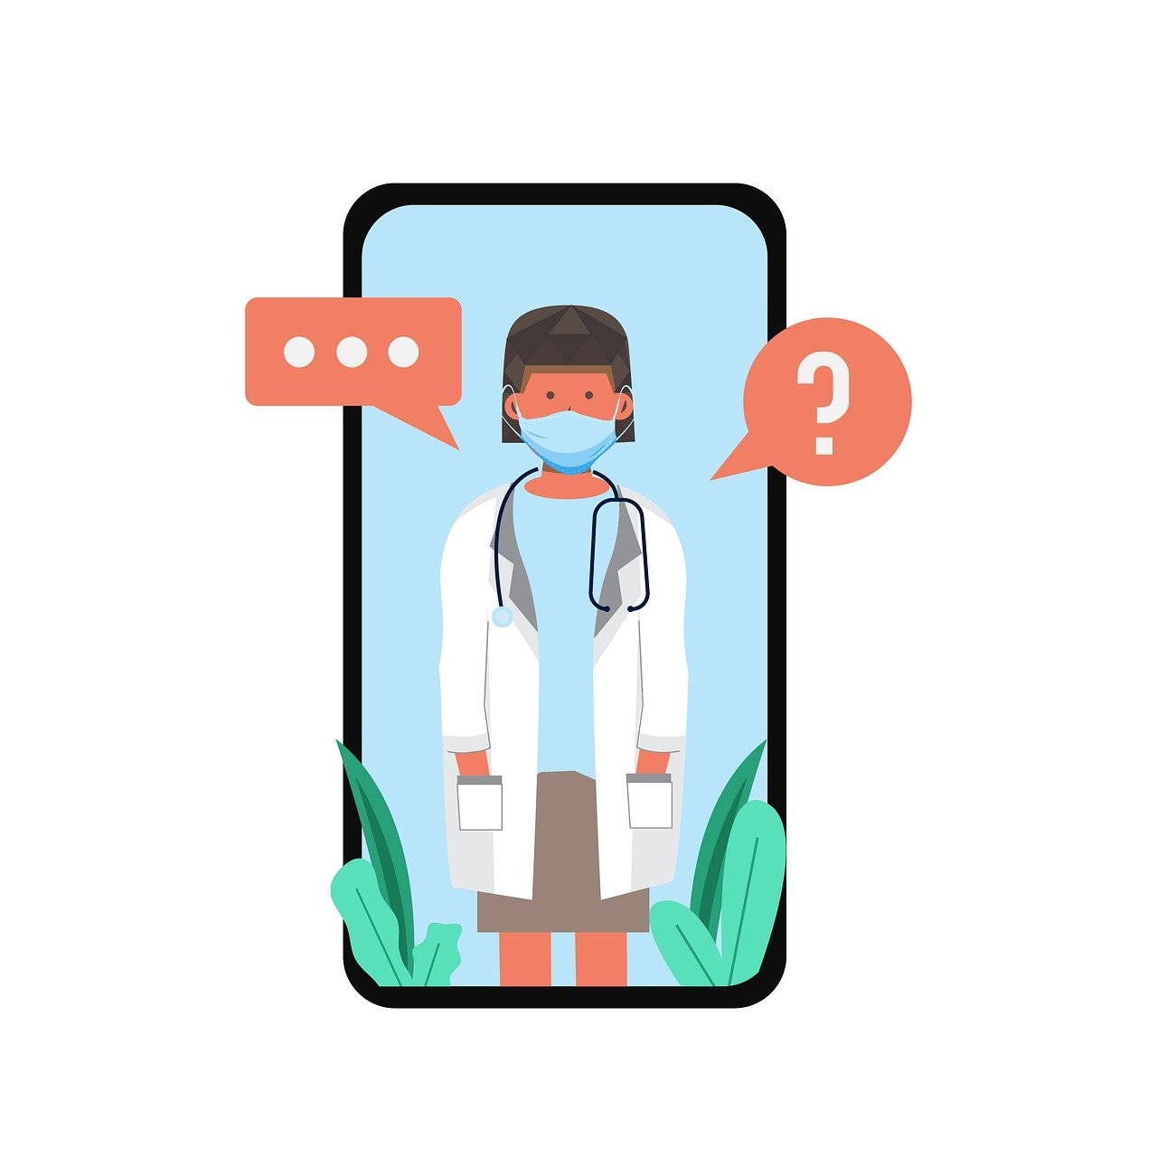
Remote Monitoring Devices
It can be a good idea exploring digital tools that provide remote monitoring of health parameters with the elders.
This can be particularly useful for older persons who would like to be more autonomous and self-efficient in terms of monitoring their health.
For caregivers and healthcare professionals this offers the possibility to track the well-being of elders from a distance, but still be in touch if needed.
Note: Module 2 & 3 elaborates further on specific digital tools and apps.

Slide 48
Summary
Having completed Module 4 unit 2 regarding; Involving older people in decisions about care technologies, assessing and suggesting the right tools, and reflecting on the advantages and challenges of digital tools for the elderly, you are now better prepared to actively support older adults in their assessment, selection and use of digital tools and media to strengthen their autonomy and improve their quality of life.

Slide 49
Self-Reflection Exercise
!
Time for
Exercise and Self-Reflection

Slide 50
Brainstorm Exercise
This exercise is performed online in groups, initiated by your facilitator. You will be asked to discuss two questions.
Alternatively, it can also be carried out individually, with your thoughts documented in your (digital) journal.
This is followed by a plenary discussion/presentation where input from you/ groups/ individuals are presented to form the basis for a joint discussion or sharing of thoughts.
https://jamboard.google.com/
https://padlet.com/

Slide 51
Brainstorm questions
Aim: How to consider older persons’ learning conditions when organising training in the use of digital tools?
Questions:
What to consider when selecting digital tools that best meet the older adults’ learning needs and improve their quality of life?
How to create the most suitable learning environment for older adults when training them in the use of digital media?

Slide 52
Jamboard/Padlet: Creating a digital mind map
Exercise for blended-learning:
You will receive an invitation for an online workshop, e.g. via Jamboard or Padlet, by your facilitator who will introduces you to a digital mind map. In the centre of the mind map is the sentence: "What factors do you think are important to support older clients in digital use"?
This first round serves as inspiration and awareness of various factors that influence the success of supporting clients in digital use.
https://jamboard.google.com/
https://padlet.com/

Slide 53
Jamboard/Padlet: Creating a digital mind map
Exercise follow up:
In the second round, you will be asked by the facilitator to discuss in groups whether, based on the factors in the mind map, you feel equipped to support your clients in digital use?
https://jamboard.google.com/
https://padlet.com/

Slide 54
Self-Reflection Exercise
Having completed the digital mindmap and brainstorm, reflect on your ability to support clients in digital tool use.

Slide 55
This learning unit has been developed as part of an Erasmus+ KA2 project DiMiCare and is funded with the support from the European Union. The work is intended for educational purposes and is licensed under Creative Commons Attribution-NonCommercial-ShareAlike 4.0 International License @ The DiMiCare Consortium (except for referenced screenshots and content).
Funded by the European Union. Views and opinions expressed are however those of the author(s) only and do not necessarily reflect those of the European Union or OeAD-GmbH. Neither the European Union nor the granting authority can be held responsible for them

Slide 56
References
Web Accessibility Initiative - Strategies, standards, resources to make the Web accessible to people with disabilities
https://www.w3.org/WAI/older-users/
Web Accessibility Initiative - Strategies, standards, resources to make the Web accessible to people with disabilities
https://www.w3.org/WAI/fundamentals/accessibility-usability-inclusion/
WORLD TELECOMMUNICATION AND INFORMATION SOCIETY DAY--17 MAY 2022
https://www.un.org/en/un-chronicle/digital-technologies-can-help-older-persons-maintain-healthy-productive-lives
ITUPublications International Telecommunication Union - Ageing in a digital world – from vulnerable to valuable
https://www.itu.int/dms_pub/itu-d/opb/phcb/D-PHCB-DIG_AGE-2021-PDF-E.pdf

Slide 58
Module 4
Supporting clients in digital tool use
Unit 3
Experts in supporting older clients in the use of digital tools

Slide 59
01 How to involve older persons in decisions about care technologies
Know the Older Persons Needs
Engage in Open Communication
Educate and Empower
Demonstrate Technologies
Address Privacy and Security Concerns
02 How to assess and suggest the right technologies and tools for older persons in need of care
TABLE OF CONTENTS
Identify Key Areas of Support
Consider User-Friendly Devices
Health Monitoring and Telehealth
Consult Healthcare Professionals
03 Being able to reflect about the advantages and challenges of digital tools in the lives of older persons
Advantages
Challenges

Slide 60
?
Involving individuals in decisions about care technologies
How to involve older persons in decisions about care technologies

Slide 61
BRAINSTORM
Brainstorm questions:
What comes to your mind, when you think of:
How to involve older people in decisions about care technologies
How to asses and suggest the right technologies and tools for elderly in need of care
Share your thoughts and ideas online in a common forum such as Jamboard or Padlet
https://jamboard.google.com/
https://padlet.com/

Slide 62
How to involve older persons in decisions about care technologies
Involving older persons in decisions and selection of care technologies is crucial to ensure that the technologies meet their needs and preferences.
Here are some strategies to involve older persons in this process:
Know the Older Persons Needs
Engage in Open Communication
Educate and Empower
Demonstrate Technologies
Address Privacy and Security Concerns

Slide 63
Know The Older Persons Needs
Involving older persons in decisions about care technologies and reflecting on the advantages and challenges of digital tools for older persons, requires a thoughtful and inclusive approach.
By focusing on the needs of the older person, involving the person in the decision-making, you can ensure that care technologies are not only suitable for their needs but also enhance their overall quality of life.

Slide 64
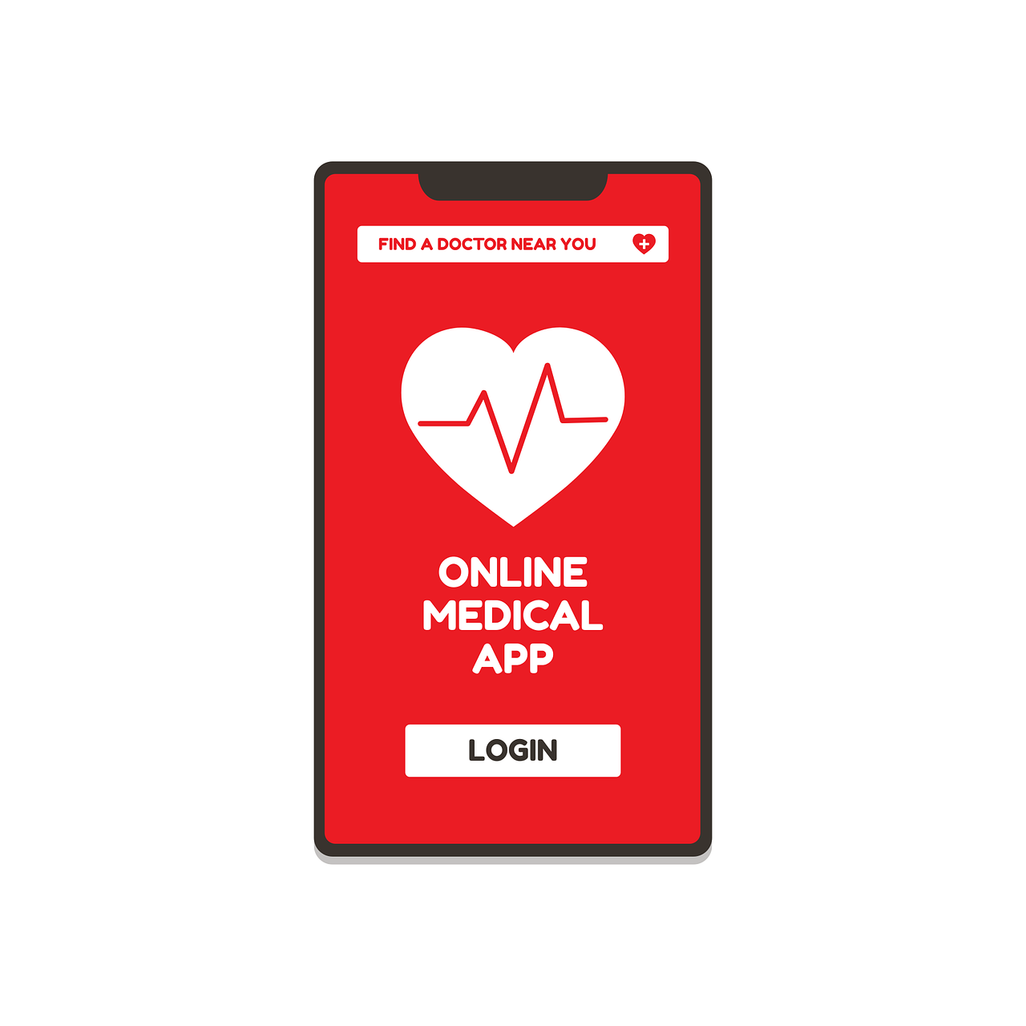
Know The Older Persons Needs
Start by familiarising yourself with the needs of the older person. A simple dialogue, exploring the needs of the person will clarify many issues.
Understand their specific health conditions, daily routines, and the challenges they face in order to make sure their needs are covered.

Slide 65
Engage in open communication
Foster open and transparent communication with older persons in order to help them in the best possible way in discovering and clarifying their needs.
Encourage them to share their thoughts, concerns, and preferences regarding care technologies.

Slide 66
Educate and empower
Provide information about available care technologies, explaining their benefits and potential impact on daily life.
Empower older persons to make decisions about technologies or apps based on their specific needs.
Note: Module 2 & 3 elaborates further on specific digital tools and apps.

Slide 67
Demonstrate technologies
If possible, organise demonstrations of different care technologies. Allow the older person to interact with and experience the technologies in a hands-on tryout.
This hands-on approach can help the older person better understand how the technologies work and how they can benefit from them.

Slide 68
Address privacy and security concerns
Address any concerns about privacy and security associated with the use of care technologies. Ensure that older persons feel confident that their personal information is protected.
Example: Your client has just learned about the possibilities of online patient information. He asks for your help to access his online patient journal to read a scan result.
What do you need to consider in this situation?

Slide 69
?
Assessing and suggesting the right technologies and tools
How to assess and suggest the right technologies and tools for older persons in need of care

Slide 70
How to assess and suggest the right technologies and tools for older persons in need of care
Assessing and suggesting the right technologies and tools for older persons involves considering their specific needs, capabilities, and preferences.
Here are some guiding steps for your assessment and recommendations:
Identify Key Areas of Support
Consider User-Friendly Devices
Health Monitoring and Telehealth
Consult Healthcare Professionals

Slide 71
Identify Key areas of support
Determine the areas where technology can provide meaningful support.
This could include health monitoring, medication management, social interaction, safety, and home automation.

Slide 72
Consider user-friendly devices
Select technologies that are user-friendly and have simple/ easy to understand interfaces.
Look for devices with large buttons, touch screens, voice commands, and intuitive navigation to make it easier for the elderly to use.

Slide 73
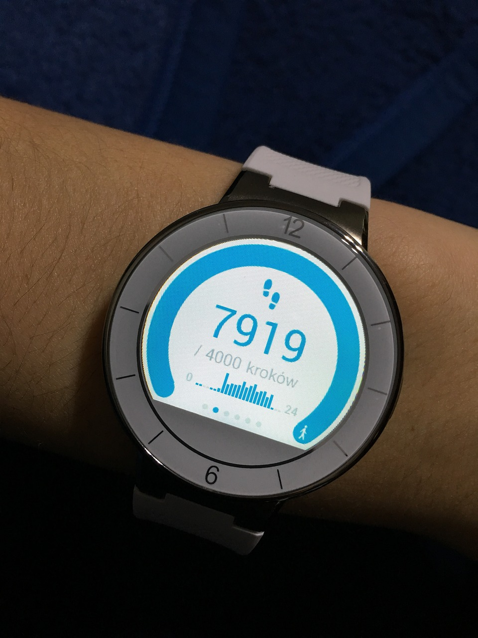
Health monitoring and telehealth
Explore health monitoring devices such as wearable fitness trackers or smartwatches that can track vital signs and activities.
Consider telehealth solutions that allow remote monitoring of health conditions and video consultations with healthcare professionals.
Note: For a more in-depth information please see Module 2, Unit 4.

Slide 74
Consult healthcare professionals
Seek advice from healthcare professionals, including doctors, nurses, or occupational therapists, who may have valuable insights into specific technologies that align with the individual's healthcare needs.
Example: Your client has elevated blood pressure but feels uncomfortable measuring the blood pressure with a regular blood pressure monitor because the cuff pinches. Now he's heard that a special smartwatch can measure his blood pressure regularly and communicate results to his doctor via an app.

Slide 75
?
Advantages and challenges of digital tools
What are the advantages and challenges of digital tools in the lives of older people

Slide 76
Being able to reflect about the advantages and challenges of digital tools in the lives of the older person
The integration of digital tools in the lives of older persons represents both advantages and challenges. As a caregiver, it is important to reflect on both these aspects:
Advantages:
Communication and social connection
Access to information
Health monitoring
Convenience and access to services
Challenges:
Digital literacy and learning curve
Privacy and security concerns
Physical limitations
Isolation and technological exclusion

Slide 77
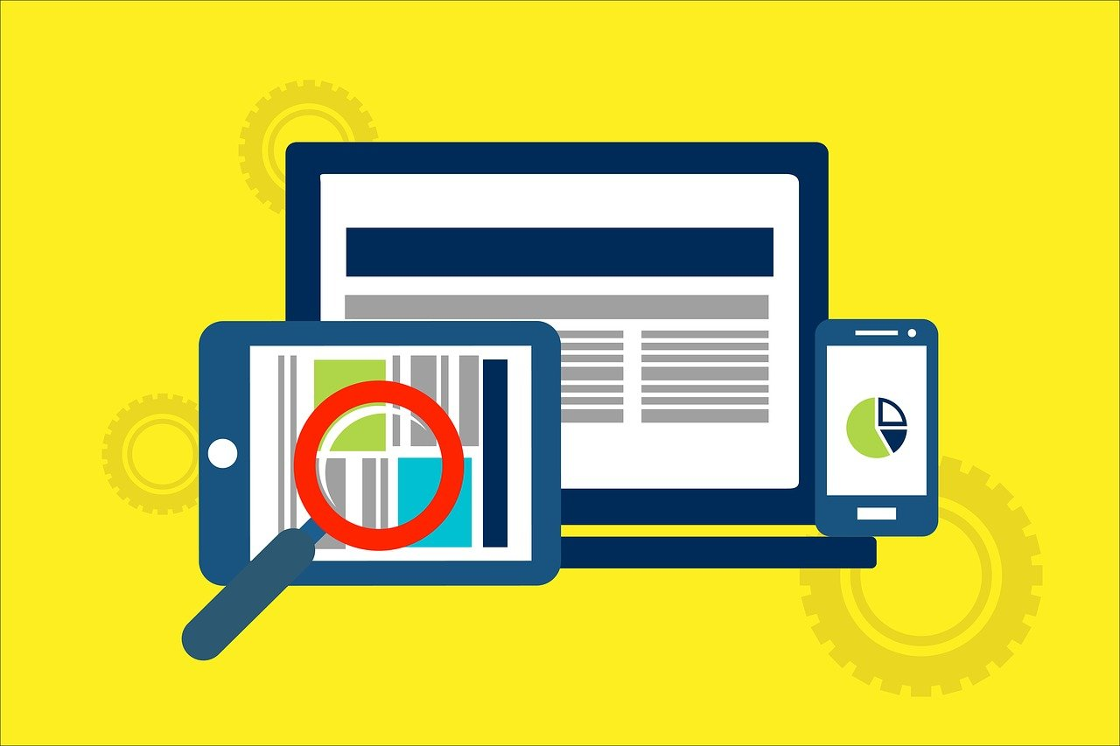
Advantages
Advantages:
Communication and social connection
Access to information
Health monitoring
Convenience and access to services

Slide 78
Communication and social connections
Digital tools enable older persons to stay connected with family and friends, especially if they are geographically separated.
Video calls, social media, and messaging apps can help combat social isolation and promote mental well-being.

Slide 79
Access to information
The internet provides a wealth of information, allowing older persons to stay informed about health, news, and various topics.
Online resources can empower them to learn new things, fostering mental stimulation.

Slide 80
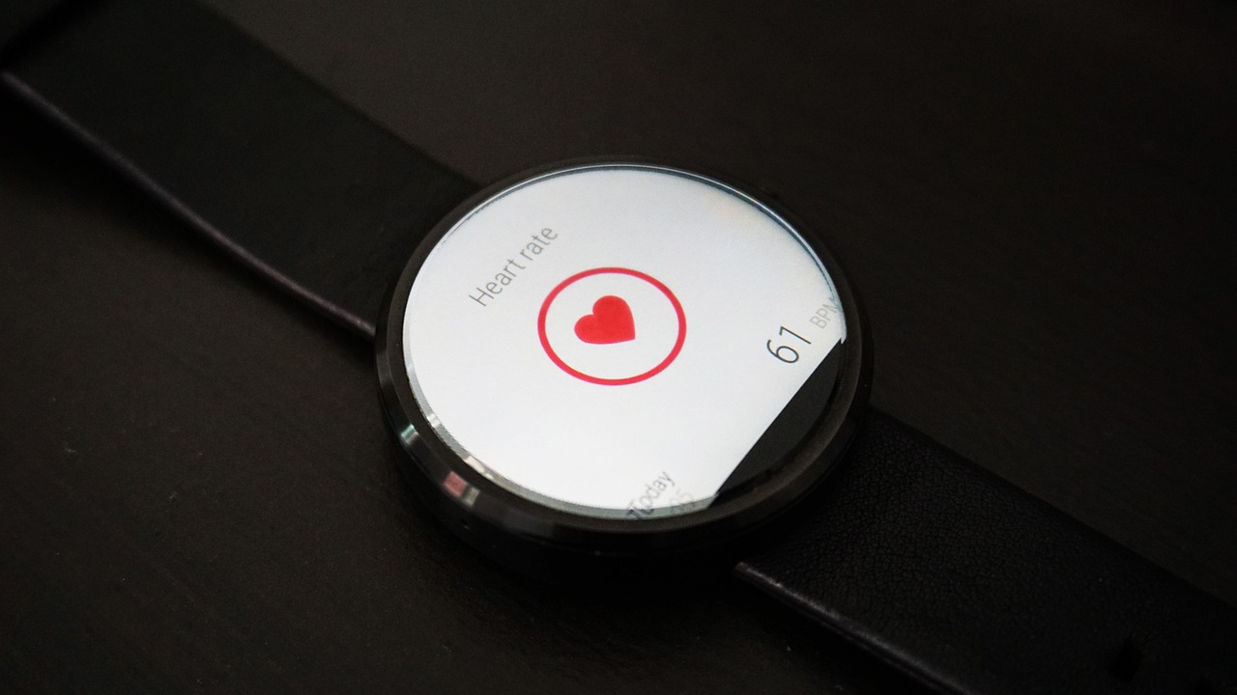
Health Monitoring
Wearable devices and health apps can assist in monitoring vital signs, medication adherence, and overall health, providing a sense of security for both seniors and their caregivers.
Note: For a more in-depth information please see Module 2, unit 4.

Slide 81
Convenience and access to services
Online shopping, telehealth services, and digital banking make daily tasks more convenient for older persons, especially those with mobility issues.

Slide 82
Challenges
Challenges:
Digital literacy and learning curve
Privacy and security concerns
Physical limitations
Isolation and technological exclusion

Slide 83
Digital literacy and learning curve
Many elderly individuals may not be familiar with technology, leading to a steep learning curve.
Lack of digital literacy can be a barrier to fully utilising the potential benefits of digital tools.

Slide 84
Privacy and security concerns
Older persons may be more vulnerable to scams, phishing, and privacy breaches online.
Ensuring the security of personal information becomes crucial to protect them from potential threats.

Slide 85
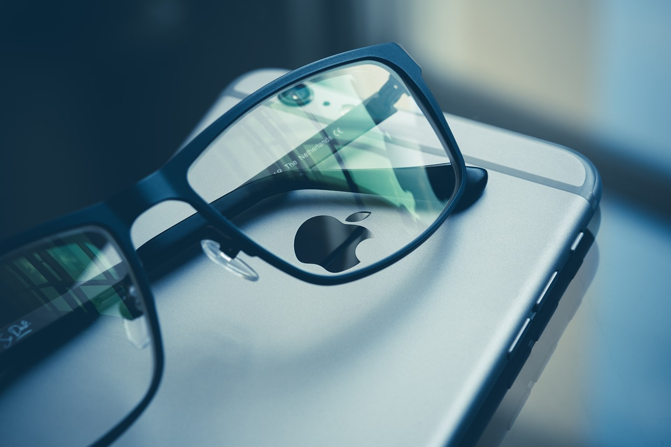
Physical limitations
Physical challenges such as impaired vision, arthritis, or motor skill issues can make using digital devices difficult.
Design considerations must account for these limitations to make digital tools accessible.

Slide 86
Isolation and technological exclusion
Not all older persons have access to or can afford digital devices and internet connectivity, leading to a digital divide.
Reliance on technology for communication may exacerbate feelings of isolation for those without access.

Slide 87
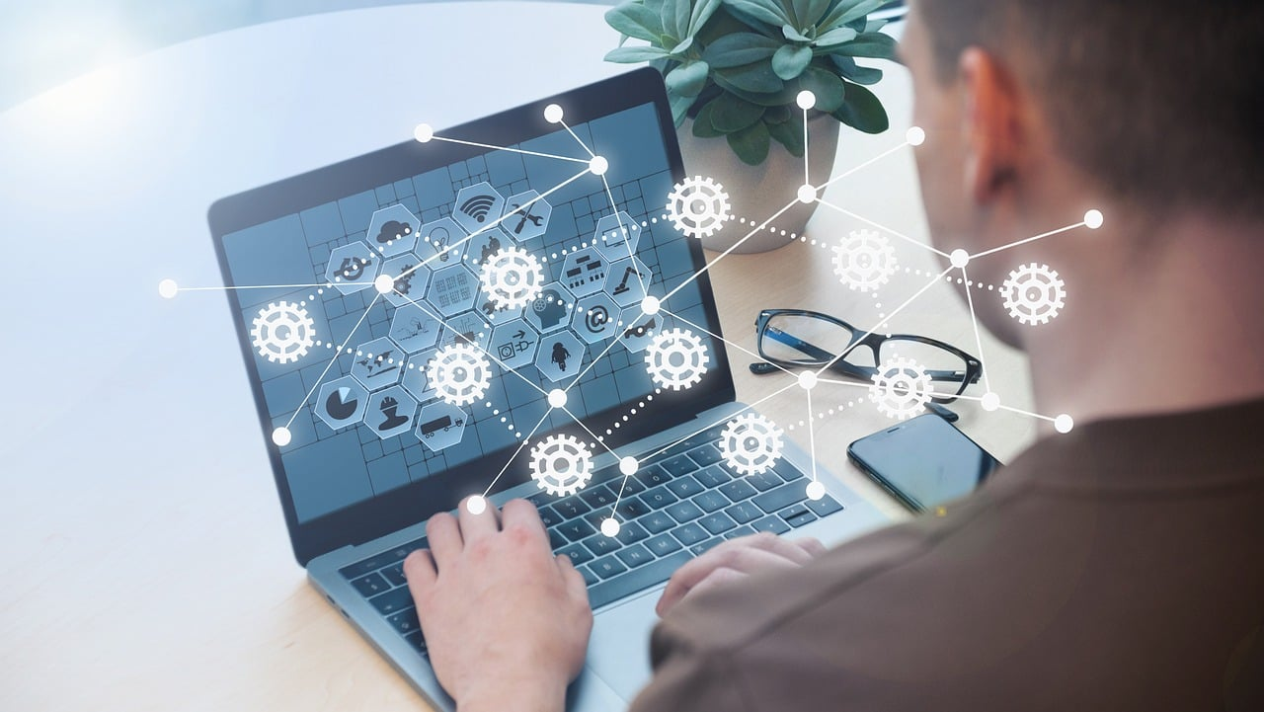
Case-study
In groups online, participants are now asked to consider the following:
How to involve older persons in decisions about care technologies?
How to asses and suggest the right technologies and tools for older persons in need of care?
How to consider older persons' learning conditions when organising training in the use of digital tools?
How to select the digital tools that best meet the older persons' learning needs and improve their quality of life?
How to create the most suitable learning environment for older persons when training them in the use of digital media?
After 30 minutes, the groups gather in the online forum for a common presentation of group discussions.
Use Jamboard or Padlet as online forum: https://jamboard.google.com/ https://padlet.com/
Case description: Mr. Lopez is living on his own. His 3 children live approximately 2 hours drive from him.
His physical and mental energy levels have decreased significantly over the last three years, and he often goes long periods of time without going outside. As a result, Mr Lopez has become more dependent on outside help, which affects his quality of life. On top of this, Mr Lopez also feels lonely and isolated.

Slide 88
Summary
Having completed Module 4 unit 3 regarding; How to consider elders’ learning conditions when organising training in the use of digital tools and how to select the digital tools that best meet the eledrs’ learning needs and improve their quality of life, you are now better prepared to actively support older adults in their assessment, selection and use of digital tools and media to strengthen their autonomy and improve their quality of life.

Slide 89
Self-Reflection Exercise
!
Time for
Self-Reflection

Slide 90
Self-Reflection Exercise
Next on, you will see questions related to the content of this unit.
Reflect on the questions and answer them in writing in your (digital) journal!

Slide 91
Self-Reflection Exercise
Based on the content in this unit, please reflect on:
What were the three key points from the material you worked with that you will take with you?
Ideas for skills or competences you could improve on?

Slide 92
This learning unit has been developed as part of an Erasmus+ KA2 project DiMiCare and is funded with the support from the European Union. The work is intended for educational purposes and is licensed under Creative Commons Attribution-NonCommercial-ShareAlike 4.0 International License @ The DiMiCare Consortium (except for referenced screenshots and content).
Funded by the European Union. Views and opinions expressed are however those of the author(s) only and do not necessarily reflect those of the European Union or OeAD-GmbH. Neither the European Union nor the granting authority can be held responsible for them

Slide 93
References
Web Accessibility Initiative - Strategies, standards, resources to make the Web accessible to people with disabilities
https://www.w3.org/WAI/older-users/
Web Accessibility Initiative - Strategies, standards, resources to make the Web accessible to people with disabilities
https://www.w3.org/WAI/fundamentals/accessibility-usability-inclusion/
WORLD TELECOMMUNICATION AND INFORMATION SOCIETY DAY--17 MAY 2022
https://www.un.org/en/un-chronicle/digital-technologies-can-help-older-persons-maintain-healthy-productive-lives
ITUPublications International Telecommunication Union - Ageing in a digital world – from vulnerable to valuable
https://www.itu.int/dms_pub/itu-d/opb/phcb/D-PHCB-DIG_AGE-2021-PDF-E.pdf

