Slide 2
Module 5
Data Protection
Unit 1
Data Protection in General: What you have to know

Slide 3
01 Understanding Data Protection
What is Data Protection?
What is the purpose of Data protection?
02 Importance of Data Protection
Why is Data Protection so Important?
TABLE OF CONTENTS
03 EU GDPR
What is GDPR?
What happens if you disclose someone‘s personal data
04 Self-Refection Exercise
Time for Self-Reflection!

Slide 4
?
Understanding Data Protection
?
What is data protection

Slide 5
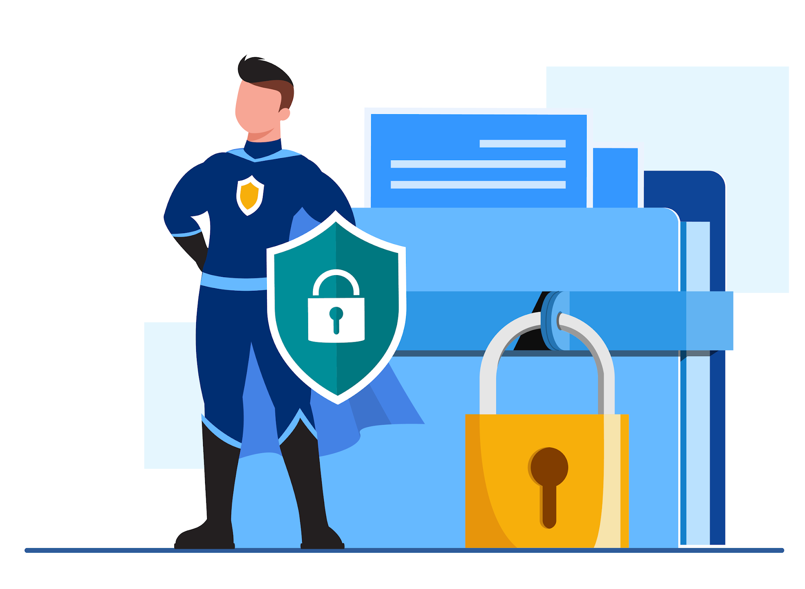
Understanding Data Protection
Data protection is the process of safeguarding important information from corruption, compromise or loss.¹
¹Boehm (2023). What is Data Security?.Crowdstrike
Designed by Freepik
Notes:
https://www.crowdstrike.com/cybersecurity-101/security-operations/data-security/

Slide 6
Understanding Data Protection
?
?
What is the purpose of data protection

Slide 7
Understanding Data Protection
The primary goal is to protect sensitive information from unauthorised access, use, disclosure, alteration, and destruction², thereby maintaining individuals' privacy and ensuring trust in data handling processes.
Designed by Freepik
²Boehm (2023). What is Data Security?.Crowdstrike
Notes:
https://www.crowdstrike.com/cybersecurity-101/security-operations/data-security/

Slide 8
What is personal data?
Personal data is any information that relates to an identified or identifiable living individual.
Different pieces of information, which collected together can lead to the identification of a particular person, also constitute personal data.³
³European Commission. What is personal Data?
Notes:
https://commission.europa.eu/law/law-topic/data-protection/reform/what-personal-data_en

Slide 9
Examples of personal data⁴
name and surname
home address
email address such as name.surname@company.com
identification card number
location data (for example the location data function on a mobile phone)
Internet Protocol (IP) address*
cookie ID**
the advertising identifier of your phone
data held by a hospital or doctor, which could be a symbol that uniquely identifies a person
*An Internet Protocol (IP) address is the unique identifying number assigned to every device connected to the internet.
** A cookie ID is a unique identifier assigned to a web browser by a website's server. It helps the website recognise the browser and track its activities, preferences, and settings across different pages or visits to the site.
⁴European Commission. What is personal Data?

Slide 10
What is sensitive personal data?
personal data revealing racial or ethnic origin, political opinions, religious or philosophical beliefs
trade-union membership
genetic data, biometric data processed solely to identify a human being
health-related data
data concerning a person’s sex life or sexual orientation

Slide 11
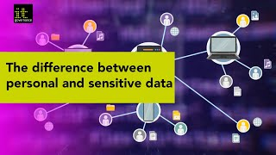
VIDEO
Watch this video about personal and sensitive data!

Slide 12
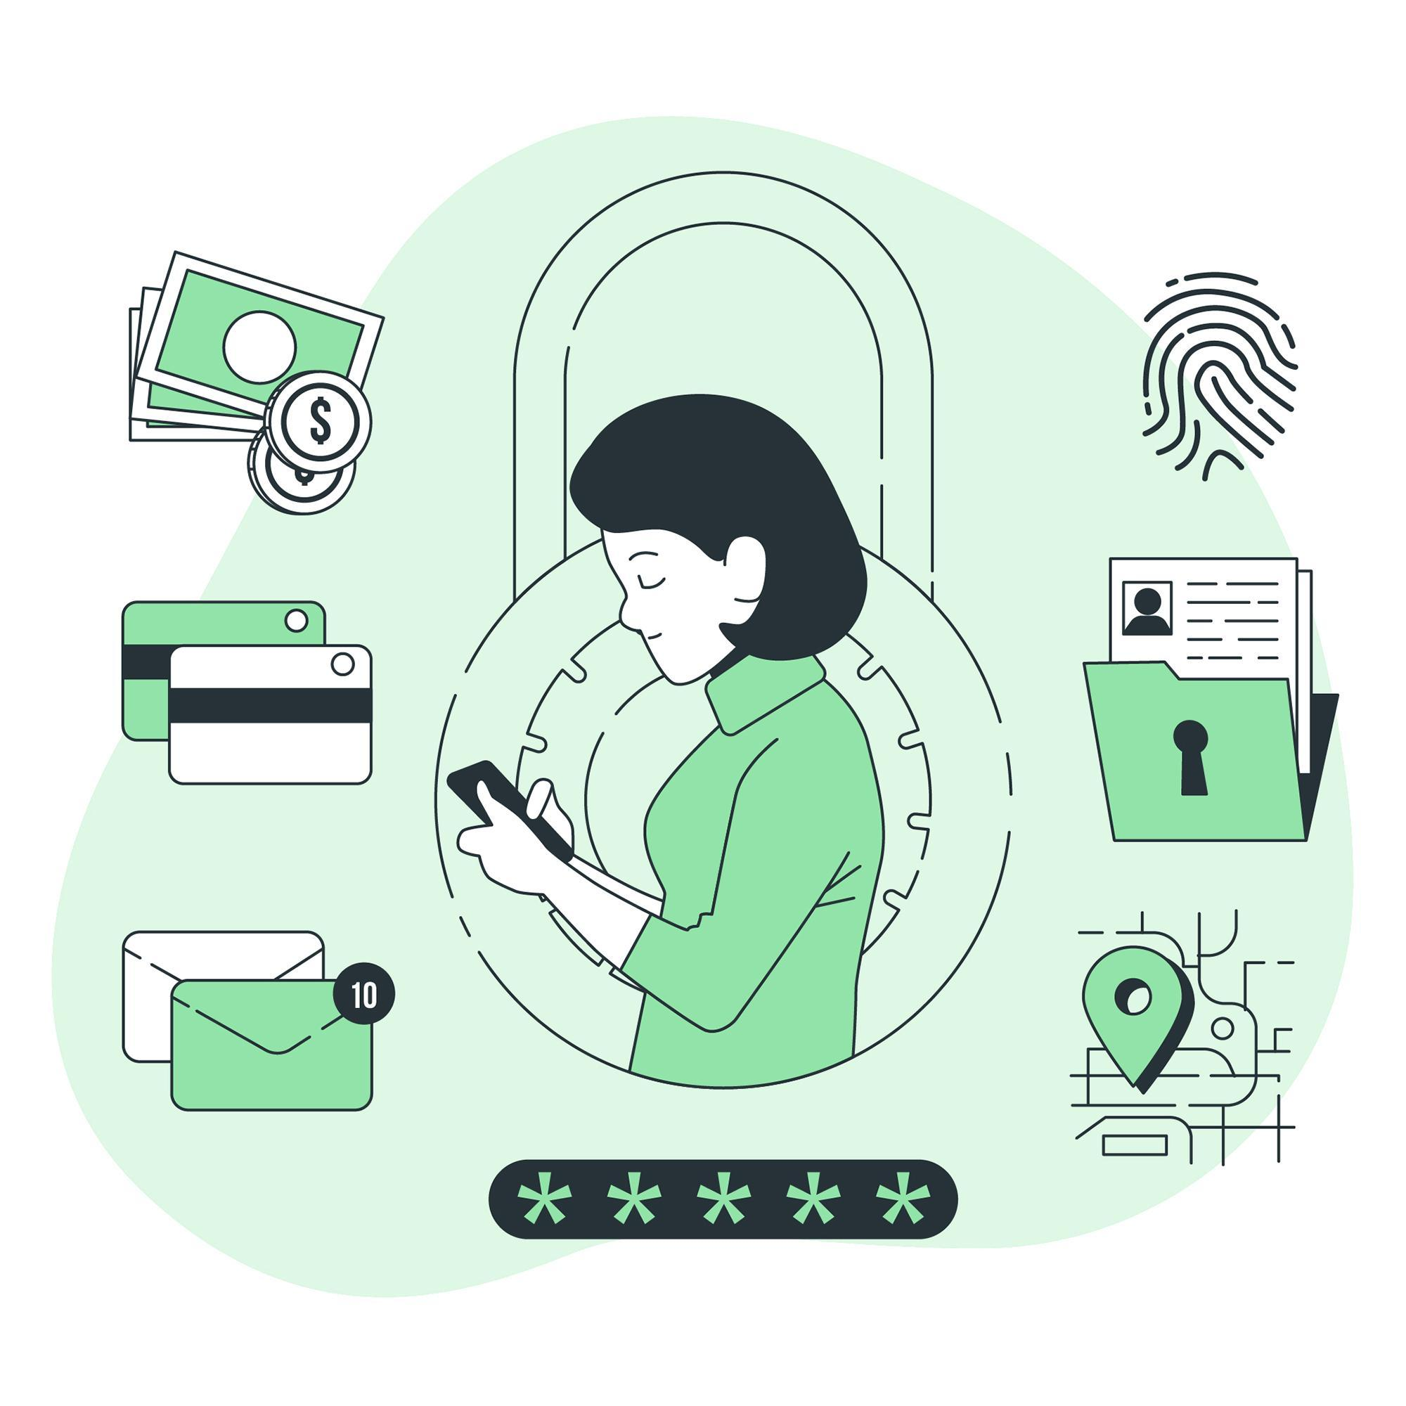
When are you confronted with personal and sensitive data?
You encounter personal and sensitive data in various aspects of your life, often without even realising it.
Now you will be shown some common scenarios where you might come across personal and sensitive data in your everyday life.
Designed by Freepik

Slide 13
When are you confronted with personal and sensitive data?
Healthcare
Whenever you visit a doctor, hospital, or pharmacy, you provide personal information such as your medical history, symptoms, and insurance details.
This information is essential for providing you with appropriate medical care and must be handled confidentially to protect your privacy.

Slide 14
When are you confronted with personal and sensitive data?
Financial Transactions
When you make purchases using a credit card, apply for a loan, or open a bank account, you share personal and financial information such as your name, address, social security number, and income details.
Safeguarding this data is crucial to prevent identity theft and fraud.

Slide 15
When are you confronted with personal and sensitive data?
Social Interactions
Sharing personal information with friends, family, and colleagues through conversations, emails, or social media interactions is common in everyday life.
While this information is typically shared in trusted relationships, it's essential to be mindful of privacy and respect others' boundaries.

Slide 16
Importance of Data Protection
?
?
Why is data protection so important

Slide 17
Importance of data protection
Privacy is recognised as a
basic human right!

Slide 18
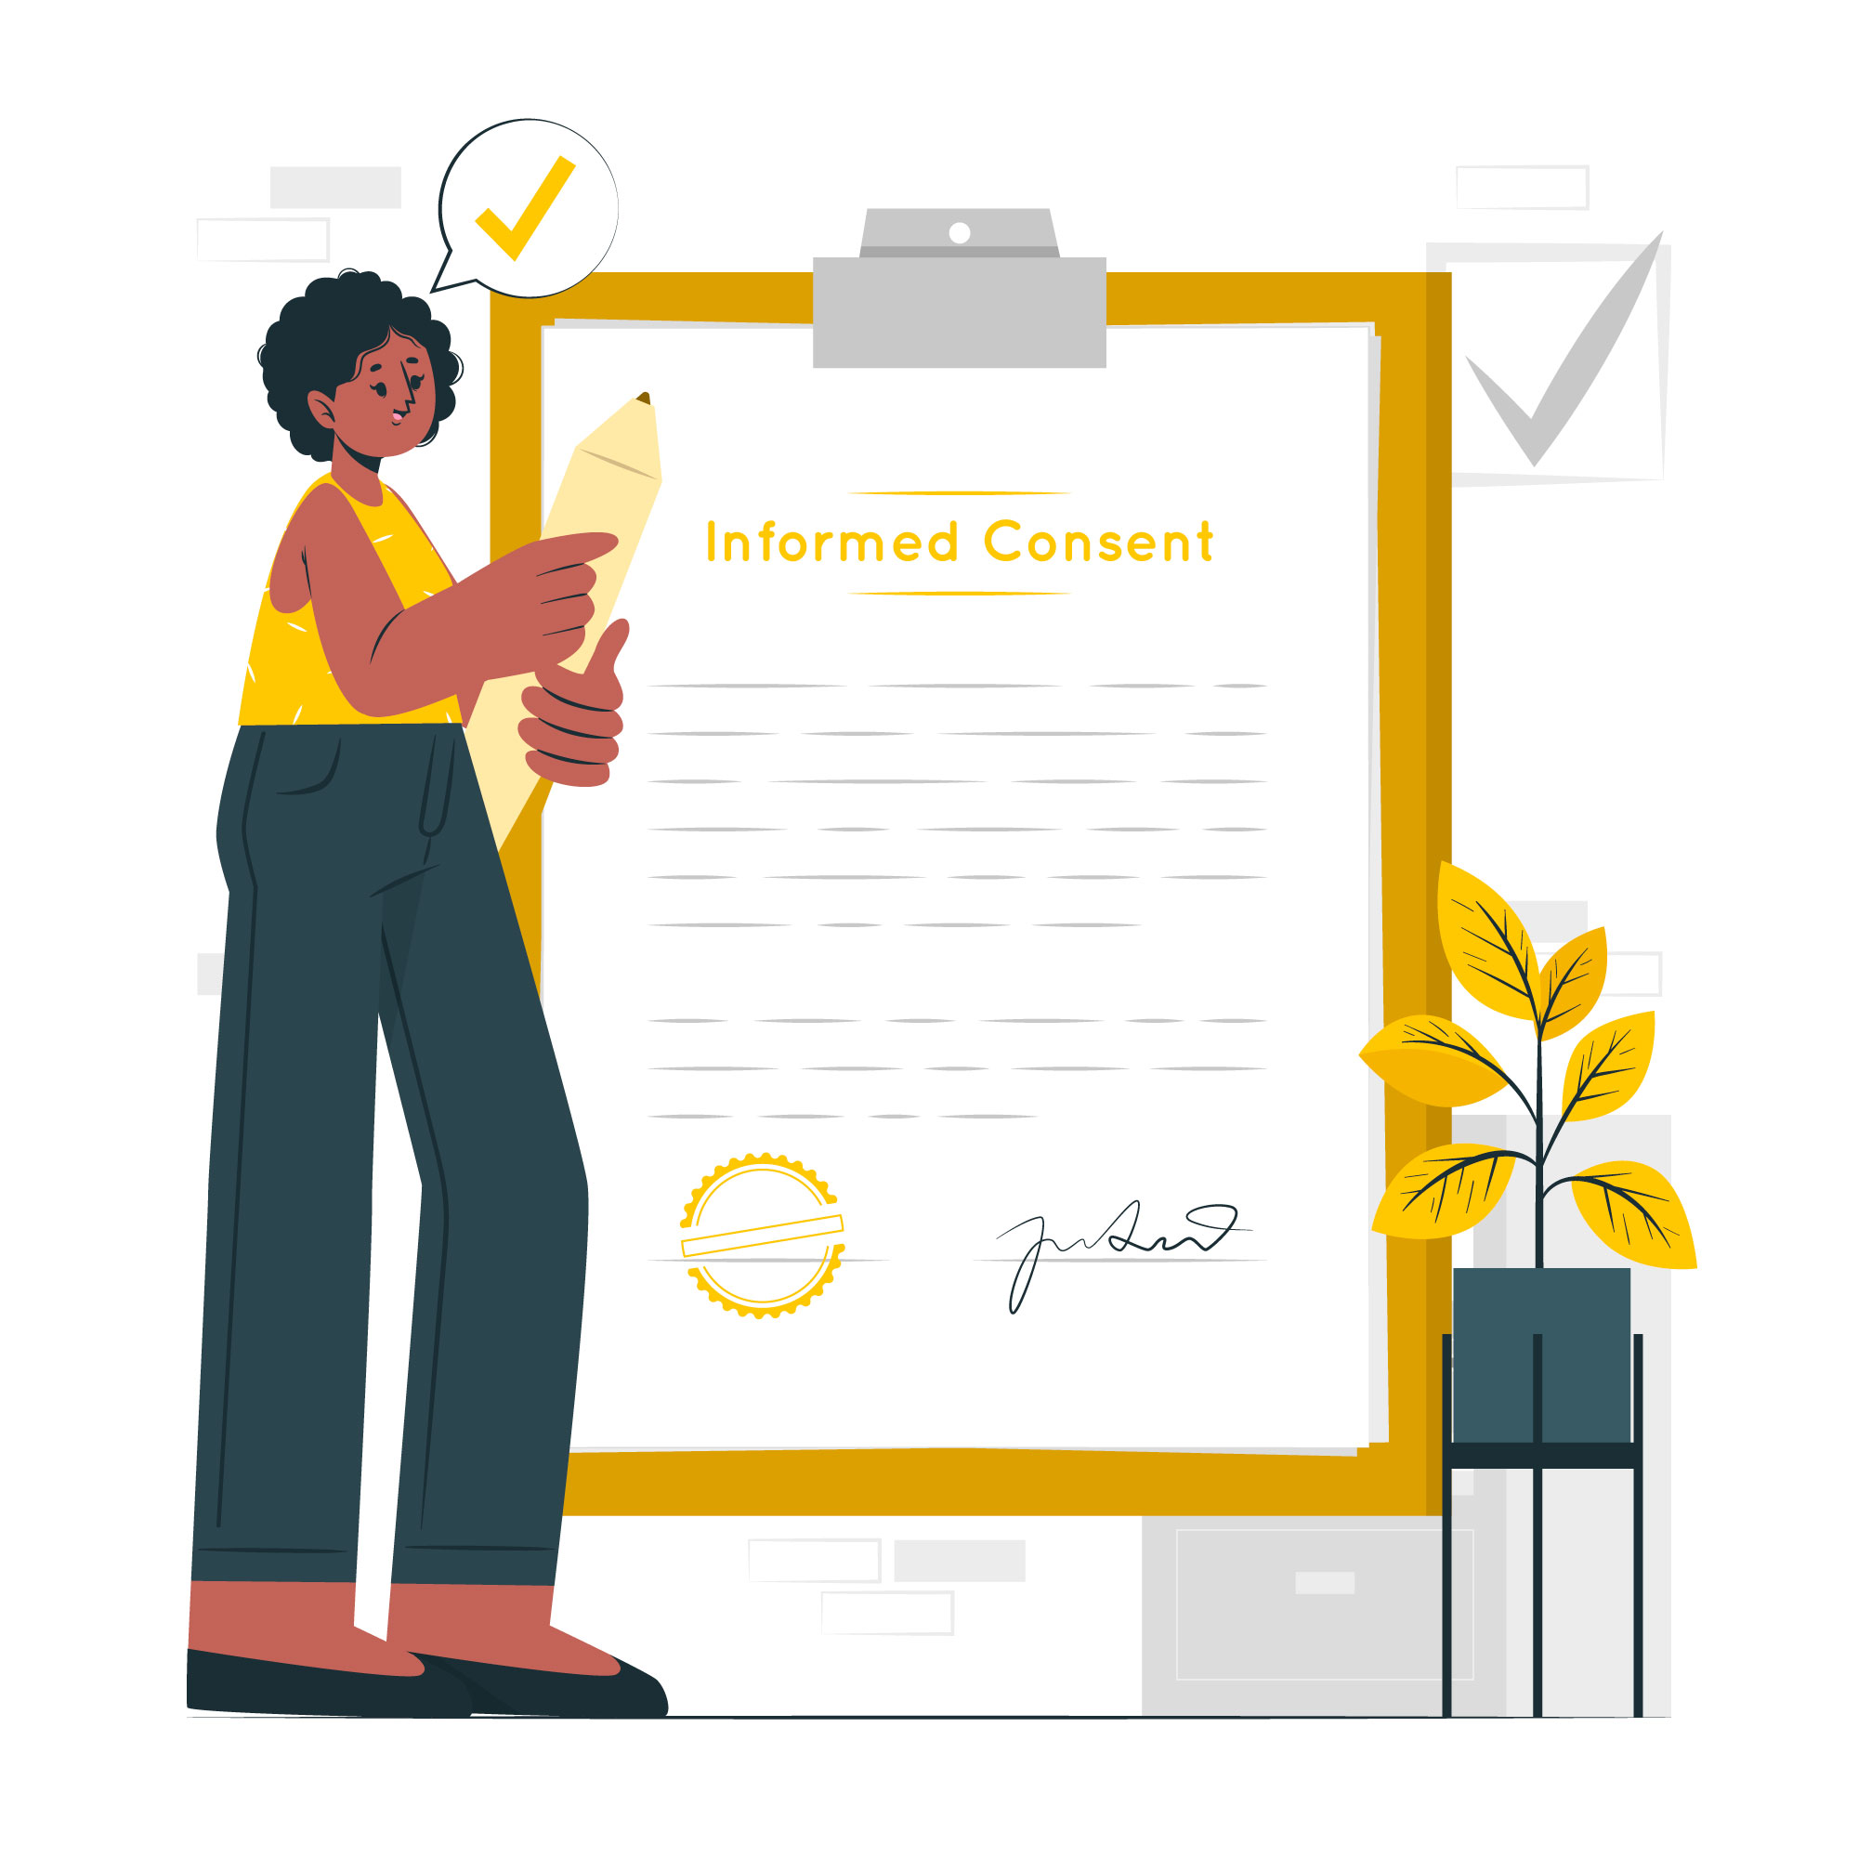
Why is data protection important
Building Trust with Users/Clients
Protecting Individuals' Rights
Avoiding Reputational Damage
Legal and Regulatory Compliance
Global Perspectives on Data Protection
Designed by Freepik

Slide 19
Building Trust with Users
Data protection is fundamental in building trust with users
Users are more likely to share information if they trust that their data is protected and handled responsibly
Designed by Freepik

Slide 20
Protecting Individuals' Rights
Data protection safeguards individuals' rights to control their personal information
It ensures that individuals have the right to know what data is collected and how it is used
Designed by Freepik

Slide 21
Avoiding Reputational Damage
Strong data protection practices prevent data breaches and mitigate the risk of reputational damage.
Organisations with robust data protection measures demonstrate a commitment to safeguarding sensitive information.
Designed by Freepik

Slide 22
Legal and Regulatory Compliance
Adhering to data protection regulations, such as GDPR (General Data Protection Regulation), is a legal obligation for organisations
Compliance ensures that organisations meet legal standards for handling and protecting personal data
Designed by Freepik

Slide 23
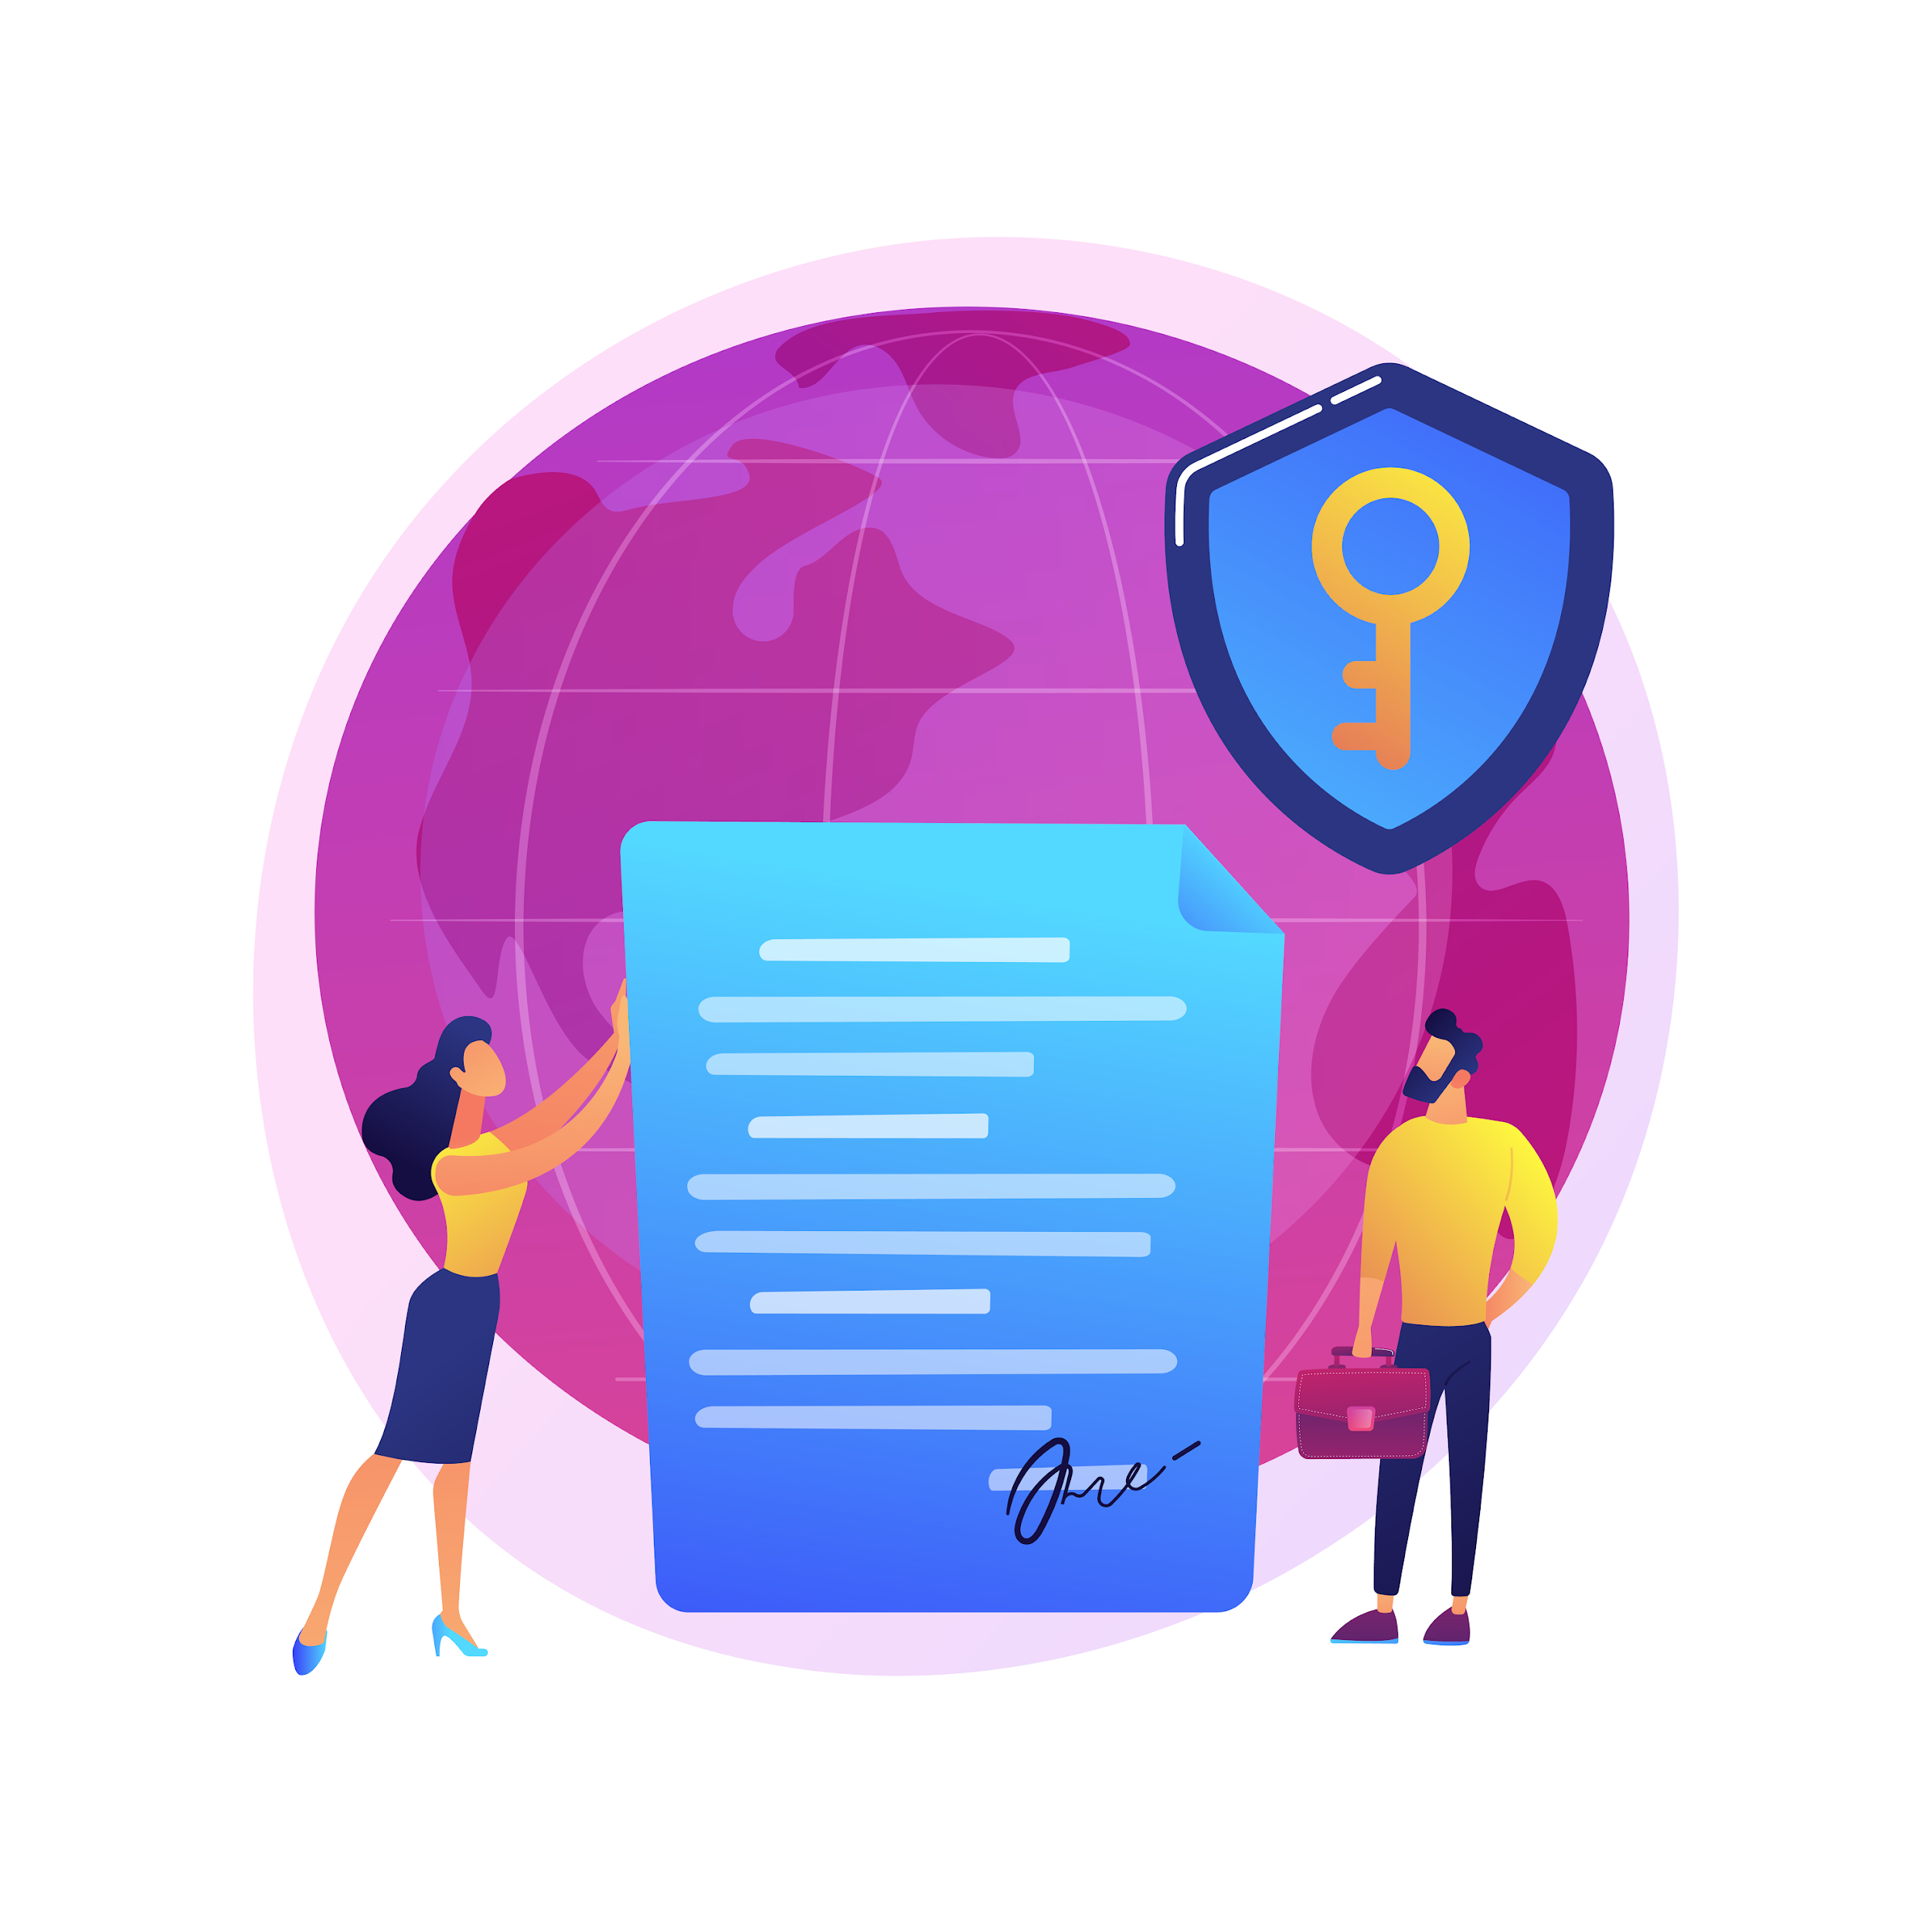
Global Perspectives on Data Protection
Data protection is a global concern with varying regulations worldwide
Understanding and complying with different jurisdictions are essential for organisations operating on a global scale
Designed by Freepik

Slide 24
KEY TAKEAWAYS
Establishing trust is foundational for data protection.
Safeguarding individual rights is a priority.
Mitigating reputational damage through strong data protection practices is crucial.
Legal compliance is mandatory for data protection.
Global perspectives shape data protection considerations.

Slide 25
?
EU GDPR
?
What is
GDPR

Slide 26
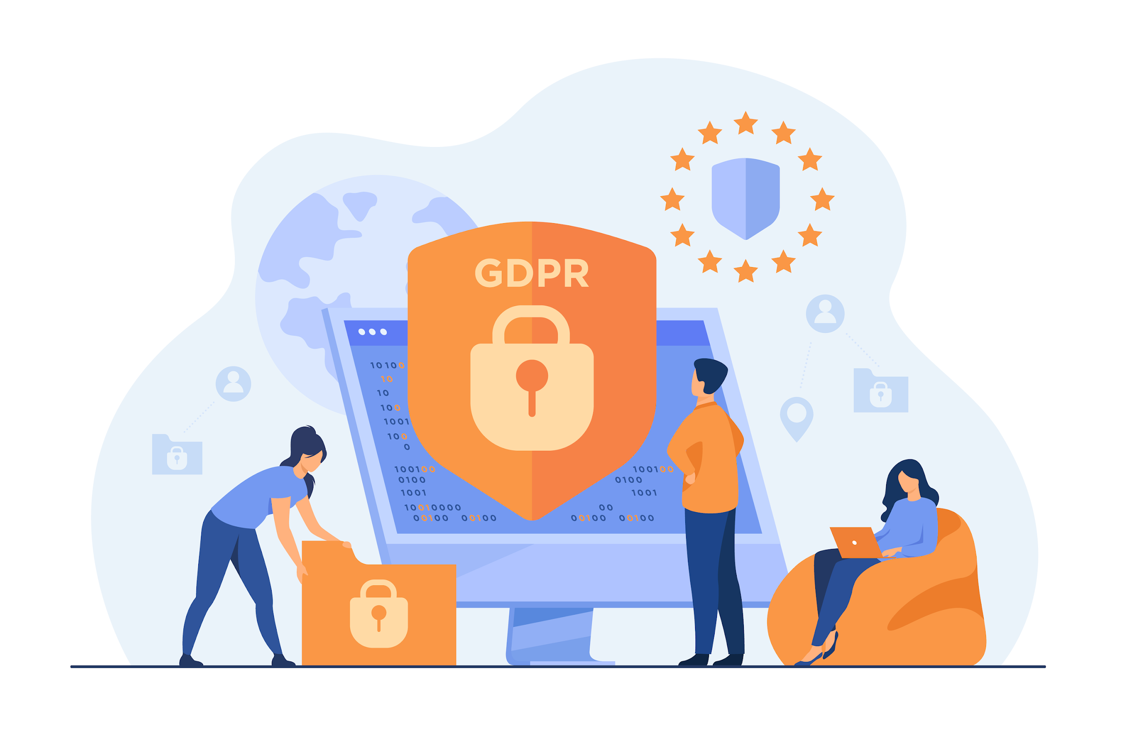
EU GDPR
The GDPR (General Data Protection Regulation) enacted in 2018, empowers individuals within the European Union with greater control over their personal data and imposes strict requirements on organisations processing such data.
toughest privacy and security law in the world
Applicable in the EU, but also it imposes obligations onto organisations anywhere, so long as they target or collect data related to people in the EU⁵
Designed by Freepik
⁵GDPR.EU.What is GDPR?
Notes:
https://gdpr.eu/what-is-gdpr/

Slide 27
Subject-Matter and Objectives of the GDPR⁶
1
2
3
This Regulation lays down rules relating to the protection of natural persons with regard to the processing of personal data and rules relating to the free movement of personal data.
This Regulation protects fundamental rights and freedoms of natural persons and in particular their right to the protection of personal data.
The free movement of personal data within the EU shall be neither restricted nor prohibited for reasons connected with the protection of natural persons with regard to the processing of personal data.
⁶ GDPR-INFO.eu. Art.1 GDPR Subject-matter and objectives
Notes:
https://gdpr-info.eu/art-1-gdpr/#:~:text=1%20GDPR%20Subject%2Dmatter%20and,free%20movement%20of%20personal%20data.

Slide 28
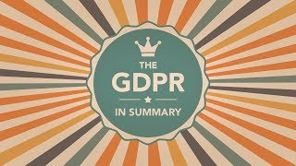
The GDPR fundamental principles
To learn about the GDPR in more detail, watch this video!
Notes:
https://www.youtube.com/watch?v=Assdm6fIHlE

Slide 29
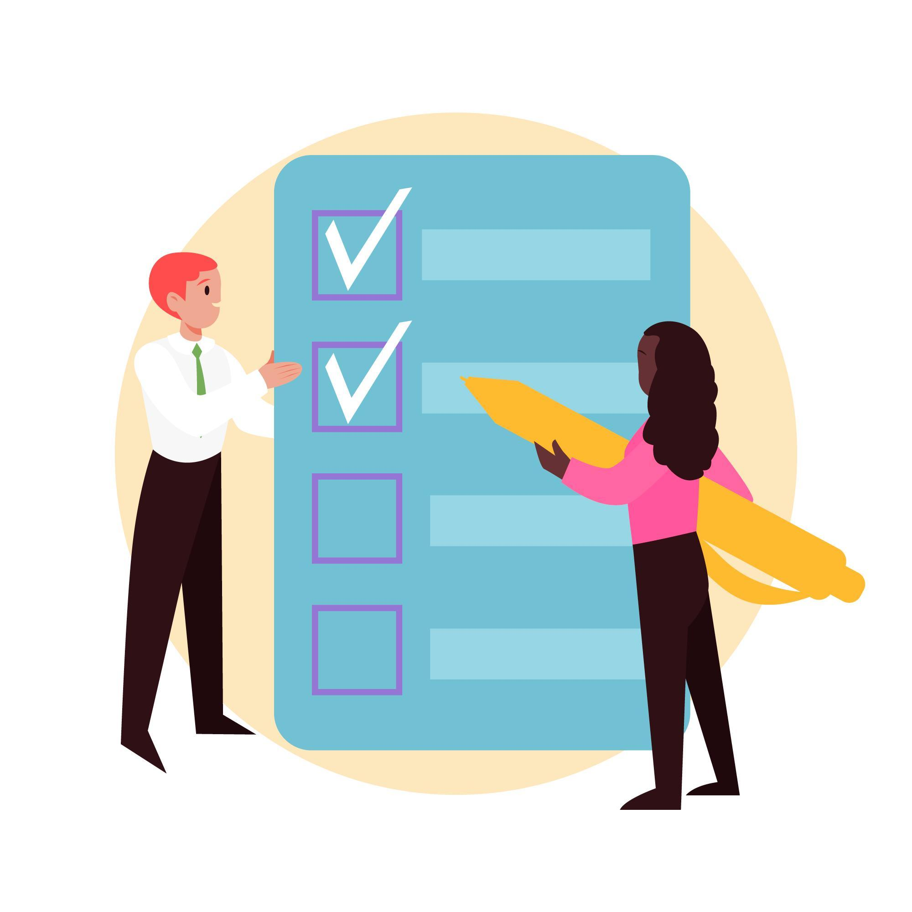
The GDPR fundamental principles
Lawfulness, fairness and transparency
Purpose limitation
Data minimisation
Accuracy
Storage limitation
Integrity and confidentiality
Accountability⁷
Designed by Freepik
⁷ Information Commissioner‘s Office. A guide to the data protection principles

Slide 30
The GDPR fundamental principles
Watch the video to learn more about the seven fundamental priciples of GDPR
Notes:
https://www.youtube.com/watch?v=NcHSD3fWJiQ

Slide 31
The GDPR fundamental principles
Always have the principles at the back of your mind when you are working with personal data!

Slide 32
?
EU GDPR
?
What happens if you disclose someone‘s personal data

Slide 33
Data Breach
Unauthorised access or exposure of sensitive information, often resulting from cyberattacks, human error, or malicious activities, posing risks to individuals and organisations is called
data breach.¹
⁸ European Commission. What is a data breach what do we have to do in case of a data breach?
Designed by Freepik
Notes:
https://commission.europa.eu/law/law-topic/data-protection/reform/rules-business-and-organisations/obligations/what-data-breach-and-what-do-we-have-do-case-data-breach_en#:~:text=A%20data%20breach%20occurs%20when,of%20confidentiality%2C%20availability%20or%20integrity.

Slide 34
Data Breach
Importance of Prompt Action
Rapid response is crucial to minimise potential harm and comply with legal obligations!

Slide 35
Data Breach
What to do in case of a data breach?
Isolate and Contain:
Identify the source of the breach and isolate affected systems.
Assess the Impact:
Evaluate the scope and severity of the breach.
Notify Relevant Parties:
Report the breach to supervisors and Data Protection Officer (DOP), IT support, and other relevant authorities as necessary.

Slide 36
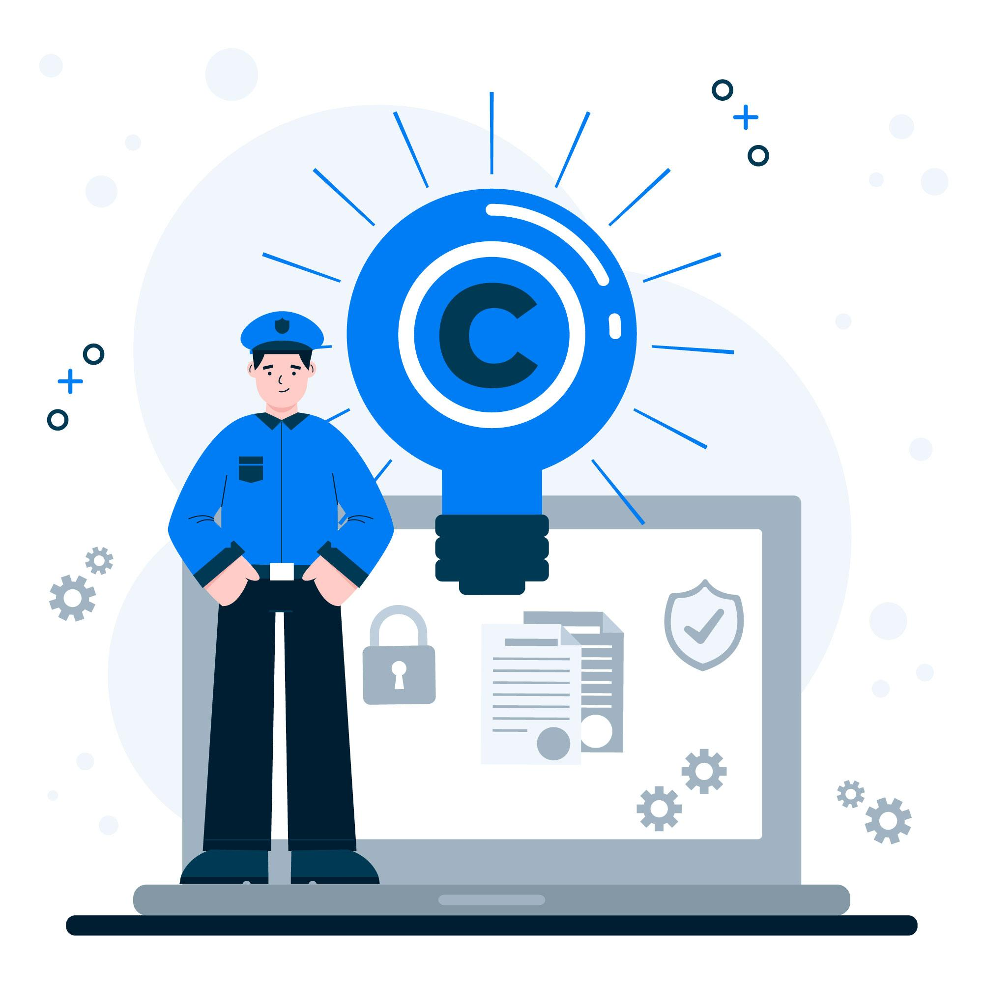
Data Protection Officer (DPO)
The Data Protection Officer (DPO) is responsible for ensuring an organisation's compliance with data protection laws, advising on privacy matters, conducting impact assessments, serving as a point of contact for regulatory authorities, and promoting a culture of data protection through training and awareness initiatives.
Designed by Freepik
⁸ EUROPEAN DATA PROTECTION SUPERVISOR. Data Protection Officer (DPO)
Notes:
https://www.edps.europa.eu/data-protection/data-protection/reference-library/data-protection-officer-dpo_en

Slide 37
Data Protection Officer (DOP)
How can they help you?
Each organisation/company in the EU that handles personal data is required to assign a DOP.
Always ask your employer to inform you who the DOP is!
In case you commit a data breach, or notice one, contact your DOP and they will instruct you how exactly you should proceed with the matter.

Slide 38
Data Protection Officer (DOP)
Watch this video if you would like to find out what exactly the DOP does and what their responsibilities are!
Notes:
https://www.youtube.com/watch?v=vPkEvH4aDsE

Slide 39
Data Breach
Real–life Scenario
Sophia works as a caregiver at an elderly care facility. One day, she accidentally sends an email containing sensitive resident information to the wrong recipient.
Sophia mistakenly includes an incorrect email address when sending out a monthly treatment plan to a resident’s family. The email contains personal details such as medical records, dietary preferences, and care plans of an elderly resident.
Upon realising her error, Sophia immediately contacts the facility's Data Protection Officer (DPO) to report the data breach and provide details of the email content and unintended recipient. The DPO assesses the potential impact of the data breach, considering the sensitive nature of the resident information disclosed and the potential risk to their privacy and security.

Slide 40
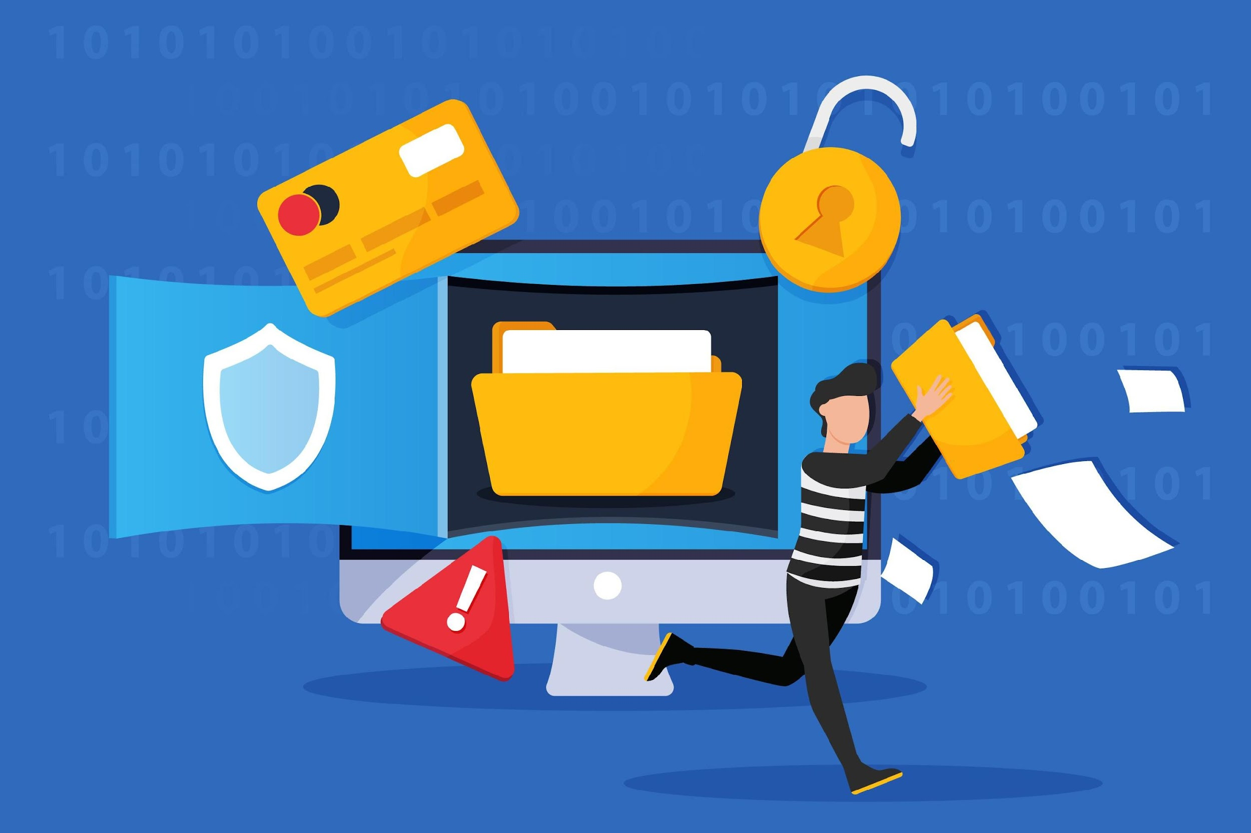
Data Breach
Real–life Scenario
The DPO contacts the unintended recipient, who is a family member of one of the residents, and explains the situation. The recipient is requested to delete the email and any associated attachments to prevent further dissemination of the information.
Sophia informs her supervisor and the facility administration about the data breach, emphasising the importance of double-checking email recipients and following proper data handling procedures to prevent similar incidents in the future.
The facility evaluates the need to notify affected residents and their families about the data breach, providing them with information on the incident and steps they can take to protect their privacy.
Designed by Freepik

Slide 41
Summary
This module on Data Protection in Elderly Care provides a comprehensive understanding of key principles and practices. It begins with the importance of data protection in the context of caring for the elderly, emphasising the sensitivity of elderly care data. The module covers essential terms, concepts, and regulations related to data protection, including the General Data Protection Regulation (GDPR) and considerations of human rights and ethical technology use. Learners explore the significance of compliance, learn about security measures, and delve into case studies to gain practical insights.

Slide 42
Self-Reflection Exercise
!
Time for
Self-Reflection

Slide 43
Self-Reflection Exercise
Next on, you will see questions related to the content of this unit.
Reflect on the questions and answer them by writing in your (digital) journal!

Slide 44
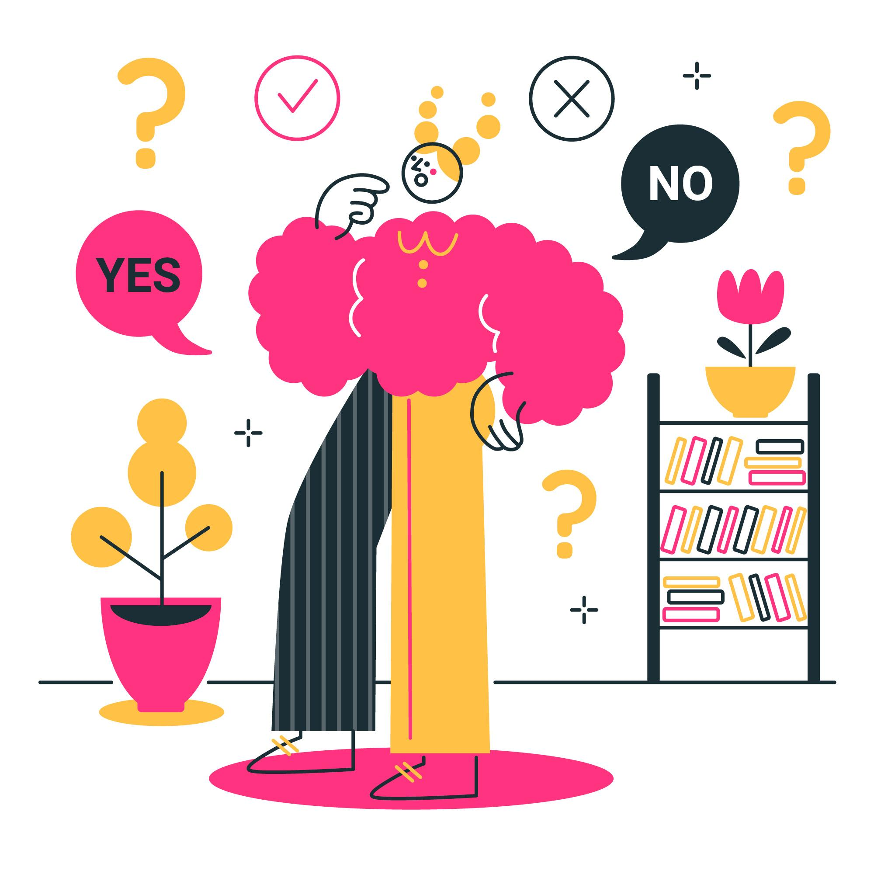
Self-Reflection Exercise
What is one key concept about data protection or GDPR that you found most important or interesting? How might you apply this concept in your daily life or work?
Can you identify a situation in your personal or professional life where recognising sensitive data could be crucial? How might your awareness impact your decision-making in that situation?
After learning about individual rights in data protection, which right do you think is most valuable for individuals? How can respecting these rights benefit both individuals and organisations?
Designed by Freepik

Slide 45
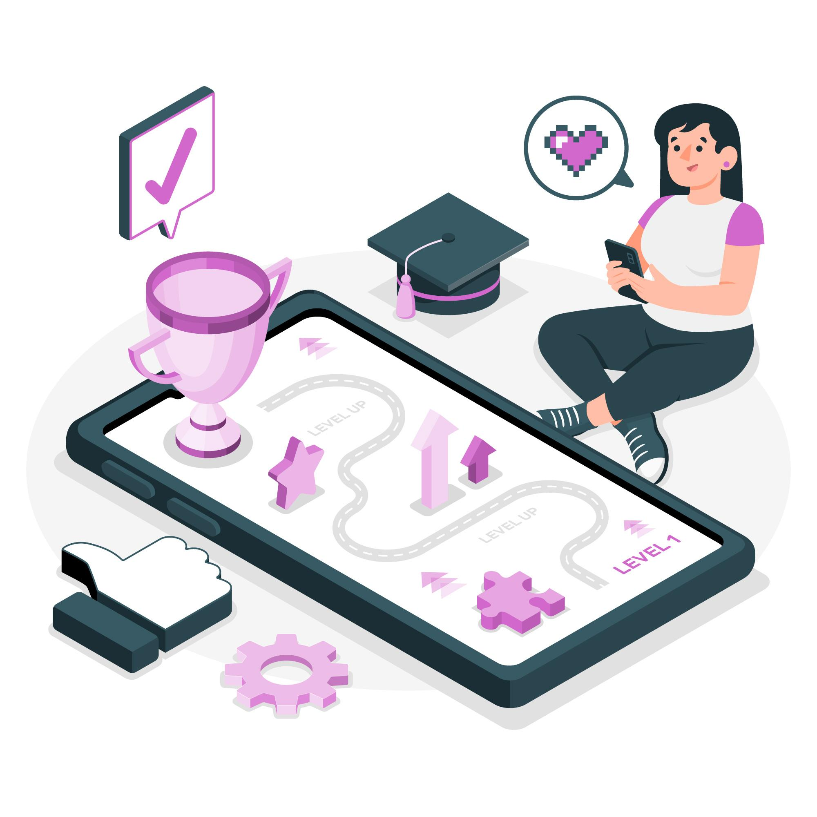
Congratulations, you completed Unit 1 of the Module 5.
Designed by Freepik

Slide 46
List of References
Boehm, Amber (2023). What is Data Security?.Crowdstrike https://www.crowdstrike.com
European Commission. What is personal Data? https://commission.europa.eu/law/law-topic/data-protection/reform/what-personal-data_en
GDPR.EU. What is GDPR? https://gdpr.eu/what-is-gdpr/
GDPR-INFO.eu. Art.1 GDPR Subject-matter and objectives https://gdpr-info.eu/art-1-gdpr/#:~:text=1%20GDPR%20Subject%2Dmatter%20and,free%20movement%20of%20personal%20data.
Information Commissioner‘s Office. A guide to the data protection principles https://ico.org.uk/for-organisations/uk-gdpr-guidance-and-resources/data-protection-principles/a-guide-to-the-data-protection-principles/
European Commission. What is a data breach what do we have to do in case of a data breach? https://commission.europa.eu/law/law-topic/data-protection/reform/rules-business-and-organisations/obligations/what-data-breach-and-what-do-we-have-do-case-data-breach_en#:~:text=A%20data%20breach%20occurs%20when,of%20confidentiality%2C%20availability%20or%20integrity.
EUROPEAN DATA PROTECTION SUPERVISOR. Data Protection Officer (DPO). https://www.edps.europa.eu/data-protection/data-protection/reference-library/data-protection-officer-dpo_en
IT Governance Ltd. GDPR Explained | Personal Data vs. Sensitive Data https://www.youtube.com/watch?v=4qYMWiSyIOk
IT Governance Ltd. What is the GDPR? | A summary of the EU GDPR https://www.youtube.com/watch?v=Assdm6fIHlE
Privacy Kitchen. What are the 7 principles of GDPR? https://www.youtube.com/watch?v=NcHSD3fWJiQ

Slide 47
This learning unit has been developed as part of an Erasmus+ KA2 project DiMiCare and is funded with the support from the European Union. The work is intended for educational purposes and is licensed under Creative Commons Attribution-NonCommercial-ShareAlike 4.0 International License @ The DiMiCare Consortium (except for referenced screenshots and content).
Funded by the European Union. Views and opinions expressed are however those of the author(s) only and do not necessarily reflect those of the European Union or OeAD-GmbH. Neither the European Union nor the granting authority can be held responsible for them

Slide 49
Module 5
Data Protection
Unit 2
Data Protection in Elderly Care: Acting Accordingly

Slide 50
01 Importance of Data Protection in Elderly Care
Why is Data protection Important in Elderly Care?
02 Ethical Handling of Data
What does ethical handling of data in care for the elderly imply?
TABLE OF CONTENTS
03 Data Protection and Sensitive Data
When am I confronted with sensitive data or data protection in my daily work?
04 GDPR in Elderly Care
How do I apply GDPR at my work?
05 Self-Refection Exercise
Time for Self-Reflection!

Slide 51
Importance of Data Protection in Elderly Care
Data protection is crucial in elderly care for various reasons, emphasising the need for safeguarding the personal information and well-being of elderly individuals.

Slide 52
?
Importance of Data Protection in Elderly Care
?
Why is data protection important in elderly care

Slide 53
Privacy and Dignity
Elderly individuals, like everyone else, have a right to privacy and dignity.
Data protection ensures that their personal information, including health records and living preferences, is kept confidential and used only for the intended purposes.

Slide 54
Vulnerable Population
Elderly individuals may be more vulnerable to exploitation or identity theft.
Data protection measures help prevent unauthorised access to their sensitive information, reducing the risk of financial and personal harm.
Designed by Freepik

Slide 55
Healthcare Information
Similar to healthcare settings, elderly care involves managing health records.
Protecting this data is essential for providing accurate and personalised care, maintaining trust, and complying with healthcare regulations

Slide 56
Family and Caregiver Communication
Elderly care often involves communication with family members and caregivers.
Data protection ensures that relevant information is shared appropriately and securely, fostering trust among all parties involved in the care process

Slide 57
Preventing Abuse
Elderly individuals may be at risk of abuse, and protecting their personal data can contribute to identifying and preventing such situations.
Monitoring and reporting mechanisms can be implemented while respecting privacy

Slide 58
Legal and Ethical Considerations
Many regions have specific regulations governing the protection of personal data, and elderly care providers must comply with these laws.
Ethical considerations also emphasise the importance of respecting the autonomy and privacy of elderly individuals.

Slide 59
Technological Integration
With the increasing use of technology in elderly care, such as smart home devices and health monitoring tools, data protection becomes critical to prevent unauthorised access and misuse of data collected through these technologies.

Slide 60
?
Ethical Handling of Data
?
What does ethical handling of data in care for the elderly imply

Slide 61
Ethical Handling of Data
Ethical handling of data in care for the elderly involves managing and utilising data in a morally sound and responsible manner. This includes respecting individuals' privacy, obtaining informed consent for data collection, ensuring data security and confidentiality, and using the data for legitimate and beneficial purposes.¹
It also involves being transparent about how data is being used, providing individuals with control over their own data, and adhering to relevant laws and ethical standards in the field of elderly care.
¹Porsdam Mann, Savulescu, Sahakian. Facilitating the ethical use of health data for the benefit of society: electronic health records, consent and the duty of easy rescue

Slide 62
?
Data Protection and Sensitive Data
?
When am I confronted with sensitive data or data protection in my daily work

Slide 63
When am I confronted with sensitive data
Patient Health Records
You may have access to and be responsible for maintaining the health records of the individuals under your care.
This information includes medical history, current health conditions, medications, and any treatment plans.
Handling and safeguarding this data is crucial for privacy and compliance with data protection regulations.
Designed by Freepik

Slide 64
When am I confronted with sensitive data
Personal Preferences and Lifestyle Information
Elderly individuals often share personal preferences, lifestyle choices, and daily routines with care assistants.
This information is sensitive and should be treated with confidentiality to provide personalised and respectful care.

Slide 65
When am I confronted with sensitive data
Communication with Family Members
Interacting with the families of those under your care may involve sharing updates on the individual's well-being.
Ensuring that only relevant and necessary information is shared, and obtaining consent where required, is part of respecting privacy.

Slide 66
When am I confronted with sensitive data
Assisting with Personal Care
Physical care assistance, such as bathing or dressing, involves close and personal contact.
Being mindful of the privacy and dignity of the individuals is a key aspect of data protection in a care setting!

Slide 67
When am I confronted with sensitive data
Medication Management
Administering medication requires accurate record-keeping and adherence to strict protocols. Protecting this information is crucial for the well-being of the individual and compliance with healthcare regulations.

Slide 68
When am I confronted with sensitive data
Technology Use in Care
The use of technology, such as electronic health records or assistive devices, may involve handling sensitive data. Ensuring that these technologies are used securely and that access is restricted to authorised personnel is essential.
Notes:
<a href="https://www.freepik.com/free-vector/general-data-security-personal-information-protection-database-access-control-cyber-privacy-synchronized-gadgets-cross-platform-devices-regulation-vector-isolated-concept-metaphor-illustration_12083584.htm#fromView=search&page=1&position=5&uuid=2c30810c-79fc-49b2-869e-81daffabbdac">Image by vectorjuice on Freepik</a>

Slide 69
When am I confronted with sensitive data
Reporting and Documentation
Reporting incidents or changes in an individual's health status requires accurate and timely documentation. Proper data protection measures involve ensuring that this information is shared only with relevant parties and is stored securely.

Slide 70
When am I confronted with sensitive data
Interactions with Other Healthcare Professionals
Collaborating with other healthcare professionals, such as nurses or doctors, may involve sharing information about the individuals you are caring for. Ensuring that such communication is done securely and with the appropriate permissions is important

Slide 71
When am I confronted with sensitive data
Real-life scenario
As a care assistant, you regularly handle sensitive personal information about patients or clients, including their medical history, medications, and personal preferences.
One day, while working on the computer at the nursing station, you receive a phone call from someone claiming to be a family member of a patient you're assisting. They ask for an update on the patient's condition and any recent changes in their treatment plan.

Slide 72
When am I confronted with sensitive data
Real-life scenario
In this situation, you're confronted with data protection concerns.
Here's how you might handle it!
Designed by Freepik

Slide 73
When am I confronted with sensitive data
Real-life scenario
Firstly, you must verify the identity of the caller. Ask for specific information that only a family member would know, such as the patient's date of birth, or a previously agreed upon password or code.
Remember your duty to maintain patient confidentiality. Even if the caller sounds legitimate, avoid disclosing any sensitive information over the phone without proper verification.
Inform the caller that you need to follow the facility's procedures for disclosing patient information. Explain that you'll need to check their relationship with the patient and verify their identity before sharing any details.

Slide 74
When am I confronted with sensitive data
Real-life scenario
If you're unsure about how to proceed, consult your supervisor or the facility's data protection officer. They can provide guidance on handling such situations while ensuring compliance with data protection laws and regulations.
Document the details of the phone call, including the caller's name (if provided), the purpose of the call, and any steps taken to verify their identity. This documentation can serve as a record of your adherence to data protection protocols.
By following these steps, you can uphold patient confidentiality and ensure compliance with data protection regulations while effectively communicating with concerned family members.

Slide 75
?
GDPR in Elderly Care
How do I apply GDPR at my work

Slide 76
GDPR in Elderly Care
The EU GDPR (General Data Protection regulation) applies to elderly care facilities as well, as they handle personal data in large amounts.
Designed by Freepik

Slide 77
GDPR in Elderly Care
The GDPR even outlines the specific regulations and importance of data protection and handling sensitive data in the healthcare sector in general.
Processing of sensitive data in health and social sector²
Processing of sensitive data in public health sector³
Special categories of personal data, like health information, demand heightened safeguards.
Processing health data should serve individual and societal interests, especially in managing healthcare services and enabling research.
The regulation aims to establish consistent rules for handling health data while upholding professional secrecy and safeguarding fundamental rights.
Member States may impose additional conditions, but these should not hinder data flow within the EU.
Special categories of personal data may be processed without consent for public health reasons.
Stringent measures are necessary to protect individuals' rights and freedoms.
'Public health' includes various health-related elements as defined by Regulation (EC) No 1338/2008.
Processing health data for public interest should not permit third parties to utilize the data for unrelated purposes, such as employers or insurance companies.
²GDPR.EU. Recital 53: Processing of sensitive data in health and social sector
³GDPR.EU. Recital 54: Processing of sensitive data in public health sector

Slide 78
GDPR in Elderly Care
In order to comply with the GDPR regulations and the regulations of your employing organisation in the EU, you are required to have a training on this topic.
Also, each organisation might have somewhat different and more specific regulations which complement the overall GDPR.
In case you did not receive a training, contact the DPO at your workplace who will inform you on the procedures and specifics regarding data protection at your organisation.

Slide 79
Digital Tools and Data Protection
As technology becomes increasingly integrated into healthcare and elderly care services, digital tools offer numerous benefits in improving efficiency, communication, and quality of care.
However, with the adoption of digital tools comes the responsibility to ensure robust data protection measures are in place, especially when dealing with sensitive information related to elderly individuals.
Designed by Freepik

Slide 80
Digital Tools and Data Protection
Here are some examples of digital tools frequently used in elderly care, as well as their benefits, risks, and what to consider in order to use them ethically.

Slide 81
Digital Tools and Data Protection
Digital Health Records
Digital health records allow healthcare providers to efficiently record and access patient information, reducing the time spent on paperwork and administrative tasks.
Electronic records can be accessed remotely, enabling healthcare professionals to retrieve patient data whenever and wherever necessary, facilitating timely and informed decision-making.
Digital records enable seamless communication among healthcare team members, allowing for better coordination of care and the sharing of vital information.
But, are there any risks?

Slide 82
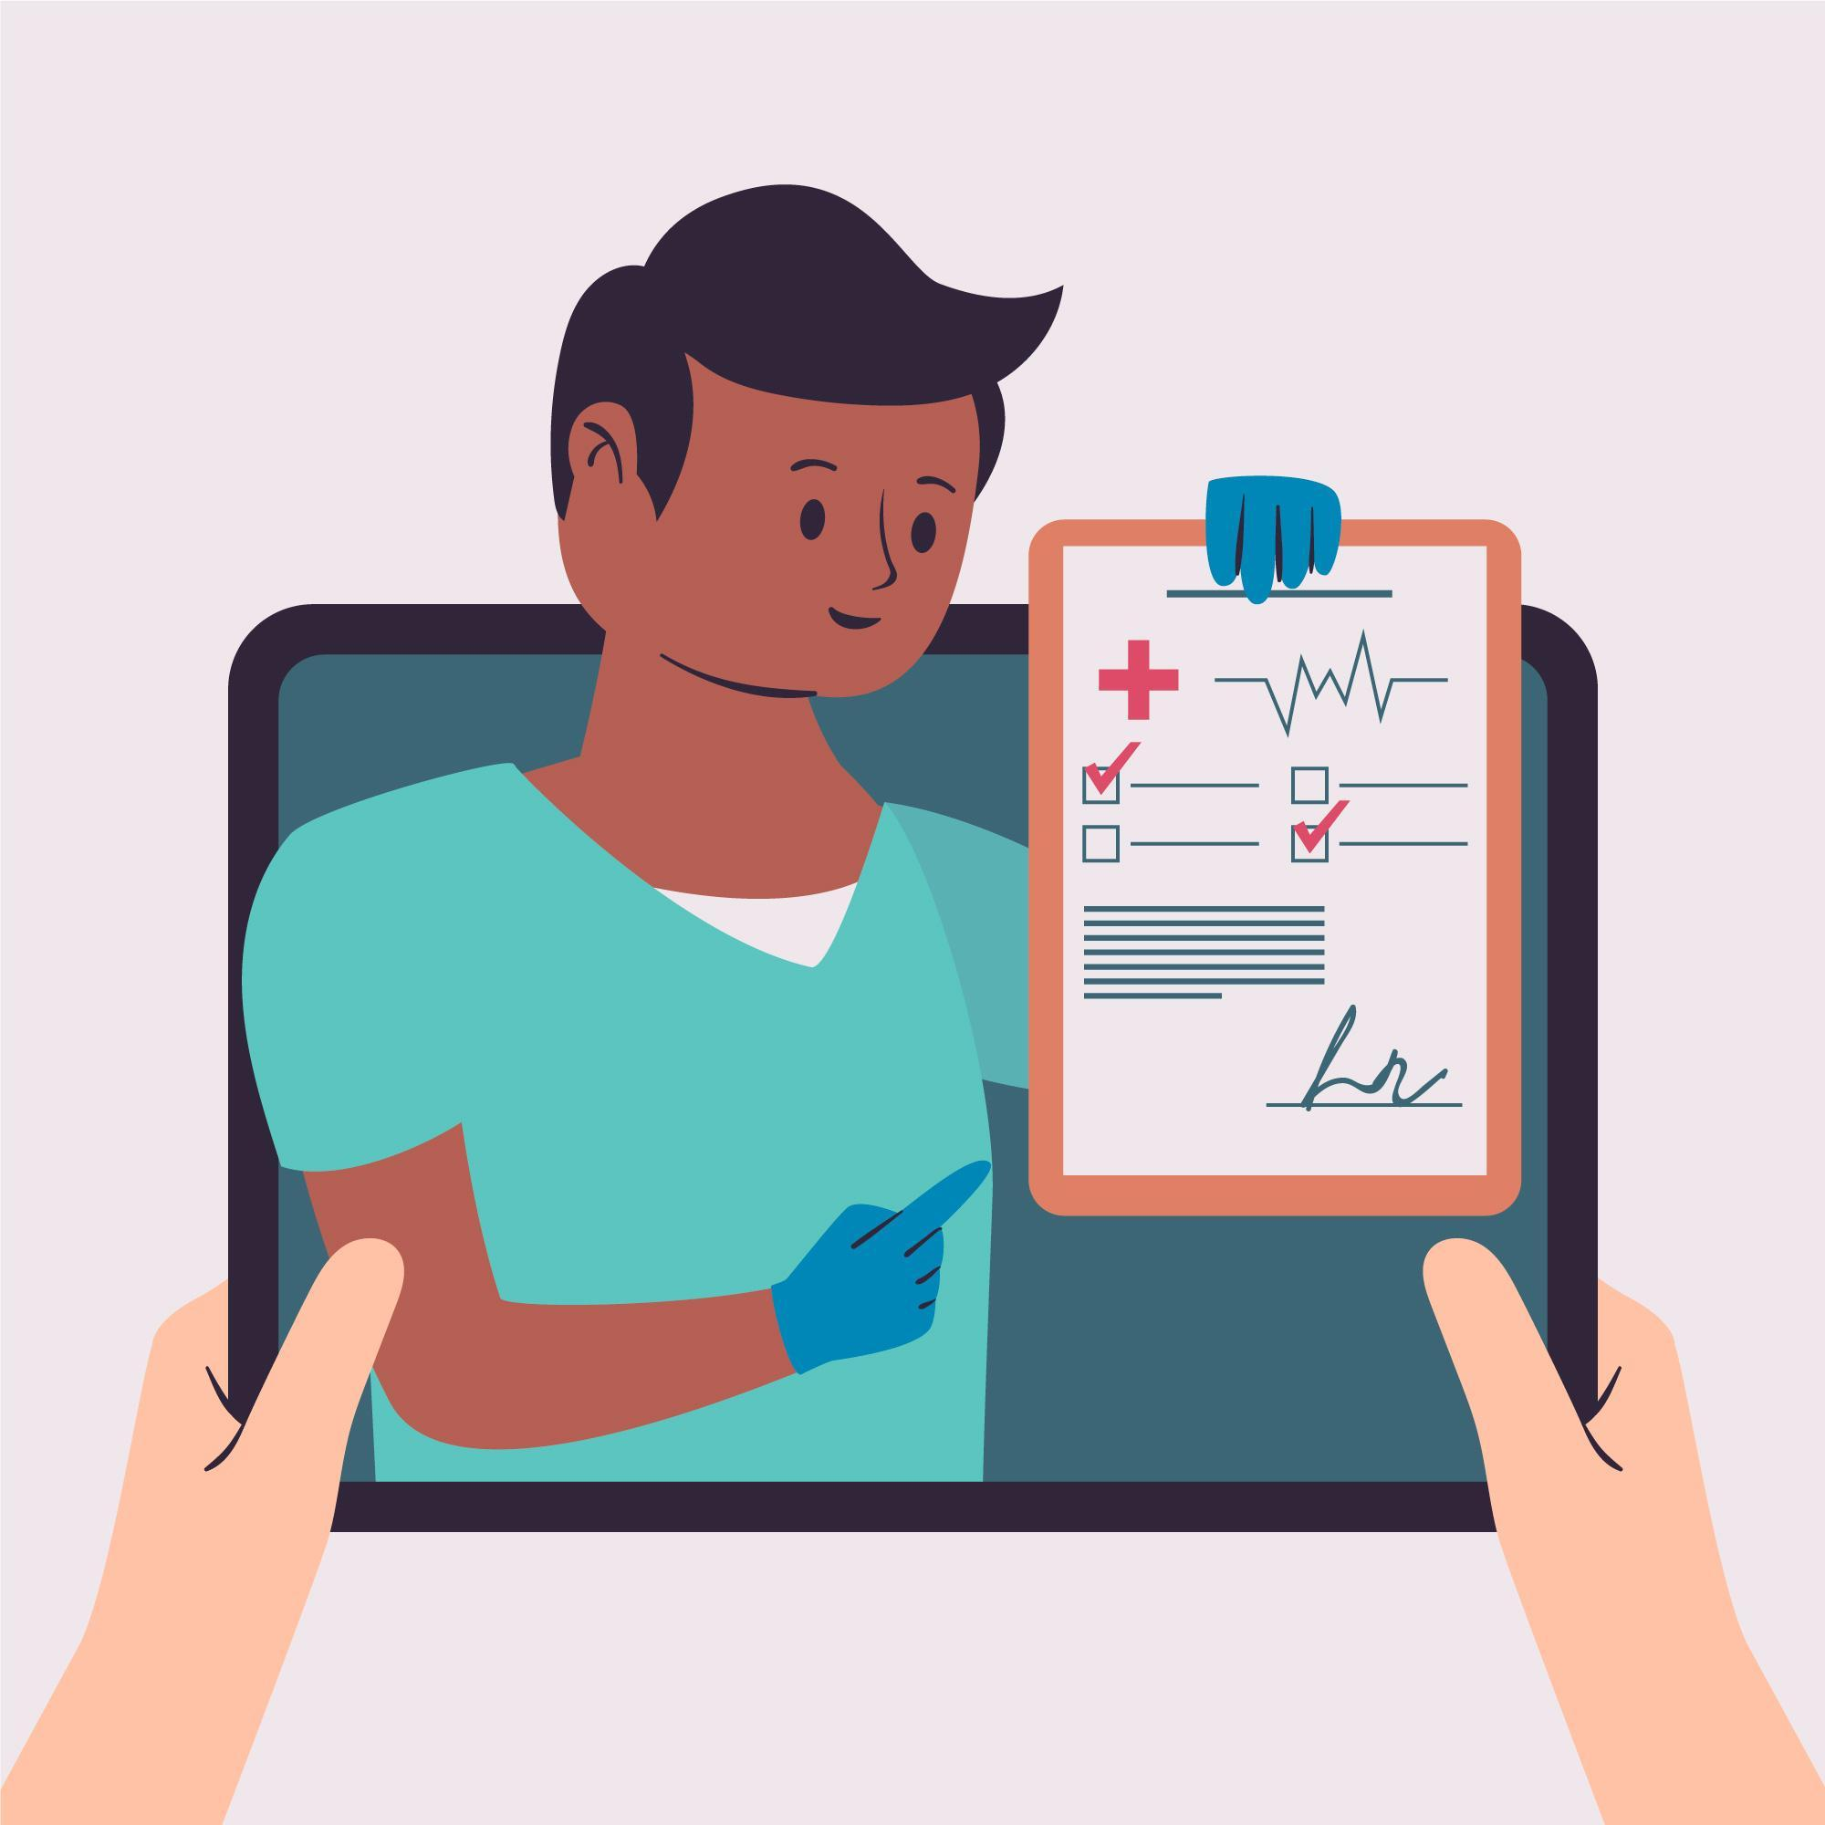
Digital Tools and Data Protection
Digital Health Records
Digital health records are susceptible to unauthorised access, potentially resulting in breaches of patient privacy. Hackers or malicious insiders may exploit vulnerabilities in the system to gain access to sensitive medical information, leading to identity theft, fraud, or other privacy violations.
Besides, inaccurate or incomplete documentation within digital health records can compromise the quality of care provided to patients. Errors in recording patient information, such as medication dosages or medical histories, can lead to misdiagnosis, inappropriate treatment, or adverse health outcomes.
Image by Freepik
Notes:
<a href="https://www.freepik.com/free-vector/online-doctor-concept_7851261.htm#fromView=search&page=1&position=0&uuid=c7eb110f-5e23-4f65-b5ce-c323e1de3632">Image by freepik</a>

Slide 83
Digital Tools and Data Protection
Digital Health Records
As care workers, it's crucial to ensure that your practices align with the General Data Protection Regulation (GDPR).
This means obtaining informed consent from patients before collecting their data and minimising the collection of unnecessary information.
By adhering to GDPR principles, you not only protect patient privacy but also promote trust and transparency in caregiving practices. Additionally, implementing robust security measures, such as encryption and access controls, helps safeguard patient data from unauthorised access or disclosure, reinforcing thrcommitment to ethical and responsible care.

Slide 84
Digital Tools and Data Protection
People Locator Tools
People locator tools offer valuable assistance in quickly locating elderly individuals who may be lost or in distress, especially in situations such as medical emergencies or instances of wandering associated with conditions like dementia.
This rapid response capability can potentially save lives and reduce the risk of harm.
But, are there any risks?

Slide 85
Digital Tools and Data Protection
People Locator Tools
Constant monitoring through people locator tools may infringe upon the privacy of elderly individuals, as their movements and whereabouts are continuously tracked and monitored. This invasion of privacy can lead to feelings of discomfort or loss of autonomy, especially if the individual feels their every move is being scrutinised.
Over-reliance on technology for locating elderly individuals may lead to a decreased emphasis on human interaction and personal care.
It is important to not neglect regular check-ins, communication, and emotional support.
Image by Freepik

Slide 86
Digital Tools and Data Protection
People Locator Tools
It's essential to implement people locator tools with a careful balance between privacy and safety considerations. This involves obtaining informed consent from the elderly individual or their legal guardian before using such tools and ensuring transparency regarding how the technology operates and how data is handled.
Caregivers should continue to prioritise regular check-ins, communication, and emotional support, recognising that technology alone cannot fulfill the complex emotional and social needs of elderly individuals.

Slide 87
Digital Tools and Data Protection
Real-life scenario
In a care facility, staff members decide to implement a people locator tool to ensure the safety of residents, particularly those prone to wandering or disorientation.
However, without proper training or oversight, a staff member decides to use the locator tool to monitor the movements of a resident, Mr. Johnson, without his knowledge.

Slide 88
Digital Tools and Data Protection
Real-life scenario
Mr. Johnson, an independent-minded individual, enjoys taking walks in the facility's garden to relax and reflect. Unbeknownst to him, the staff member activates the locator tool on his behalf, believing it will provide an added layer of security.
However, this action violates Mr. Johnson's privacy and autonomy, as he has not consented to being continuously monitored.

Slide 89
Digital Tools and Data Protection
Real-life scenario
As a result, Mr. Johnson feels a sense of intrusion and mistrust towards the staff and the facility. He becomes hesitant to engage in his usual activities, feeling like his every move is being scrutinised without his consent.
This misuse of the people locator tool erodes the trust between residents and caregivers and undermines the ethical principles of privacy and individual autonomy in elderly care.

Slide 90
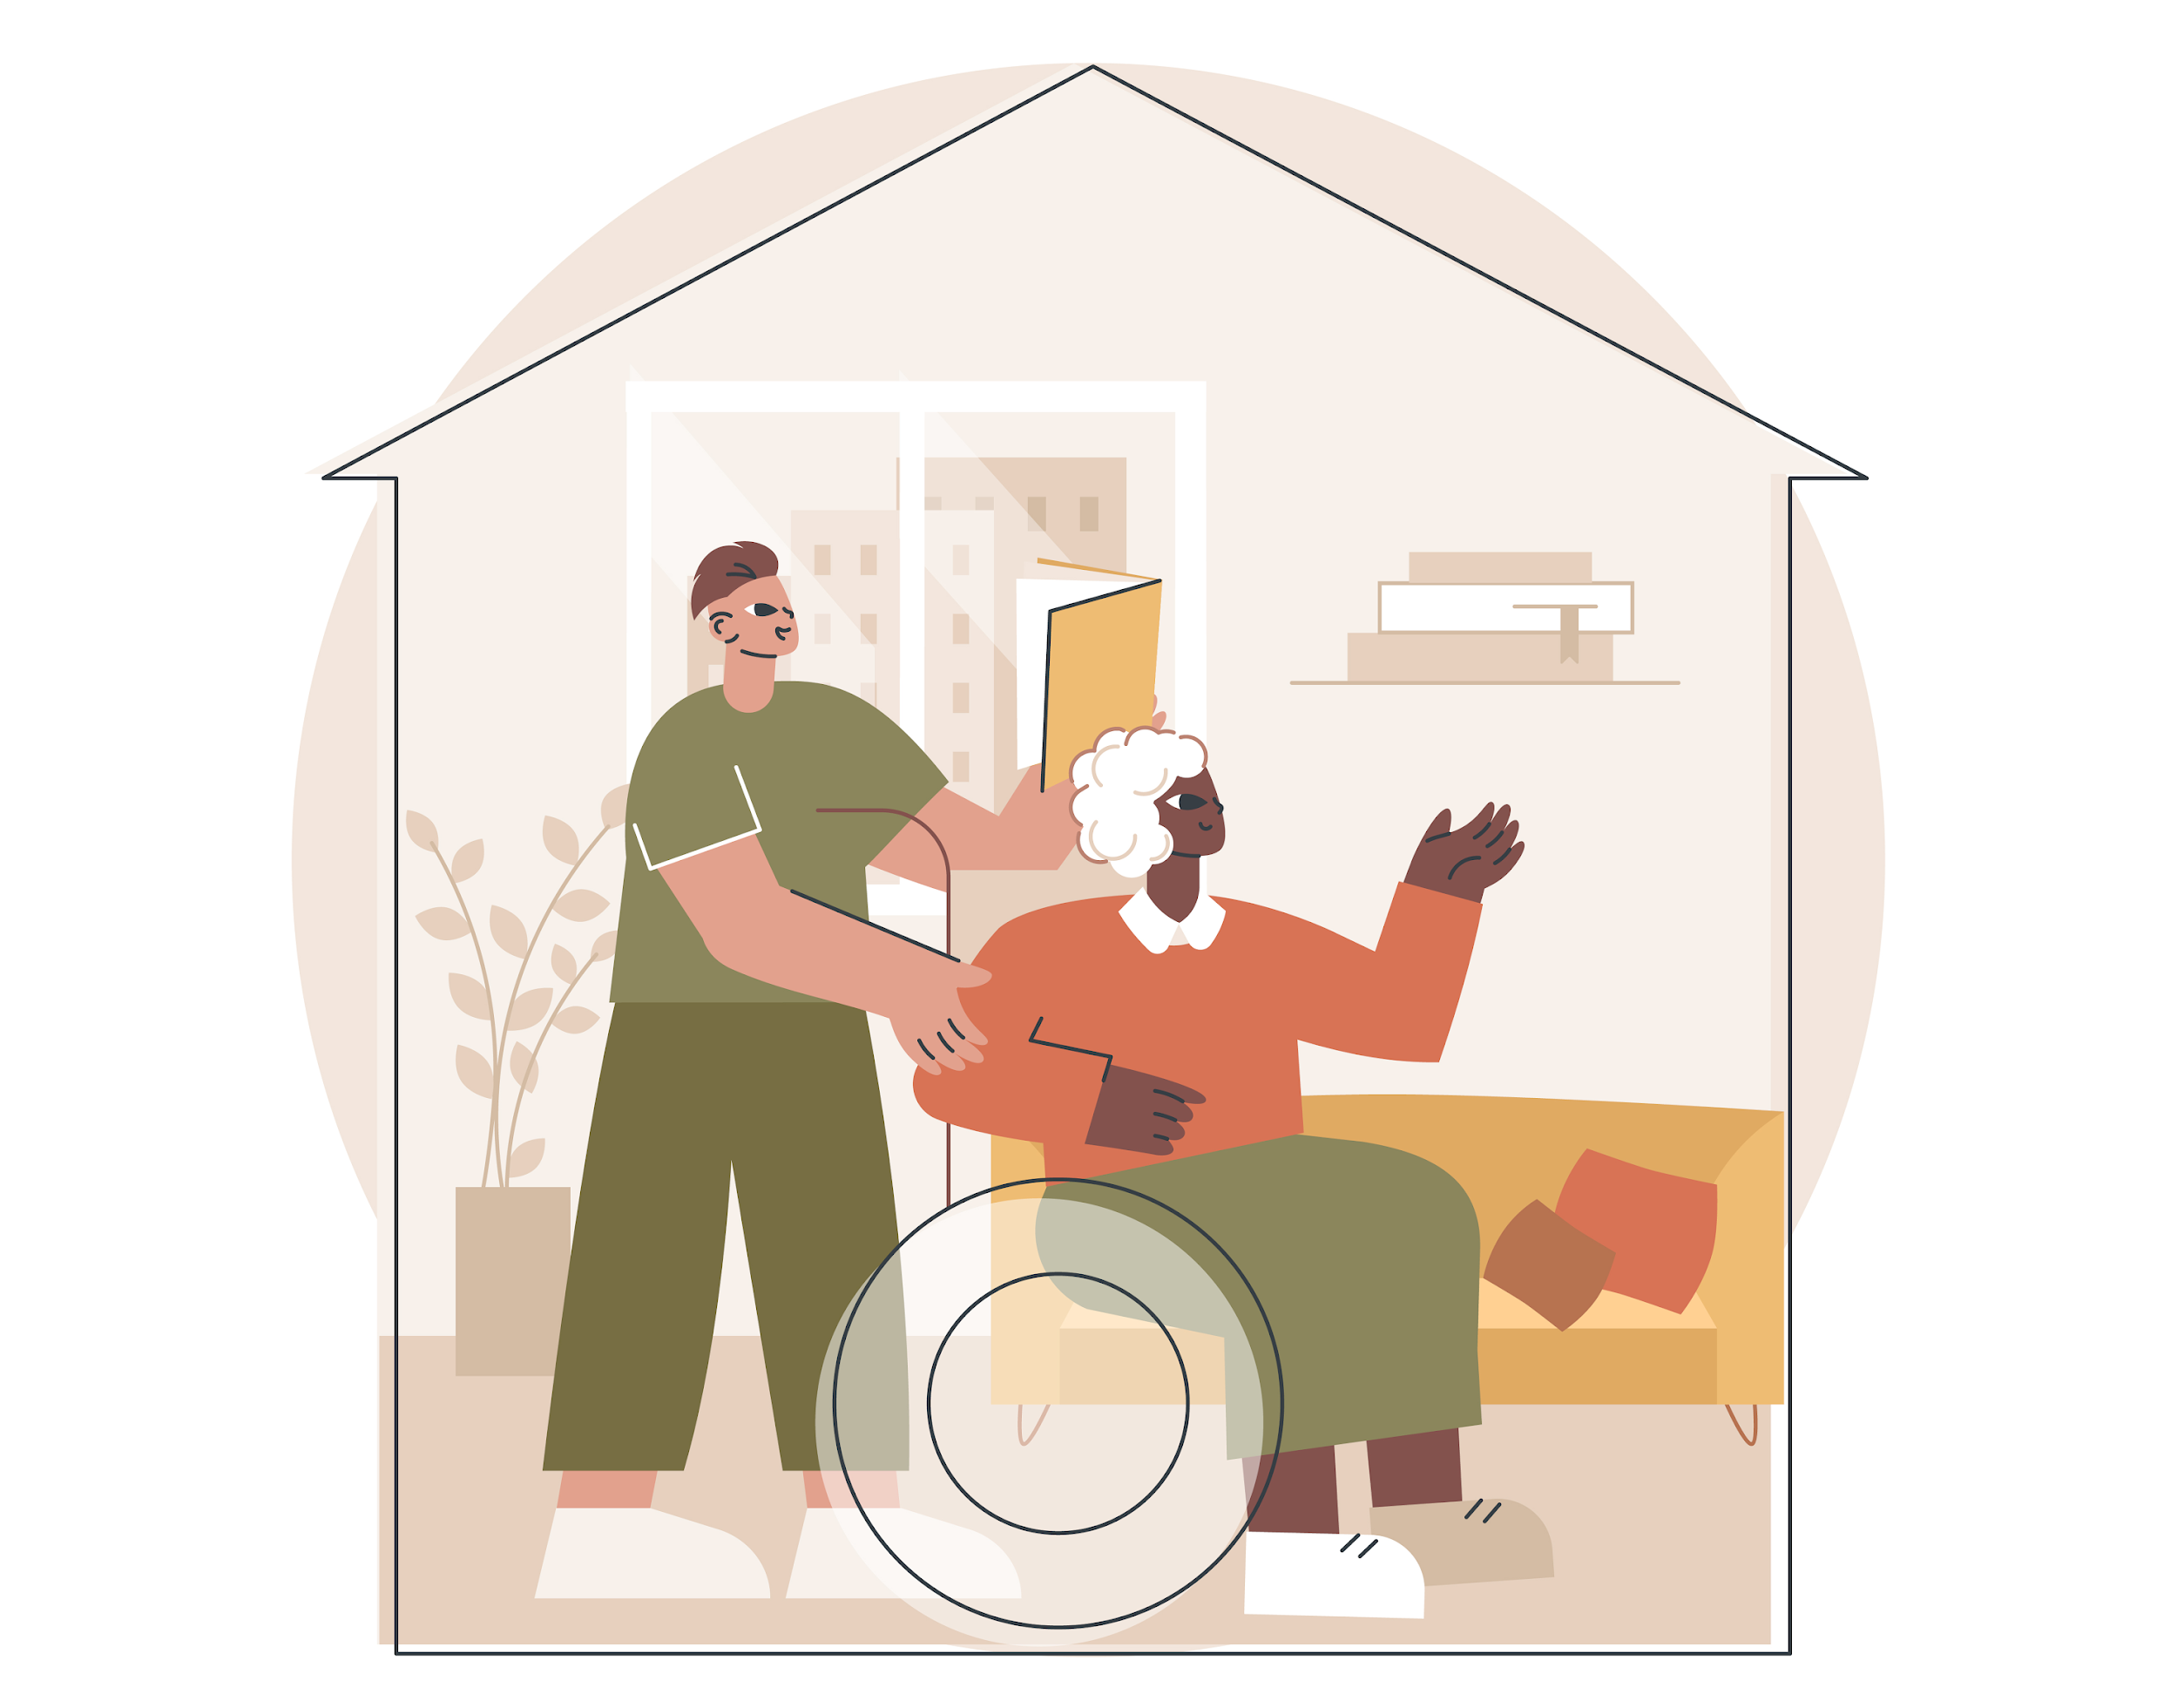
Prioritising data protection in elderly care is essential.
By safeguarding privacy and autonomy through informed consent and secure practices, we uphold dignity and trust in caregiving!
Designed by Freepik

Slide 91
Summary
This module on Data Protection in Elderly Care provides a comprehensive understanding of key principles and practices. It begins with the importance of data protection in the context of caring for the elderly, emphasising the sensitivity of elderly care data. The module covers essential terms, concepts, and regulations related to data protection, including the General Data Protection Regulation (GDPR) and considerations of human rights and ethical technology use. Learners explore the significance of compliance, learn about security measures, and delve into case studies to gain practical insights.

Slide 92
Self-Reflection Exercise
How can I apply the principles of data protection discussed in this presentation to my role in caring for the elderly? What specific steps can I take to ensure the ethical use of technology and safeguard the privacy and dignity of those under my care?
After studying the material, how can I take proactive steps to handle potential data protection challenges in my work? What improvements can I recommend in my organisation to strengthen our approach to data security and ethical use, especially in the context of elderly care?
Designed by Freepik

Slide 93
Congratulations, you completed Unit 2 of the Module 5.
Designed by Freepik

Slide 94
This learning unit has been developed as part of an Erasmus+ KA2 project DiMiCare and is funded with the support from the European Union. The work is intended for educational purposes and is licensed under Creative Commons Attribution-NonCommercial-ShareAlike 4.0 International License @ The DiMiCare Consortium (except for referenced screenshots and content).
Funded by the European Union. Views and opinions expressed are however those of the author(s) only and do not necessarily reflect those of the European Union or OeAD-GmbH. Neither the European Union nor the granting authority can be held responsible for them

Slide 95
List of References
Porsdam Mann, Savulescu,Sahakian. Facilitating the ethical use of health data for the benefit of society: electronic health records, consent and the duty of easy rescue. https://www.ncbi.nlm.nih.gov/pmc/articles/PMC5124071/
GDPR.EU. Recital 53: Processing of sensitive data in health and social sector. https://gdpr.eu/Recital-53-Processing-of-sensitive-data-in-health-and-social-sector/
GDPR.EU. Recital 54: Processing of sensitive data in public health sector. https://gdpr.eu/recital-54-processing-of-sensitive-data-in-public-health-sector/

