Slide 2
Module 1
Basic digital competences
Unit 1
Information and data literacy

Slide 3
01 Digital competence
What are the digital competences
Digital Competence Framework for Citizens (DigComp)
Key components of digital competence
Why digital literacy is Crucial for care professionals?
02 Foundational digital knowledge
What is a computer
Mobile devices
Hardware and software
Application software
03 Setting up a computer
The basics of using Windows
The basics of using macOS
Installing and uninstalling applications
04 Internet connection
What is Internet
Connecting to the Internet
Internet browsing, searching & filtering information
TABLE OF CONTENTS

Slide 4
?
01 Digital competence
What are digital competences?

Slide 5
01 Digital competence
The meaning of digital literacy is dynamic and dependent on the current technological landscape and its practical applications, as the ongoing development of technologies constantly introduces new activities and objectives.
DIGITAL COMPETENCE
is a combination of knowledge, skills and attitudes with
regards to the use of technology to perform tasks, solve problems, communicate, manage information, collaborate, as well as to create and share content effectively, appropriately, securely, critically, creatively, independently and ethically.

Slide 6
Digital Competence Framework for Citizens (DigComp 2.2)
The Digital Competence Framework for Citizen (DigComp)¹, developed by the Joint Research Centre (JRC) of the European Commission, provides a common understanding of what digital competence is.
Digital competence involves the "confident, critical and responsible use of, and engagement with, digital technologies for learning, at work, and for participation in society. It is defined as a combination of knowledge, skills and attitudes.”

Slide 7
Key components of digital competence
DigComp describes which competencies are needed by today's citizens so that they can use digital technologies in a confident, critical, collaborative and creative way to achieve goals related to work, learning, leisure, inclusion and participation in our digital society.
The 5 key areas of digital competence according to the DigComp framework are as follows:
INFORMATION AND DATA LITERACY
COMMUNICATION AND COLLABORATION
DIGITAL CONTENT CREATION
SAFETY
PROBLEM SOLVING

Slide 8
Key components of digital competence
1. INFORMATION AND DATA LITERACY:
Browsing, searching and filtering data, information and digital content
Evaluating data, information and digital content
Managing data, information and digital content
To explore some useful aspects of information and data literacy for care assistants and home helpers, see Module 1, Unit 1.

Slide 9
Key components of digital competence
2. COMMUNICATION AND COLLABORATION:
Interacting through digital technologies
Sharing through digital technologies
Engaging in citizenship through digital technologies
Collaborating through digital technologies
Netiquette (the correct or acceptable way of using the internet)
Managing digital identity
To explore some useful aspects of communication and collaboration for care assistants and home helpers, see Module 1, Unit 2.

Slide 10
Key components of digital competence
3. DIGITAL CONTENT CREATION:
Developing digital content
Integrating and re-elaborating digital content
Copyright and licenses
Programming
To explore some useful aspects of digital content creation for care assistants and home helpers, see Module 1, Unit 3.

Slide 11
Key components of digital competence
4. SAFETY:
Protecting devices
Protecting personal data and privacy
Protecting health and well-being
Protecting the environment
To explore some useful aspects of safety for care assistants and home helpers, see Module 5.

Slide 12
Key components of digital competence
5. PROBLEM SOLVING:
Solving technical problems
Identifying needs and technological responses
Creatively using digital technologies
Identifying digital competence gaps
To explore some useful aspects of problem solving for care assistants and home helpers, see Module 1, Unit 4.

Slide 13
Digital Literacy: Why It's Crucial?
Why digital literacy is Crucial for care
Professionals?/1
ENHANCED COMMUNICATION AND COLLABORATION
Digital literacy empowers care professionals to communicate and collaborate more efficiently through a variety of digital tools such as email, instant messaging, and video calling.
HEIGHTENED PRODUCTIVITY AND EFFICIENCY
Care professionals can boost productivity and streamline tasks by leveraging digital tools and software, reducing the time spent on manual processes.

Slide 14
Why digital literacy is Crucial for care
professionals?/2
Digital Literacy: Why It's Crucial?
SEAMLESS ACCESS TO INFORMATION AND RESOURCES
Digital literacy facilitates swift access to information, enabling care professionals to quickly analyse data and enhance their knowledge, thus improving decision-making agility.
INCREASED ADAPTABILITY AND RESILIENCE
In the dynamic technological landscape, digital literacy equips care professionals to effortlessly adapt to new tools, systems, and processes, fostering greater adaptability and resilience.

Slide 15
02 Foundational digital knowledge
In today's technology-driven healthcare landscape, it is imperative for healthcare professionals to possess essential digital skills, especially when caring for elderly patients.
This course aims to address the issue by providing home helpers and care workers with a structured pathway to digital competency, starting from foundational knowledge.
The program caters to individuals with diverse educational backgrounds, ensuring they acquire the necessary skills to excel in a digitally evolving healthcare environment.

Slide 16
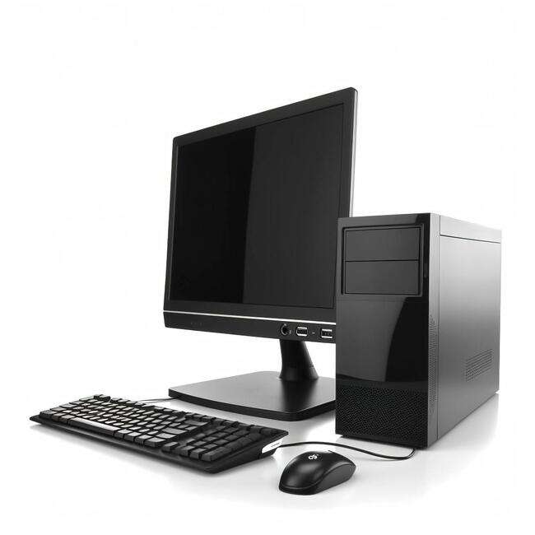
What is a computer
A COMPUTER is a versatile electronic device that takes in raw data, processes it using programs through the interaction of hardware and software components, stores intermediate and final results in memory, and produces desired outputs.
It plays a crucial role in various aspects of modern life, ranging from personal computing to complex scientific simulations and data analysis.
Designed by Freeepik

Slide 17
What is a computer
DESKTOP COMPUTERS
Desktop computers are designed to be placed on a desk, and they're typically made up of a few different parts, including the computer case, monitor, keyboard, and mouse.
LAPTOP COMPUTERS
Laptops are battery-powered computers that are more portable than desktops, allowing you to use them almost anywhere.
Designed by Freeepik
Personal computers come in two main styles: PC and Mac. Both are fully functional, but they have a different look and feel, and many people prefer one or the other.

Slide 18
What is a computer
Key characteristics of computers:
TIME EFFICIENCY: Swift completion of tasks, solving complex problems in seconds, and saving valuable time.
INTERNET CONNECTIVITY: Providing access to crucial information, facilitating global communication, and connecting to the vast world of the internet.
STORAGE CAPACITY: Enabling the storage of large volumes of data, including projects, documents, and multimedia content.

Slide 19
What is a computer
ENTERTAINMENT HUB: Serving as a significant source of entertainment through gaming, music, movies, and social networking.
DATA ORGANIZATION: Efficiently storing and organizing data with the ability to create distinct folders for easy accessibility.
ACCESSIBILITY FOR PHYSICALLY CHALLENGED: A boon for individuals with physical challenges, offering specialized software for assistance, such as screen-reading for the visually impaired.

Slide 20
Mobile devices
TABLET COMPUTERS
Tablet computers, designed for portability like laptops, lack physical keyboards and touchpads.
The touch-sensitive screen facilitates virtual keyboard usage and finger-based navigation.
While tablets may not perform all tasks of traditional computers, their convenience makes them an ideal secondary computing device for many users.
Designed by Freeepik

Slide 21
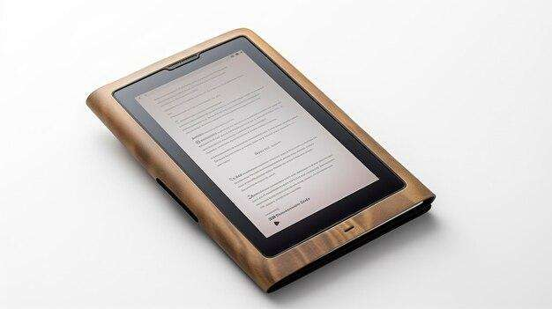
Mobile devices
E-READERS
E-book readers, also called e-readers, are similar to tablet computers, except they are mainly designed for reading e-books (digital, downloadable books).
Designed by Freeepik
Notable examples include the Amazon Kindle, Barnes & Noble Nook, and Kobo.
Most e-readers use an e-ink display, which is easier to read than a traditional computer display. You can even read in bright sunlight, just like if you were reading a regular book.

Slide 22
Mobile devices
SMARTPHONES
Featuring touch-sensitive screens, most smartphones eliminate the need for a physical keyboard and offer a virtual keyboard and intuitive finger-based interface.
It allows you to combine various electronic gadgets such as old notebooks, digital music players and digital cameras in one versatile unit.
You can connect to the Internet via Wi-Fi or mobile networks (data plan required).
Designed by Freeepik

Slide 23
Hardware and software
A computer system is divided into two categories:
​HARDWARE: any physical part of a computer​.
SOFTWARE: a set of instructions that directs hardware operations.
​
Everything you do on your computer relies on both hardware and software. ​
For example, viewing this lesson in a web browser (software) and using a mouse (hardware) to navigate​.

Slide 24
Hardware and software
There are four main types of computer hardware:
PROCESSING DEVICES are the components responsible for the processing of information within the computer system. This includes devices such as CPU (Central Processing Unit) memory and motherboard.
STORAGE DEVICES are components which allow data to be stored within a computer system. This includes devices such as hard disk drives and compact disk drives.
INPUT DEVICES include things like keyboards, mice, and scanners.
OUTPUT DEVICES include things like monitors and printers.

Slide 25
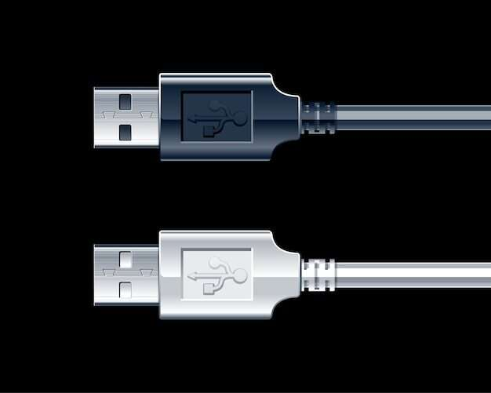
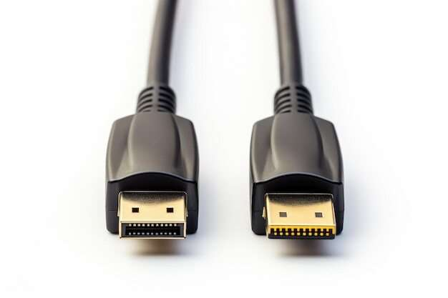
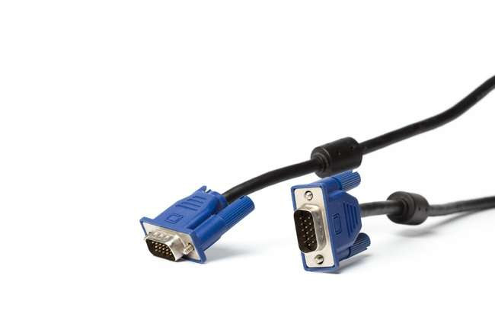
Hardware and software
USB (Universal Serial Bus) is a standard for connecting external devices to computers.
HDMI (High Definition Multimedia Interface): This type of cable can transmit video and audio signals without interference over a maximum length of 15 meters.
CABLES TO CONNECT INPUT AND OUTPUT DEVICES
Audio cables: These are usually two cables, one for the speakers and one for the microphone.
VGA (Video Graphics Array) is a standard for connecting to a monitor.
Network cables are used to connect the computer to a network by cable.

Slide 26
Hardware and software
A SOFTWARE program is a set of code and instructions that tells a computer how to run and execute specific tasks. A single computer can complete multiple functions simultaneously, depending on the installed software programs.
Essentially, software serves as the brain of a computer, guiding its every function and enabling it to process and respond to various inputs and requirements.

Slide 27
Hardware and software
There are four key types of software programs:
APPLICATION SOFTWARE (or applications) carries out one specific task on a computer. This software has common usage even among those with a basic understanding of computers.
SYSTEM SOFTWARE allows software applications to run on a computer's hardware. This software can include operating systems like Windows, macOS and Linux.
PROGRAMMING SOFTWARE can allow the user to create an application. These programs provide individuals with the tools to develop, write, test and debug programming code.
DRIVER SOFTWARE is a software program that enables the communication between the operating system and a hardware device. Some hardware requires a driver installation before its usage, like printers, scanners and modems.

Slide 28
Application software
APPLICATION SOFTWARE programs are designed to perform specific tasks, simplify workflows, and improve communication.
Be it completing your tasks, jotting down notes, completing your online research, setting the alarm, keeping an account log, or even playing games; there are explicit application software programs that can help you out.

Slide 29
Application software
The most common examples of applications used by millions daily are listed below:
A SUITE OF MICROSOFT PRODUCTS such as MS Office, PowerPoint, MS Word, Excel, and Outlook.
INTERNET BROWSERS like Google Chrome, Safari, Firefox, etc.
REAL-TIME ONLINE COMMUNICATION TOOLS like Skype, Hangouts, Google Meet, Zoom, and WhatsApp.
MULTIMEDIA AND MUSIC STREAMING SOFTWARE such as Spotify, Pandora, etc.
GRAPHICS AND DESIGN SOFTWARE such as Adobe Photoshop.

Slide 30
03 Setting up a computer
You've got your new computer and can start configuring.
This may seem like an overwhelming and complicated task, but it's actually a lot easier than you might think it would be!
It doesn't matter what brand of computer you have, as most computers are set up in a similar way.
Designed by Freeepik

Slide 31
VIDEO CONTENT
Learn more about the basics of using Windows
by watching the video¹ below
Windows Basics: Getting Started with the Desktop
¹ Windows Basics: Getting Started with the Desktop [online video], @GCFLearnFree, May 14, 2019, https://youtu.be/GDKIxBr6yhI
Notes:
https://youtu.be/GDKIxBr6yhI

Slide 32
VIDEO CONTENT
Learn more about the basics of using macOS
by watching the video¹ below
Mac OS X Basics: Getting Started with the Desktop
¹ Mac OS X Basics: Getting Started with the Desktop [online video], @GCFLearnFree, Sep 18, 2014, https://youtu.be/bEQ8u3LViDU
Notes:
https://youtu.be/bEQ8u3LViDU

Slide 33
VIDEO CONTENT
Learn more about how to install Software on Windows
by watching the video¹ below
How to Install Software on Windows
¹ How to Install Software on Windows [online video], @GCFLearnFree, Feb 22, 2023, https://youtu.be/J-UUJH_3eGg
Notes:
https://youtu.be/J-UUJH_3eGg

Slide 34
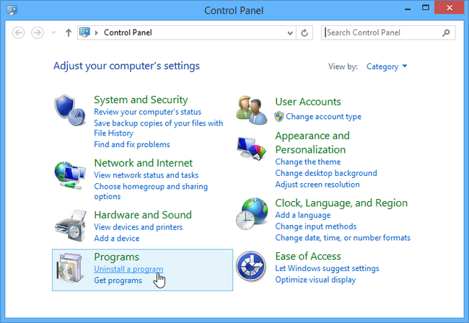
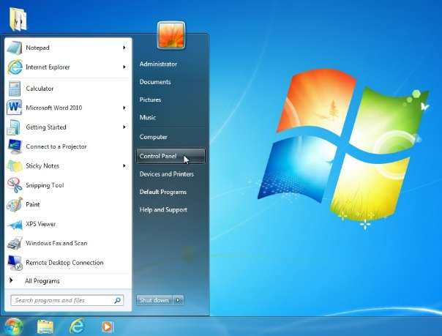
Uninstalling applications on your Windows PC
1. Open the Control Panel
2. Select Uninstall a program

Slide 35
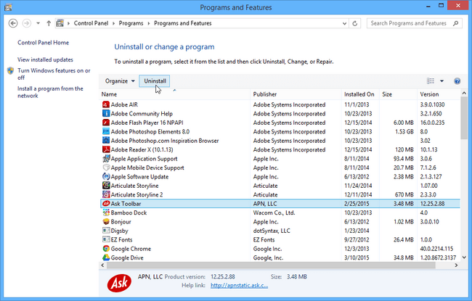
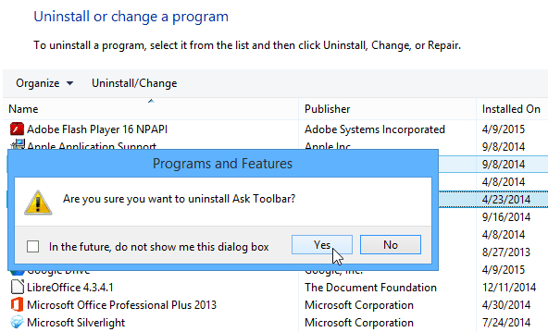
Uninstalling applications on your Windows PC
3. Select the desired application,
then click Uninstall
4.Confirm the uninstallation
That's it!
The program will be removed from your computer!

Slide 36
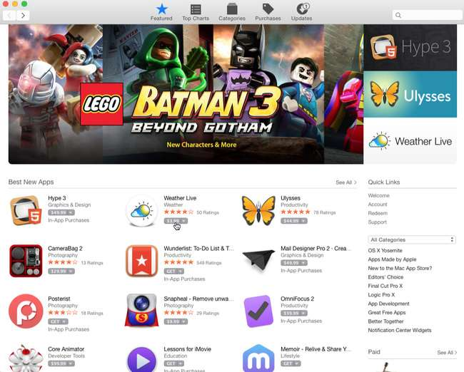
Installing applications on your Mac
The Mac App Store
If you're using macOS, you can download and install software from the Mac App Store.
The Mac App Store is meant to simplify the process of locating and installing software from third-party developers—when you find an app, you won't have to do any extra work to install it.

Slide 37
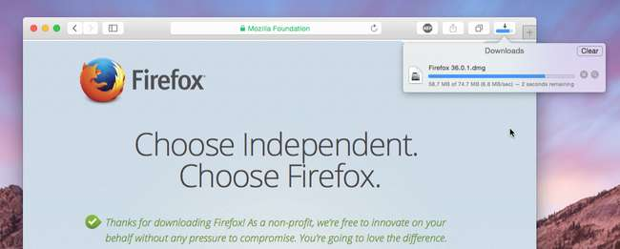
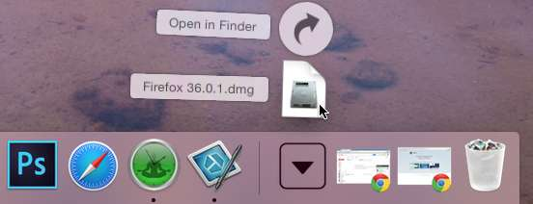
Installing applications on your Mac
1. Locate and download a .dmg file*.
2. Locate and select the .dmg file. (It will usually be in your Downloads folder.)
*A DMG file (short for Disk Image) is a type of file format used on Apple's macOS operating system
Notes:
https://edu.gcfglobal.org/en/basic-computer-skills/installing-software-on-your-windows-pc/1/

Slide 38
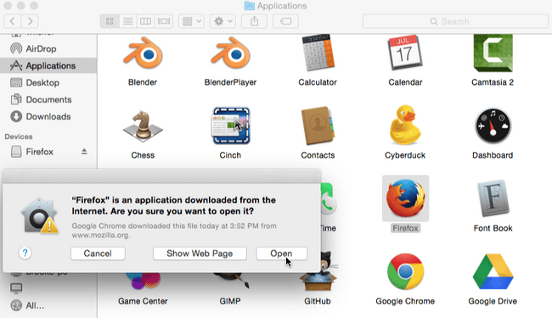
Installing applications on your Mac
3. A dialog box will appear. Click and drag the icon to your Applications folder.
4. The application is now installed!
You can double-click the icon to open the program.
Notes:
https://edu.gcfglobal.org/en/basic-computer-skills/installing-software-on-your-windows-pc/1/

Slide 39
Installing applications on your Mac
5. On the desktop, there will probably be a disk drive icon with the name of the application. This is known as a volume, and it is not needed after the application has been installed.
You can simply drag it into the Trash on the dock.
Notes:
https://edu.gcfglobal.org/en/basic-computer-skills/installing-software-on-your-windows-pc/1/

Slide 40
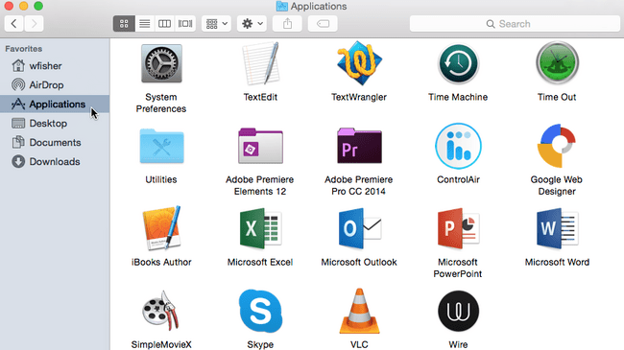
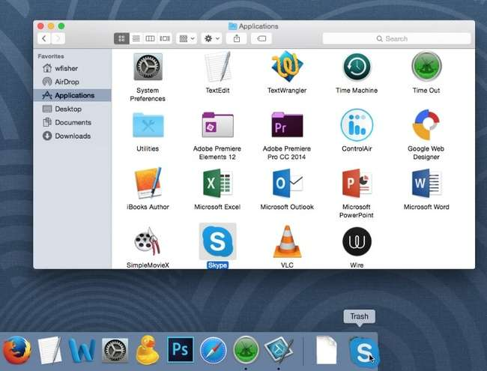
Uninstalling applications on your Mac
1. Open a new Finder window, then select Applications.
2. Locate the desired application, then click and drag it to the Trash Can on the Dock.
Notes:
https://edu.gcfglobal.org/en/basic-computer-skills/installing-software-on-your-windows-pc/1/

Slide 41
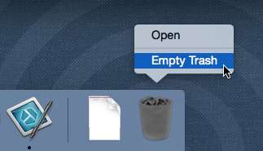
Uninstalling applications on your Mac
3. Empty the Trash Can.
That's it!
The application will be removed from your computer.
Notes:
https://edu.gcfglobal.org/en/basic-computer-skills/installing-software-on-your-windows-pc/1/

Slide 42
?
04 Internet connection
What is the Internet?

Slide 43
04 Internet connection
The INTERNET is a vast network that connects computers all over the world. Through the Internet, people can share information and communicate from anywhere with an Internet connection.
Once you've set up your computer, you may want to purchase home INTERNET ACCESS so you can send and receive email, browse the Web, stream videos, and more.
Designed by Freeepik

Slide 44
VIDEO CONTENT
Learn more about connecting to the Internet
by watching the video¹ below
Computer Basics: Connecting to the Internet
¹ Computer Basics: Connecting to the Internet [online video], @GCFLearnFree, Sep 2, 2020, https://youtu.be/93-3zmVvCGU
Notes:
https://youtu.be/93-3zmVvCGU

Slide 45
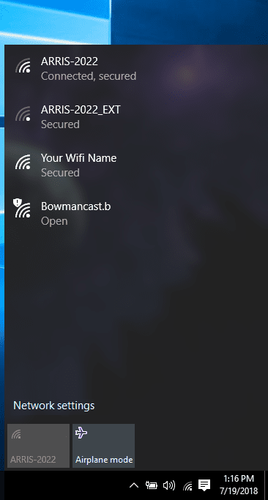
Connecting to the Internet
If you want to see even more information about your connection status, click the Network icon itself regardless of what status it currently displays.
or
This will bring up the Network menu. Within your network menu, you can see the status of your current connection.
If your device is capable of connecting to WiFi, you will also see a list of wireless networks your device is currently in range of.

Slide 46
Internet browsing, searching & filtering information
Most information on the Internet is on websites. Once you are connected to the Internet, you can access websites using a kind of application called a web browser.
A WEB BROWSER allows you to connect to and view websites. The web browser itself is not the Internet, but it displays pages on the Internet. Each website has a unique address. By typing this address into your web browser, you can connect to that website and your web browser will display it.

Slide 47
Internet browsing, searching & filtering information: the most used browsers/1
Best overall — Google Chrome
Supports Google services
Includes tab group management
Outperforms other browsers in tests
Best for security — Mozilla Firefox
Blocks cryptominers
Prevents fingerprinting
Stores passwords locally
Ranks the lowest for speed in tests
Best for customization — Vivaldi
Provides high customization
Protects against phishing
Syncs data between devices

Slide 48
Internet browsing, searching & filtering information: the most used browsers/2
Best for social media — Opera
Includes a built-in VPN client
Includes social tools
Verifies all websites
Best for Mac — Apple Safari
Provides a clean privacy report
Supports extensions
Displays tab previews
Competes with Chrome in speed on Mac
Best for Windows — Microsoft Edge
Stacks tabs vertically
Groups websites into Collections
Supports Dolby Audio and 4K
Competes with Chrome in speed on Windows

Slide 49
VIDEO CONTENT
Learn more about the basics of using a web browser
by watching the video¹ below
Browser Basics
¹ Browser Basics [online video], @GCFLearnFree, Jul 16, 2014, https://youtu.be/FxirRVJWUTs
Notes:
https://youtu.be/FxirRVJWUTs?si=Rn3--WtelHAT8EDZ

Slide 50
Internet browsing, searching & filtering information: search engines
A search engine is a system and program that makes it easy for all people to search the Internet and find answers on the Internet with the keywords and phrases they are searching for online. A search engine searches all of the online pages when someone types in a keyword to discover the result, and the process is very fast.
The top 5 search engines are very popular and useable for all:
GOOGLE
BING
YAHOO!
DUCKDUCKGO
BAIDU

Slide 51
Internet browsing, searching & filtering information: search engines
When it comes to starting a search, there are two common methods that are both easy to find and user-friendly.
Option 1: The homepage. Go to the search engine's homepage, for example google.com, and type your search terms into the text box.
To see your results, you can press the Enter key, or you can click an icon, such as the Google Search button or a magnifying glass.

Slide 52
Internet browsing, searching & filtering information: search engines
Option 2: Your browser's address bar. Depending on your browser, you may be able to conduct a search right from the browser's interface.
For example, in Chrome, you can enter your search term directly into the address bar (pictured below).

Slide 53
How do you assess online information – TIPS!
CHECK THE SOURCE - evaluate online content by scrutinizing its source. Examine authorship, credentials, affiliations, and potential biases. Explore website sections or conduct searches for details.
CHECK THE DATE - check online information's date, relevance, and source credibility. Examine headers, footers, metadata, URL, or citations for accuracy and timeliness.
CHECK THE EVIDENCE - check data accuracy, source credibility, proper citations, and alignment with other reliable sources.
CHECK THE PURPOSE - check if it informs, educates, persuades, entertains, sells; examine objectivity, bias, and suitability for needs.
CHECK THE QUALITY - assess online information by checking content quality, clarity, coherence, organization, grammar, visuals, and adherence to standards. Examine structure, functionality, and compare with other sources.
CHECK YOUR OWN BIAS - reflect on preconceptions, seek diverse perspectives, and address gaps or uncertainties in your thinking process.

Slide 54
Summary
This unit covers digital literacy, focusing on the Digital Literacy Framework (DigComp) and its key components. Particular emphasis is placed on data literacy because of the crucial role it plays in everyday life and in the care sector. Digital literacy includes an understanding of computers, mobile devices, hardware, software and the process of setting up and managing a computer. The basics of using Windows and MacOS are explored, along with installing and uninstalling applications. The unit also looks at connecting to the Internet, searching and filtering information online.

Slide 55
Self-Reflection Exercise
!
Time for
Self-Reflection

Slide 56
Self-Reflection Exercise
Next on, you will see questions related to the content of this unit.
Reflect on the questions and answer them in writing in your (digital) journal!

Slide 57
Self-Reflection Exercise
How can you integrate the key components of digital competence outlined in the DigComp framework into your daily work as a care assistant? Think about a specific situation where data literacy would be crucial in your role. How can you use data literacy skills to improve the quality of care you provide?
How can you use your understanding of computers, mobile devices, hardware and software in your daily care tasks and to improve communication with patients and colleagues? Think about a scenario where a computer needs to be set up. How can you do this effectively, or assist a patient in this process, given your digital literacy skills?
Consider a situation where a patient needs help to connect to the internet. How can you effectively guide them through the process? How can your knowledge of browsing, searching and filtering information on the Internet help you and the client find relevant information or engage in activities they enjoy online?

Slide 58
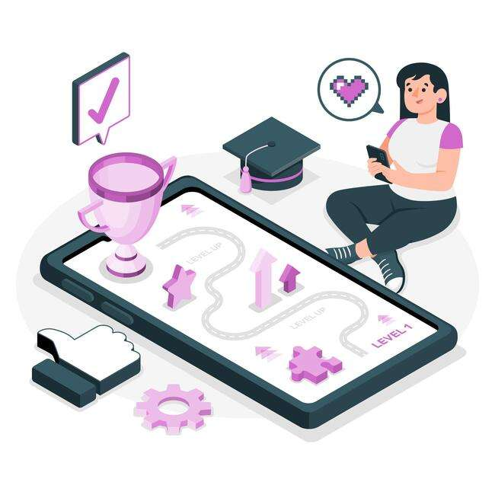
Congratulations, you completed Unit 1 of the Module 1.

Slide 59
This learning unit has been developed as part of an Erasmus+ KA2 project DiMiCare and is funded with the support from the European Union. The work is intended for educational purposes and is licensed under Creative Commons Attribution-NonCommercial-ShareAlike 4.0 International License @ The DiMiCare Consortium (except for referenced screenshots and content).
Funded by the European Union. Views and opinions expressed are however those of the author(s) only and do not necessarily reflect those of the European Union or OeAD-GmbH. Neither the European Union nor the granting authority can be held responsible for them

Slide 60
References/Resources
Skov, A. Center for Digital Dannelse 2016. What is Digital Competence? The digital competence wheel. Digital-competence.eu. https://digital-competence.eu/dc/en/front/what-is-digital-competence/ (accessed March 2024)
PMS Consulting, April 11, 2023. Digital Literacy in the Workplace: Why It's Crucial for Success. Linkedin.com. https://www.linkedin.com/pulse/digital-literacy-workplace-why-its-crucial-success-pms-consulting/ (accessed March 2024).
DigComp. EU Science Hub. Joint-research-centre.ec.europa.eu. https://joint-research-centre.ec.europa.eu/digcomp_en (accessed March 2024).
Aparna, Dec. 15, 2023. What is Computer? Definition, Characteristics and Classification. Careerpower.in. https://www.careerpower.in/school/computer/what-is-a-computer (accessed March 2024).
Indeed Editorial Team, Oct. 1, 2022. What Is a Software Program? Definition, Types and Benefits. Indeed.com. https://www.indeed.com/career-advice/career-development/what-is-software-program (accessed March 2024).
Fingent, January 2024. Types of Application Software: Guide for 2024. Fingent.com. https://www.fingent.com/blog/a-detailed-guide-to-types-of-software-applications/ (accessed March 2024).
Sayantoni Das, Oct. 19, 2023. What is Application Software? (With Examples). Simplilearn.com. https://www.simplilearn.com/tutorials/programming-tutorial/what-is-application-software (accessed March 2024).
Installing software on your Windows PC, Installing software on your Mac, Uninstalling software from your Windows PC, Uninstalling software from your Mac. GFC, Global, Creating Opportunity for a Better Life. Edu.gcfglobal.org. https://edu.gcfglobal.org/en/basic-computer-skills/installing-software-on-your-windows-pc/1/ (accessed March 2024).
Setting up a computer. GFC Global, Creating Opportunity for a Better Life. Edu.gcfglobal.org. https://edu.gcfglobal.org/en/computerbasics/setting-up-a-computer/1/ (accessed March 2024).
Dennis, M. A., Kahn, R., Feb 5, 2024. Internet, computer network. The Editors of Encyclopaedia Britannica. Britannica.com. https://www.britannica.com/technology/Internet (accessed March 2024).
How to Check Connection on Windows 10. RealDefense LLC, 2023. Techsolutions.support.com. https://www.techsolutions.support.com/how-to/how-to-check-connection-on-windows-10-10937 (accessed March 2024).
How do I connect to the Internet? GFC Global, Creating Opportunity for a Better Life. Edu.gcfglobal.org. https://edu.gcfglobal.org/en/computerbasics/connecting-to-the-internet/1/ (accessed March 2024).
Using a web browser. GFC Global, Creating Opportunity for a Better Life. Edu.gcfglobal.org. https://edu.gcfglobal.org/en/internetbasics/using-a-web-browser/1/ (accessed March 2024).
Parrish, K., Haynes, C., Dec 19, 2023. The Best Web Browsers of 2024. HighSpeedInternet.com. https://www.highspeedinternet.com/resources/best-web-browsers (accessed March 2024).
Introduction to searching online. GFC Global, Creating Opportunity for a Better Life. Edu.gcfglobal.org. https://edu.gcfglobal.org/en/search-better-2018/introduction-to-searching-online/1/ (accessed March 2024).
Batool, A., June 12, 2023. Best Top 5 Search Engines in 2023. LinkedIn.com. https://www.linkedin.com/pulse/best-top-5-search-engines-2023-ayesha-batool/ (accessed March 2024).
AI and the LinkedIn community, How do you assess online information? LinkedIn.com. https://www.linkedin.com/advice/0/how-do-you-assess-online-information-skills-critical-thinking (accessed March 2024).

Slide 62
Module 1
Basic digital competences
Unit 2
Communication and collaboration

Slide 63
01 What is the digital communication?
Benefits of Digital Communication
02 Different types of communication channels
Email
Instant Messaging
Instant Messaging Apps
What is a video call?
Video call Apps
Newsletter
Internet Forum
03 How to share data, information and digital contents
What is data sharing?
What are the benefits of data sharing in health care?
How to share data with internet connection
How to share data without internet connection
TABLE OF CONTENTS

Slide 64
Digital Communication
?
What is the
digital communication

Slide 65
01 What is the digital communication ?
Digital communication is the electronic exchange of information, data, or messages. It takes many forms and has become the communication standard for individuals and organizations over the past few decades.
When you send an email, text a friend, or post on social media, you're using digital communication. And with the introduction of new technologies, it has become a mainstay for our everyday interactions.

Slide 66
Benefits of Digital Communication/1
Digital tools have revolutionized the way we connect, making it faster, more efficient, and more accessible to talk to each other. Here are some of the main benefits of digital communication:
Faster: It’s almost instantaneous. Emails, instant messages, and text messages can be sent and received within seconds, making communication faster and more efficient.
Accessible: With an internet connection or a mobile device, people can reach one another anywhere and at any time.

Slide 67
Benefits of Digital Communication/2
Cost-Effective: It's generally cheaper than traditional communication methods. For example, VoIP and video conferencing are often less expensive than long-distance phone calls and in-person meetings.
Increased Productivity: Digital communication enables people to collaborate quickly and efficiently. It's handy for companies and organizations working across different time zones.
Environmentally-Friendly: Going digital reduces paper use and minimizes carbon emissions, making it a more environmentally friendly option.

Slide 68
02 Different types of communication channels
This session will introduce some types of communication channels, in particular: email, instant messaging with examples of apps, what is a video call with examples of some apps, what are newsletter and internet forum and their possible uses for care assistants.
Designed by Freeepik

Slide 69
E-mail
It is a message transmitted and received by digital computers through a network. An e-mail system allows computer users on a network to send text, graphics, sounds, and animated images to other users.
Network users typically have an electronic mailbox that receives, stores, and manages their correspondence. Recipients can elect to view, print, save, edit, answer, forward, or otherwise react to communications.
Examples of email providers: Gmail (Google), Yahoo! Mail (Yahoo), Outlook (Microsoft), iCloud Mail (Apple)
Click here to learn How to create a Gmail account
Designed by Freeepik

Slide 70
Instant Messaging
Instant Messaging is a form of text-based communication in which two persons participate in a single conversation over their computers or mobile devices within an Internet-based chatroom.
Instant Messaging could be used in health care to consult with medical specialists, share tests and exams, coordinate with colleagues.

Slide 71
Instant Messaging
WhatsApp allows users to send text, voice messages and video messages, make voice and video calls, and share images, documents, user locations, and other content. The service requires a cellular mobile telephone number to sign up.
How to download or uninstall WhatsApp
With Telegram, you can send messages, photos, videos and files of any type (doc, zip, mp3, etc). You can access your messages from several devices at once, including tablets and computers, and share an unlimited number of photos, videos and files (doc, zip, mp3, etc.) of up to 2 GB each.
How to download Telegram
Designed by Freeepik
Facebook Messenger is an instant messaging feature built into Facebook. It allows Facebook users to connect with each other and send instant messages, photos, videos, and perform other tasks. In order to use Facebook Messenger you must first have a Facebook account. If you already have a Facebook account, or just created one, you can continue by downloading the Facebook Messenger application from Google Play, App Store, Windows Phone Store, or by visiting Messenger.com.
Designed by Freeepik

Slide 72
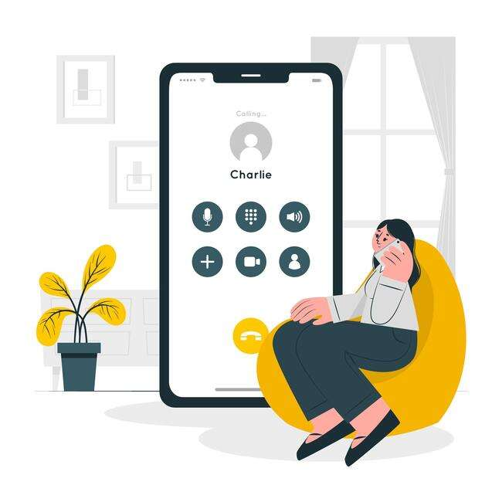
What is a video call?
A video call is a phone call using an Internet connection, sometimes called VoIP (Voice over Internet Protocol), that utilizes video to transmit a live picture of the person making the call.
Video calls are made using a computer's webcam or other electronic hardware devices with a video-capable camera, like a smartphone, tablet, or video-capable phone system. You may also need headphones with a microphone.
Designed by Freeepik

Slide 73
Video call apps - Skype
Skype is an instant messaging and video call service, a division of Microsoft.
It's built for both one-on-one and group conversations and works wherever you are – via mobile, PC.
With Skype, you can have meetings. It’s free to use – to send messages and have audio and video calls with groups of up to 100 people.
Designed by Freeepik

Slide 74
VIDEO CONTENT
Learn how to use Skype by watching the video¹ below
How to Download & Install Skype
¹ How to Download & Install Skype [online video], Technoboomers, Apr 15, 2017, https://www.youtube.com/watch?v=lb31wbnoz_c
Notes:
https://www.youtube.com/watch?v=lb31wbnoz_c

Slide 75
Video call apps – Google Meet
Google Meet is Google’s video conferencing app that’s available to everyone who has a Google account.
An online meeting is easy to set up whether you’re an individual getting together with a patient, medical expert or colleagues. You’re allowed to have up to 100 participants and can be in the meeting for as long as 60 minutes.
Click here to learn how to make video or voice calls with Google Meet
Designed by Freeepik

Slide 76
Video call apps – Zoom
Zoom is a video conferencing platform that can be used through a computer desktop or mobile app, and allows users to connect online for video conference meetings, webinars and live chat.
The app is available to download for free. The free services allows users to create unlimited meetings with up to 100 participants, although the time limit for group meetings is 40 minutes.
Click here to learn how to use Zoom
Designed by Freeepik

Slide 77
Newsletter
A newsletter is an electronic report containing news concerning the activities of a business or an organization that is sent to its members, customers, employees or other subscribers. Newsletters generally contain one main topic of interest to its recipients.
Subscribing to a newsletter can be useful for healthcare assistants to keep up to date with news from the Ministry of Health, associations, pharmacies, medical groups, etc.

Slide 78
How to subscribe to a newsletter
In order to subscribe to a newsletter you should complete the form that you will find in the website of the organization you want to be updated about:
1. Complete the mandatory fields with your name, surname and email address
2. Tick the privacy policy option
3. Click “Register/Sign up”
4. Confirm your subscription on the email you will receive

Slide 79
Internet Forum
Internet Forum is a website that provides an online exchange of information between people about a particular topic. It provides a venue for questions and answers and may be monitored to keep the content appropriate.
Joining an online forum can be useful for carers to update online with distant colleagues, receive medical consultations, get practical information on bureaucratic and administrative paperwork for the client.
Designed by Freeepik

Slide 80
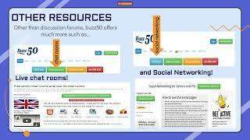
VIDEO CONTENT
Learn how to join an online forum by watching the video¹ below
How to Use Online Forums
¹ How to Use Online Forums [online video], Cyber-Seniors, Oct 5, 2022, https://www.youtube.com/watch?v=PsYfFfqV20c
Notes:
https://www.youtube.com/watch?v=PsYfFfqV20c

Slide 81
03 How to share data, information and digital
contents
?
What is data sharing

Slide 82
03 How to share data, information and digital
contents
Data sharing is the deliberate act of providing access to specific data sets, either internally within a company or externally to other colleagues, medical experts, patients, etc.
The types of data shared can vary widely, like pictures, documents, medical exams, medical prescriptions etc. It’s crucial to manage and share data responsibly to ensure it serves its intended purpose without compromising any patient’s interests.
Designed by Freeepik

Slide 83
What are the benefits of data sharing in health care?
Data sharing in healthcare has numerous benefits, significantly enhancing patient care, research, and the overall efficiency of health systems.
For example:
give a more complete view of a patient’s health history, leading to better-informed decisions and more comprehensive;
enable more personalized healthcare, where treatments can be tailored to the specific characteristics of an individual patient;
patients have access to their own health data;
reduce time and costs for medical consultations.
Designed by Freeepik

Slide 84
How to share data with internet connection
If you have an internet connection you can save and share data, documents, pictures through these digital tools:
WeTransfer, Google Drive, Dropbox.
Designed by Freeepik

Slide 85
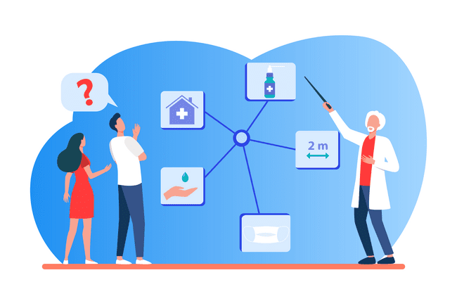
How to share data with internet connection
WeTransfer is a Dutch internet-based computer file transfer service company that was founded in 2009. It is based in Amsterdam, the Netherlands.
WeTransfer also falls into the basic-free-and-fast camp, at least if you want to send files smaller than 2GB. You can upgrade to WeTransfer Pro, which sends up to 200GB of data at once, password-protects the shared files, and allows you to set custom expiration dates on the download links.
Designed by Freeepik

Slide 86
VIDEO CONTENT
Learn how to use WeTransfer by watching the video¹ below
How to use WeTransfer file transfer service
¹ How to use WeTransfer file transfer service [online video], Care home Marketing Expert, Dec 13, 2018, https://www.youtube.com/watch?v=gmzMsSCKj4E
Notes:
https://www.youtube.com/watch?v=gmzMsSCKj4E

Slide 87
How to share data with internet connection
Google Drive enables users to store and access files online. The service syncs stored documents, photos and more across all the user's devices, including mobile devices, tablets and PCs.
In Google Drive you have 15 GB of free space across Drive, Gmail, and Google’s other apps. If this space is not enough for your needs, you can upgrade your account for more GB with a paid service.
Designed by Freeepik

Slide 88
VIDEO CONTENT
Learn how to share files on Google Drive by watching the video¹ below
How To Share Files On Google Drive
¹ How To Share Files On Google Drive [online video], WebPro Education, Mar 29, 2019, https://www.youtube.com/watch?v=6yYvvZSz5XI
Notes:
https://www.youtube.com/watch?v=6yYvvZSz5XI

Slide 89
How to share data with internet connection
Dropbox is a storage service that enables users to store files securely online and access them from virtually anywhere with an internet connection. Its functionality extends beyond mere storage, offering an array of features designed to streamline file synchronization, sharing, and collaboration.
Designed by Freeepik

Slide 90
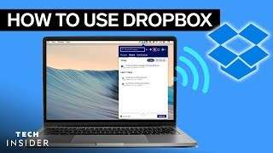
VIDEO CONTENT
Learn how to use Dropbox by watching the video¹ below
How To Use Dropbox
¹ How To Use Dropbox [online video], Insider Tech, Feb 12, 2021, https://www.youtube.com/watch?v=Bp_BHX4ZbOI
Notes:
https://www.youtube.com/watch?v=Bp_BHX4ZbOI

Slide 91
How to share data without internet connection
If you don’t have an internet connection you can share data, documents, pictures through the Bluetooth technology.
Designed by Freeepik

Slide 92
How to share data without internet connection
Bluetooth is a wireless radio technology that allows many different devices to connect to each other and work together. It was originally invented as an affordable wireless alternative to wired keyboards, headphones, speakers, and other peripherals. Many kinds of devices use Bluetooth, including cell phones, stereos, health monitors, and safety trackers. Almost any wireless device you encounter might use Bluetooth technology.
Click here to learn how to use and connect Bluetooth devices
Designed by Freeepik

Slide 93
Summary
In this unit, essential proficiency has been gained in understanding digital communication, its benefits, and the various channels it encompasses. You have explored the significance of email, instant messaging apps, and video calls for interpersonal interactions, as well as the effectiveness of newsletters and internet forums for broader communication purposes; you have learned practical skills in sharing data and digital content using platforms like WeTransfer, Google Drive, and Dropbox, ensuring seamless collaboration across multiple devices. Additionally, a comprehensive understanding of the Bluetooth technology has been acquired.​

Slide 94
Self-Reflection Exercise
!
Time for
Self-Reflection

Slide 95
Self-Reflection Exercise
Next on, you will see questions related to the content of this unit.
Reflect on the questions and answer them in writing in your (digital) journal!

Slide 96
Self-Reflection Exercise
What key aspect of digital communication do you find most impactful or intriguing? How might you apply this concept in your daily life or work?​
Can you recall a situation where recognizing the benefits of different types of communication channels could be essential? How might leveraging these channels effectively improve your communication outcomes in that scenario?​
After learning about various methods for sharing data and digital content through different tools, which approach do you believe is most efficient or practical? How might utilizing this method streamline your workflow and collaboration efforts across multiple devices or platforms?​

Slide 97
Congratulations, you completed Unit 2 of the Module 1.

Slide 98
This learning unit has been developed as part of an Erasmus+ KA2 project DiMiCare (2022-1-AT01-KA220-VET-000085278) and is funded with the support from the European Commission.

Slide 99
This learning unit has been developed as part of an Erasmus+ KA2 project DiMiCare and is funded with the support from the European Union. The work is intended for educational purposes and is licensed under Creative Commons Attribution-NonCommercial-ShareAlike 4.0 International License @ The DiMiCare Consortium (except for referenced screenshots and content).
Funded by the European Union. Views and opinions expressed are however those of the author(s) only and do not necessarily reflect those of the European Union or OeAD-GmbH. Neither the European Union nor the granting authority can be held responsible for them

Slide 100
References/Resources
Sana Ashraf (2023). Digital Communication: What It Is and Where It's Headed. Airalo.com. https://www.airalo.com/blog/digital-communication-what-it-is-and-where-its-headed ​(accessed March 2024).
Create a Gmail account. Support.google.com. https://support.google.com/mail/answer/56256?hl=en&ref_topic=7065107&sjid=16374137821709521462-EU ​​(accessed March 2024).
Gary W. Larson (2024). Instant messaging. Britannica.com. https://www.britannica.com/topic/instant-messaging ​(accessed March 2024).
WhatsApp. Wikipedia.org. https://it.wikipedia.org/wiki/WhatsApp ​(accessed March 2024).
How to download or uninstall WhatsApp. Faq.whatsapp.com. https://faq.whatsapp.com/807139050546238/?helpref=hc_fnav&cms_platform=android​ ​(accessed March 2024).
How to use Zoom for beginners. Support.zoom.com. https://support.zoom.com/hc/en/article?id=zm_kb&sysparm_article=KB0059590#h_01FS896ZWMFKY14JBB4RQVDZ19​ ​(accessed March 2024).
Newsletter. Wikipedia.org. https://en.wikipedia.org/wiki/Newsletter ​(accessed March 2024).
Internet Forum. Pcmag.com. https://www.pcmag.com/encyclopedia/term/internet-forum​​ (accessed March 2024).
What is data sharing? Atlan.com. https://atlan.com/benefits-of-data-sharing/#what-is-data-sharing​ ​(accessed March 2024).
What are the benefits of data sharing in health care? Atlan.com. https://atlan.com/benefits-of-data-sharing/​ ​(accessed March 2024).
WeTransfer. Wikipedia.org. https://en.wikipedia.org/wiki/WeTransfer ​(accessed March 2024).
David Nield (2022). How to share huge files online. Popsci.com. https://www.popsci.com/share-huge-files-online/​ ​(accessed March 2024).
Erica Mixon, Ivy Wigmore (2023). What is Google Drive?. Techtarget.com. https://www.techtarget.com/searchmobilecomputing/definition/Google-Drive ​(accessed March 2024).
Linika Ghosh (2023). What is Dropbox? How does it work?. Znetlive.com. https://www.znetlive.com/blog/what-is-dropbox-how-does-it-work/​ ​(accessed March 2024).
What is Telegram? What do I do here?. Telegram.org. https://telegram.org/faq#q-what-is-telegram-what-do-i-do-here ​(accessed March 2024).
Messaging basics. Messenger.com. https://www.messenger.com/help/345021679200618/?helpref=hc_fnav​ ​(accessed March 2024).
Video call. Computerhope.com https://www.computerhope.com/jargon/v/video-call.htm ​(accessed March 2024).
Everything you need to know about Google Meet. Sherweb.com https://www.sherweb.com/blog/g-suite/google-meet/ ​(accessed March 2024).
Make video or voice calls with Google Meet. Support.google.com https://support.google.com/phoneapp/answer/12387460?hl=en&co=GENIE.Platform%3DAndroid​ ​(accessed March 2024).
What is Zoom Video Conferencing?. Support.zoom.com. https://support.zoom.com/hc/en/article?id=zm_kb&sysparm_article=KB0059590 ​(accessed March 2024).
What is Bluetooth?. Gcfglobal.org. https://edu.gcfglobal.org/en/mobile-device-tips/what-is-bluetooth/1/# ​(accessed March 2024).
Spike Baron (2023). A Beginner's Guide to Use and Connect Bluetooth Devices. Wikihow.com. https://www.wikihow.com/Use-a-Bluetooth-Device ​(accessed March 2024).

Slide 102
Module 1
Basic digital competences
Unit 3
Digital Content Creation

Slide 103
01 Digital Content Creation
What is digital content?
Digital tools for creating and managing text content
02 Microsoft Excel: the basics
What is Microsoft Excel?
Enter data into a spreadsheet
Enter a simple formula
Create a named range from selected cells in a worksheet
Insert or delete rows and columns
Sort and filter data
Create and format tables
Print an Excel document
03 Microsoft Word: the basics
What is Microsoft Word?
Create a document in Word
Add and edit text
Insert tables and pictures
Save and print a document
TABLE OF CONTENTS

Slide 104
01 Digital Content Creation
?
What is
digital content?

Slide 105
01 Digital Content Creation
Digital content is almost everything that we are faced with when we turn on our computer and that we find on the World Wide Web. This includes various forms of:
Text files
Image files
Video files
Audio files
Even when you write and send an email, you have created digital content and transmitted information.
In this Unit we will present some useful tools for care assistants to create and manage text content.

Slide 106
Digital tools for creating and managing text content
Care assistants play a crucial role in providing support and assistance to individuals who may need help with daily activities due to age, illness, or disability.
In addition to their hands-on caregiving tasks, they often engage in administrative tasks and documentation.
Care assistants need to incorporate some digital tools into their daily work to streamline administrative processes, improve documentation accuracy and increase overall efficiency in delivering quality care.

Slide 107
Digital tools for creating and managing text content
Microsoft Office can be valuable tool for care assistants in creating and managing text content.
By effectively utilizing it, care assistants can streamline their administrative tasks, improve communication, and enhance the overall quality of care provided to individuals in need.

Slide 108
Digital tools for creating and managing text content
Microsoft Office is an office software package that is considered to be the most widely used of its kind for both personal and business use.
The package, developed by Microsoft, includes various programs for text and data processing.
Some of the most popular programs are Word, Excel, PowerPoint, Access and Outlook.
The Office package is available for a fee in different versions for Windows and MacOS on PC and mobile versions. The price and components included vary by model. If you buy a Windows operating system or a computer that comes with it pre-installed, you will receive a trial version of Microsoft Office.

Slide 109
Digital tools for creating and managing text content
In this unit, we will give you the basics of using two of Microsoft's main tools for content creation:
Microsoft Word
Microsoft Excel

Slide 110
Digital tools for creating and managing text content
Microsoft Word for basic text content creation and data management:
Documentation and Reports:
Create and format care plans, progress reports, and incident documentation.
Utilize templates to streamline the creation of standard documents.
Insert tables for easy organization of information, such as medication schedules or daily routines.
Communication:
Draft letters and emails for communication with healthcare professionals, residents, or their families.
Use the review features for collaborative editing, ensuring accurate and well-reviewed content.

Slide 111
Digital tools for creating and managing text content
Microsoft Excel for basic text content creation and data management:
Data Management:
Maintain a database of patient information, including medical history and preferences.
Track medication schedules, appointments, and other essential details.
Budgeting and Finance:
Create and manage budgets for resident care and tracking expenses.
Use formulas for automatic calculations.
Task Lists:
Generate to-do lists for daily tasks and reminders.
Apply filters and sorting options to organize tasks based on priority or urgency.

Slide 112
03 Microsoft Word: the basics
?
What is Microsoft Word

Slide 113
03 Microsoft Word: the basics
Microsoft Word is a word processor software that allows you to create and edit texts. It differs from a text editor because it allows the use of complex formatting (bold, italic, underlined text), characters of different sizes and the use of fonts.
Microsoft Word is a Microsoft product and is covered by copyright, it is distributed under a commercial license; It is part of the Microsoft Office suite of personal productivity software, and is available for Windows and MacOS operating systems.

Slide 114
03 Microsoft Word: the basics
Microsoft Word can be used for the following purposes:
Creating documents with various graphics, including images and diagrams.
Creating letters and letterheads for personal and business purposes.
Designing curricula vitae or invitation cards.
Saving and reusing pre-built and formatted content such as cover pages.
Designed by Freeepik

Slide 115
Create a document in Word
In the screen capture you can see the ribbon (A), which is the heart of the interface.
It offers you a nice overview of all setting options for the program.

Slide 116
Create a document in Word
Furthermore, you can see different tabs (B) in the screen capture above. These contain various function groups (C), in which you can choose some settings.
In the workspace (D) you can create your content, for example a text with pictures.

Slide 117
Create a document in Word
On this screen you can see that the "Start" tab is open.
This is divided into the function groups "Clipboard", "Font”, and "Styles”.
In the "File" tab you can create a new document or insert an existing document, as well as other files. The user interface is structured the same way in every Microsoft Office program and differs only in its functions.

Slide 118
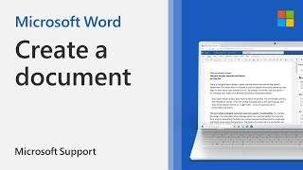
VIDEO CONTENT
Learn more about how to create a document using Word by watching the video¹ below
Create a document
¹ Create a document, [online video], Microsoft Support, https://support.microsoft.com/en-us/office/create-a-document-28508ada-9a3c-4333-a17b-cb29723eb64c
Notes:
Create a document - Microsoft Support

Slide 119
Exercise
Open Word.
Select Blank document.
Or, if Word is already open, select File > New > Blank document.
To create a document using a template
Open Word. Or, if Word is already open, select File > New.
Double-click a template to open it.

Slide 120
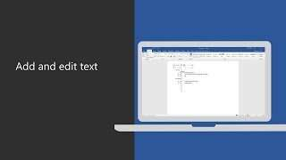
VIDEO CONTENT
Learn more about how to add and edit text by watching the following video¹
Add and edit text
¹ Add and edit text, [online video], Microsoft Support, https://support.microsoft.com/en-us/office/add-and-edit-text-ed1e3147-a846-41ca-8087-49e324cb50bd
Notes:
https://support.microsoft.com/en-us/office/add-and-edit-text-ed1e3147-a846-41ca-8087-49e324cb50bd

Slide 121
Exercise
Add text
Place the cursor where you want to add the text.
Start typing.

Slide 122
Exercise
Replace text
Select the text you want to replace.
To select a single word, double-click it.
To select a line, click to the left of it.
Start typing.

Slide 123
Exercise
Format text
Select the text you want to format.
From the pop up toolbar or the Home tab, select an option to change the Font, Font Size, Font Color, or make the text bold, italics, or underline.

Slide 124
Exercise
Copy formatting
Select the text with the formatting you want to copy.
Click Format Painter icon Format painter, and then select the text you want to copy the formatting to.

Slide 125
VIDEO CONTENT
Learn more about how to change document layout by watching the video¹ provided by Microsoft
“Change document layout”
Please click here to watch the video
¹ Change document layout, [online video], Microsoft Support, https://support.microsoft.com/en-au/office/change-document-layout-d8eae84b-756b-4e7d-8b3d-7fbcb41e50cc
Notes:
https://support.microsoft.com/en-au/office/change-document-layout-d8eae84b-756b-4e7d-8b3d-7fbcb41e50cc

Slide 126
Exercise
Margins
Select Layout > Margins.
Choose the margins you want or select Custom Margins to define your own.
Page Orientation
To change orientation, select Layout > Orientation.
Select Portrait or Landscape.
Line Spacing
Select Home > More Paragraph Options > Line Spacing.
Choose the spacing you want

Slide 127
Insert tables and pictures
Insert a table or picture into your document to give it structure or a visual touch.
Insert a table
Select Insert > Table.
Highlight the number of columns and rows you want, and then select them.
To create a larger table, select Insert > Table > Insert Table.
Choose the number or columns and rows you want.

Slide 128
Save and print a document
Save your document, so you don't lose all your hard work, then print it to share it with others.
On the File tab, select Save As or Save a Copy.
In the Save dialog, select a location (like your desktop)
Update the name and file type if you want, and select Save file button in the save dialog Save.

Slide 129
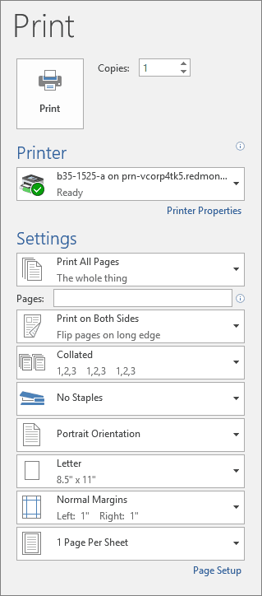
Save and print a document
Preview your document
Select File > Print.
To preview each page, select the forward and backward arrows at the bottom of the page.
If the text is too small to read, use the zoom slider at the bottom of the page to enlarge it.
Choose the number of copies, and any other options you want, and select the Print button.

Slide 130
VIDEO CONTENT
Learn more about how to how to save Microsoft Word documents in different file formats by watching the video¹ below
How to save Microsoft Word documents in different file formats
¹ How to save Microsoft Word documents in different file formats, [online video], Intelos, Jan 10, 2023 https://www.youtube.com/live/Dru5Yw-_ec8?si=VmIqyxoogFx3WKwO
Notes:
https://www.youtube.com/live/Dru5Yw-_ec8?si=VmIqyxoogFx3WKwO

Slide 131
02 Microsoft Excel: the basics
?
What is Microsoft Excel

Slide 132
02 Microsoft Excel: the basics
Microsoft Excel is a programme developed by Microsoft for creating and managing spreadsheets.
It is part of the Microsoft Office suite of personal productivity software and is available for Microsoft Windows and MacOS operating systems.
Excel is an incredibly powerful tool for extracting meaning from large amounts of data. But it also works really well for simple calculations and tracking almost any kind of information.
The key to unlocking all this potential is the grid of cells. Cells can hold numbers, text or formulas. You enter data into your cells and group them into rows and columns. This allows you to add up your data, sort and filter it, put it in tables and create great-looking charts.

Slide 133
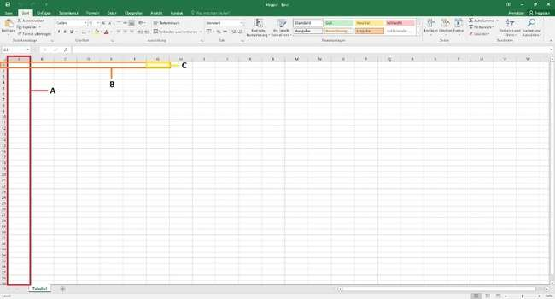
Enter data into a spreadsheet
This screenshot shows an empty Excel document.
The document is divided into columns (A) and rows (B).
The columns are arranged in alphabetical order and the rows are numbered consecutively.
The highlighted field (C) is therefore in position G1.

Slide 134
Enter data into a spreadsheet
Some of the applications of Microsoft Excel are used to create:
All kinds of calculations
Graphs and charts
Calendars and schedules
Task lists
Forms
Email lists
Data analysis
and much more...

Slide 135
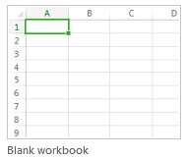
Enter data into a spreadsheet
Excel documents are called workbooks.
Each workbook has sheets, typically called spreadsheets. You can add as many sheets as you want to a workbook, or you can create new workbooks to keep your data separate.
Click File, and then click New.
Under New, click the Blank workbook

Slide 136
Exercise
Enter data
Click an empty cell.
For example, cell A1 on a new sheet.
Cells are referenced by their location in the row and column on the sheet, so cell A1 is in the first row of column A.
2. Type text or a number in the cell.
3. Press Enter or Tab to move to the next cell.

Slide 137
Enter a simple formula
Adding numbers is just one of the things you can do, but Excel can do other math as well. Try some simple formulas to add, subtract, multiply, or divide your numbers.
1. Select a cell, and then type an equal sign (=).
That tells Excel that this cell will contains a formula
2. Type a combination of numbers and calculation operators, like the plus sign (+) for addition, the minus sign (-) for subtraction, the asterisk (*) for multiplication, or the forward slash (/) for division.
3. Press Enter.
This runs the calculation.
You can also press Ctrl+Enter to keep the cursor on the active cell.
For more information, see Create a simple formula

Slide 138
Create a named range from selected cells in a worksheet
You can quickly create a named range by using a selection of cells in the worksheet.
Select the range you want to name, including the row or column labels.
Click Formulas > Create from Selection.
Need more help?
You can always ask an expert in the Excel Tech Community or get support in Communities
In the Create Names from Selection dialog box, select the checkbox (es) depending on the location of your row/column header. If you have only a header row at the top of the table, then just select Top row. Suppose you have a top row and left column header, then select Top row and Left column options, and so on.
Click OK

Slide 139
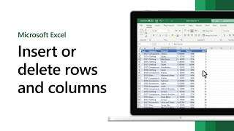
VIDEO CONTENT
Learn more about how to insert and delete rows and columns to better organise your worksheet by watching the video¹ below
Insert or delete rows and columns
¹ Insert or delete rows and columns, [online video], Microsoft Support, https://support.microsoft.com/en-us/office/insert-or-delete-rows-and-columns-6f40e6e4-85af-45e0-b39d-65dd504a3246#ID0EBBH=Windows
Notes:
https://support.microsoft.com/en-us/office/insert-or-delete-rows-and-columns-6f40e6e4-85af-45e0-b39d-65dd504a3246#ID0EBBH=Windows

Slide 140
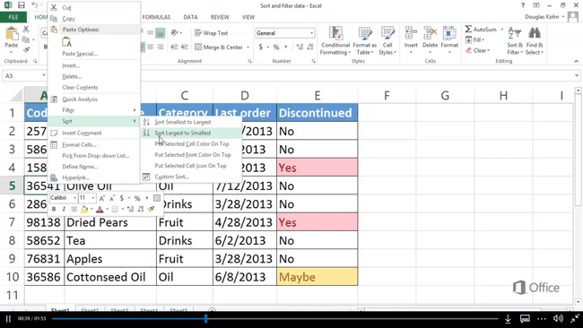
Sort and filter data
Excel is an amazing tool for analyzing data.
And sort and filter are some of the most commonly used features to help you do this:
- to change the order of your data, sort it.
- to focus on a specific set of data, filter a range of cells or a table.

Slide 141
Exercise
Select the data that you want to sort
Select a range of data, such as A1:L5 (multiple rows and columns), or C1:C80 (a single column). The range can include titles (headers) that you create to identify columns or rows.
Sort quickly
Select a single cell in the column you want to sort.
Click Sort A to Z to perform an ascending sort (A to Z or smallest number to largest).
Click Sort Z to A to perform a descending sort (Z to A or largest number to smallest).

Slide 142
VIDEO CONTENT
Learn more about sorting and filtering data by watching the video¹ provided by Microsoft
Sort and filter data
Please click here to watch the video
¹ Sort and filter data, [online video], Microsoft Support, https://support.microsoft.com/en-us/office/video-sort-data-in-a-range-or-table-ffb9fcb0-b9cb-48bf-a15c-8bec9fd3a472
Notes:
https://support.microsoft.com/en-us/office/video-sort-data-in-a-range-or-table-ffb9fcb0-b9cb-48bf-a15c-8bec9fd3a472

Slide 143
Create and format tables
Select a cell within your data.
Select Home > Format as Table.
Choose a style for your table.
In the Create Table dialog box, set your cell range.
Mark if your table has headers.
Select OK.

Slide 144
VIDEO CONTENT
Learn more about how to create and format tables by watching the video below
Create data entry forms
Notes:
https://support.microsoft.com/en-us/office/create-and-format-tables-e81aa349-b006-4f8a-9806-5af9df0ac664

Slide 145
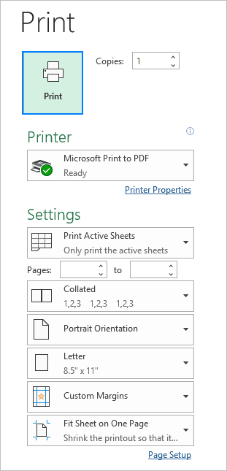
Print an Excel
Print Excel worksheets and workbooks one at a time, or several at one time.
You can also print a partial worksheet, such as an Excel table.

Slide 146
VIDEO CONTENT
Learn more about how to print worksheets and workbooks
by watching the video¹ provided by Microsoft
Print worksheets and workbooks
Click here to watch the video
¹ Print worksheets and workbooks, [online video], Microsoft Support, https://support.microsoft.com/en-us/office/video-print-worksheets-and-workbooks-a86daa14-f63a-41d2-8043-1f3c0fa57076
Notes:
https://support.microsoft.com/en-us/office/video-print-worksheets-and-workbooks-a86daa14-f63a-41d2-8043-1f3c0fa57076

Slide 147
Print an Excel
Here are other useful links for more complex printing of excel documents:
More print options VIDEO HERE
Print specific pages VIDEO HERE
Print headings, gridlines, and formulas VIDEO HERE

Slide 148
Summary
In this unit, you have developed essential proficiency in Digital Content Creation, focusing on Microsoft Word and Excel.
You have mastered a range of skills, including document creation/editing, and text manipulation methods in Word.
In Excel, you have gained expertise in tasks such as data entry, formula creation, sorting/filtering, and formatting tables. These skills empower you to produce documents and reports to excel in your daily tasks and make a positive impact in your professional journeys.

Slide 149
Self-Reflection Exercise
!
Time for
Self-Reflection

Slide 150
Self-Reflection Exercise
Next on, you will see questions related to the content of this unit.
Reflect on the questions and answer them in writing in your (digital) journal!

Slide 151
Self-Reflection Exercise
What key aspect of digital content creation with Word and Excel do you find most significant? How might you apply this concept in your daily life or work?
Can you recall a situation in your personal or professional life where effectively utilizing digital content creation tools like Word and Excel was crucial? How did your proficiency in these tools impact the outcome of that situation?
After learning about various features and functionalities in digital content creation with Word and Excel, which aspect do you believe is most valuable for care assistants?

Slide 152
Congratulations, you completed Unit 3 of the Module 1.

Slide 153
This learning unit has been developed as part of an Erasmus+ KA2 project DiMiCare and is funded with the support from the European Union. The work is intended for educational purposes and is licensed under Creative Commons Attribution-NonCommercial-ShareAlike 4.0 International License @ The DiMiCare Consortium (except for referenced screenshots and content).
Funded by the European Union. Views and opinions expressed are however those of the author(s) only and do not necessarily reflect those of the European Union or OeAD-GmbH. Neither the European Union nor the granting authority can be held responsible for them

Slide 154
References/Resources
Cordray, J., October 10, 2023. Should Healthcare Professionals Create Content? LinkedIn.com. https://www.linkedin.com/pulse/should-healthcare-professionals-create-content-john-cordray/ (accessed March 2024).
Microsoft Word, Microsoft.com. https://www.microsoft.com/it-it/microsoft-365/word?market=it (accessed March 2024).
Microsoft Excel, Microsoft.com. https://www.microsoft.com/it-it/microsoft-365/excel?market=it (accessed March 2024).
Enter data manually in worksheet cells, Microsoft Support, Microsoft.com. https://support.microsoft.com/en-us/office/enter-data-manually-in-worksheet-cells-c798181d-d75a-41b1-92ad- (accessed March 2024). 6c0800f80038#:~:text=On%20the%20worksheet%2C%20click%20a,break%20by%20pressing%20ALT%2BENTER (accessed March 2024).
Create a document in Word. Microsoft Support. Microsoft.com. https://support.microsoft.com/en-us/office/create-a-document-28508ada-9a3c-4333-a17b-cb29723eb64c (accessed March 2024).
Add and edit a ext in Word, Microsoft Support. Microsoft.com. https://support.microsoft.com/en-us/office/add-and-edit-text-ed1e3147-a846-41ca-8087-49e324cb50bd (accessed March 2024).
Document layout, Microsoft Support. Microsoft.com. https://support.microsoft.com/en-au/office/change-document-layout-d8eae84b-756b-4e7d-8b3d-7fbcb41e50cc (accessed March 2024).
Insert tables and pictures in your document. Microsoft Support. Microsoft.com. https://support.microsoft.com/en-us/office/insert-tables-and-pictures-9e2be863-fcb8-4f20-af24-905121643da8 (accessed March 2024).
How to Save Microsoft Word Documents in Different File Formats. Microsoft Support. Microsoft.com. https://www.youtube.com/watch?v=Dru5Yw-_ec8 (accessed March 2024).
Save a Word document. Microsoft Support. Microsoft.com. https://support.microsoft.com/en-us/office/video-save-a-word-document-fb0f9081-7c62-4fbf-954d-81b9707c0678 (accessed March 2024).
Print a document in word. Microsoft Support. Microsoft.com. https://support.microsoft.com/en-us/office/print-a-document-in-word-591022c4-53e3-4242-95b5- (accessed March 2024). 58ca393ba0ee#:~:text=Select%20File%20%3E%20Print.,and%20select%20the%20Print%20button (accessed March 2024).
Create a simple formula in Excel. Microsoft Support. Microsoft.com. https://support.microsoft.com/en-au/office/create-a-simple-formula-3d90ac89-8ad8-4674-8d8b-4017c86d1a11 (accessed March 2024).
Create a named range from selected cells in a worksheet. Microsoft Support. Microsoft.com. https://support.microsoft.com/en-us/office/create-a-named-range-from-selected-cells-in-a-worksheet-fd8905ed-1130-4cca-9bb0-ad02b7e594fd (accessed March 2024).
Excel 2013 training. Print worksheets and workbooks. Microsoft Support. Microsoft.com. https://support.microsoft.com/en-us/office/video-print-worksheets-and-workbooks-a86daa14-f63a-41d2-8043-1f3c0fa57076 (accessed March 2024).
Sort and filter data. Microsoft Support. Microsoft.com. https://support.microsoft.com/en-au/office/video-sort-data-in-a-range-or-table-ffb9fcb0-b9cb-48bf-a15c-8bec9fd3a472 (accessed March 2024).
Create and format tables. Microsoft Support. Microsoft.com. https://support.microsoft.com/en-au/office/video-sort-data-in-a-range-or-table-ffb9fcb0-b9cb-48bf-a15c-8bec9fd3a472 (accessed March 2024).
More print options. Microsoft Support. Microsoft.com. https://support.microsoft.com/en-us/office/video-more-print-options-4c22fa89-d8b2-45a5-993f-461a66c046c4 (accessed March 2024).
Print specific pages. Microsoft Support. Microsoft.com. https://support.microsoft.com/en-us/office/video-print-a-worksheet-on-a-specific-number-of-pages-bc7d8a8b-48a1-485c-a091-23fb9f300a57 (accessed March 2024).
Print headings, gridlines, and formulas. Microsoft Support. Microsoft.com. https://support.microsoft.com/en-us/office/video-print-headings-gridlines-formulas-and-more-1e0adb41-cc93-4299-b862-c53ba6d31b54 (accessed March 2024).

Slide 156
Module 1
Basic Digital Competences
Unit 4
Problem solving

Slide 157
01 Problem Solving
Definition and phases
Digital Problem Solving
Troubleshooting
Digital problem-solving skills for healthcare
02 Identification of the problem
How to identify a problem in the hardware
List of problems that can affect the hardware
How to identify a problem in the software
Anti-virus / Anti-malware software
List of problems that can affect the software
03 Support and Resources
Internet research
Where to find professional assistance for devices
TABLE OF CONTENTS

Slide 158
?
01 Problem solving
What is
Problem Solving

Slide 159
Problem solving
Problem solving is the act of defining a problem, determining the cause of the problem, identifying, prioritizing, and selecting alternatives for a solution, and implementing a solution¹.
Most Important Digital Skills
What skills will employees need to succeed in the next five years.
Most important 21st century workplace skill: Problem solving (85,3%).
¹ https://asq.org/quality-resources/problem-solving

Slide 160
Definition and phases
What are the 4 phases of problem solving:
the method for solving problems.
Define the problem
Generate new ideas
Evaluate and select solutions
Implement and evaluate
DEFINE A PROBLEM
GENERATE NEW IDEAS
IMPLEMENT AND EVALUATE
EVALUATE AND SELECT SOLUTIONS

Slide 161
Digital Problem Solving
Digital problem solving is the ability “to identify needs and problems, and to resolve conceptual problems and problem situations in digital environments. To use digital tools to innovate processes and products. To keep up-to-date with the digital evolution.” ²
Designed by Freeepik
² EU COMMISSION; EU Science Lab https://joint-research-centre.ec.europa.eu/digcomp/digcomp-framework_en

Slide 162
Troubleshooting
In digital jargon, digital problem solving is called troubleshooting, that is a form of problem solving, often applied to repair failed products or processes on a machine or a system. It is a logical, systematic search for the source of a problem in order to solve it and make the product or process operational again. Troubleshooting is needed to identify the symptoms. Determining the most likely cause is a process of elimination potential causes of a problem. Finally, troubleshooting requires confirmation that the solution restores the product or process to its working state.

Slide 163
Troubleshooting
Basic troubleshooting typically involves a simplified set of phases:
Identification of the problem: Recognize and understand the symptoms or issues affecting the system/device.
Isolation: Narrow down the possible causes and identify the general area or component where the problem originates.
Solution Implementation: Apply a straightforward solution based on common issues, such as restarting the system, checking connections, or adjusting settings.
Verification: Confirm whether the applied solution resolves the issue by checking if the symptoms persist

Slide 164
Digital problem-solving skills for healthcare
In informal healthcare, digital problem-solving skills are crucial. They allow individuals to independently fix technical issues on computers and mobile devices, ensuring continuous access to health apps and online resources. This self-reliance promotes better health management and access to care, especially in informal settings.
Designed by Freeepik

Slide 165
?
02 Identification of the problem
How can I
identify a problem

Slide 166
02 Identification of the problem
The problems that a device could encounter are different and can vary from those related to the hardware to those related to the software.
HARDWARE
SOFTWARE
PROBLEM

Slide 167
How to identify a problem in the hardware
Here is a general guide to identifying hardware problems:
Observe Physical Signs: Check for obvious physical signs of malfunction.
Analyze Error Messages: Pay attention to any error messages displayed on the screen or issued by the operating system.
Test Specific Hardware Components: Perform specific tests for the hardware components involved.
Designed by Freeepik

Slide 168
How to identify a problem in the hardware
Check Physical Connections: Make sure all cables and connections are securely connected.
Monitor Temperatures: Use temperature monitoring programs to ensure that components, particularly the CPU and graphics card, do not reach excessive heat levels.
Designed by Freeepik

Slide 169
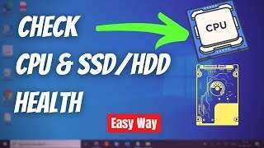
VIDEO CONTENT
Learn more about how to check processor CPU & Hard Drive health by watching the video¹ below
How to Check Processor CPU & Hard Drive Health (2022)
¹ How to Check Processor CPU & Hard Drive Health (2022) [online video], EasyTechGeek, Mar 29, 2022, https://www.youtube.com/watch?v=U_GNkhEUJAA
Notes:
https://www.youtube.com/watch?v=U_GNkhEUJAA

Slide 170
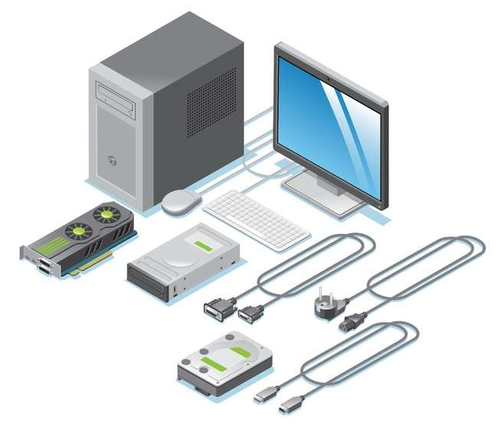
List of problems that can affect the hardware
Computer Not Turning On
Slow Performance
Noisy Hard Drive
Blue Screen of Death (BSOD)
No Display on Monitor
Unresponsive Peripherals
Internet Connectivity Issues
Distorted Graphics
Random Shutdowns
System Freezing
Laptop Battery Not Charging
Noisy Fans
Printer Connection Issues
External Drive Not Detected
Incorrect Date and Time
CD/DVD Drive Not Working
USB Device Not Recognized
Designed by Freeepik

Slide 171
How to identify a problem in the software
Software problems usually appear after the “boot process” (the process of starting a device) is complete. If you find that some programs are not working as efficiently or quickly as they used to, this is probably due to software problems.
Designed by Freeepik

Slide 172
How to identify a problem in the software
Here is a general guide to identifying software problems:
Rule out software problems: Verify that the problem is not caused by software. Reboot the system and, if necessary, perform a clean reinstallation of the operating system.
Consult Online Resources: Consult online forums or the manufacturer's support resources.

Slide 173
How to identify a problem in the software
Test Replacement Components: If possible, replace components with replacement parts known to be in good working order.
Update Drivers and Firmware: Make sure you have the latest drivers for all hardware components.
Use Manufacturer Diagnostic Tools: Many companies provide specific tools for hardware diagnostics.

Slide 174
Anti-virus / Anti-malware software
To identify software problems, check also that your anti-virus or anti-malware software is running, and that it is running correctly, and that all programs are up to date and have the latest version.
Antivirus software can identify and block many viruses before they can infect your computer.
Antimalware can scan a computer system to prevent, detect and remove malware.
Designed by Freeepik

Slide 175
List of problems that can affect the software
Computer Keeps Restarting: this could be your graphics card, motherboard, or network drivers, it could also be down to your problems when updating.
Slow Internet: this could be one of several things, it could be an issue with your supplier and the speed they are providing you with, it could potentially be the hard disk on its way out.
Computer Is Running At A Snail's Pace: this could be either software or hardware related. If it is the software it could be as a result of malware or a build-up of temporary files.
Frozen Computer: this will be a software problem. Try and establish what software you are using just prior to your computer freezing.

Slide 176
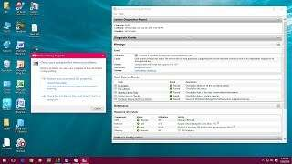
VIDEO CONTENT
Learn how to check Hardware & Software Problems In Windows PC watching the video below¹
How to check hardware & software problems in Windows PC without software
¹ How to Check Hardware & Software Problems In Windows PC without Software [online video], MJ Tube, Jan 20, 2016, https://youtu.be/O0IDxfQviys?si=Hbvgp2v3pDqW58zS
Notes:
https://youtu.be/O0IDxfQviys?si=Hbvgp2v3pDqW58zS

Slide 177
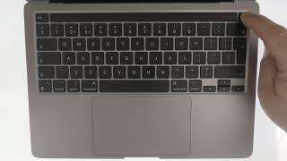
VIDEO CONTENT
Learn how to run a diagnostic test on an Apple Macintosh computer watching the video below²
How to run a diagnostic test on an Apple Macintosh computer
¹ How to run a diagnostic test on an Apple Macintosh computer [online video], mydoodads, Aug 20, 2021, https://www.youtube.com/watch?v=Cm4TJvdmoS4
Notes:
https://www.youtube.com/watch?v=Cm4TJvdmoS4

Slide 178
?
03 Support and Resources
How can I find support and resources

Slide 179
Internet Research
As in the module 1 is explained, through the Internet, people can share information and communicate from anywhere with an Internet connection.
Indeed, Internet research is a valuable and often essential tool for fixing device problems for several reasons.
Designed by Freeepik

Slide 180
Internet Research
That's why Internet research is particularly important for finding solutions to device problems:
Vast Information Repository: The internet is a vast repository of information covering a wide range of topics.
Diverse Solutions: Different users may encounter and resolve similar problems in various ways.
User Communities and Forums: Online communities and forums bring together users who have faced and solved similar problems.
1/2

Slide 181
Internet Research/2
Manufacturer Resources: Manufacturers often maintain official websites with support pages guides.
Visual Guides and Tutorials: Video-sharing platforms like YouTube host a plethora of visual guides and tutorials.
Timely Updates: The internet provides real-time information.
Accessibility of Documentation: User manuals, technical documentation, and official guides for devices are often available online
2/2

Slide 182
Internet Research
Useful resources are the web communities created by digital service providers. In them you can find common problems of certain types of devices and recurring solutions:
Microsoft: https://techcommunity.microsoft.com/
Apple: https://discussions.apple.com/welcome
Google: https://support.google.com/accounts/community?hl=en
Designed by Freeepik

Slide 183
Summary
In this unit essential proficiency has been gained in problem-solving, encompassing its definition, phases, and application in digital contexts. You've delved into troubleshooting techniques, including how to identify hardware and software problems. For hardware, common issues such as connectivity failures, and hardware component malfunctions were explored. Similarly, software problems were identified, including software crashes, and malware infections. Moreover, the module emphasized the importance of accessing support and resources for effective problem resolution.

Slide 184
Self-Reflection Exercise
!
Time for
Self-Reflection

Slide 185
Self-Reflection Exercise
Next on, you will see questions related to the content of this unit.
Reflect on the questions and answer them in writing in your (digital) journal!

Slide 186
Self-Reflection Exercise
What key aspect of digital problem-solving and troubleshooting do you find most crucial? How might understanding this concept enhance your ability to resolve software and hardware issues effectively in your daily life or work?
Can you recall a situation in your personal or professional life where recognizing software and hardware problems was crucial? How did your awareness of these issues impact your decision-making and problem-solving approach in that situation?
After learning about recognizing basic software and hardware problems and how to solve them, which aspect do you believe is most valuable for individuals? How can effectively addressing these issues benefit both individuals and organizations in improving productivity and efficiency in their digital environments?
Designed by Freeepik

Slide 187
Congratulations, you completed Unit 4 of the Module 1.

Slide 188
This learning unit has been developed as part of an Erasmus+ KA2 project DiMiCare and is funded with the support from the European Union. The work is intended for educational purposes and is licensed under Creative Commons Attribution-NonCommercial-ShareAlike 4.0 International License @ The DiMiCare Consortium (except for referenced screenshots and content).
Funded by the European Union. Views and opinions expressed are however those of the author(s) only and do not necessarily reflect those of the European Union or OeAD-GmbH. Neither the European Union nor the granting authority can be held responsible for them

Slide 189
List of References
What is a problem solving? American Society for Quality (ASQ). Asq.org. https://asq.org/quality-resources/problem-solving (accessed March 2024).
DigComp Framework. Definition of Digital Competence. EU Science Hub. https://joint-research-centre.ec.europa.eu/digcomp/digcomp-framework_en (accessed March 2024).
Digital Skills Gap Index 2021. © John Wiley & Sons, Inc. dsgi.wiley.com. https://dsgi.wiley.com/wp-content/uploads/2021/10/DSGI-whitepaper.pdf (accessed March 2024).
Troubleshooting. Wikipedia.org. https://en.wikipedia.org/wiki/Troubleshooting (accessed March 2024).
Daniel Hall, 22/02/2021.How to identify computer problems: software and hardware issues you may experience. bbntimes.com. https://www.bbntimes.com/technology/how-to-identify-computer-problems-software-and-hardware-issues-you-may-experience (accessed March 2024).
Welcome to the Microsoft Support Community. Microsoft.com. https://answers.microsoft.com/en-us (accessed March 2024).
Apple Support Community. Apple.com. https://discussions.apple.com/welcome (accessed March 2024).
Welcome to the Google Search Help Community. Google.com. https://support.google.com/websearch/community?hl=en (accessed March 2024).

