Slide 2
Module 2
Care-related technology
Unit 1
The role of technology in long-term care

Slide 3
01 What is technology in long-term care
Digital Transformation in the care sector
What is technology in care?
Types of technology and tools in care
02 Benefits for caregivers and care recipients
TABLE OF CONTENTS
03 Challenges and Barriers
Barriers to technology adoption
Digital divide
Ethics, Privacy and Data Security

Slide 4
What is technology in long-term care?
?
The digital transformation in the care sector
What is technology in care?
Types of technology in care

Slide 5
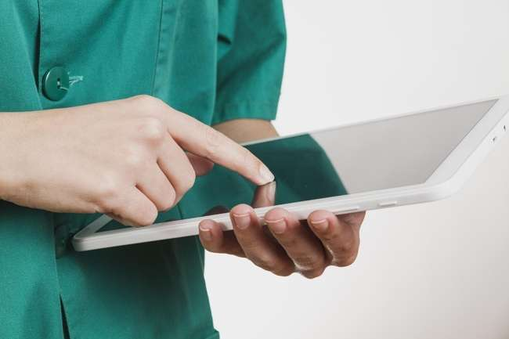
Digital transformation in the care sector
Digital transformation or digitalisation in the care sector refers to use of digital technologies and internet to improve the delivery and management of care
The aim is to relieve burden of care staff and at the same time improve care conditions and the well-being of care-dependent individuals

Slide 6
Digital transformation in the care sector
The Covid-19 pandemic has accelerated the use of digital technologies in care
However, the digital transformation in the care sector has just started and is an ongoing process

Slide 7
Video: Digital transformation in the care sector
Watch this video to understand how the ongoing trend of digital transformation is impacting the care sector.
World Governments Summit | How is technology changing the healthcare sector?

Slide 8
Digital transformation in the care sector
A practical example involves the shift from traditional, paper-based documentation to digital records.
Many care providers switched from pen and paper to an electronic care documentation software on tablets or smartphones.
This reduces the amount of paperwork, centralises information and simplifies updates and information sharing among care workers.

Slide 9
Exercise - What is technology in care?
What does care technology actually mean? Before you are introduced to specific types of technology in care, let‘s start with an exercise:
1. In your own words, explain what care technology means to you.
2. List three examples of care technology and describe its purpose.

Slide 10
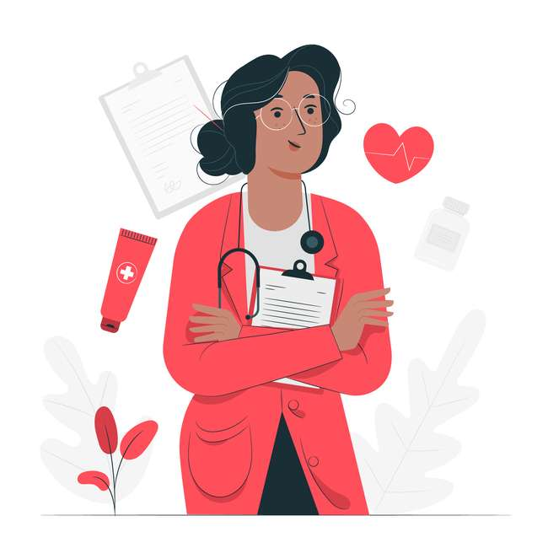
What is technology in care?
Here are some possible definitions of care-related technology:
In care, technology refers to modern and networked information and communication technologies, including software and hardware.
Care-related technology is the use of technology to support people to live longer, healthier and more independent lives at home or in a community setting like a care home.
Care technology refers to a wide range of digital processes and products that are used in mobile care and stationary care.

Slide 11
Types of technology in care
There are different ways of categorising care-related technology. One approach is to classify based on technology types:
Telemedicine and remote monitoring
Robotics and Artificial Intelligence
Electronic care planning
E-health and M-health
Assistive Technologies

Slide 12
Types of technology in care
Another approach involves grouping technology based on its function:
However, these are very broad categories and often technologies serve multiple purposes.
Monitoring and Surveillance Technology
Monitoring and Surveillance Technology
Assistive tools
Assistive tools
Education & Training Resources
Education & Training Resources
Care Management tools
Care Management tools
Communication and Social Interaction tools
Communication and Social Interaction tools
For tracking health parameters
For improving independence and well-being of clients
For better training of care workers
For improving and easing the delivery of care
For social engagement and collaboration

Slide 13
Video
In this short video, a care manager talks about various technologies that were implemented in his organization.
TSA | Embracing a Digital Future for Care Workforce and Residents
Watch the video and reflect on the following questions:
Which of the equipment did you already know? What is new to you?
What purpose do these technologies serve?
Notes:
Embeding code: <iframe width="560" height="315" src="https://www.youtube.com/embed/e6Nyats33Gc?si=8v1ndUrorueuoZtx" title="YouTube video player" frameborder="0" allow="accelerometer; autoplay; clipboard-write; encrypted-media; gyroscope; picture-in-picture; web-share" allowfullscreen></iframe>

Slide 14
Benefits of technology in long-term care?
?
How can technology support caregivers and improve working conditions in the sector?
How can technology improve the quality of care services and the quality of life of older people?

Slide 15
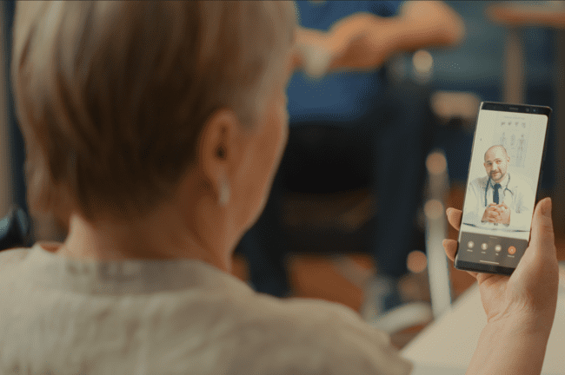
Improved Accessibility
Technology offers the potential to have more immediate access to a consultation remotely.
For example, telecare enables to monitor patient care and conduct remote consultations. Patients who live in remote areas are easier accessible through remote monitoring tools.

Slide 16
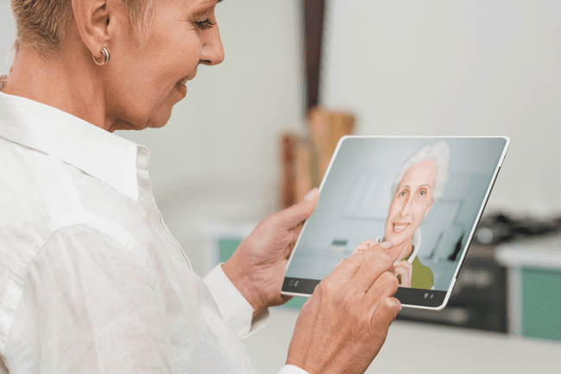
Improved Connection and Communication
Older people who live alone often struggle with loneliness and social isolation. Technology may be a big help in dealing with this.
Social media, video calls or connected care apps facilitate communication and make it easy to stay connected with friends, family and support networks.

Slide 17
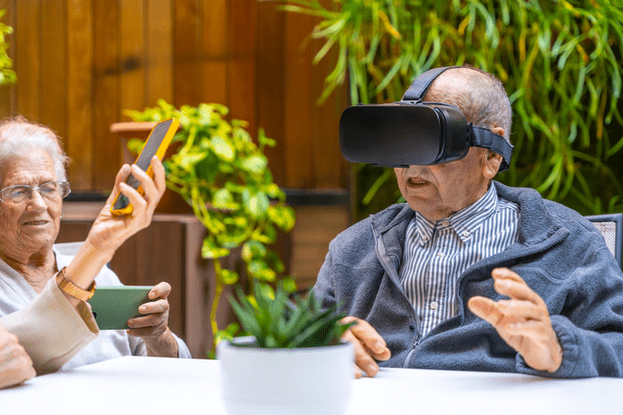
Promotion of Active Ageing
Immersive experiences created by Augmented Reality (AR) and Virtual Reality (VR) may help people to stay mentally, physically and socially engaged through a wide range of experiences and activities.

Slide 18
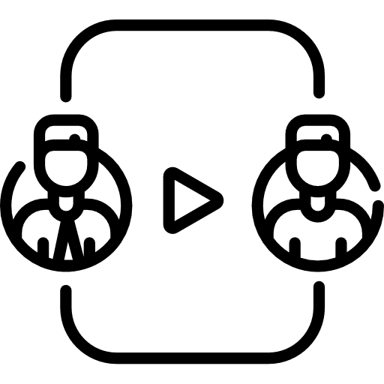
Improved efficiency and accuracy in care delivery
Technology allows care workers to work more accurate, efficiently and safer.
Digital systems such as care planning softwares make it easier for care providers to collaborate and plan care well.
Digital recording reduces the chances of mistakes.
Moreover, digital information is less likely to be lost or damaged.

Slide 19
Reduced stress and workload for care workers
Lack of time is a major challenge in the day-to-day work of professional carers. Electronic care documentation and assistive technologies may reduce stress and create more time for care tasks.
Just think of monitoring or emergency call systems. Thanks to digital support, the emergency call center is notified more quickly when a patient needs help.

Slide 20
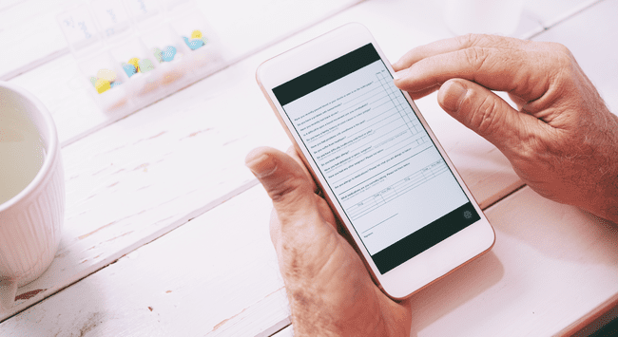
Improved quality of care
Also, mobile apps and websites provide instant access to information, help with scheduling appointments, and remind patients to take their medicines. This may decrease the need for unnecessary hospital visits.

Slide 21
Support independence and quality of life
Assistive technologies can help care-dependent people to live on their own for a longer time and have a better quality of life.
Wearable gadgets, like sensors that detect falls and GPS trackers improve the personal safety of a person living alone.
Self-management apps provide care recipients more control over their health, safety and well-being.

Slide 22
Challenges and Barriers
?
What are possible challenges when it comes to the use of technology in mobile and stationary care

Slide 23
Exercise
Before we discuss some challenges and barriers that arise with the use of technology, try to answer the following question:
What are your concerns and worries when you think of care and technology?
Write everything down that is in your head.

Slide 24
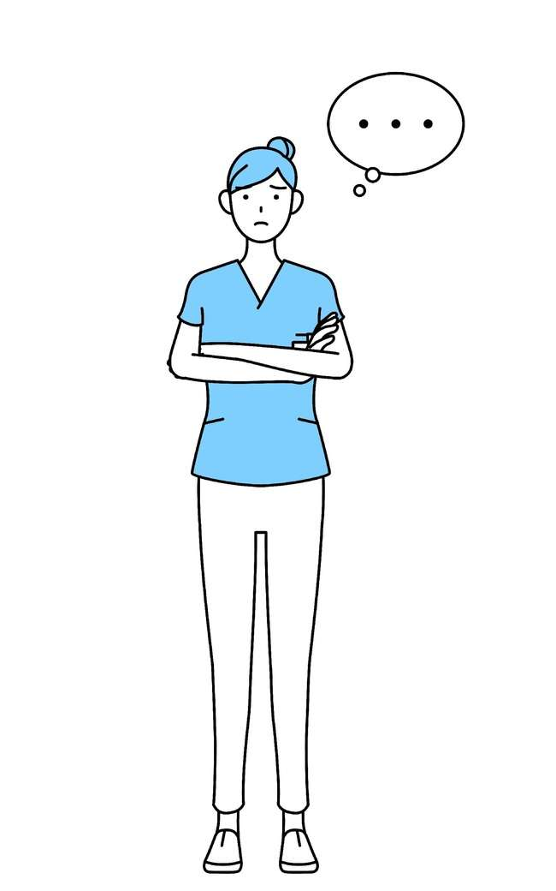
Barriers to care technology adoption
„Technology will sooner or later replace my role as caregiver“
CONSIDER
Technology in care is designed to complement and support carers rather than replace them.
Technology lacks the emotional intelligence, empathy and other essential human qualities that can never be fully replicated.

Slide 25
Barriers to care technology adoption
„Older people are not interested in technology“
CONSIDER
The majority of older people has the desire to age in place. They recognise the practical benefits of assistive technologies which play a crucial role in enabling them to maintain their independence and enhance their safety.

Slide 26
Barriers to care technology adoption
„Technology is too expensive. No one can afford this“
CONSIDER
Given the swift progression of technology, it is expected that technologies and tools will become more affordable over time.

Slide 27
Barriers to care technology adoption
„I struggle with digital skills and find it challenging to handle technical tools“
CONSIDER
Given your active participation in this online course, you are already on the path to improving your digital skills. If you want to enhance your basic digital skills, consider exploring Module 1. Additionally, if your care provider utilizes specific software or tools, it is essential for everyone to undergo appropriate training to ensure a comprehensive understanding of how these tools operate.

Slide 28
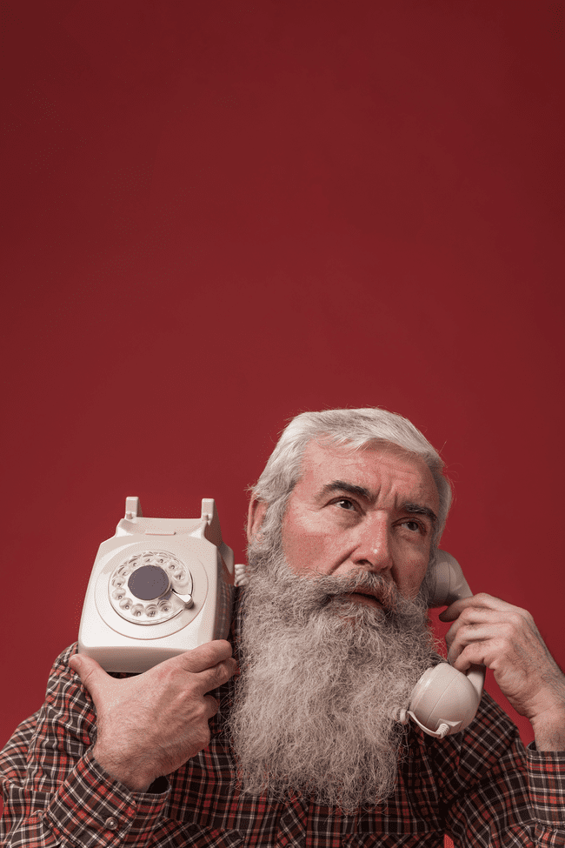
Digital divide
The digital divide refers to the gap between people who have full access to digital technology and those who do not.
Internet availability varies geographically, with rural areas often lacking sufficient technological infrastructure.
Older people without access to broadband and devices cannot benefit from digital tools and services

Slide 29
Ethics, Privacy and Data Security
There is limited public awareness of how digital devices process and store data
Increase in the risk of cyber attacks and data theft
Informed consent and choice for users are crucial
For more information on ethics, privacy and data security please check out Module 5 of the training course.

Slide 30
Summary
The digital transformation in the care sector is ongoing. Many care providers have transitioned to electronic care systems and are using digital tools like smartphones and tablets for daily tasks. These technologies serve various purposes including improved connection and communication, increased efficiency and accuracy in care, reduced stress for care workers and higher independence and quality of life of care-dependent people. On the other side, also challenges need to be overcome, in particular with respect to privacy and data protection and ethical regulations.

Slide 31
Self-Reflection Exercise
!
Time for
Self-Reflection

Slide 32
Self-Reflection Exercise
Next on, you will see questions related to the content of this unit.
Reflect on the questions and answer them in writing in your (digital) journal!

Slide 33
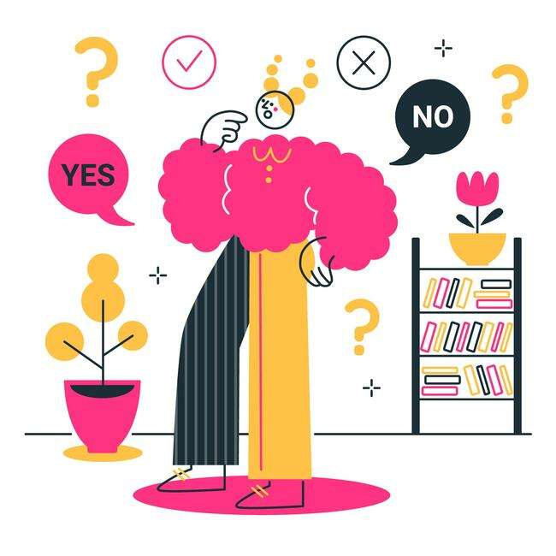
Self-Reflection Exercise
The Digital Mindset of Carers
How is technology affecting your role and your tasks as a careworker?
Which digital tools do you think will improve your daily work?
What is the biggest challenge for you in the context of digital transformation?

Slide 34
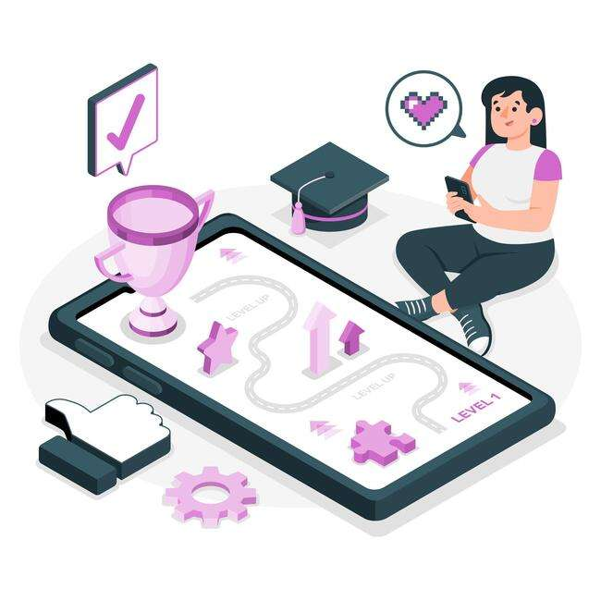
Congratulations, you completed Unit 1 of the Module 2.

Slide 35
This learning unit has been developed as part of an Erasmus+ KA2 project DiMiCare and is funded with the support from the European Union. The work is intended for educational purposes and is licensed under Creative Commons Attribution-NonCommercial-ShareAlike 4.0 International License @ The DiMiCare Consortium (except for referenced screenshots and content).
Funded by the European Union. Views and opinions expressed are however those of the author(s) only and do not necessarily reflect those of the European Union or OeAD-GmbH. Neither the European Union nor the granting authority can be held responsible for them

Slide 36
List of References
Averio (2023): The Role of Technology in Social Care; https://averio.co.uk/2023/06/15/the-role-of-technology-in-social-care/
EC (2020): The role of new technologies in modernizing long-term care systems. A scoping review, Brussels.
Lorenz K. et al (2017): Technology-based tools and services for people with dementia and
carers: Mapping technology onto the dementia care pathway’, Dementia. SAGE Publications
Ltd, pp. 725–741.
Stoumpos et al.(2023): Digital Transformation in Healthcare. Technology Acceptance and its Applications, in: International Journal of Environmental Research and Public Health, 20/4: 3407; https://www.ncbi.nlm.nih.gov/pmc/articles/PMC9963556/
Tak, Sunghee H. et al (2010): Technology for Long-Term Care, in Research in Gerontological Nursing 3 (1), 61-72; https://www.ncbi.nlm.nih.gov/pmc/articles/PMC3622259/
University of Plymouth: How can closing the digital divide improve older people’s lives: https://www.plymouth.ac.uk/discover/how-can-breaking-the-digital-divide-improve-the-health-and-wellbeing-of-older-people

Slide 38
Module 2
Care-specific technology
Unit 2
Tools and Technology for Managing and Organising Care Services

Slide 39
01 Introduction
Tools and Technology in Care
02 Electronic Care Documentation
Benefits
Care Documentation Softwares
TABLE OF CONTENTS
03 Route Planning Tools
Possible Features
Route Planning Apps
04 Digital Communication & Coordination
Digital Collaboration Tools
Digital Collaboration in Telehealth

Slide 40
Introduction
?
What do we understand by tools and technology in care

Slide 41
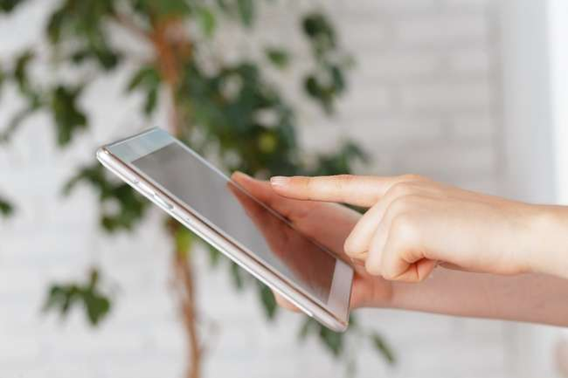
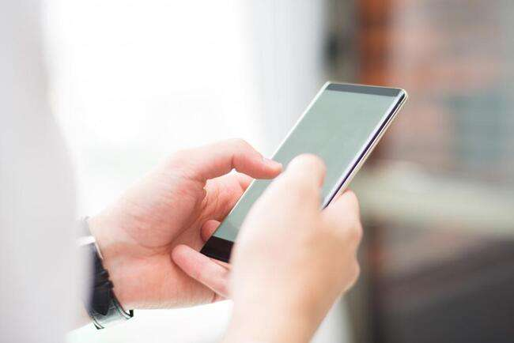
Introduction
Tools in healthcare can help with managing and organising daily tasks.
Some organisations have their own digital tools and you may only be allowed to use them for work.
There are different tools for planning, monitoring and reporting.

Slide 42
?
Electronic Care Documentation
What are the benefits of electronic care documentation
What are care documentation softwares

Slide 43
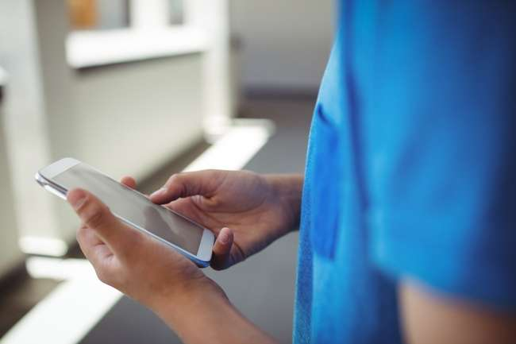
Electronic Care Documentation
Care documentation is an important basis for needs-based, quality-oriented and safe care.
Nowadays, many care providers abandon paper and pen in favor of digital care documentation.
In Austria, digital care documentation is already quite widespread.
Electronic Care Documentation helps to maintain more accurate and consistent documentation compared to paper documentation.
Notes:
https://www.freepik.com/premium-photo/schoolboy-using-mobile-phone-corridor-school_9845055.htm#query=care%20software%20APP&position=33&from_view=search&track=ais&uuid=058165fb-0ce8-4878-b4d1-9755b8b161cb

Slide 44
Exercise
Before you move on to the next slide, take a pen and a paper and reflect on the following questions:
What are possible benefits of electronic care documentation compared to paper-based documentation?
If you already have experience with both methods, which method was more beneficial to you?
What are possible downsides of electronic care documentation?

Slide 45
Positive Aspects of Electronic Care Documentation
Data can be entered at the point of treatment through mobile devices
Quick access to specific data for all professionals involved in the care process
Standardised, legible documentation ensures a reliable flow of documentation

Slide 46
Positive Aspects of Electronic Care Documentation
The use of standardised technical terms is less prone to errors as everyone involved “speaks” the same language. It facilitates the exchange with other care professionals involved
Digital photos can be added (e.g. wound documentation)
Optimisation of the care process by a systematic analysis of important risk factors (Falls, Pressure sores, Pain, Malnutrition, Incontinence)
→ Higher safety for the patient

Slide 47
Possible Downsides of Electronic Care Documentation
Reliance on technology
Initial learning curve
Risk of technical issues

Slide 48
Care Documentation Software
Care organisations use different softwares for electronic care documentation. In Austria there is no uniform software used by all care organisations.
This means that depending on where you work in the care sector, you will be using a specific software. To navigate this, introductory training is usually provided to familiarise you with the particular features and functionalities of the software.

Slide 49
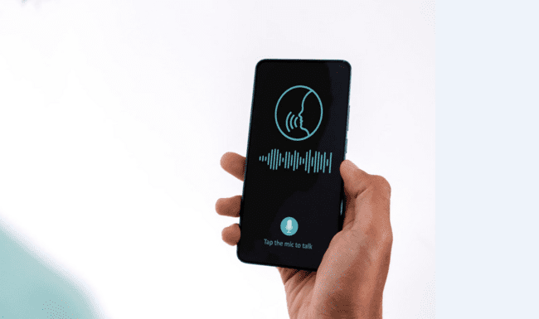
AI-supported care documentation
Some care documentation softwares are already offering intelligent documentation via voice input on a smartphone.
This allows carers to dictate notes hands-free directly into the patient’s record.

Slide 50
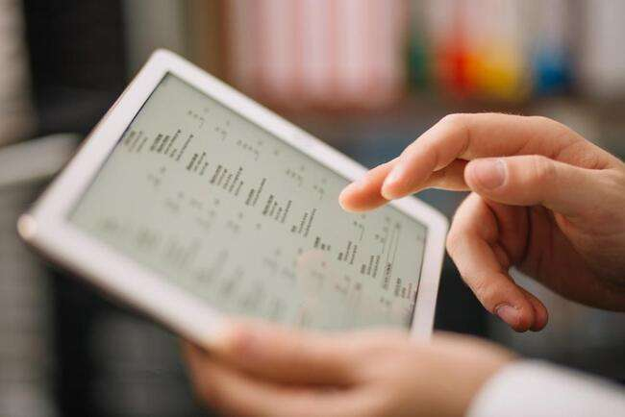
Electronic Health Records (EHR)
An Electronic Health Record (EHR) is like a digital file that keeps track of a person’s health history. It is managed by the care provider and contains important information such as:
Personal details
Progress notes
Medical issues
Medications
Vital signs
Test results
etc.

Slide 51
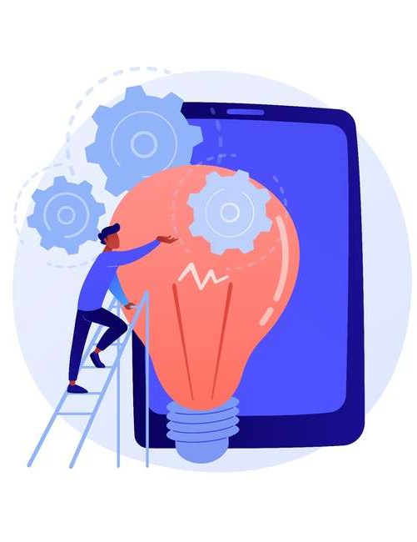
Basic Digital skills requirement for electronic care documentation
Handling digital devices such as Smartphones or Tablets
IT-Basics
PC-Basics
Software-specific knowledge

Slide 52
Digital Route Planning
?
What are the essential features of digital route planning tools?
What Apps are available for digital route planning and what are their benefits?

Slide 53
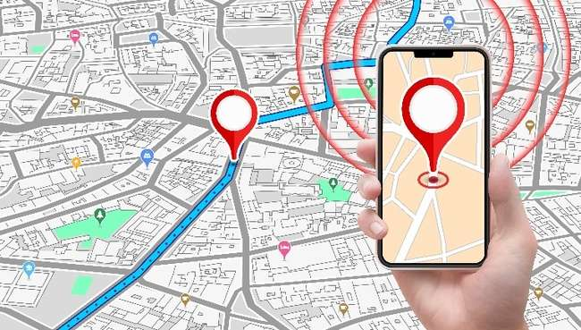
Digital Route Planning
Digital Route Planning is especially beneficial in home care, where you need to travel between various client locations.
Instead of manual route planning, digital tools can help you in planning your client visits by calculating travel times and suggesting the most efficient routes.
Notes:
https://www.freepik.com/premium-vector/hand-holding-phone-with-gps-navigation-tracking-alert_24960831.htm#query=google%20maps%20several%20stops&position=7&from_view=search&track=ais&uuid=d6cfa6e3-21c5-4147-aa0a-cd1fe727f2d0

Slide 54
Possible Features of Route Planning Tools
Priority status can be allocated to clients
Time constraints of clients can be added to the route
Real-time tracking
The client can be updated about the arrival time with text notification
Visit cancellations and new appointments can be added to create a new route

Slide 55
Google Maps
Google Maps is the most widely used routing software.
+ free tool
+ easy interface
+ you can plan up to 10 stops
+ you can plan the routes on a desktop and email them to
your mobile device for navigation
Limit of 10 stops per route
No route optimisation
Notes:
Embedding code: <iframe width="560" height="315" src="https://www.youtube.com/embed/EXO0OeGo3xc?si=J9CRfguJETnAd7S1" title="YouTube video player" frameborder="0" allow="accelerometer; autoplay; clipboard-write; encrypted-media; gyroscope; picture-in-picture; web-share" allowfullscreen></iframe>

Slide 56
Route Planning App “Straightaway”
Straightaway is a Smartphone App for efficient route planning available on Google Play and the App Store
+ you can upload the addresses by taking a picture of the stops
+ you can plan up to 25 stops for free
+ an algorithm finds the most optimal route taking into account traffic patterns, road conditions, distance between stops, etc.
You need to upgrade to a premium account to unlock additional features
Notes:
Embedding code: <iframe width="560" height="315" src="https://www.youtube.com/embed/EXO0OeGo3xc?si=J9CRfguJETnAd7S1" title="YouTube video player" frameborder="0" allow="accelerometer; autoplay; clipboard-write; encrypted-media; gyroscope; picture-in-picture; web-share" allowfullscreen></iframe>

Slide 57
Route Planning App “MyWay Route”
Another option for efficient route planning is the„MyWay Route“ App, also available on Google Play and the App Store.
+ you can import the addresses from Excel or a photo of the adresses
+ you can plan up to 20 stops for free
+ an optimisation algorithm finds the most efficient route
+ you have unlimited routes and optimisations
You need to buy the premium account for planning more
than 20 stops

Slide 58
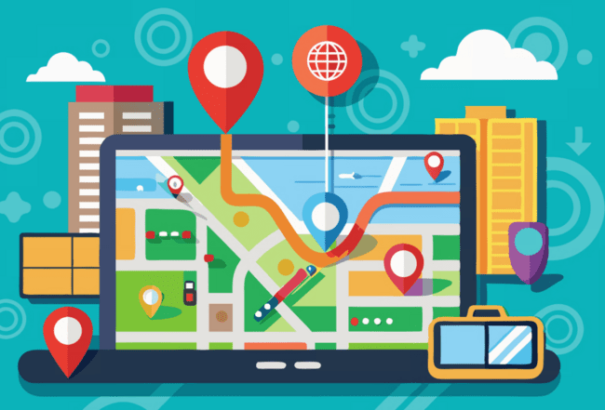
Use of Digital Route Planning Tools
Some care providers have their own special route planning software, so their staff doesn't have to plan routes on their own.
However, the suggested Apps can support you in case you have to use your own tools for planning.

Slide 59
Digital Communication and Collaboration
?
What are the essential features of digital communication and collaboration tools?

Slide 60
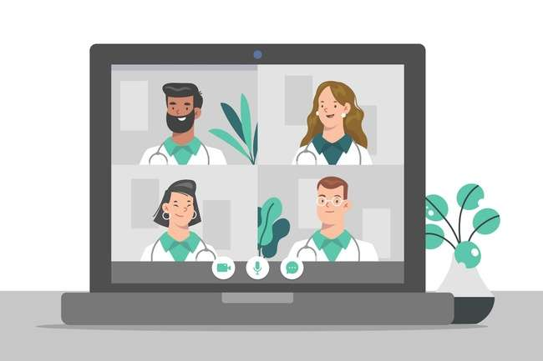
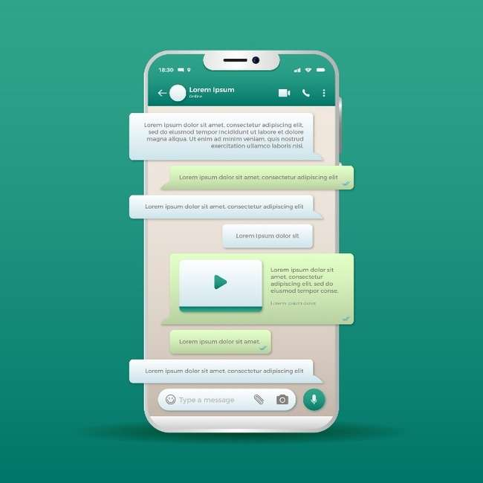
Digital collaboration tools
Remote communication tools help you to connect easily with your colleagues, receive immediate updates and exchange sensitive patient information.

Slide 61
Secure Messaging Platforms
Secure messaging platforms enable you to securely and efficiently exchange sensitive patient information. They emphasise data privacy and encryption.
Examples:
SecureHealth Messaging
MedChat

Slide 62
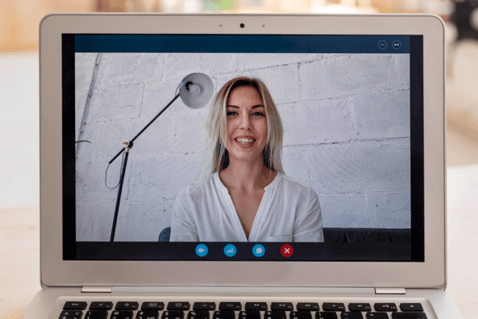
Video Conferencing Tools
Video conferencing tools enable you to connect in real-time with colleagues, participate in (interdisciplinary) meetings or attend online trainings.
Examples:
HealthConnect
MediMet

Slide 63
Exercise
What kind of digital collaboration tools do you use for work?
Do you think you have sufficient skills to use the collaboration tools at work? What skills are you lacking?

Slide 64
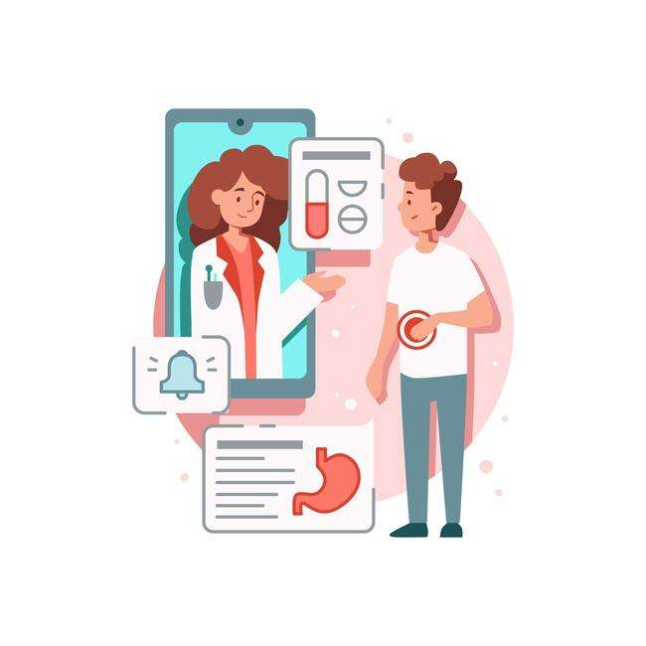
Digital Collaboration in Telehealth
Telehealth is a broad term defining the use of communication technologies to provide health at a distance.
It is a way of virtual consultation between care provider and client.
Even if you're not directly participating in telehealth activities, it's beneficial to have some knowledge about the various technologies being used.

Slide 65
Telehealth vs. Telemedicine
The terms telehealth and telemedicine are often used interchangeably.
However, to be precise, telemedicine is a segment of telehealth. It refers specifically to the use of technologies and telecommunication systems for medical diagnosis and treatment of clients at distance.
For instance, a doctor conducting a video consultation for urgent
care in non-life-threatening situations.

Slide 66
Example technologies used in telehealth
Mobile health apps (M-Health)
Video technology on tablets
Remote patient monitoring: Different types of information technology (IT) is used to monitor clients at a distance, typically at home. It includes the monitoring of information, like blood pressure, heart rate, body weight or blood sugar levels. The measured health parameters are then transmitted to the provider.

Slide 67
Benefits of Telehealth
Telehealth services allow clients who reside in rural areas or areas that are difficult to access to get immediate support
Can provide timely and patient-centered care to those living at a distance with chronic disease
Improve the coordination of care when multiple providers are involved

Slide 68
Summary
Care documentation software improves the accuracy and consistency of documentation. Depending on your workplace, various software programs are used, each requiring specific knowledge. This includes understanding basic IT skills and proficiency in using smartphones and tablets.
Digital route planning tools, such as Google Maps or Straightaway, assist in planning efficient routes for visiting multiple clients.
Digital collaboration tools, like secure messaging platforms and video conferencing tools, enable real-time connection with colleagues and secure data sharing.

Slide 69
Self-Reflection Exercise
!
Time for
Self-Reflection

Slide 70
Self-Reflection Exercise
Next on, you will see questions related to the content of this unit.
Reflect on the questions and answer them in writing in your (digital) journal!

Slide 71
Reflection
Which of the presented tools and technologies for organising and managing care services seems most useful to you?
What basic digital competences do you need to improve in order to benefit from the digital tools provided in your work environment?

Slide 72
Congratulations, you completed Unit 2 of the Module 2.

Slide 73
This learning unit has been developed as part of an Erasmus+ KA2 project DiMiCare and is funded with the support from the European Union. The work is intended for educational purposes and is licensed under Creative Commons Attribution-NonCommercial-ShareAlike 4.0 International License @ The DiMiCare Consortium (except for referenced screenshots and content).
Funded by the European Union. Views and opinions expressed are however those of the author(s) only and do not necessarily reflect those of the European Union or OeAD-GmbH. Neither the European Union nor the granting authority can be held responsible for them

Slide 74
List of References
Free Route Planner with unlimited stops (2023): https://www.track-pod.com/blog/route-planner-unlimited-stops/
Gesund.bund de: Telemonitoring; https://gesund.bund.de/en/telemonitoring#at-a-glance
Hero Health (2023): Pill Management Systems. Which one is right for you? https://herohealth.com/blog/medication-management/pill-management-systems/
Ho et al (2017): Part 2: Health apps, wearables, and sensors: The advancing frontier of digital health; https://bcmj.org/articles/part-2-health-apps-wearables-and-sensors-advancing-frontier-digital-health
Redl, Viktoria (2021): Digitalisierung. Aspekt Pflegealltag, https://www.pflegeinformatik.at/digitalisierung-aspekt-pflegealltag/
Route Planning Solutions for Homehealth care: https://zeorouteplanner.com/healthcare/

Slide 76
Module 2
Care-specific technology
Unit 3
Assistive and Smart Home Technologies

Slide 77
01 What are Home-based Assistive Technologies?
Target group
Benefits
02 Devices for Security and Safer Walking
Personal Alarms & Fall detectors
Emergency Call Aids
Tracking devices
Home sensors
TABLE OF CONTENTS
03 Memory Aids and Reminders
Medication Management Systems
Digital Reminder Apps
04 Smart Home Devices
What are smart home devices
How to control smart home devices
Examples

Slide 78
What is Assistive Technology?
?
What are assistive technologies and AAL?
Who benefits from assistive technologies and how?

Slide 79
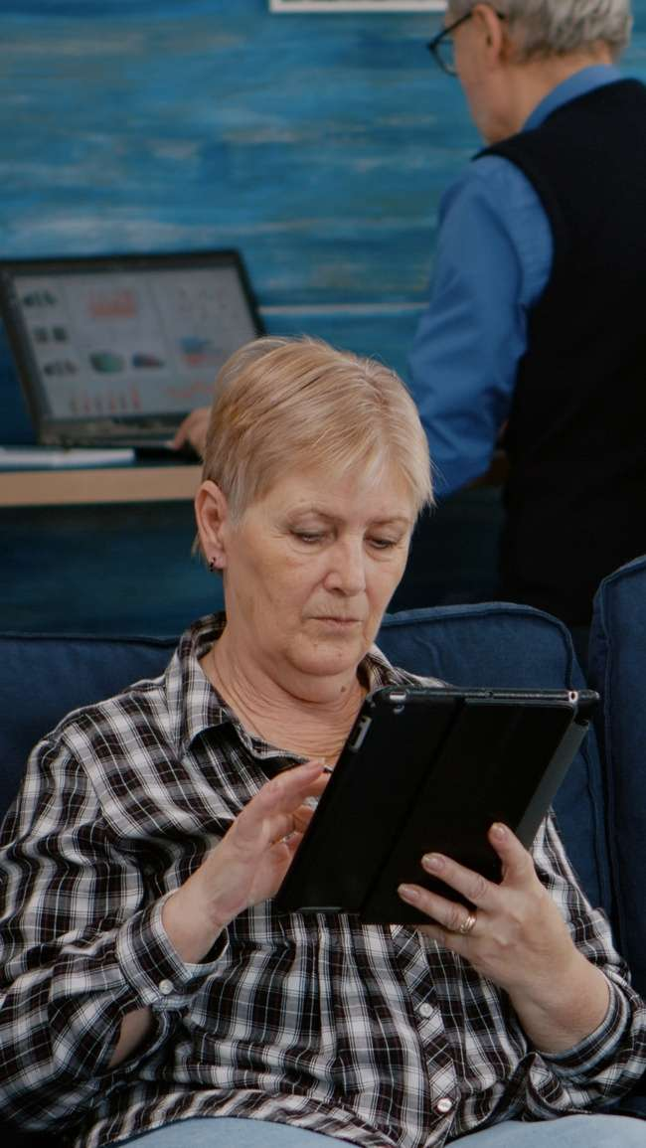
What are Home-Based Assistive Technologies?
Assistive technologies refer to devices or systems that help a person to maintain or improve their independence, safety and quality of life.
They enable people to remain in their own home as long as possible.

Slide 80
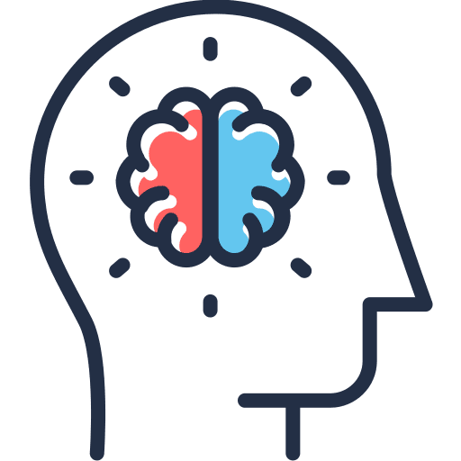
For whom do assistive and smart technologies serve in the care context?
People who have problems with:
Safe walking
Finding their way around
Speech
Hearing and eyesight
Memory and cognition
Daily living activities
Socialising and leisure

Slide 81
What are the benefits of assistive technologies?
Promote independence and autonomy
Promote confidence and quality of life
Help manage potential risks around the home
Support a person to remain at home for longer
Provide reassurance to carers and help them to feel less stressed

Slide 82
Video – Benefits of Assistive Technologies
Watch the video presenting different scenarios of commonly used assistive technology in care settings and reflect on the questions below:
NHS Forth Valley | What is Technology Enabled Care?
In what ways do you think these technology solutions can improve the quality of life of care-dependent people?
How may these tools ease your work as a caregiver?
Notes:
Embeding code: <iframe width="560" height="315" src="https://www.youtube.com/embed/n697R3qL4fI?si=J9hlDMpbprhZopsB" title="YouTube video player" frameborder="0" allow="accelerometer; autoplay; clipboard-write; encrypted-media; gyroscope; picture-in-picture; web-share" allowfullscreen></iframe>

Slide 83
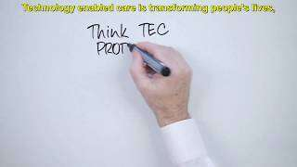
VIDEO - Benefits of Assistive Technologies for people with dementia
This video shows simple assistive tools that can support people who suffer from Dementia.
Which tools does Tom use?
Do you think these tools help a person with certain neurological conditions such as Alzheimer to live a safer and more independent life?
TSA | How Technology Enabled Care helps those with Dementia
Notes:
<iframe width="560" height="315" src="https://www.youtube.com/embed/FCAsEGyNlsg?si=1YGmsjOqQfqPxAhq" title="YouTube video player" frameborder="0" allow="accelerometer; autoplay; clipboard-write; encrypted-media; gyroscope; picture-in-picture; web-share" allowfullscreen></iframe>

Slide 84
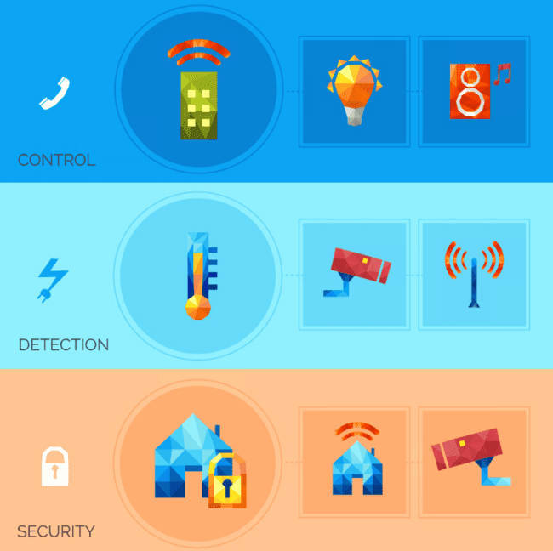
Devices for Security and Safer Walking
Emergency call aids
Fall detection systems
Tracking devices
Home Sensors
Automatic shut-off devices

Slide 85
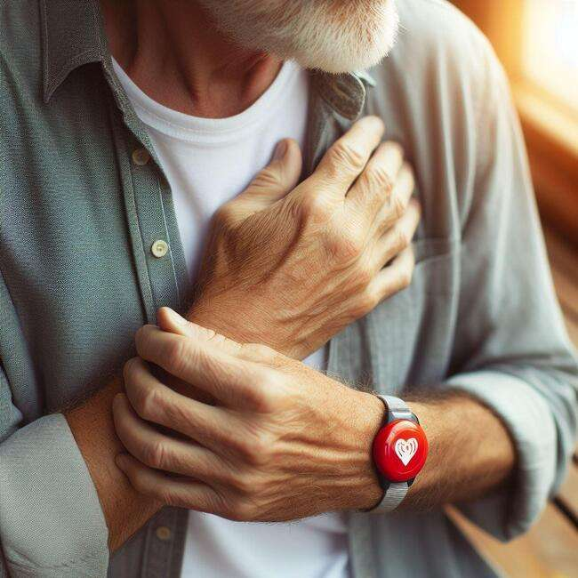
Emergency call aids
Emergency call aids are simple devices that help people to receive immediate help in case of an emergency.
The systems consist of a base unit and an emergency
call transmitter. This is usually worn like a wristwatch or a necklace. In case of an emergency ( e.g. a fall), the individual can make an emergency call by pressing the button. The call is directed to the emergency call control center or to a family member.
Notes:
Video for emergency call systems in German: https://www.youtube.com/watch?v=_IAvAeCQuWc

Slide 86
Emergency call aids
Who can benefit from emergency call aids?
People who live alone and often feel insecure
People whose mobility is limited due to age, illness or disability
People who are at risk of falling, suffer from cardiovascular problems or may be particularly dependent on rapid assistance for other reasons
Notes:
Video for emergency call systems in German: https://www.youtube.com/watch?v=_IAvAeCQuWc

Slide 87
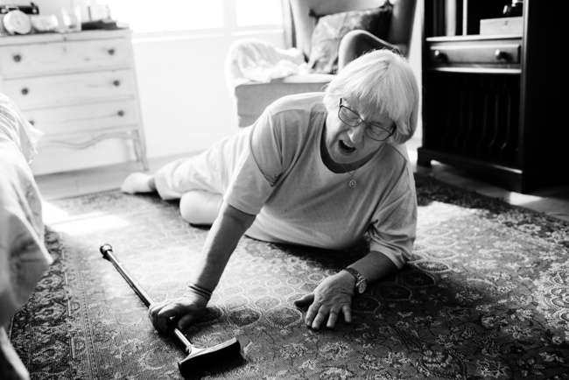
Fall detection system
Fall detection are similar to emergency call aids, but they go a step further. In case of a fall, the device sends a signal to the emergency control center.
How does it work?
The device, available in the form of a watch, a pendant or a belt, contains a sensor.
The sensor measures speed, distance and direction and is programmed to detect a common pattern in falls:
A quick downward movement followed by no more motion.
Notes:
What happens next depends on your fall alert system. If your device is linked to a monitoring center, a person there gets the fall alert and talks to you through the device's speaker. If you don't respond, they send emergency help to ensure you're safe.
If your device isn't connected to a monitoring center, a family member or friend gets the fall alert. Their job is to reach out to you or call 911 to make sure you're okay.

Slide 88
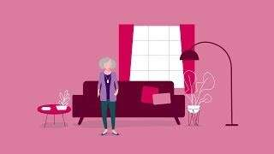
Fall detection system
Watch this short video to understand how fall the detection system works:
Lifeline Systems | Lifeline - How Fall Detection Works
Notes:
Embedding-code: <iframe width="560" height="315" src="https://www.youtube.com/embed/j_h5WWPtvwc?si=C9Pltv7UZS7RBlBn" title="YouTube video player" frameborder="0" allow="accelerometer; autoplay; clipboard-write; encrypted-media; gyroscope; picture-in-picture; web-share" allowfullscreen></iframe>

Slide 89
Tracking devices
Tracking devices or location monitoring services that use satellite or mobile phone technology to locate and track a person. They can be used for spatially disoriented persons (e.g. people suffering from dementia).
How does it work?
GPS sensors are built into a watch or used on a smartphone and thus allow the location of the person to be monitored on a computer or similar device. Their position can be determined with an accuracy of up to 5 metres.
In addition, they system can alert the carer if the monitored person leaves a defined area.

Slide 90
Home sensors/Monitoring
Watch this short video demonstrating how home sensors empower Bob, who faces mobility challenges, to remain independent at home:
National Science Foundation News | Home sensors enable seniors to live independently
Notes:
<iframe width="560" height="315" src="https://www.youtube.com/embed/NCixWY3eaOc?si=p3tT2IOXx7TPaitJ" title="YouTube video player" frameborder="0" allow="accelerometer; autoplay; clipboard-write; encrypted-media; gyroscope; picture-in-picture; web-share" allowfullscreen></iframe>

Slide 91
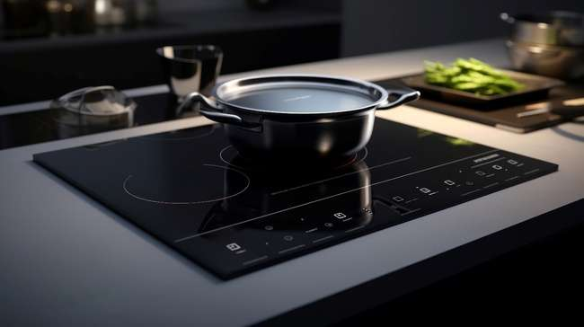
Automated shut-off devices
With the assistance of a monitoring tool, electronic devices are switched off automatically.
For instance, the stove switches off automatically when the temperature exceeds a critical threshold or after a predefined time has passed.

Slide 92
Memory Aids and Reminders
?
In what way do smart systems help your clients to sort, organise and manage daily activities

Slide 93
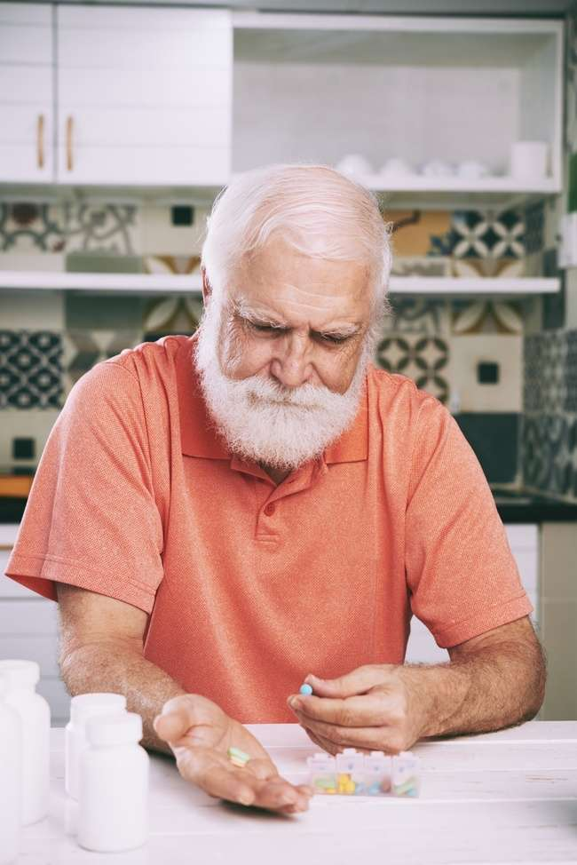
Medication Management Apps
The simplest form of pill management is the well-known pill boxes. However, nowadays there are already quite smart devices available.
Medication Management Apps, for example, allow to enter dosage information for medication or supplements, set up reminders and keep track of when the client has to take their pills. Ideally, the App is paired with a smart pill organiser.
Notes:
Embedding code: <iframe width="560" height="315" src="https://www.youtube.com/embed/P9dlRqRlMMw?si=ccCAPACG78UfIdYo" title="YouTube video player" frameborder="0" allow="accelerometer; autoplay; clipboard-write; encrypted-media; gyroscope; picture-in-picture; web-share" allowfullscreen></iframe>

Slide 94
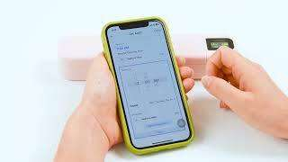
Video - Smart Pill Organiser
Watch the video of a smart pill organiser connected to an App via Bluetooth and answer the questions below.
Who do you think could benefit from such a technology?
Do you think it would be difficult for you to handle such an App and pill organiser?
What skills are you lacking?
Zoksi | How does the pillbox connect to Bluetooth？
Notes:
Embedding code: <iframe width="560" height="315" src="https://www.youtube.com/embed/P9dlRqRlMMw?si=ccCAPACG78UfIdYo" title="YouTube video player" frameborder="0" allow="accelerometer; autoplay; clipboard-write; encrypted-media; gyroscope; picture-in-picture; web-share" allowfullscreen></iframe>

Slide 95
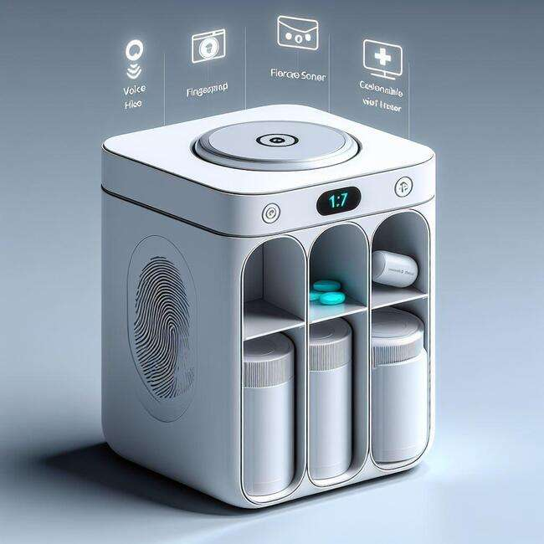
Automatic Medication Dispenser
The most advanced pill management are automatic medication dispensers. They can be pre-loaded with medication and programmed to dispense the right dose at the right time. When connected to an App, the user can get notifications and track the progress.

Slide 96
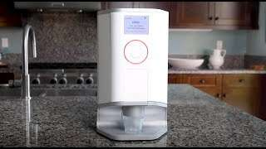
Video - Automatic Medication Dispenser
The video shows how “Hero” an automatic in-home medication manager works:
While watching the short clip consider the following questions:
Who would benefit most from using such an automatic medication manager?
Do you think this device could help someone with cognitive disabilities?
Hero | How Hero works

Slide 97
Digital Reminder Apps
There are various Apps, that help people to remember appointments, everyday tasks and other essential information.
Examples are:
MinimaList: To Do List
Structured- Daily Schedule
It’s Done! (free download on iOS and Android)

Slide 98
Smart Home Devices
?
What are smart home devices and how do they work

Slide 99
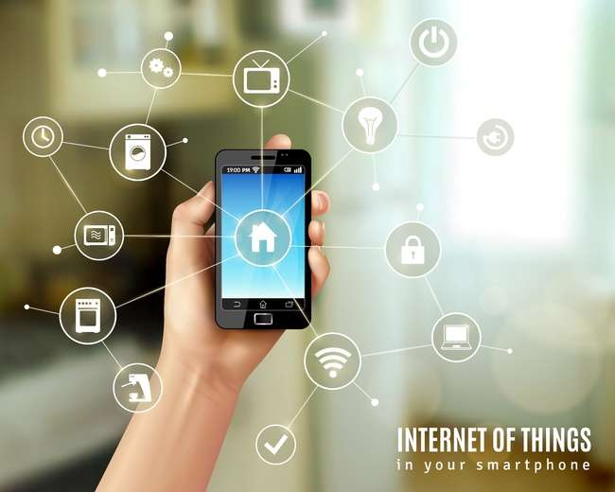
What are smart homes?
A smart home is a tech-savy living space where various devices, known as IoT (Internet of Things) devices, are connected through the internet.
These gadgets can share information through a special app or carry out tasks automatically or upon the owner’s command.

Slide 100
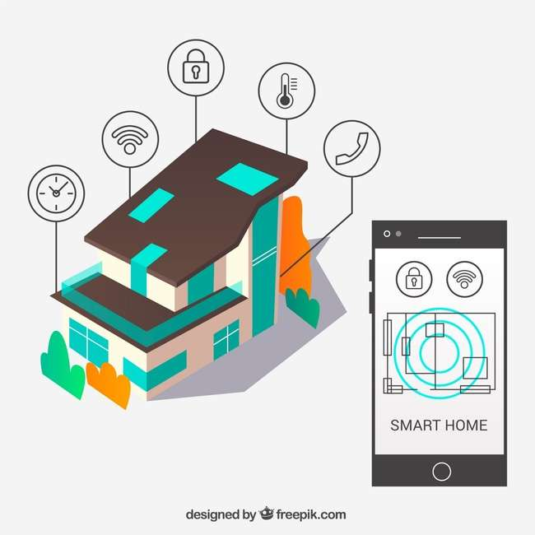
What are smart homes?
As an example, you can operate the following activities with a simple command:
Adjust indoor temperatures
Tilt your bed
Turn lights/fans on and off
Open and close doors
Operate TV, stereos, computers

Slide 101
How to control a smart home
There are different ways to give commands and thus control the smart devices in a home.
App remote control: Through a simple App, users can check and control the status of home appliances such as shutter, lights, blinds, heater, etc.

Slide 102
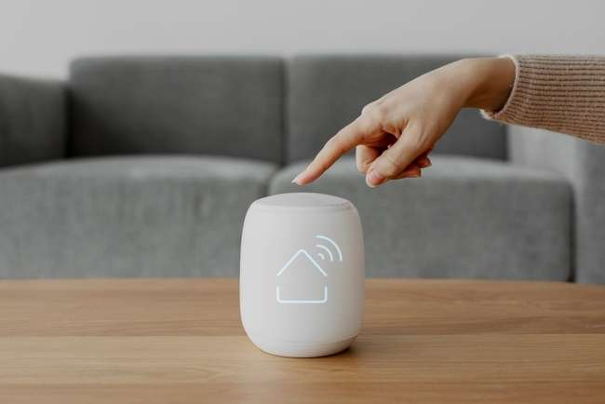
How to control a smart home
Voice-activated control: Through speech recognition, users can operate lights and home appliances without the need for hands-on interaction. This is particularly helpful for people who are restricted in their motoric skills.
On the next slides, you will get familiar with different smart home devices that can be installed in the house.

Slide 103
Smart Security systems
Smart Security Systems, including cameras and motion sensors, allow remote monitoring of the home 24/7.
Smart doorbells with cameras let you see who’s at the door before answering, and smart locks allow family members or rescue teams (in case of an emergency) to check in by using passwords or codes.

Slide 104
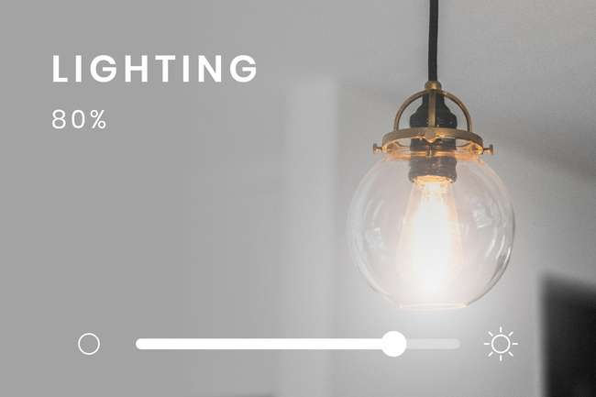
Smart Lighting/ Blinds:
Smart Lighting allows users to control the lights remotely, turning them on and off without being physically present.
Similarly, smart blinds enable users to open and close the blinds from a distance.

Slide 105
Smart Home Monitoring
Another helpful feature is smart home monitoring covering temperature control, leak detectors, and air quality sensors.
This gives older adults improved control over their home and serves as a safety measure.
For instance, gas sensors can alert residents to a gas leak and, in certain situations, automatically contact emergency services.

Slide 106
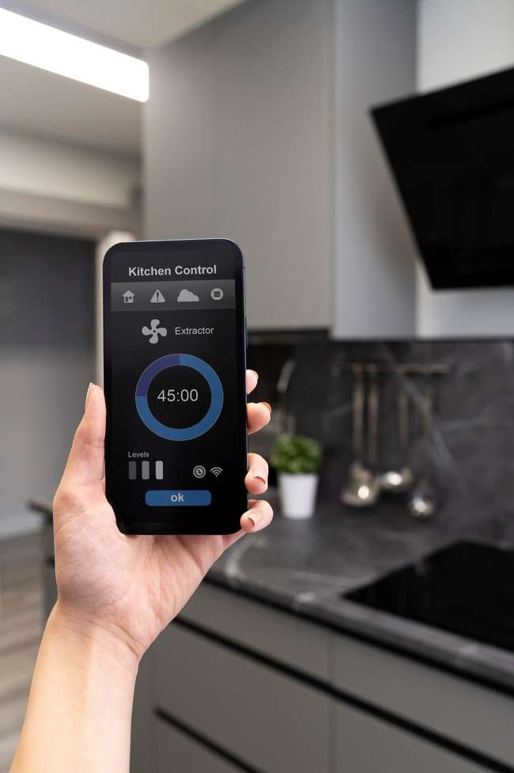
Smart Kitchen Appliances
Smart kitchen appliances, such as ovens and microwaves, enable the older person to set cooking timers remotely, control power, and adjust temperatures, reducing the risk of accidents.
Additionally, built-in sensors in refrigerators send alerts if a fridge door was left open.

Slide 107
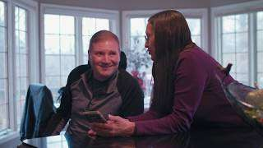
VIDEO
Watch the short story of Pat and Ray to understand how the use of smart home technology helps the couple to lead a more independent and relaxed life.
Caregiver Stress | Living Independently with the Help of Smart Home Technology
Notes:
Embedding code: <iframe width="560" height="315" src="https://www.youtube.com/embed/WWUcEA7Qhvw?si=QDkRUdrPz9opl1NK" title="YouTube video player" frameborder="0" allow="accelerometer; autoplay; clipboard-write; encrypted-media; gyroscope; picture-in-picture; web-share" allowfullscreen></iframe>

Slide 108
Relevant digital skills to understand assistive technologies
Being able to download an App
Being able to schedule a reminder
Being able to make a Bluetooth connection to another device (e.g. electronic pill organiser)

Slide 109
What you should keep in mind when it comes to assistive technologies
Assistive technologies never replace human contact
It is important to be aware that these technologies will not eliminate risks
Assistive technologies, in particular certain high-tech devices can be quite expensive. Sometimes it is possible to rent them.
Ethical issues need to be considered, especially in the context of monitoring people. Please check out Module 5 for a comprehensive exploration of this subject.

Slide 110
Summary
Assistive technologies for older people who live at home are special tools or devices designed to help them with everyday tasks. These technologies make it easier for seniors to do things on their own and stay independent. Some examples are Personal Alarms and Emergency Aids, Medication Reminders or different Smart Home Devices such as smart lightening or a smart stove.
Notes:
However, digitalisation allows for smart systems that help you and your clients to sort, organise and track medication and refill.

Slide 111
Self-Reflection Exercise
!
Time for
Self-Reflection

Slide 112
Self-Reflection Exercise
Next on, you will see questions related to the content of this unit.
Reflect on the questions and answer them in writing in your (digital) journal!

Slide 113
Self-Reflection Exercise
Do you think assistive technologies can make a difference in the life of a care dependent person? Explain why and how!
Which of the technologies would you use if you imagine yourself being a care-dependent person with various health issues and limited mobility who wants to stay independent at home as long as possible.

Slide 114
Congratulations, you completed Unit 3 of the Module 2.

Slide 115
This learning unit has been developed as part of an Erasmus+ KA2 project DiMiCare and is funded with the support from the European Union. The work is intended for educational purposes and is licensed under Creative Commons Attribution-NonCommercial-ShareAlike 4.0 International License @ The DiMiCare Consortium (except for referenced screenshots and content).
Funded by the European Union. Views and opinions expressed are however those of the author(s) only and do not necessarily reflect those of the European Union or OeAD-GmbH. Neither the European Union nor the granting authority can be held responsible for them

Slide 116
List of References
Habas, Cathay (2023): What is Fall Detection? https://www.safewise.com/what-is-fall-detection/
Oesterreich.gv.at (2023): Home emergency call systems: https://www.oesterreich.gv.at/en/themen/senior_innen/sicherheit_fuer_senioren/1.html
DAA-Stiftung Bildung und Beruf (2017): Digitalisierung und Technisierung der Pflege in Deutschland; https://www.input-consulting.de/files/inpcon-DATA/download/20170215_Digitalisierung%20und%20Technisierung%20der%20Pflege%20in%20Deutschland_INPUT.pdf
Alzheimer‘s Society (2015): Assistive technology – devices to help with everyday living; https://www.alzheimers.org.uk/sites/default/files/migrate/downloads/factsheet_assistive_technology_%25E2%2580%2593_devices_to_help_with_everyday_living.pdf
12 Smart Home Assistant Devices For Elderly And Seniors (2023): https://www.ecovacs.com/us/blog/smart-home-for-seniors

Slide 118
Module 2
Care-specific technology
Unit 4
Health and Self-Management Apps

Slide 119
01 Definition of Health Apps
Health Apps and Wearables
Health Apps and Personal Data
02 Types of Health Apps
Health Management Apps
Lifestyle Apps
Telemedicine Apps
Medical Apps
TABLE OF CONTENTS
03 Benefits of Health Apps
Benefits
Tips for safe use
04 Examples of Health Apps
Examples
Case Study

Slide 120
Defining Health Apps
?
What are health apps and how do they work?

Slide 121
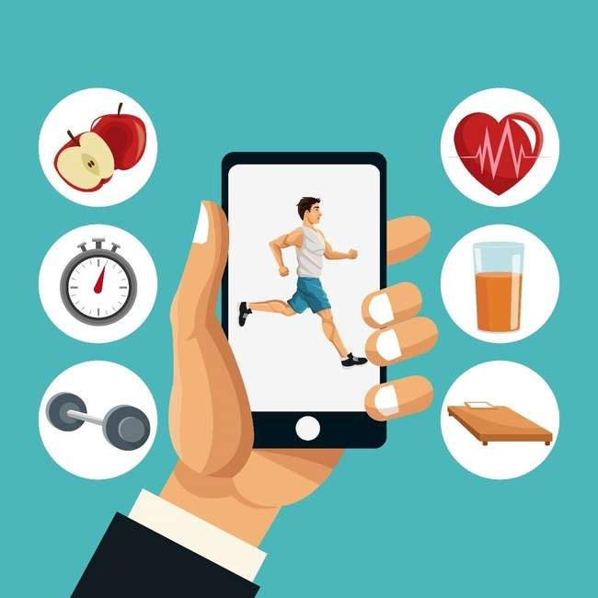
Definition of Health Apps
Health apps are digital applications for mobile devices (Smartphones, Tablets, Smartwatches) that provide users with functions for the areas of health and medicine.
They may provide information on health topics, allow to self-monitor certain diseases or provide access to exercise and nutrition programmes.
Notes:
Currently around 40 Health Apps for different health conditions such as diabetes, chronic pain, pain killer addiction, asthma, anxiety states are approved in the EU.

Slide 122
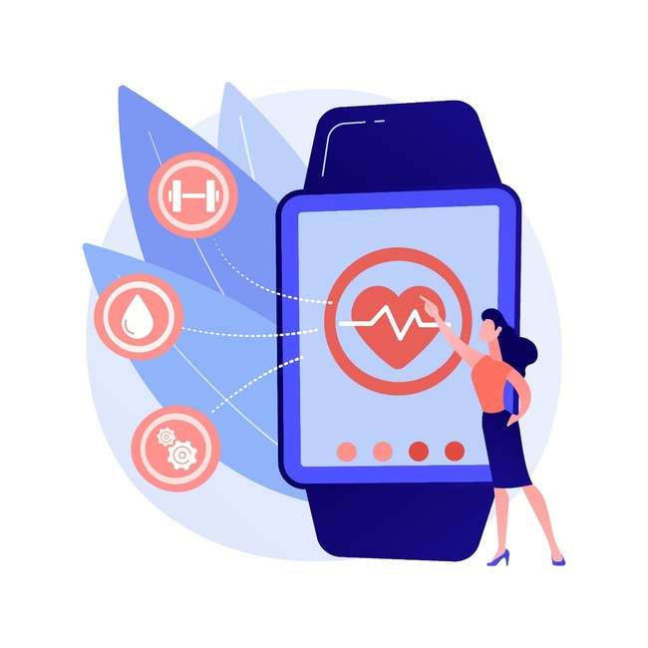
Definition of Health Apps
Health apps are available in App Stores where users can directly download them
Providers of Health Apps may be IT-companies, pharma companies or health insurance companies
There are no standardised quality criteria for Health Apps
Some health insurances carry the costs of specific and prescribed Medical Apps (e.g. for diabetes or tinnitus)

Slide 123
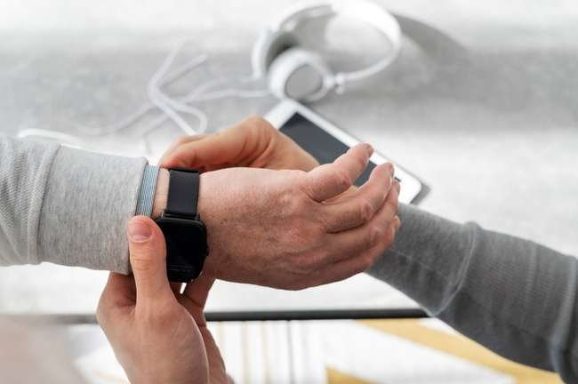
Health Apps and Wearables
Health apps may be combined with wearables
Wearables are small digital devices that can be worn on the body such as watches, arm bands, adhesive bandages, or clothing.
Within these items sensors are placed that are programmed to gather data on things like heart rhythm, heart rate, blood pressure, breathing, movements, body temperature, etc.

Slide 124
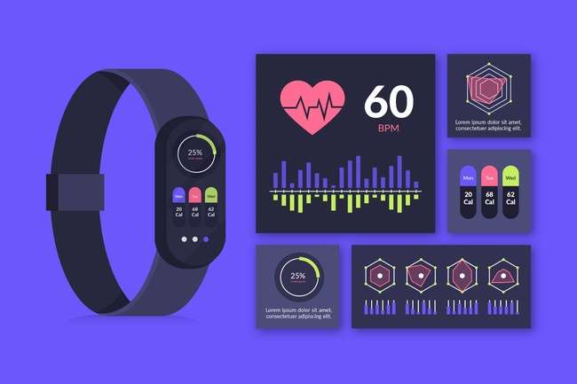
Health Apps and Wearables
Examples are activity-trackers or smart watches
In some cases, the measured information can be sent to the medical team in real time
If something looks wrong, doctors can quickly figure out what to do next and make fast decisions

Slide 125
Health Apps and Privacy
The function of health apps is based on the collection and processing - potentially also sharing - of personal data.
Personal health information is highly sensitive
To safeguard user’s data robust privacy measures are necessary

Slide 126
Health Apps and Privacy
Privacy Concerns
Data Safety
Inadequate data protection
Data breaches
Data sharing without user consent
User consent and control
Transparent privacy policies
Informed-decision making
Notes:
https://www.betteryou.ai/exploring-privacy-concerns-in-health-apps/#:~:text=First%20and%20foremost%2C%20health%20information,access%20to%20one's%20personal%20life.

Slide 127
Types of Health Apps
?
What are the different categories of Health Apps

Slide 128
Health Management Apps
Help individuals monitor and track their own health condition such as heart disease, diabetes, chronic diseases, mental health, etc.
Involved parameters are for example blood pressure glycemia/blood sugar, headache, sleep patterns, physical activity, etc.
Notes:
In the health care context, self-management often refers to chronic illnesses, such as diabetes, heart failure, cardiovascular diseases, COPD or mental diseases. It means paying attention to symptoms and vital parameters to take care of their own health.

Slide 129
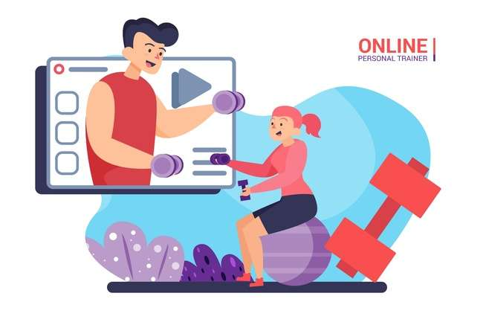
Lifestyle-Apps
Help users make healthier choices in their everyday life regarding fitness or nutrition
Some provide a digital trainer that gives feedback and motivates the users
Examples are Fitness trackers, Dietary guidance, Calorie tracking

Slide 130
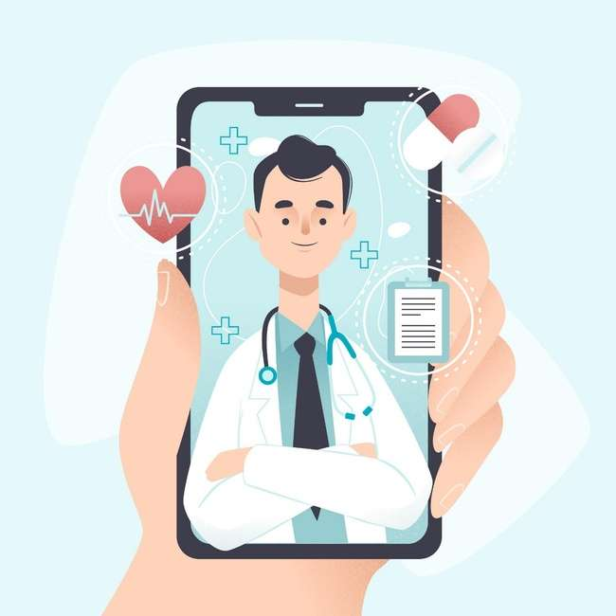
Telemedicine Apps
Provide remote care by connecting clients with medical professionals
Help doctors to monitor certain parameters, like Apps for Diabetics that automatically send glucose values to the physician
Telemedicine Apps are always used together with a healthcare provider

Slide 131
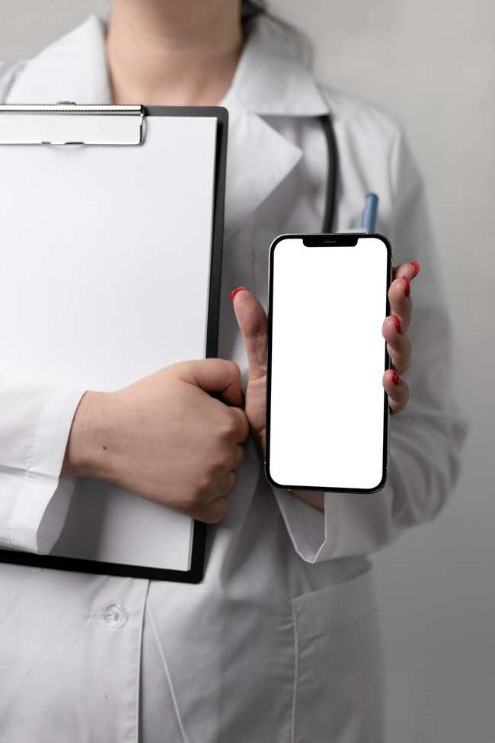
Medical Apps
Medical apps are used to diagnose and/ or treat a disease and are used for medical or clinical purposes.
They must be approved as medical devices and must meet certain quality and safety standards
In the EU, medical Apps are regulated under the Medical Device Regulation (MDR)

Slide 132
Benefits of Health Apps
?
What advantages do health apps offer to older people in improving their health and well-being

Slide 133
Benefits of Health Apps
Eric Topol, an American physician once said:
So what could the benefits of Health Apps be?
I do not prescribe drugs for my patients, I prescribe Apps.

Slide 134
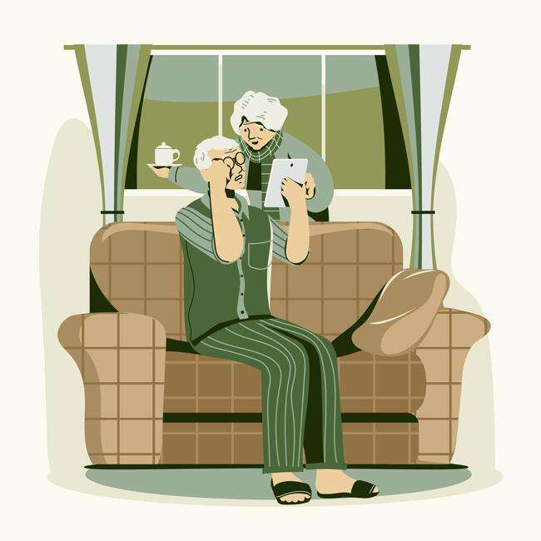
Benefits of Health Apps
Support Self-Care: Empower clients to take an active role in managing their own health and understanding their condition.
Increase treatment and prevention of chronic diseases: Help patients to adhere to treatment plans, monitor their condition and avoid complications.

Slide 135
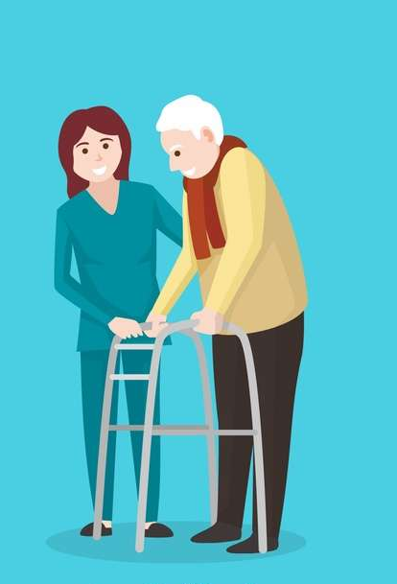
Benefits of Health Apps
Improve health-care delivery: Ease data collection and data quality.
Reduce the work load of care: Can reduce the pressure placed on care workers and reduce the need of care services.

Slide 136
Ethical and regulatory considerations
Health apps have the ability to collect, and potentially share, user data. This makes the management and protection of data an important ethical consideration and one that requires compliance with regulatory standards.
As there is no legal term for Health Apps, it is important to make informed choices when recommending an App.
For more information on the ethical use of apps, we recommend watching the micro-learning videos Topic 2.

Slide 137
Tips for a safe use of Health Apps
Check the source and credibility of the app
Read the terms and conditions and privacy policy
Choose the app that best suits your needs and preferences
Consider the app as a supplement to professional care
Regularly review and update the app

Slide 138
Examples of Health Apps
?
Health Apps for different purposes
Key features of the App

Slide 139
Fitness Apps/ Digital Coaches
Name: Step Tracker - Pedometer
Target Group: People who want to monitor and track their physical activity, particularly their daily step count
Benefits: Promote physical activity, increase awareness of daily movement patterns
Data Protection: No data shared with third party companies, Data is encrypted during transmission
Costs: Free/In-App Purchase
Languages: English, others?
Image Source: Google Play Store – Step Tracker-Pedometer

Slide 140
Drink Reminder
Name: WaterMinder Water Tracker
Target Group: People who want to improve their drinking habits
Benefits: Smart reminders during the day
Data Protection: Uncritical
Costs: Free/In-App Purchase
Languages: English, German, French, Italian, Dutch, …
Source: waterminder.com

Slide 141
Blood-Sugar Diary
Name: DiabetesConnect
Target Group: People with diabetes- type I and II
Benefits: Documentation of diabetes data (blood sugar, meals, insulin, medication, etc.), analysation of data, exporting values via pdf-documents
Costs: Free/In-App Purchase
Languages: English, German, French
Developer: SquareMed Software
Image Source: App Store Diabetes Connect

Slide 142
Memory and Attention
Name: Lumosity Brain Training
Target Group: For people who want to train their memory and attention with different games
Benefit: Lumosity is a cognitive training programme that offers an interactive way for users to train their brain, memory, speed, flexibility and problem solving. Platforms: Android, iPhone, Apple Watch, iPad
Cost: Free
Languages: English, German, French, Spanish, Portuguese
Image Source: App Store: Lumosity Brain Training

Slide 143
Magnifier App
Name: Magnifying glass
Target Group: For people who have difficulties in reading small text
Benefits: The app helps to read small text with ease, e.g. fine prints on medicine bottles, etc.
Costs: Free/In-App Purchase
Platforms: Apple
Data Protection: Uncritical
Languages: English
Image source: Google Play Store: Magnifying Glass

Slide 144
Mental Health Support Apps
Name: Daylio Diary & Habits
Target Group: For people who want to improve self-care by tracking their mood and happiness without writing down words
Benefits: Users can select their moods and activities that they have been doing during the day using different icons. They can notice patterns of behaviour and explore statistics created from their logs
Costs: Free/In-App Purchase
Data Protection: Uncritical
Languages: 28 languages
Source: Daylio.net

Slide 145
Mental Health Support Apps
Name: Wysa: Anxiety, therapy chatbot
Target Group: For people who want to improve their mental and emotional health through mindfulness, meditation and mood tracking
Benefits: Wysa is a chatbot that helps deal with anxiety and stress with calming meditations, mindfulness audios, friendly chats and different tracking functions
Costs: Free/In-App Purchase
Data Protection: Uncritical
Languages: English
Image source: App Sore- Wysa Mental Health Support

Slide 146
Certified Medical App
Name: Ada – Symptom Checker
Target Group: People who have questions regarding their own health or the health of others
Benefits: Ada was developed by doctors and scientists and helps patients to assess their medical symptoms on a centralised platform. The software requests users to answer multiple automated questions and assesses them against a built-in medical dictionary of disorders and conditions.
Costs: Free
Data Protection: Uncritical
Languages: English, German, …
Image source: Google Play Store Ada-check your health

Slide 147
Case-Study
Maria is a 72 -year-old woman diagnosed with Type 2 diabetes some years ago.
Managing her condition requires consistent monitoring of blood sugar levels, medication adherence, dietary choices, and physical activity. She struggles to keep track of all the relevant information, leading to inconsistent management of her diabetes.

Slide 148
Case-Study
She was recommended by her doctor to use a diary app designed for diabetes management.
Possible features of the App
Blood Sugar Tracking
Medication Log
Diet and Nutrition Journal
Physical Activity Tracking

Slide 149
Case-Study
Benefits
Maria and the healthcare-team have a holistic overview of the diabetes management
Patterns can be identified
The app motivates Maria to adhere to her prescribed treatment plan

Slide 150
Case-Study
Your role
How do you think this app could help Maria?
What digital skills do you need in order to help her using the App?

Slide 151
Summary
mHealth apps are mobile applications designed to help people manage their health using smartphones or tablets. These applications empower care-dependent people to take control of their well-being, offering assistance in self-care, enhancing treatment and prevention of chronic illnesses. In the last few years, many mHealth Apps have been developed worldwide and cover a wide range of areas like lifestyle, health management, telemedicine and medical assistance. In the context of care, mHealth Apps should be considered as complementary to professional care.
Notes:
However, digitalisation allows for smart systems that help you and your clients to sort, organise and track medication and refill.

Slide 152
Self-Reflection Exercise
!
Time for
Self-Reflection

Slide 153
Self-Reflection Exercise
Next on, you will see questions related to the content of this unit.
Reflect on the questions and answer them in writing in your (digital) journal!

Slide 154
Self-Reflection Exercise
Do you think certain Apps used by your clients could make your work easier or more efficient? Explain why (not)?
Do you use similar Apps for yourself, e.g. a fitness tracker or a pedometer? Why do use these Apps? What are the benefits for you of using these Apps?

Slide 155
Congratulations, you completed Unit 4 of the Module 2.

Slide 156
This learning unit has been developed as part of an Erasmus+ KA2 project DiMiCare and is funded with the support from the European Union. The work is intended for educational purposes and is licensed under Creative Commons Attribution-NonCommercial-ShareAlike 4.0 International License @ The DiMiCare Consortium (except for referenced screenshots and content).
Funded by the European Union. Views and opinions expressed are however those of the author(s) only and do not necessarily reflect those of the European Union or OeAD-GmbH. Neither the European Union nor the granting authority can be held responsible for them

Slide 157
List of References
Daley Sam (2022): Wearable Technology Definition. Builtin. https://builtin.com/wearables
Interdisciplinary Literature Overview; https://www.ncbi.nlm.nih.gov/pmc/articles/PMC9664324/
Johnsson, Natali et al (2023): Delineating and clarifying the concept of self-care monitoring: a concept analysis, in: International Journal of Qualitative. https://www.ncbi.nlm.nih.gov/pmc/articles/PMC10392281/
Maaß, Laura et al. (2022): The Definitions of Health Apps and Medical Apps From the Perspective of Public Health and Law: Qualitative Analysis of an
Mit Wearables und Health Apps zu einem gesünderen Leben (2022). AT&S. https://ats.net/a-healthier-life-with-wearables-and-health-apps/
Wearables und Gesundheits-Apps: Chancen und Risiken (2020). Verbraucherportail Baden-Württemberg. https://www.verbraucherportal-bw.de/,Lde/Startseite/Verbraucherschutz/Wearables+und+Gesundheits-Apps_+Chancen+und+Risiken

